Slide 1
Reshaping in Pandas

Slide 2
Content..
Pivot table
Stack
Unstack

Slide 3
Pandas Reshaping
Pandas data reshaping means the transformation of the structure of a table or vector (i.e. DataFrame or Series) to make it suitable for further analysis.
Some of Pandas reshaping capabilities do not readily exist in other environments (e.g. SQL or bare bone R) and can be tricky for a beginner.

Slide 4
Pivot
The pivot function is used to create a new derived table out of a given one.
Pivot takes 3 arguements with the following names: index, columns, and values.
As a value for each of these parameters you need to specify a column name in the original table.
Then the pivot function will create a new table, whose row and column indices are the unique values of the respective parameters.
The cell values of the new table are taken from column given as the values parameter.

Slide 5
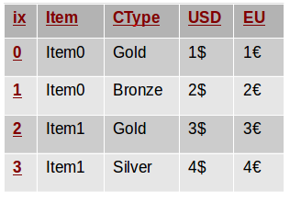
Example

Slide 6
Cont..
he Item column contains the item names, USD is the price in US dollars and EU is the price in euros.
Each client can be classified as Gold, Silver or Bronze customer and this is specified in the CType column

Slide 7
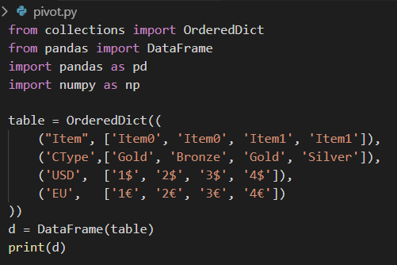
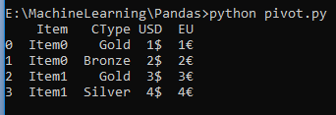
Cont..

Slide 8
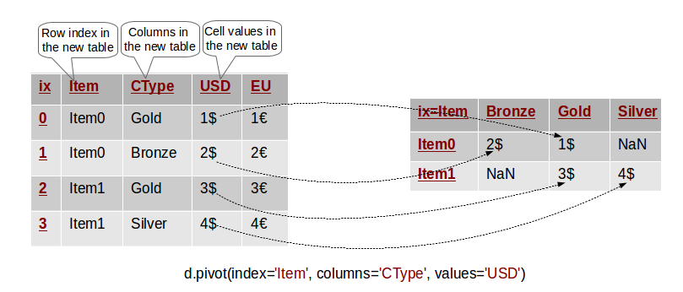
Cont..
In the last result, it is not easy to see how the USD price varies over different customer types.
We may like to reshape/pivot the table so that all USD prices for an item are on the row to compare more easily

Slide 9

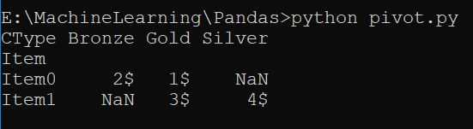
Cont..

Slide 10
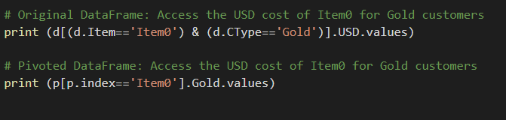

Compare Original Data frame with Pivoted Data frame
Result:
Note:The pivoted table is a simplified version of the original
data and only contains information about the columns we
specified as parameters to the pivot method.

Slide 11
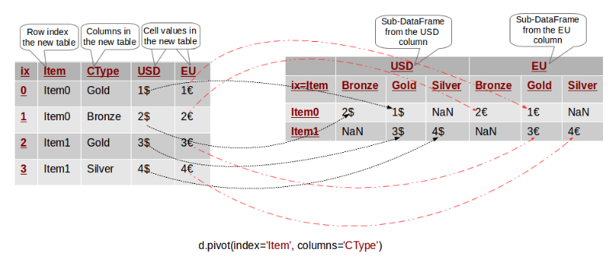
Pivoting By Multiple Columns

Slide 12
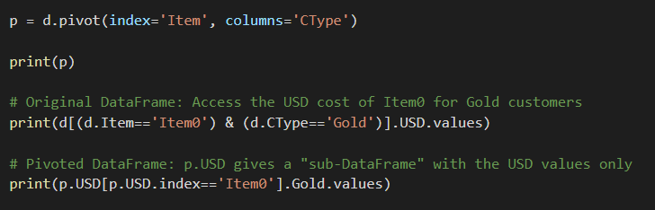
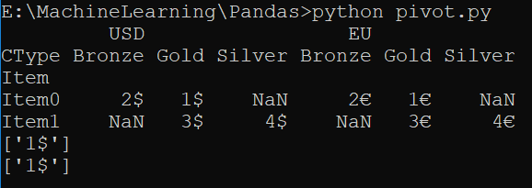
Comparison

Slide 13
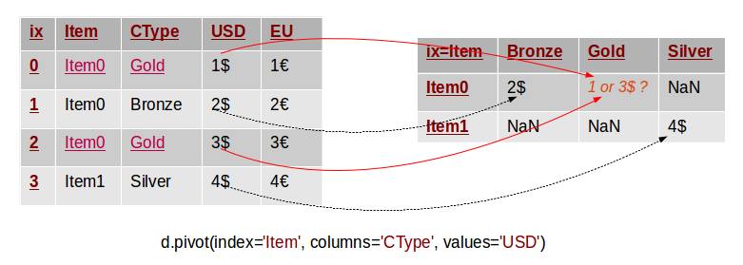
Common Mistake in Pivoting

Slide 14
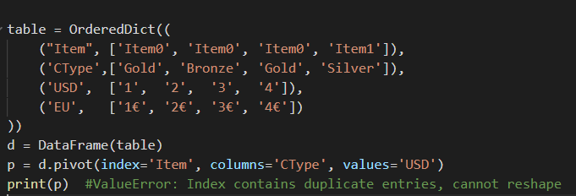

Slide 15
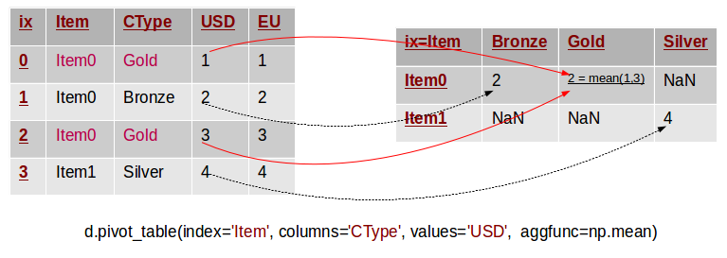

Slide 16
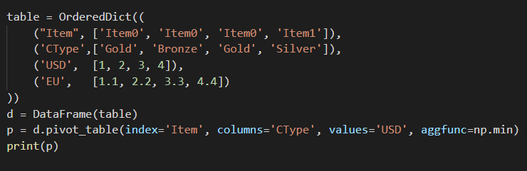
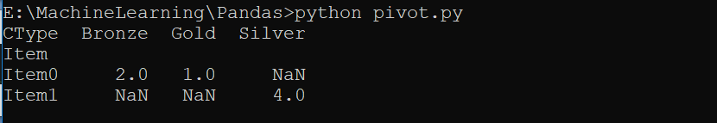

Slide 17
Stack & Unstack
The concept of stacking comes in handy when we have data with multi indices.
Using the stack() function will reshape the dataframe by converting the data into a stacked form.
Since we are having multiple indices, that means converting (also called rotating or pivoting) the innermost column index into the innermost row index.
Unstacking, as the name implies, does exactly the inverse operation — it will convert the innermost row index back into the innermost column index.

Slide 18
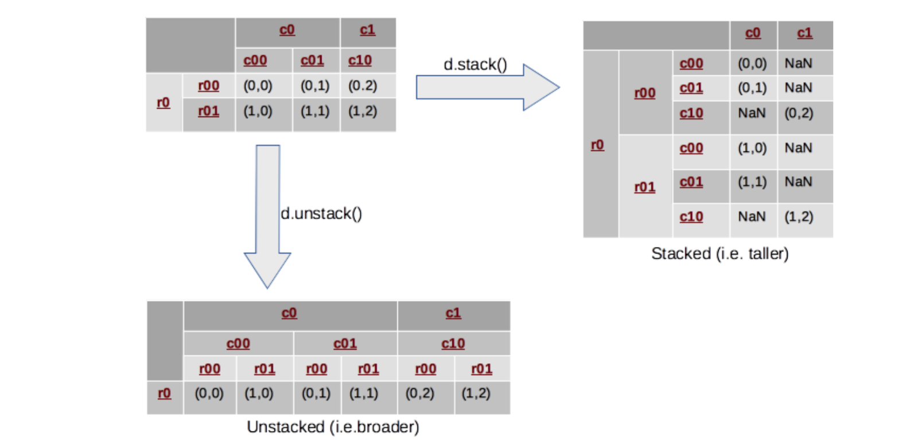

Slide 19
Cont..
stacking means rearranging the data vertically (or stacking it on top of each other, hence the name “stacking”), making the shape of the dataframe as a taller and narrower stack (with fewer columns and more rows).
And as you probably could figure out, unstacking will do just the opposite, spreading out the data and reshaping it into a shorter but wider dataframe (with fewer rows but more columns).

Slide 20
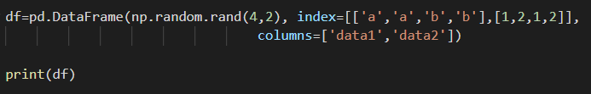
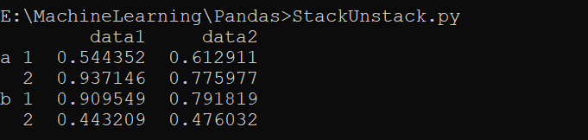
Methods of Multi-index creation
There are various ways to create multiple indices. One of the simplest ways to create a multi index Series or DataFrame object is by passing a list of two or more arrays to the constructor:

Slide 21
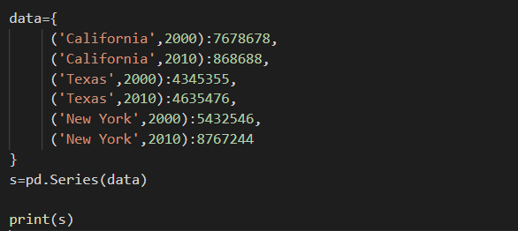
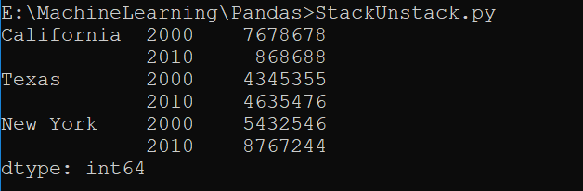
Cont..
Other options include passing a dictionary where the keys are spelled out as tuples:

Slide 22
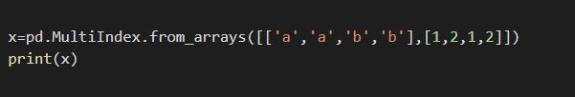
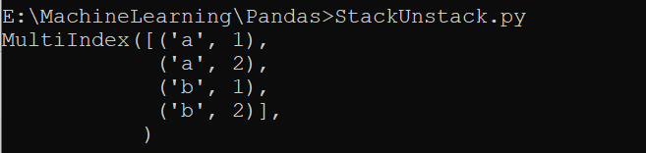
Cont..
Finally, you can explicitly create a multi index by using the class method constructors available in the pd.MultiIndex:

Slide 23
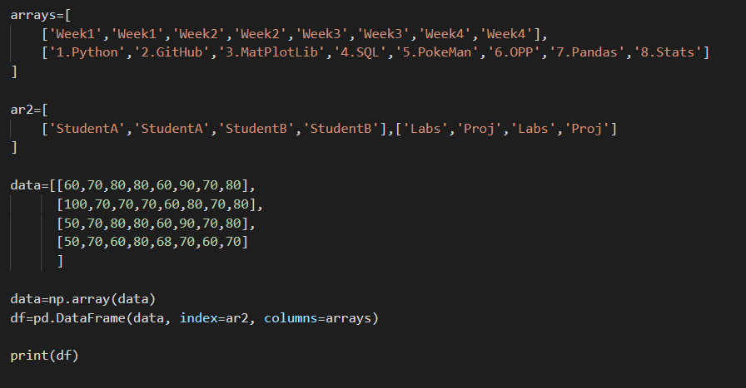

Slide 24
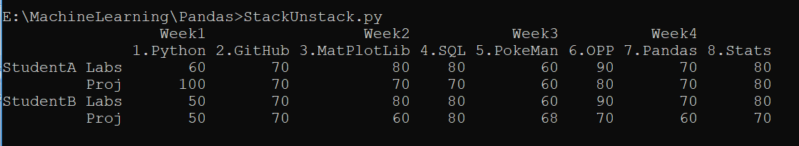

Slide 25

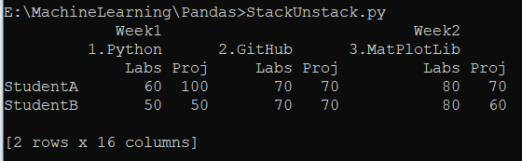
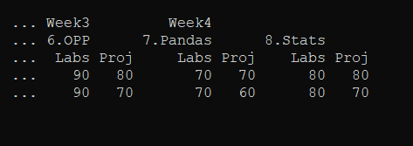
Cont..

Slide 26
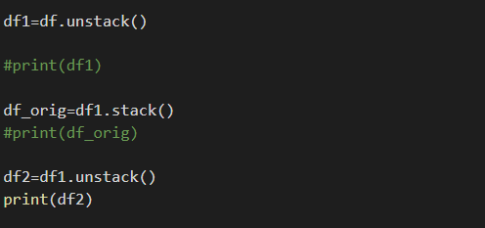
Cont..

Slide 27


Thank You
https://medium.com/swlh/reshaping-in-pandas-with-stack-and-unstack-functions-bb169f64467d
https://nikgrozev.com/2015/07/01/reshaping-in-pandas-pivot-pivot-table-stack-and-unstack-explained-with-pictures/

