Slide 1
Series

Slide 2
Introduction
Series is a one-dimensional labeled array capable of holding data of any type (integer, string, float, python objects, etc.).

Slide 3
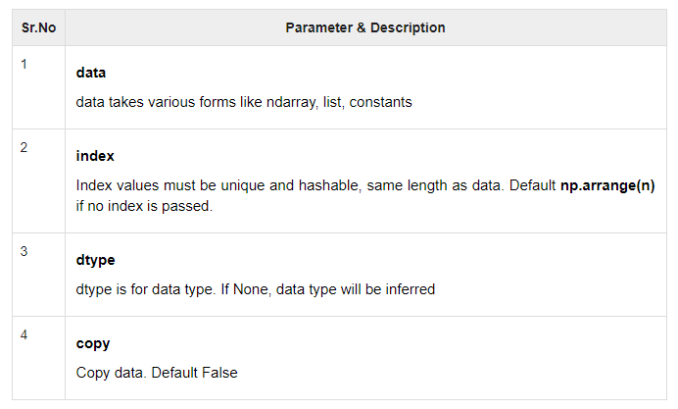
Series Constructor
pandas.Series( data, index, dtype, copy)

Slide 4
Input Elements
Array
Dict
Scalar value or constant

Slide 5
Create an empty series
import pandas as pd
s = pd.Series()
print(s)

Slide 6
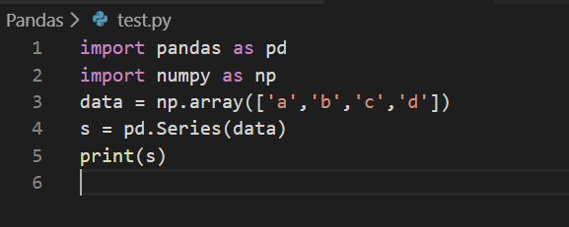
Create a Series from ndarray
If data is an ndarray, then index passed must be of the same length.
If no index is passed, then by default index will be range(n) where n is array length, i.e., [0,1,2,3…. range(len(array))-1].

Slide 7
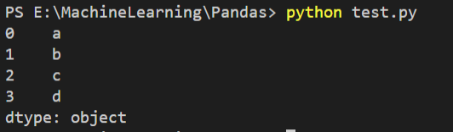
Ans..

Slide 8
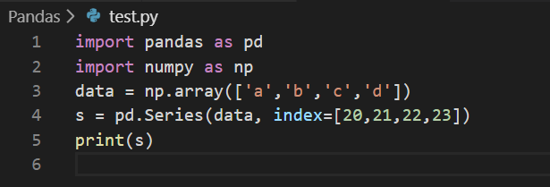
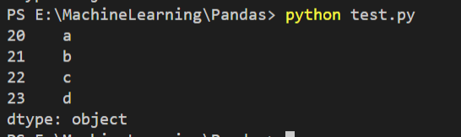
Pass index values

Slide 9
Series from Dictionary
A dict can be passed as input and if no index is specified, then the dictionary keys are taken in a sorted order to construct index.
If index is passed, the values in data corresponding to the labels in the index will be pulled out.

Slide 10
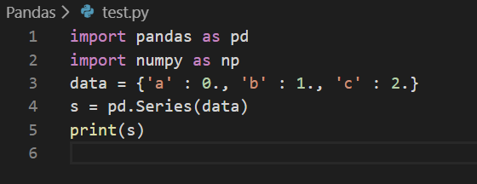
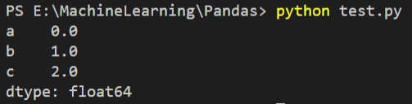
Cont..

Slide 11
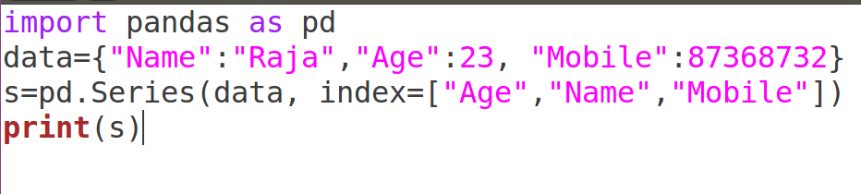

Changing keys

Slide 12
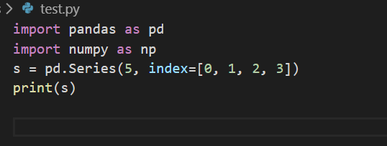
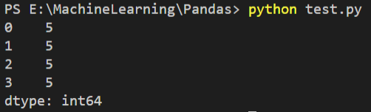
Create a Series from Scalar
If data is a scalar value, an index must be provided. The value will be repeated to match the length of index

Slide 13
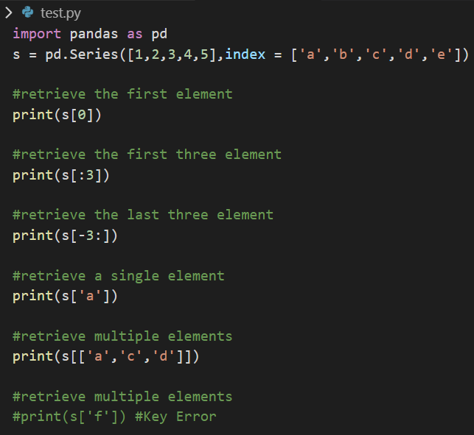
Accessing Data from Series

Slide 14
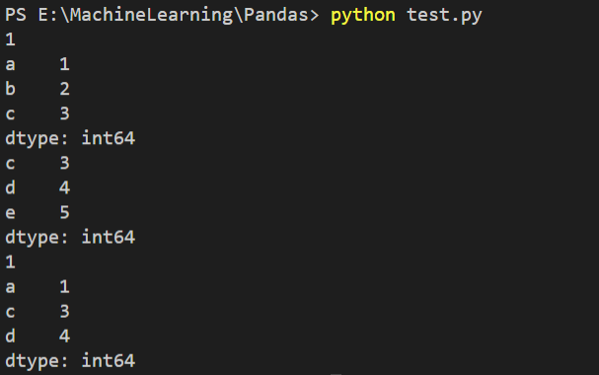
Cont..

