Slide 1
SNAPDEAL · CUSTOMER ANALYTICS
Customer Purchasing Behavior &
Product Recommendation Findings
What the survey data shows, what it means, and how it should reshape Snapdeal's recommendation strategy
Based on an 800-respondent customer survey • September 2026
Notes:
Welcome — this presentation walks through three things: what data we had, what we found in it, and most importantly, what those findings mean for how Snapdeal should redesign its product recommendation and promotional strategy. Everything here comes from an 800-respondent customer survey covering demographics, shopping habits, cart behavior, reviews, and recommendation engagement.

Slide 2
AGENDA
Three questions we'll answer
01
What's in the data?
800 survey responses across demographics, shopping habits, cart behavior, reviews, and recommendation engagement — cleaned and standardized.
02
What did we find?
Where customers are satisfied, where they drop off, how they naturally segment, and what they actually buy together.
03
What should we do about it?
Concrete changes to the recommendation engine, promotions, and retention strategy — grounded directly in the findings.
2
Notes:
Three questions structure this whole deck. First, what raw material did we have — what does the dataset actually cover. Second, what patterns did the analysis surface. Third, and this is the part leadership cares about most, what should we actually change in the recommendation engine and promotional strategy because of what we found.

Slide 3
PART 1 · WHAT'S THERE
An 800-respondent snapshot of shopping behavior
800
24 → 33
0
5
customer survey
responses
raw fields, expanded with
derived behavior scores
missing values remaining
after cleaning
themes covered by
the survey
Demographics
Shopping habits
Cart behavior
Reviews
Recommendations
Age, gender
Purchase frequency, categories, browsing
Completion, abandonment, save-for-later
Trust in reviews, perceived helpfulness
Engagement, helpfulness, satisfaction link
3
Notes:
Before any findings, here's the raw material. Eight hundred customers answered a survey spanning five themes — demographics, shopping habits, cart behavior, reviews, and recommendations. We cleaned the data thoroughly: fixed a mislabeled duplicate column, standardized inconsistent category labels like 'others' versus 'Other', converted ratings to proper numeric types, and resolved all missing values — so every chart from here on is built on a fully clean, consistent dataset.

Slide 4
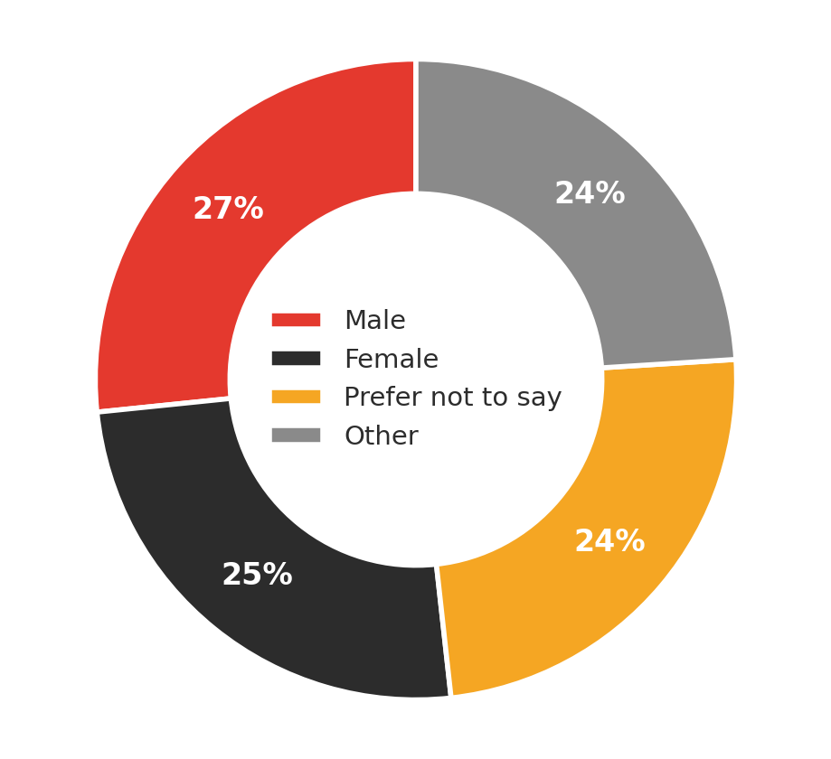
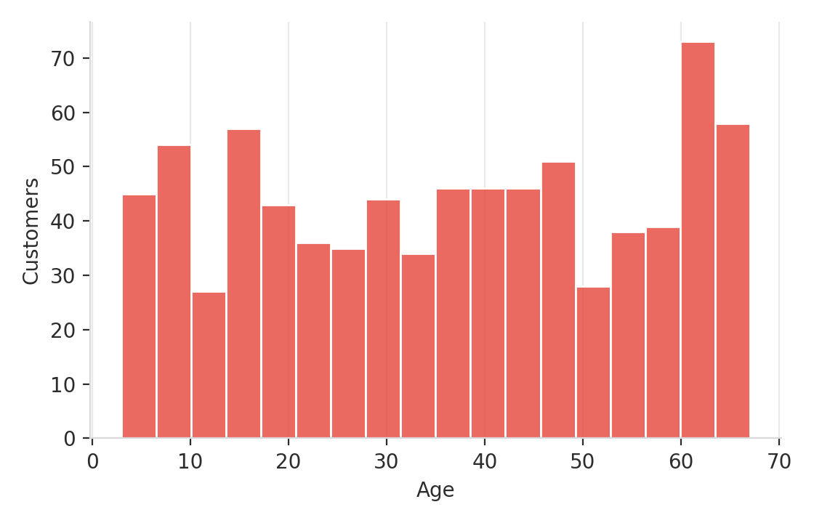
PART 2 · WHAT WE FOUND
A broad, evenly-split customer base
Ages span 18–67 (average 36) — no single life stage dominates the base
Gender is close to evenly split across all four response categories — marketing and product strategy shouldn't over-index on one demographic
4
Notes:
Starting with who these customers are. The age distribution is broad and fairly flat from 18 to 67, averaging around 36 — this isn't a single-generation customer base. Gender is close to an even four-way split. The takeaway here is mostly a caution: demographics alone won't tell you much about who's happy or unhappy with Snapdeal — we'll see shortly that the real differences are behavioral, not demographic.

Slide 5
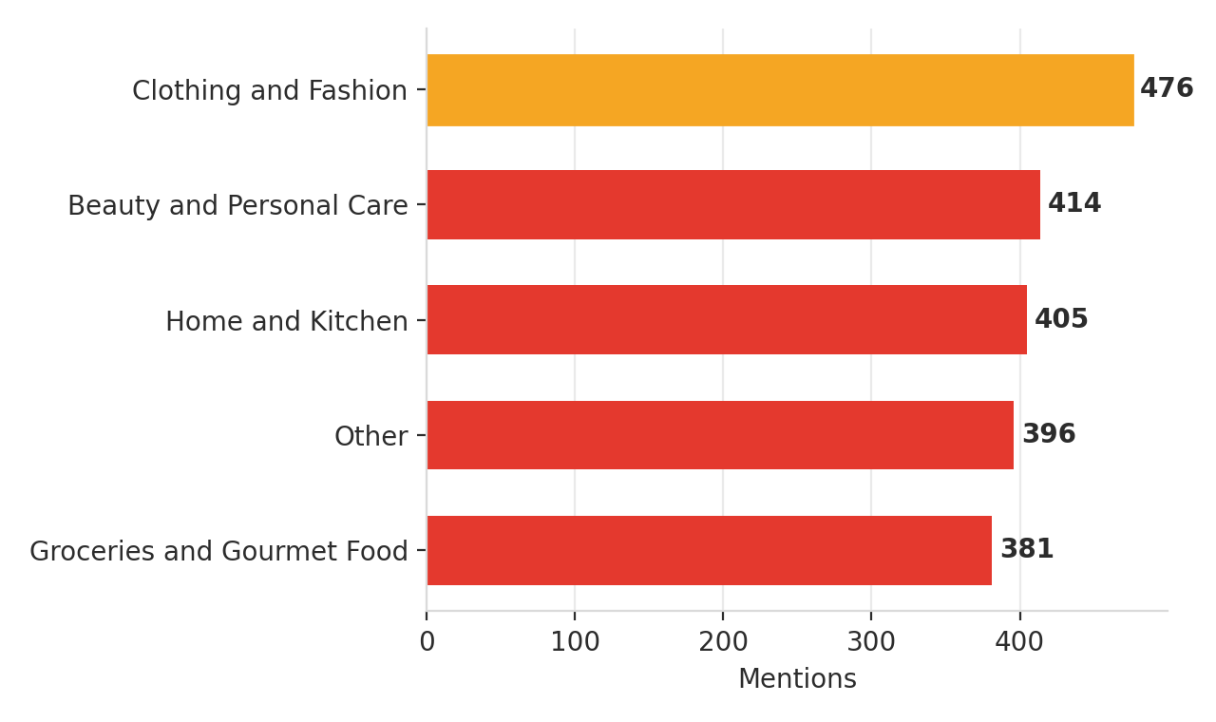
PART 2 · WHAT WE FOUND
Fashion and beauty lead a broad category spread
Reading the mix
Clothing & Fashion tops the list (476 mentions) — the natural anchor category
Beauty & Personal Care and Home & Kitchen follow closely — interest is broad, not concentrated in one vertical
Purchase frequency is nearly evenly split from monthly to multiple-times-a-week shoppers
5
Notes:
Customers select multiple categories, and Clothing & Fashion comes out clearly on top, with Beauty & Personal Care and Home & Kitchen close behind. This matters for two reasons we'll return to: Fashion is the natural anchor for cross-sell, and because interest is spread across several categories rather than concentrated in one, a one-size-fits-all recommendation strategy is unlikely to work well.

Slide 6
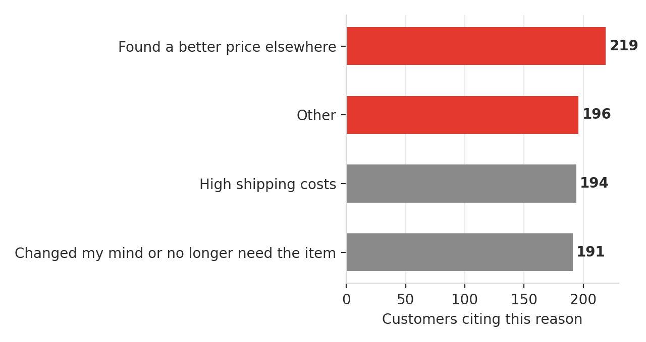
PART 2 · WHAT WE FOUND
Price and shipping — not the app — drive abandonment
219
customers abandoned a cart after finding a better price elsewhere — the single largest reason cited
194 more cited high shipping costs — together, price and shipping outweigh every app-experience factor combined.
6
Notes:
This is one of the most actionable findings in the whole survey. When we asked why carts get abandoned, the top reason by far is finding a better price elsewhere, with high shipping costs close behind. Notice what's NOT on top: app usability issues. The friction customers report is commercial — price and shipping — not experiential. That has a direct implication for where to spend improvement effort, which we'll come back to in the recommendations section.

Slide 7
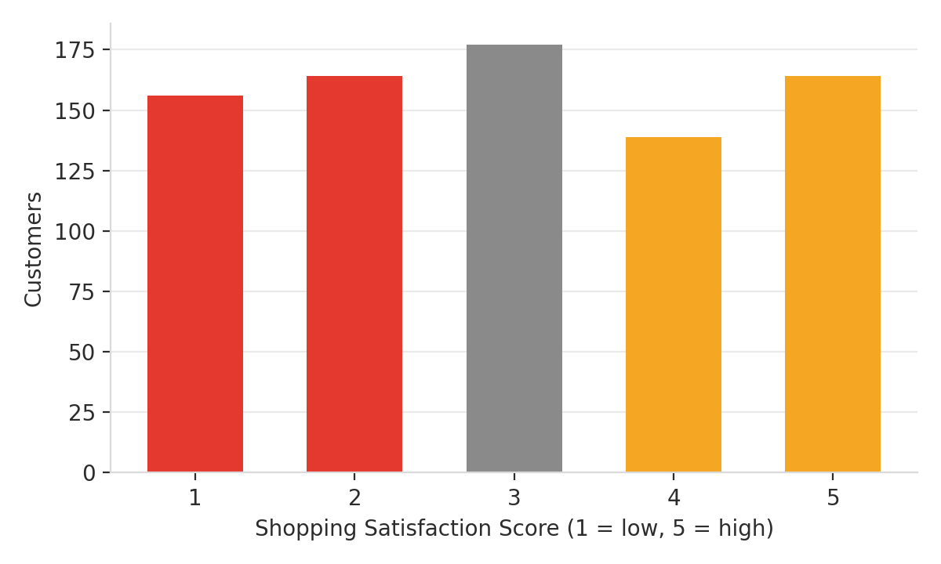
PART 2 · WHAT WE FOUND
Satisfaction is polarized, not middling
2.99 / 5
average shopping satisfaction
(median also 3.0)
1.41
standard deviation — wide spread
indicates two very different groups
This is not '3 out of 5 = mildly fine' — it's large blocks of both very satisfied and very dissatisfied customers
7
Notes:
Average satisfaction sits almost exactly at the midpoint, 2.99 out of 5. It would be easy to read that as 'customers feel neutral,' but the standard deviation of 1.41 tells a different story — look at the chart, the ratings pile up at both the low end and the high end, not in the middle. This is a polarized customer base, not a lukewarm one, and that distinction matters a lot for how we segment and target them.

Slide 8
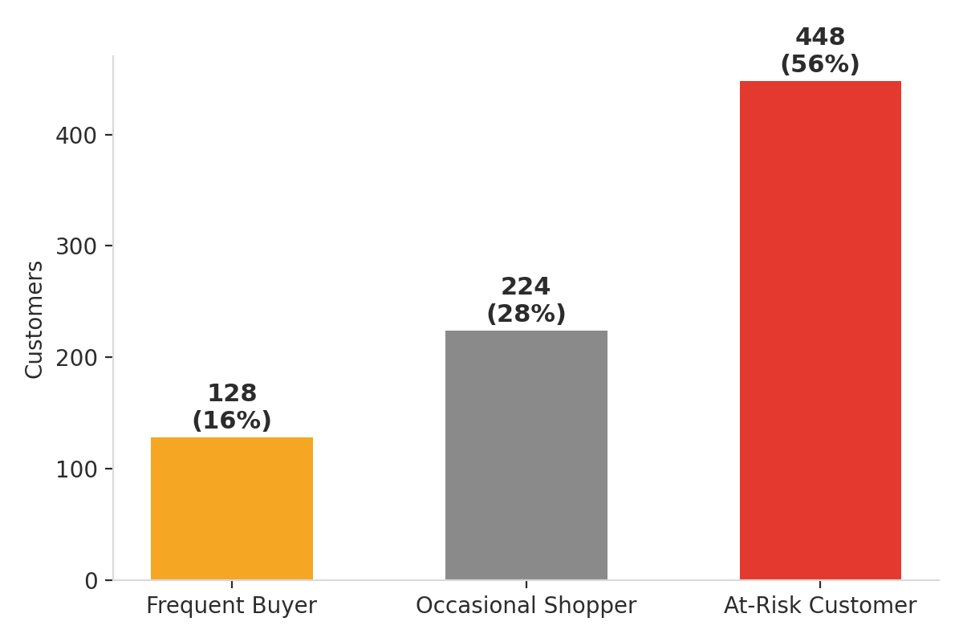
PART 2 · WHAT WE FOUND
56% of customers are currently At-Risk
128 · 16%
Frequent Buyer
High purchase frequency + high satisfaction
224 · 28%
Occasional Shopper
Medium frequency, moderate satisfaction
448 · 56%
At-Risk Customer
Low satisfaction or poor cart completion
Age and gender barely differ across segments — the divide is purely behavioral.
8
Notes:
Applying the business definitions of Frequent Buyer, Occasional Shopper, and At-Risk Customer, more than half the customer base — 56 percent — currently falls into At-Risk. Only 16 percent are true Frequent Buyers. And critically, average age and gender split are nearly identical across all three segments — this split has nothing to do with who the customer is demographically, and everything to do with how they behave. That's good news, actually: it means the fix is about experience and incentives, which we can act on, not about audience, which we can't easily change.

Slide 9
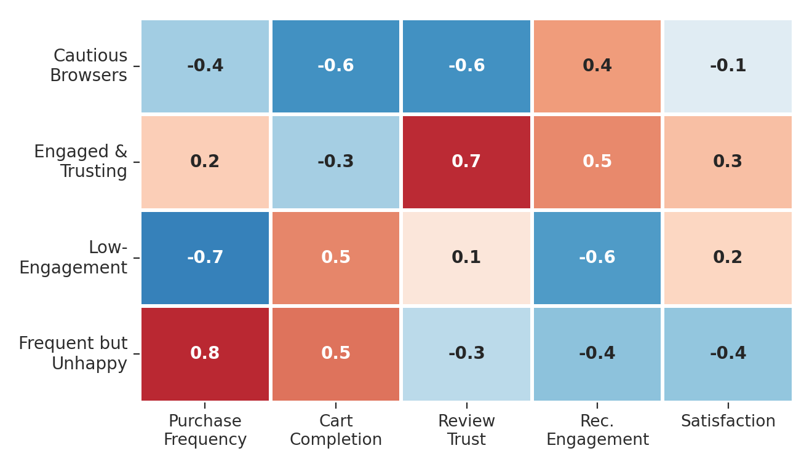
PART 2 · WHAT WE FOUND
Machine-learned clusters confirm the risk — with a twist
The cluster to watch
“Frequent but Unhappy”
Buys most often of any cluster — but has one of the lowest satisfaction scores
Represents the highest-frequency revenue currently at risk of churn
Rule-based segmentation alone would miss this — it looks 'active,' not 'at-risk,' on frequency alone
9
Notes:
We supplemented the rule-based segments with K-Means clustering across twelve behavioral signals, which independently confirms four distinct groups. The one to really pay attention to is the cluster we labeled 'Frequent but Unhappy' — they buy the most often of any group, but their satisfaction is nearly as low as the At-Risk segment. Because they're still buying frequently, a purely rule-based view could miss them as a churn risk. This is the highest-frequency revenue currently in jeopardy, and it deserves its own retention treatment separate from generic At-Risk outreach.

Slide 10
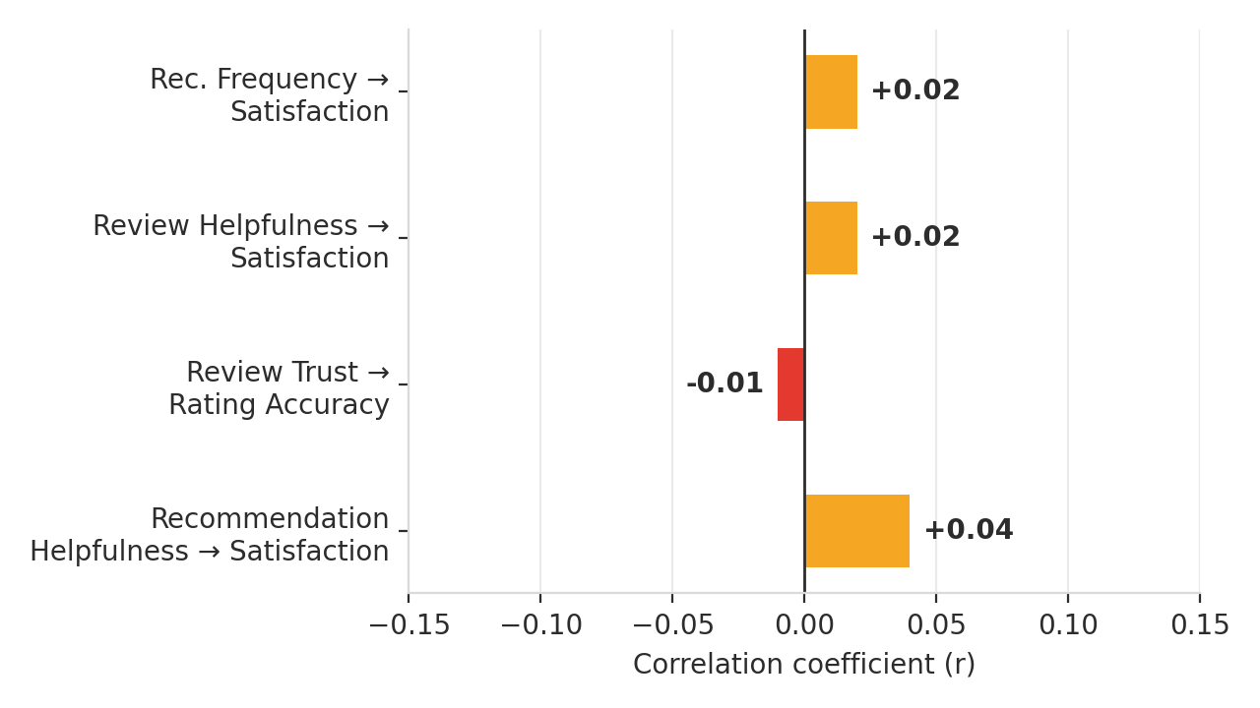
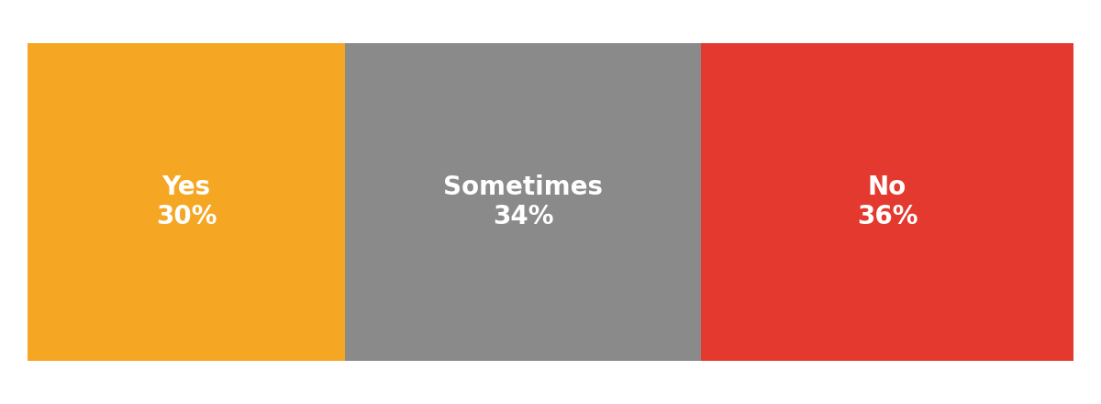
PART 2 · WHAT WE FOUND
Today's recommendations barely move satisfaction
Only
30%
of customers say personalized recommendations are consistently helpful
All four relationships are effectively zero (|r| < 0.05)
10
Notes:
Here's a finding that should reshape how we think about the recommendation and review systems. We correlated recommendation helpfulness, recommendation frequency, and review trust against both overall satisfaction and perceived rating accuracy. Every single correlation is essentially zero — under 0.05 in magnitude. And only 30 percent of customers consistently find personalized recommendations helpful. In plain terms: the current recommendation logic isn't meaningfully connected to what makes customers happy. That's a strong signal the underlying logic needs to change, not just be tuned.

Slide 11
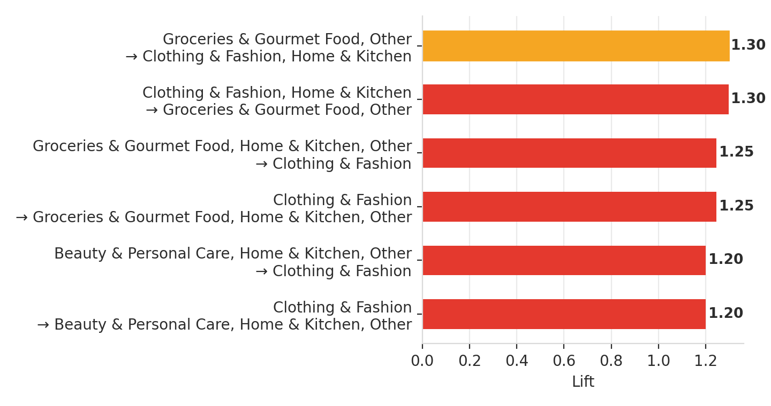
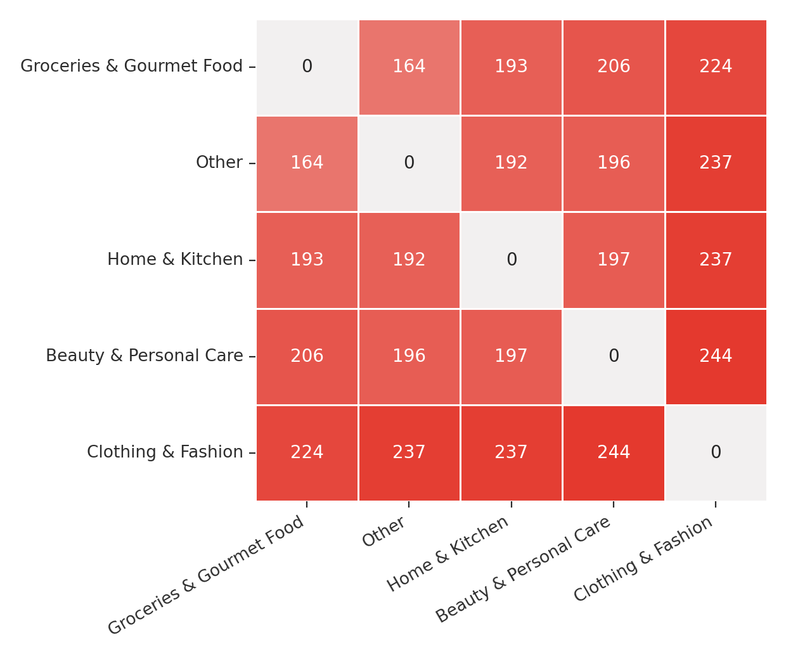
PART 2 · WHAT WE FOUND
Clothing & Fashion is the basket's anchor category
11
Notes:
Running market basket analysis on the multi-select category field shows Clothing & Fashion acting as the strongest hub — it shows up as the highest-confidence outcome when Groceries, Home & Kitchen, and other categories are already in the basket, in some cases with over 70 percent confidence. The co-occurrence matrix on the right backs this up with raw counts: Fashion, Beauty, and Home & Kitchen consistently travel together. This is real, grounded co-purchase behavior — not an assumption — and it's exactly the kind of signal a recommendation engine should be built around.

Slide 12
PART 3 · WHAT THIS MEANS
How these findings should reshape recommendations
1
From popularity to basket-affinity
2
Target the frequent-but-unhappy first
Recommendation logic barely tracks satisfaction today (r ≈ 0). Rebuild it around the Fashion-anchored association rules from real co-purchases, not generic 'frequently bought' popularity.
This cluster buys the most yet is nearly as dissatisfied as At-Risk customers. Feed them differentiated recommendations and offers before they churn — they're the highest-value save.
3
Bundle around price & shipping friction
4
Prove it before scaling
Since price and shipping — not discovery — drive abandonment, pair Fashion-anchored bundles with a shipping-fee waiver or bundle discount so recommendations address the real blocker.
With 35% of customers unconvinced by current recommendations, A/B test basket-affinity logic against the existing engine before a full rollout.
12
Notes:
This is the payoff slide — pulling everything together into what we should actually do to the recommendation system. Four changes. One: shift the underlying logic from generic popularity to the basket-affinity patterns we just saw, anchored on Fashion. Two: use behavioral clustering, not just purchase frequency, to catch the 'frequent but unhappy' customers before they churn — they're hiding in plain sight if you only look at how often someone buys. Three: since price and shipping are the actual abandonment drivers, pair any new recommendation-driven bundle with a real financial incentive, not just a better product suggestion. Four: given only 30 percent of customers trust current recommendations, validate the new approach with an A/B test rather than a full-scale rollout.

Slide 13
PART 3 · WHAT THIS MEANS
Suggested next steps
Now
Next 4–6 weeks
Ongoing
Launch a win-back offer for At-Risk and Frequent-but-Unhappy customers, focused on price/shipping incentives
Rebuild recommendation logic around basket-affinity rules; A/B test against the current engine
Track satisfaction and rating-accuracy correlation with the new engine as the success metric — not just click-through
13
Notes:
Concretely, here's a simple phasing. Immediately, launch a win-back offer targeted at At-Risk and Frequent-but-Unhappy customers, centered on price and shipping since that's what actually drives them away. Over the next four to six weeks, rebuild the recommendation logic around the basket-affinity rules we found and run it as an A/B test against the current system. And on an ongoing basis, track satisfaction and rating-accuracy correlation with the new engine as the real success metric — not just click-through rate, since we've shown click-through-style engagement doesn't reliably predict happiness.

Slide 14
Questions & discussion
Full analysis notebook and cleaned dataset available on request.
Notes:
That's the full picture — what's in the data, what it tells us, and the concrete changes it points to for Snapdeal's recommendation strategy. Happy to take questions, and the full analysis notebook and cleaned dataset are available if anyone wants to dig into the details.

