Slide 1
Homework 1A
2018312758
GUHO KIM

Slide 2
Problem explanation
Problem: 3n+1
Given an integer number n, we repeat the following process until x=1:
If the number is odd, x is set to 3*x+1;
Otherwise (even number), x is set to x/2;
Then, we can count the number of elements until x=1 (including the initial x and x=1).
For given X, and Y, print the maximum of the number of elements for X, X+1, X+2, …, Y
1 ≤ X ≤ Y ≤10000

Slide 3
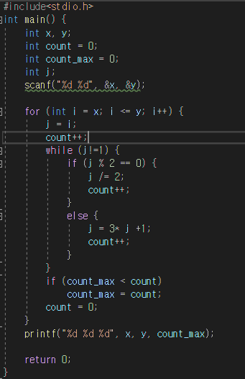
Solution explanation
We need to search from X to Y.
If element is even then element = element/2. And else if element is odd then element = element*3+1.
Every single time, I’ll count.
And I want to find the maximum of number of elements for X, X+1, …, Y. So if count_max < count then count_max=count.

