Slide 1
Homework_1B
2018312758
GUHO KIM

Slide 2
Problem explanation
Finding k Test Program
Input: n, D1, D2, …, Dn, A1, A2, …, An
n is the size of matrix (n by n). (2 ≤ n ≤ 10)
D1, D2, …, Dn are diagonal entries.
A1, A2, …, An are antidiagonal entries.
Output: n by n matrix, each of whose column and row is sorted in an ascending order. Also, each element should be a unique integer value (meaning that all elements should be different numbers). If such a matrix is not feasible, print “infeasible”.
Each entry (number) is an integer from 1 to 1000.

Slide 3
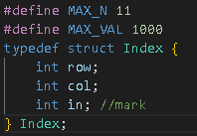

Idea for solution
First, put the input-values to the matrix[n][n].
And to check the uniqueness later, we create a structure index[1000]

Slide 4
Example(1)

Slide 5
Idea for solution
Input : 5 2 8 19 25 50 31 17 19 20 7
Example(1)
2 |  |  |  | 7
 | 8 |  | 20
 |  | 19
 | 17 |  | 25
31 |  |  |  | 50
Put the input-values to the matrix[n][n].
0 | 1 | 2 | 3 | 4 | 5 | 6 | 7 | 8 | 9 | 10 | 11 | 12 | 13 | 14 | 15 | 16 | 17 | 18 | 19 | 20 | 21 | 22 | 23 | 24 | 25 | 26 | 27 | 28 | 29 | 30 | 31 | 32 | 33 | 34 | 35 | 36 | 37 | 38 | 39 | 40
0 | 0 | 1 | 0 | 0 | 0 | 0 | 1 | 1 | 0 | 0 | 0 | 0 | 0 | 0 | 0 | 0 | 1 | 0 | 1 | 1 | 0 | 0 | 0 | 0 | 1 | 0 | 0 | 0 | 0 | 0 | 1 | 0 | 0 | 0 | 0 | 0 | 0 | 0 | 0 | 1

Slide 6
Idea for solution
Input : 5 2 8 19 25 50 31 17 19 20 7
Input : 5 2 8 19 25 50 31 17 19 20 7
Example(1)
2 | 3 |  |  | 7
 | 8 |  | 20
 |  | 19
 | 17 |  | 25
31 |  |  |  | 50
Put the input-values to the matrix[n][n].
I’ll start putting in values from the matrix[0][1] to the right side.
The initial value is matrix[0][0]+1.
If the number is not marked, then put it.
When I put some number, I’ll add 1 to the number( number+=1), and mark the index and value to structure.
0 | 1 | 2 | 3 | 4 | 5 | 6 | 7 | 8 | 9 | 10 | 11 | 12 | 13 | 14 | 15 | 16 | 17 | 18 | 19 | 20 | 21 | 22 | 23 | 24 | 25 | 26 | 27 | 28 | 29 | 30 | 31 | 32 | 33 | 34 | 35 | 36 | 37 | 38 | 39 | 40
0 | 0 | 1 | 1 | 0 | 0 | 0 | 1 | 1 | 0 | 0 | 0 | 0 | 0 | 0 | 0 | 0 | 1 | 0 | 1 | 1 | 0 | 0 | 0 | 0 | 1 | 0 | 0 | 0 | 0 | 0 | 1 | 0 | 0 | 0 | 0 | 0 | 0 | 0 | 0 | 1

Slide 7
Idea for solution
Input : 5 2 8 19 25 50 31 17 19 20 7
Input : 5 2 8 19 25 50 31 17 19 20 7
Example(1)
2 | 3 | 4 | 5 | 7
 | 8 |  | 20
 |  | 19
 | 17 |  | 25
31 |  |  |  | 50
Put the input-values to the matrix[n][n].
I’ll start putting in values from the matrix[0][1] to the right side.
The initial value is matrix[0][0]+1.
If the number is not marked, then put it.
When I put some number, I’ll add 1 to the number( number+=1), and mark the index and value to structure.
0 | 1 | 2 | 3 | 4 | 5 | 6 | 7 | 8 | 9 | 10 | 11 | 12 | 13 | 14 | 15 | 16 | 17 | 18 | 19 | 20 | 21 | 22 | 23 | 24 | 25 | 26 | 27 | 28 | 29 | 30 | 31 | 32 | 33 | 34 | 35 | 36 | 37 | 38 | 39 | 40
0 | 0 | 1 | 1 | 1 | 1 | 0 | 1 | 1 | 0 | 0 | 0 | 0 | 0 | 0 | 0 | 0 | 1 | 0 | 1 | 1 | 0 | 0 | 0 | 0 | 1 | 0 | 0 | 0 | 0 | 0 | 1 | 0 | 0 | 0 | 0 | 0 | 0 | 0 | 0 | 1
Example(1)

Slide 8
Idea for solution
Input : 5 2 8 19 25 50 31 17 19 20 7
Input : 5 2 8 19 25 50 31 17 19 20 7
Example(1)
2 | 3 | 4 | 5 | 7
6 | 8 |  | 20
 |  | 19
 | 17 |  | 25
31 |  |  |  | 50
Put the input-values to the matrix[n][n].
I’ll start putting in values from the matrix[0][1] to the right side.
The initial value is matrix[0][0]+1.
If the number is not marked, then put it.
When I put some number, I’ll add 1 to the number( number+=1), and mark the index and value to structure.
When the row is changed, I’ll start with matrix[row-1][col]+1.
If it's already marked, it'll increase until it can be put in.
0 | 1 | 2 | 3 | 4 | 5 | 6 | 7 | 8 | 9 | 10 | 11 | 12 | 13 | 14 | 15 | 16 | 17 | 18 | 19 | 20 | 21 | 22 | 23 | 24 | 25 | 26 | 27 | 28 | 29 | 30 | 31 | 32 | 33 | 34 | 35 | 36 | 37 | 38 | 39 | 40
0 | 0 | 1 | 1 | 1 | 1 | 1 | 1 | 1 | 0 | 0 | 0 | 0 | 0 | 0 | 0 | 0 | 1 | 0 | 1 | 1 | 0 | 0 | 0 | 0 | 1 | 0 | 0 | 0 | 0 | 0 | 1 | 0 | 0 | 0 | 0 | 0 | 0 | 0 | 0 | 1
Example(1)

Slide 9
Idea for solution
Input : 5 2 8 19 25 50 31 17 19 20 7
Input : 5 2 8 19 25 50 31 17 19 20 7
Example(1)
2 | 3 | 4 | 5 | 7
6 | 8 | 9 | 20 | 21
10 | 11 | 19 | 22 | 23
12 | 17 | 24 | 25 | 26
31 | 32 | 33 | 34 | 50
Put the input-values to the matrix[n][n].
I’ll start putting in values from the matrix[0][1] to the right side.
The initial value is matrix[0][0]+1.
If the number is not marked, then put it.
When I put some number, I’ll add 1 to the number( number+=1), and mark the index and value to structure.
When the row is changed, I’ll start with matrix[row-1][col]+1.
If it's already marked, it'll increase until it can be put in.
Fill up the matrix and it's over.
0 | 1 | 2 | 3 | 4 | 5 | 6 | 7 | 8 | 9 | 10 | 11 | 12 | 13 | 14 | 15 | 16 | 17 | 18 | 19 | 20 | 21 | 22 | 23 | 24 | 25 | 26 | 27 | 28 | 29 | 30 | 31 | 32 | 33 | 34 | 35 | 36 | 37 | 38 | 39 | 40
0 | 0 | 1 | 1 | 1 | 1 | 1 | 1 | 1 | 1 | 1 | 1 | 1 | 0 | 0 | 0 | 0 | 1 | 0 | 1 | 1 | 1 | 1 | 1 | 1 | 1 | 1 | 0 | 0 | 0 | 0 | 1 | 1 | 1 | 1 | 0 | 0 | 0 | 0 | 0 | 1
Example(1)

Slide 10
Example(2)

Slide 11
Idea for solution
Input : 5 2 6 17 22 50 31 18 17 20 8
Example(2)
2 |  |  |  | 8
 | 6 |  | 20
 |  | 17
 | 18 |  | 22
31 |  |  |  | 50
If you fill in this example in the same way, there is a problem.
0 | 1 | 2 | 3 | 4 | 5 | 6 | 7 | 8 | 9 | 10 | 11 | 12 | 13 | 14 | 15 | 16 | 17 | 18 | 19 | 20 | 21 | 22 | 23 | 24 | 25 | 26 | 27 | 28 | 29 | 30 | 31 | 32 | 33 | 34 | 35 | 36 | 37 | 38 | 39 | 40
0 | 0 | 1 | 0 | 0 | 0 | 1 | 0 | 1 | 0 | 0 | 0 | 0 | 0 | 0 | 0 | 0 | 1 | 1 | 0 | 1 | 0 | 1 | 0 | 0 | 0 | 0 | 0 | 0 | 0 | 0 | 1 | 0 | 0 | 0 | 0 | 0 | 0 | 0 | 0 | 1
Example(2)

Slide 12
Idea for solution
Input : 5 2 6 17 22 50 31 18 17 20 8
Example(2)
2 | 3 | 4 | 5 | 8
5 | 6 |  | 20
 |  | 17
 | 18 |  | 22
31 |  |  |  | 50
If you fill in this example in the same way, there is a problem.
I can put 3, 4, or 5 in matrix[0][1], but all of numbers are already marked.
In this case, I will fix the last value at this space.
0 | 1 | 2 | 3 | 4 | 5 | 6 | 7 | 8 | 9 | 10 | 11 | 12 | 13 | 14 | 15 | 16 | 17 | 18 | 19 | 20 | 21 | 22 | 23 | 24 | 25 | 26 | 27 | 28 | 29 | 30 | 31 | 32 | 33 | 34 | 35 | 36 | 37 | 38 | 39 | 40
0 | 0 | 1 | 1 | 1 | 1 | 1 | 0 | 1 | 0 | 0 | 0 | 0 | 0 | 0 | 0 | 0 | 1 | 1 | 0 | 1 | 0 | 1 | 0 | 0 | 0 | 0 | 0 | 0 | 0 | 0 | 1 | 0 | 0 | 0 | 0 | 0 | 0 | 0 | 0 | 1
Example(2)

Slide 13
Idea for solution
Input : 5 2 6 17 22 50 31 18 17 20 8
Example(2)
2 |  |  |  | 8
5 | 6 |  | 20
 |  | 17
 | 18 |  | 22
31 |  |  |  | 50
If you fill in this example in the same way, there is a problem.
I can put 3, 4, or 5 in matrix[0][1], but all of numbers are already marked.
In this case, I will fix the last value at this space.
I will reset all of matrix without these blue and yellow matrix.
0 | 1 | 2 | 3 | 4 | 5 | 6 | 7 | 8 | 9 | 10 | 11 | 12 | 13 | 14 | 15 | 16 | 17 | 18 | 19 | 20 | 21 | 22 | 23 | 24 | 25 | 26 | 27 | 28 | 29 | 30 | 31 | 32 | 33 | 34 | 35 | 36 | 37 | 38 | 39 | 40
0 | 0 | 1 | 0 | 0 | 1 | 1 | 0 | 1 | 0 | 0 | 0 | 0 | 0 | 0 | 0 | 0 | 1 | 1 | 0 | 1 | 0 | 1 | 0 | 0 | 0 | 0 | 0 | 0 | 0 | 0 | 1 | 0 | 0 | 0 | 0 | 0 | 0 | 0 | 0 | 1
Example(2)

Slide 14
Idea for solution
Input : 5 2 6 17 22 50 31 18 17 20 8
Example(2)
2 | 3 | 4 | 7 | 8
5 | 6 |  | 20
 |  | 17
 | 18 |  | 22
31 |  |  |  | 50
If you fill in this example in the same way, there is a problem.
I can put 3, 4, or 5 in matrix[0][1], but all of numbers are already marked.
In this case, I will fix the last value at this space.
I will reset all of matrix without these blue and yellow matrix.
And start to fill the matrix.
0 | 1 | 2 | 3 | 4 | 5 | 6 | 7 | 8 | 9 | 10 | 11 | 12 | 13 | 14 | 15 | 16 | 17 | 18 | 19 | 20 | 21 | 22 | 23 | 24 | 25 | 26 | 27 | 28 | 29 | 30 | 31 | 32 | 33 | 34 | 35 | 36 | 37 | 38 | 39 | 40
0 | 0 | 1 | 1 | 1 | 1 | 1 | 1 | 1 | 0 | 0 | 0 | 0 | 0 | 0 | 0 | 0 | 1 | 1 | 0 | 1 | 0 | 1 | 0 | 0 | 0 | 0 | 0 | 0 | 0 | 0 | 1 | 0 | 0 | 0 | 0 | 0 | 0 | 0 | 0 | 1
Example(2)

Slide 15
Idea for solution
Input : 5 2 6 17 22 50 31 18 17 20 8
Example(2)
2 | 3 | 4 | 7 | 8
5 | 6 | 9 | 20 | 21
10 | 11 | 17 | 21
 | 18 |  | 22
31 |  |  |  | 50
If you fill in this example in the same way, there is a problem.
I can put 3, 4, or 5 in matrix[0][1], but all of numbers are already marked.
In this case, I will fix the last value at this space.
I will reset all of matrix without these blue and yellow matrix.
And start to fill the matrix.
There is same problem at the matrix[2][3], so I will fix that number and reset the matrix and restart.
0 | 1 | 2 | 3 | 4 | 5 | 6 | 7 | 8 | 9 | 10 | 11 | 12 | 13 | 14 | 15 | 16 | 17 | 18 | 19 | 20 | 21 | 22 | 23 | 24 | 25 | 26 | 27 | 28 | 29 | 30 | 31 | 32 | 33 | 34 | 35 | 36 | 37 | 38 | 39 | 40
0 | 0 | 1 | 1 | 1 | 1 | 1 | 1 | 1 | 1 | 1 | 1 | 0 | 0 | 0 | 0 | 0 | 1 | 1 | 0 | 1 | 1 | 1 | 0 | 0 | 0 | 0 | 0 | 0 | 0 | 0 | 1 | 0 | 0 | 0 | 0 | 0 | 0 | 0 | 0 | 1
Example(2)

Slide 16
Idea for solution
Input : 5 2 6 17 22 50 31 18 17 20 8
Example(2)
2 |  |  |  | 8
5 | 6 |  | 20
 |  | 17 | 21
 | 18 |  | 22
31 |  |  |  | 50
If you fill in this example in the same way, there is a problem.
I can put 3, 4, or 5 in matrix[0][1], but all of numbers are already marked.
In this case, I will fix the last value at this space.
I will reset all of matrix without these blue and yellow matrix.
And start to fill the matrix.
There is same problem at the matrix[2][3], so I will fix that number and reset the matrix and restart.
0 | 1 | 2 | 3 | 4 | 5 | 6 | 7 | 8 | 9 | 10 | 11 | 12 | 13 | 14 | 15 | 16 | 17 | 18 | 19 | 20 | 21 | 22 | 23 | 24 | 25 | 26 | 27 | 28 | 29 | 30 | 31 | 32 | 33 | 34 | 35 | 36 | 37 | 38 | 39 | 40
0 | 0 | 1 | 0 | 0 | 1 | 1 | 0 | 1 | 0 | 0 | 0 | 0 | 0 | 0 | 0 | 0 | 1 | 1 | 0 | 1 | 1 | 1 | 0 | 0 | 0 | 0 | 0 | 0 | 0 | 0 | 1 | 0 | 0 | 0 | 0 | 0 | 0 | 0 | 0 | 1
Example(2)

Slide 17
Idea for solution
Input : 5 2 6 17 22 50 31 18 17 20 8
Example(2)
2 | 3 | 4 | 7 | 8
5 | 6 | 9 | 20 | 23
 |  | 17 | 21
 | 18 |  | 22
31 |  |  |  | 50
21 is only one case.
So I fix 21b
0 | 1 | 2 | 3 | 4 | 5 | 6 | 7 | 8 | 9 | 10 | 11 | 12 | 13 | 14 | 15 | 16 | 17 | 18 | 19 | 20 | 21 | 22 | 23 | 24 | 25 | 26 | 27 | 28 | 29 | 30 | 31 | 32 | 33 | 34 | 35 | 36 | 37 | 38 | 39 | 40
0 | 0 | 1 | 1 | 1 | 1 | 1 | 1 | 1 | 1 | 0 | 0 | 0 | 0 | 0 | 0 | 0 | 1 | 1 | 0 | 1 | 1 | 1 | 1 | 0 | 0 | 0 | 0 | 0 | 0 | 0 | 1 | 0 | 0 | 0 | 0 | 0 | 0 | 0 | 0 | 1
Example(2)

Slide 18
Idea for solution
Input : 5 2 6 17 22 50 31 18 17 20 8
Example(2)
2 | 3 | 4 | 7 | 8
5 | 6 | 9 | 20 | 23
10 | 11 | 17 | 21 | 24
12 | 18 | 19 | 22 | 25
31 | 32 | 33 | 34 | 50
If you fill in this example in the same way, there is a problem.
I can put 3, 4, or 5 in matrix[0][1], but all of numbers are already marked.
In this case, I will fix the last value at this space.
I will reset all of matrix without these blue and yellow matrix.
And start to fill the matrix.
There is same problem at the matrix[2][3], so I will fix that number and reset the matrix and restart.
0 | 1 | 2 | 3 | 4 | 5 | 6 | 7 | 8 | 9 | 10 | 11 | 12 | 13 | 14 | 15 | 16 | 17 | 18 | 19 | 20 | 21 | 22 | 23 | 24 | 25 | 26 | 27 | 28 | 29 | 30 | 31 | 32 | 33 | 34 | 35 | 36 | 37 | 38 | 39 | 40
0 | 0 | 1 | 1 | 1 | 1 | 1 | 1 | 1 | 1 | 1 | 1 | 1 | 0 | 0 | 0 | 0 | 1 | 1 | 1 | 1 | 1 | 1 | 1 | 1 | 1 | 0 | 0 | 0 | 0 | 0 | 1 | 1 | 1 | 1 | 0 | 0 | 0 | 0 | 0 | 1
Example(2)

Slide 19
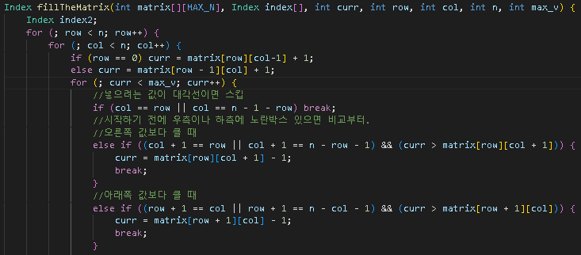
Code
This is the code for how I filled the matrix

Slide 20
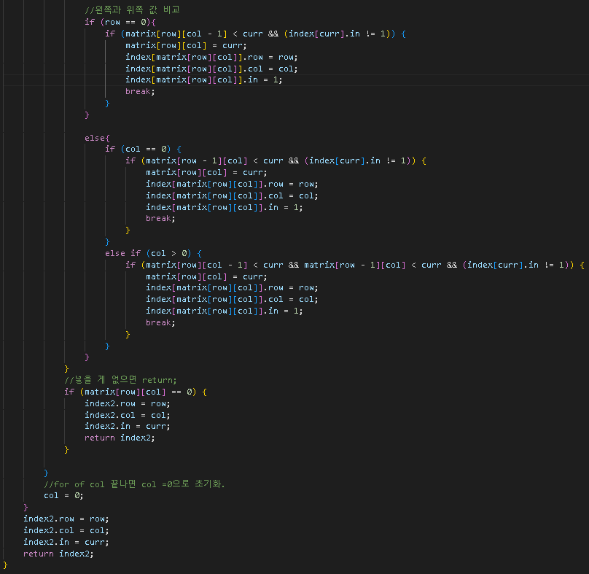
Code

Slide 21
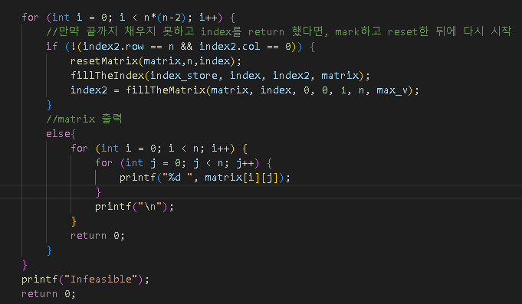
Code
If I can’t fill the matrix before n(n-2)times ,it is Infeasible.

