Slide 1
Homework 2A
2018312758
GUHO KIM

Slide 2
Problem explanation
Points for soccer teams: preliminary
A soccer league has 20 teams, and each team plays 19 games, once with all other teams. Each team gets
A points when it wins, represented by “W” (win),
B points when it ties, represented by “T” (tie), and
0 points when it is defeated, represented by “L” (lose),
where A and B are integers satisfying 0 < B < A < 10.
Then, results are represented by the 20 by 20 matrix shown in the next slide.
Calculate each team’s score sorted in descending order.

Slide 3
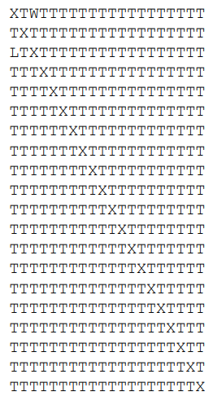
Solution explanation
The input data of 20 by 20 matrix is like that. And A and B will be given.
To solve this problem, I can think every single row is each team.
So, I’ll get every row as a string and calculate the score.

Slide 4
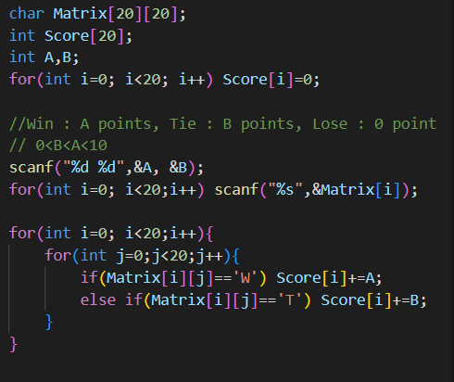
Solution explanation
To solve this problem, I can think every single row is each team.
So, I’ll get every row as a string and calculate the score. I added the score to the score array.

Slide 5
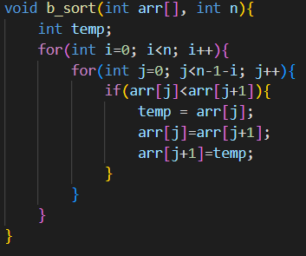
Solution explanation
And I used bubble sort for sorting

