Slide 1
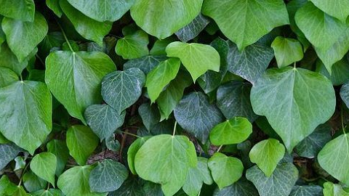

“FROM THE FIELDS TO THE NETWORK”
USING DEEP LEARNING TO DETECT DISEASES IN CROPS
FILIPA SÁ DA COSTA | 20180051 JOÃO FERNANDES | 20180061
20180056 | GUILHERME MARTINS
20180044 | LIAH ROSENFELD

