Slide 1
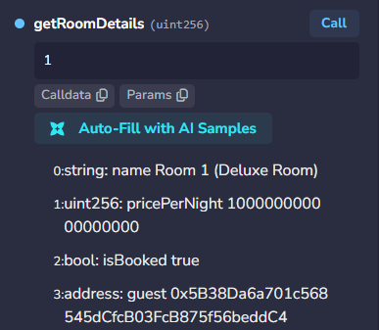
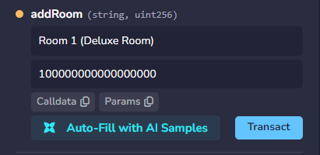
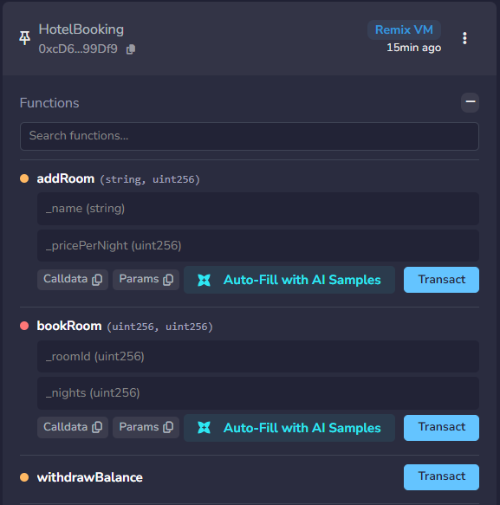
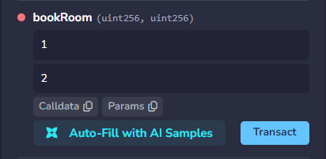
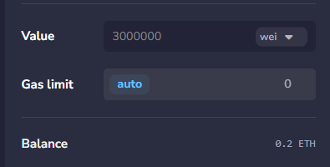
CCT COLLEGE DUBLIN | DISTRIBUTED DIGITAL TRANSACTIONS
Hotel Booking Smart Contract
Student: Guilherme Pulquerio | Student ID: 2024637 | GitHub: GuiAndrei12/CA1_DDT_Guilherme_Pulquerio
1. Real-World Business Model
2. Smart Contract & Inventory
3. Booking & Inspection
4. Security & AI Declaration
Traditional Booking Problem:
Platforms like Airbnb/Booking.com act as
centralized middlemen charging 15-30% fees,
holding host payouts, and storing data on private
servers.
Blockchain Solution (HotelBooking.sol):
Smart Contract on Ethereum acting as an Automatic
Hotel Reception. Runs 24/7 without middlemen,
employees, or servers.
Real-World Mechanics:
• Direct Payments: Guests pay ETH directly to
contract.
• Automatic Rules: Rooms lock on booking; no
double-booking.
• 100% Transparent: All listings & bookings on
public ledger.
Data Storage (struct & mapping):
• Room Struct: Stores Name, Price/Night, Booking
Status, Guest Address.
• Key Cabinet (mapping): Numbered slots storing
room details.
• Security Guard (onlyOwner): Fingerprint check
verifying msg.sender == owner for admin tasks.
Step 3 — Inspecting (getRoomDetails):
Free view function reading room details without gas
cost.
Events:
Broadcasts RoomBooked logs for DApp UI updates.
Benefits vs. Challenges
Key Benefits
• No Middlemen, Lower Fees: Guests book directly with owners, cutting out high agency commissions (15%–30%).
• No Double-Booking: The Smart Contract automatically locks room availability the moment it's paid.
• 100% Transparent: All prices, room details, and bookings are visible and cannot be changed or faked.
• Direct & Secure Payments: Money goes straight to the owner's account without risk of unpaid reservations.
Challenges
• Crypto Wallet Required: Users need a crypto wallet (like MetaMask) and ETH to book.
• Network Fees (Gas): Transactions cost a small network fee that changes depending on blockchain traffic.
• Code Cannot Be Changed Easily: Once deployed to the blockchain, fixing bugs or updating rules is difficult.
• Speed: Blockchain confirmations can take a few seconds longer than normal credit card clicks.
Step 1 — Adding Rooms (addRoom):
Owner inputs room name & price in Wei. Contract
increments roomCount and saves room state.
Step 2 — Reserving (bookRoom):
Guest selects roomId & nights, sending payable
ETH with transaction.
Validations & State Updates:
• Validates roomId, verifies !isBooked, checks exact
msg.value == totalCost.
• Sets isBooked = true, records guest wallet, credits
ownerBalance.
Step 4 — Owner Withdrawal
(withdrawBalance):
Owner calls withdrawBalance() to collect
accumulated payments.
Security (Checks-Effects-Interactions):
Prevents reentrancy by validating balance > 0,
resetting ownerBalance = 0 before transferring ETH
via .call().

