Slide 1
DATA VISUALIZATION · FINAL PROJECT · SUMMER 2026
Brazil's Marketplace in Motion
A data story of the Olist e-commerce ecosystem, 2016–2018 — 100k real orders, 27 states, one marketplace under strain.
100k+
12
27
3
orders analyzed
analytical questions
Brazilian states
linked deliverables
Dataset: Brazilian E-Commerce Public Dataset by Olist (Kaggle) · Notebook + Streamlit Dashboard + Presentation

Slide 2
THE DATASET
A rich, real-world marketplace — not a toy dataset
Numerical
Categorical
Spatial
Temporal
Price, freight, product weight & dimensions, review scores
72 product categories, payment types, order status
Customer & seller state / city / zip, geolocation
Purchase, approval, shipping & delivery timestamps, 2016–18
Source: olist/work-at-olist-data on GitHub — the official mirror of the Kaggle "Brazilian E-Commerce Public Dataset by Olist". 9 relational tables merged into a 112,650-row, 45-column order-item master table.
One dataset. Twelve questions. One story.
Brazil's Marketplace in Motion · Data Visualization Final Project
2

Slide 3
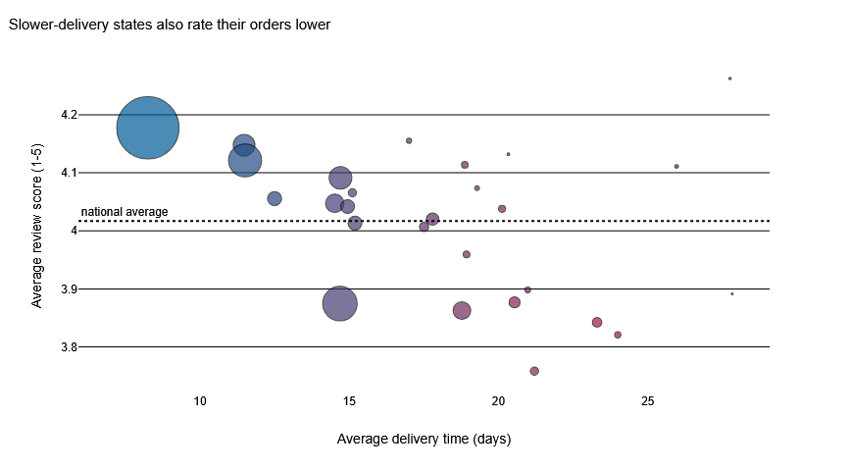
Q1 · DELIVERY & SATISFACTION
Slower delivery states also rate their orders lower
Takeaway
Northern/Northeastern states average 15–21+ day deliveries and sit visibly below the national review average — the South-East core (SP/PR/MG) delivers fastest and rates highest.
Brazil's Marketplace in Motion · Data Visualization Final Project
3

Slide 4
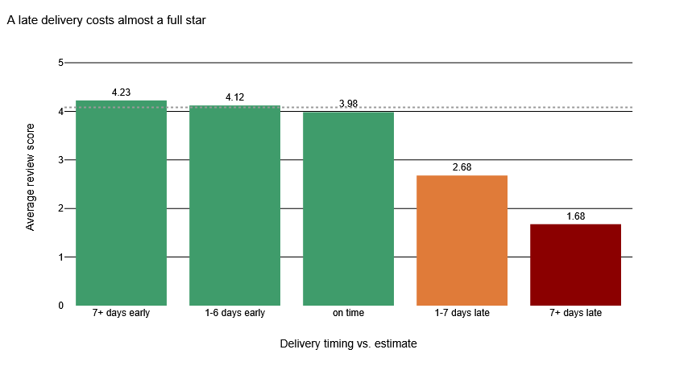
Q4 · DELIVERY & SATISFACTION
A late delivery costs almost a full star
Takeaway
Average review score falls from 3.98 (on-time) to 2.68 for orders 1-7 days late, and 1.68 past a week late. Lateness — not early arrival — is the single biggest driver of review score.
Brazil's Marketplace in Motion · Data Visualization Final Project
4

Slide 5
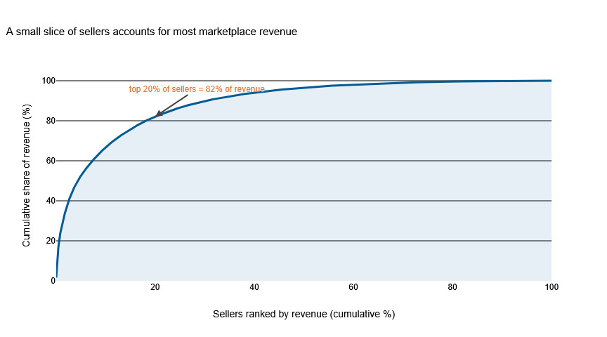
Q9 · MARKETPLACE STRUCTURE
Revenue is sharply concentrated among a few sellers
Takeaway
The top 20% of sellers generate roughly 82% of marketplace revenue — a classic Pareto pattern that makes seller-relationship management a high-leverage lever for Olist.
Brazil's Marketplace in Motion · Data Visualization Final Project
5

Slide 6
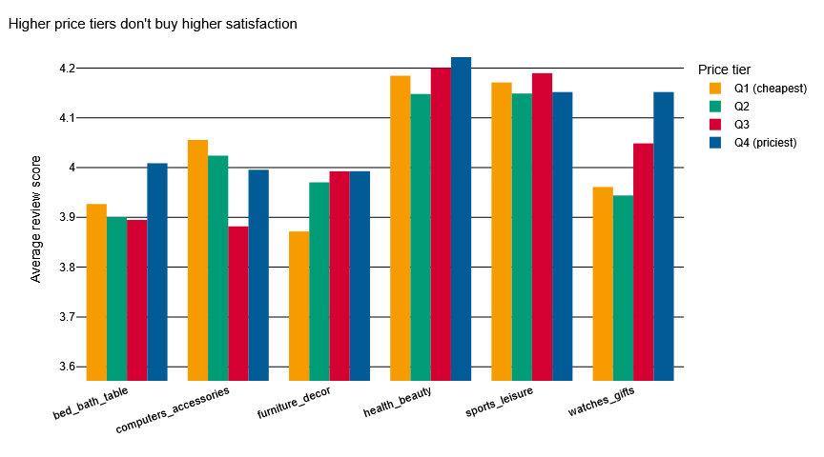
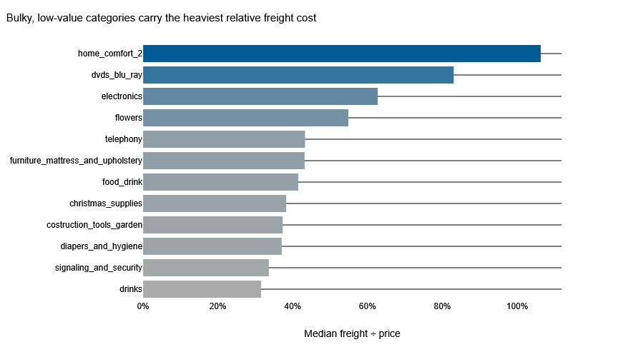
Q6 & Q3 · PRICE, FREIGHT & SATISFACTION
Price doesn't buy satisfaction — but size drives freight cost
Within every top-selling category, review scores stay essentially flat from cheapest to priciest quartile — while bulky, low-value categories like furniture and construction goods carry the heaviest freight-to-price burden. Satisfaction is an operations problem, not a pricing one.
Brazil's Marketplace in Motion · Data Visualization Final Project
6

Slide 7
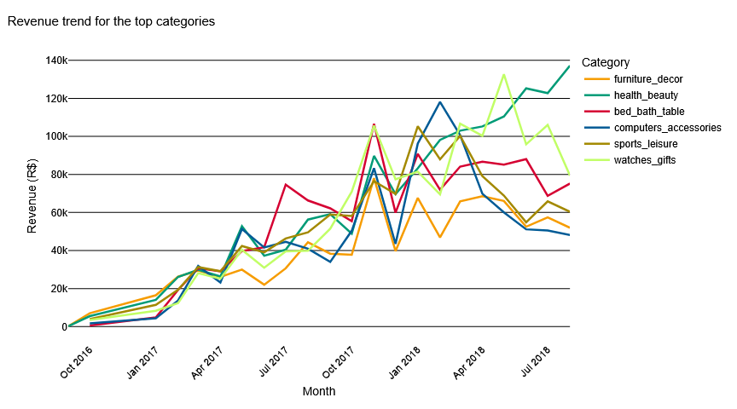
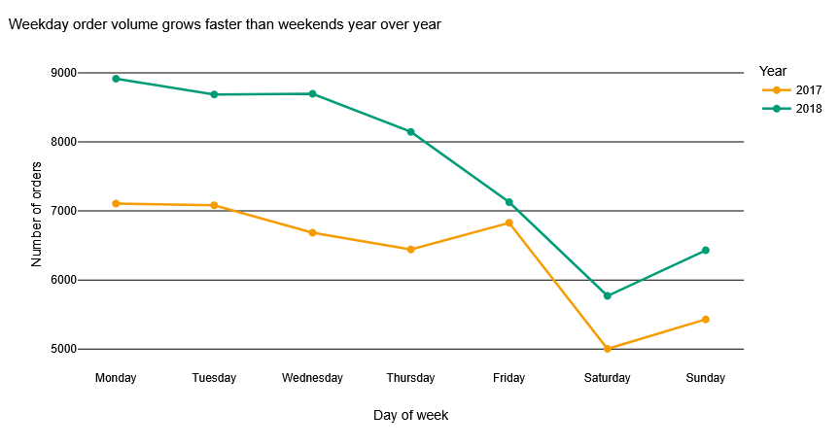
Q2 & Q7 · GROWTH OVER TIME
2018 growth was healthy, broad-based, and increasingly weekday-driven
Health & beauty and watches/gifts pulled ahead of other categories through 2018, while weekday order volume grew faster than weekends year-over-year — a marketplace maturing past its early, weekend-shopping-driven phase.
Brazil's Marketplace in Motion · Data Visualization Final Project
7

Slide 8
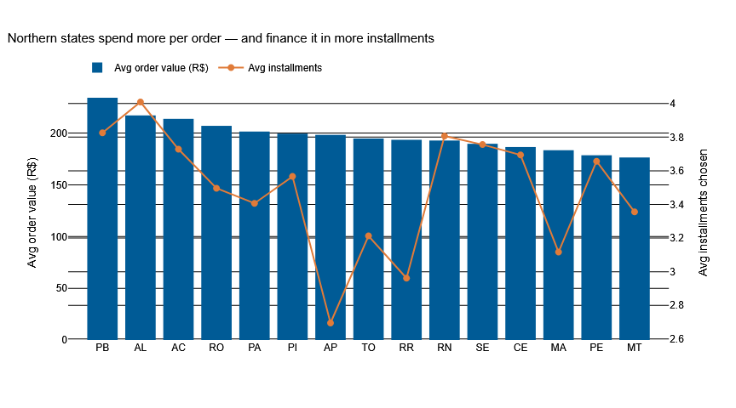
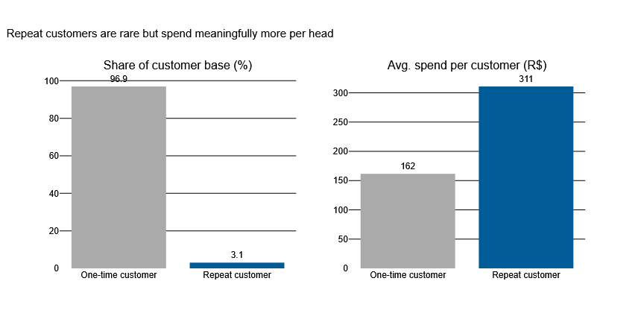
Q5, Q8 & Q12 · CUSTOMERS & PAYMENTS
Northern states spend more, finance longer, and rarely come back
Northern states post the highest average order values and lean hardest on installment financing. Meanwhile repeat customers are just ~3% of the base — but spend roughly double per head — making retention a clear, under-exploited growth lever.
Brazil's Marketplace in Motion · Data Visualization Final Project
8

Slide 9
INTERACTIVE DASHBOARD
Explore it yourself — the live Streamlit dashboard
A curated, filterable view across three tabs — Sales & Categories, Delivery & Satisfaction, Geography & Customers — built with the same CVD-safe palette and design language as the notebook.
https://brazilian-e-commerce-analysis-guilherme.streamlit.app/
Tabs
📈 Sales & Categories
🚚 Delivery & Satisfaction
🗺️ Geography & Customers
Filters: year · state · product category
Live URL: https://brazilian-e-commerce-analysis-guilherme.streamlit.app/
Repo: https://github.com/GuiAvella/Brazilian-E-Commerce-Analysis
Brazil's Marketplace in Motion · Data Visualization Final Project
9

Slide 10
Conclusions
What can be changed to improve:
1
Fix delivery reliability first
It's the single strongest lever on review score — bigger than price, category, or payment method.
2
Support outlying sellers/states operationally
Northern & Northeastern states carry the worst delivery times and heaviest freight ratios — targeted logistics investment there compounds.
3
Invest in seller diversification
Top 20% of sellers drive ~82% of revenue — concentration risk worth actively managing.
4
Build retention programs
Repeat customers are rare (~3%) but spend ~2x more — even a modest lift in repeat rate is high-value.
Full analysis: notebook (12 questions) · interactive dashboard · this deck — all linked in the project README.

