Slide 1







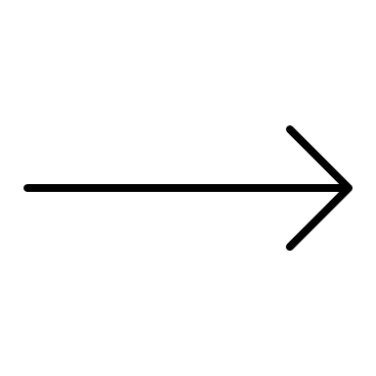



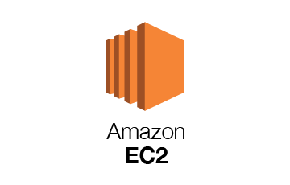
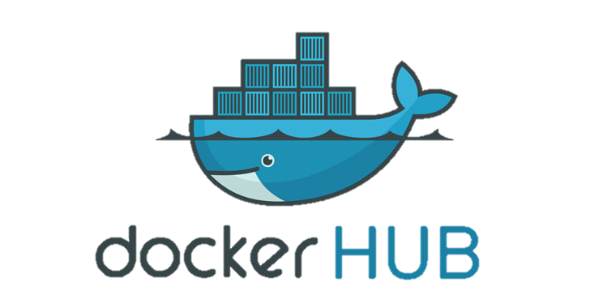

Dockerize application
3
Local Machine with uploader.py
Set up EC2 instance
-app.py -dockerfile
1
5
2
Receive results
3
6
Push image to dockerHUB
Send pictures
Set up EC2 instance
4
Pull image from dockerHUB

Slide 2
3
6

