Slide 1
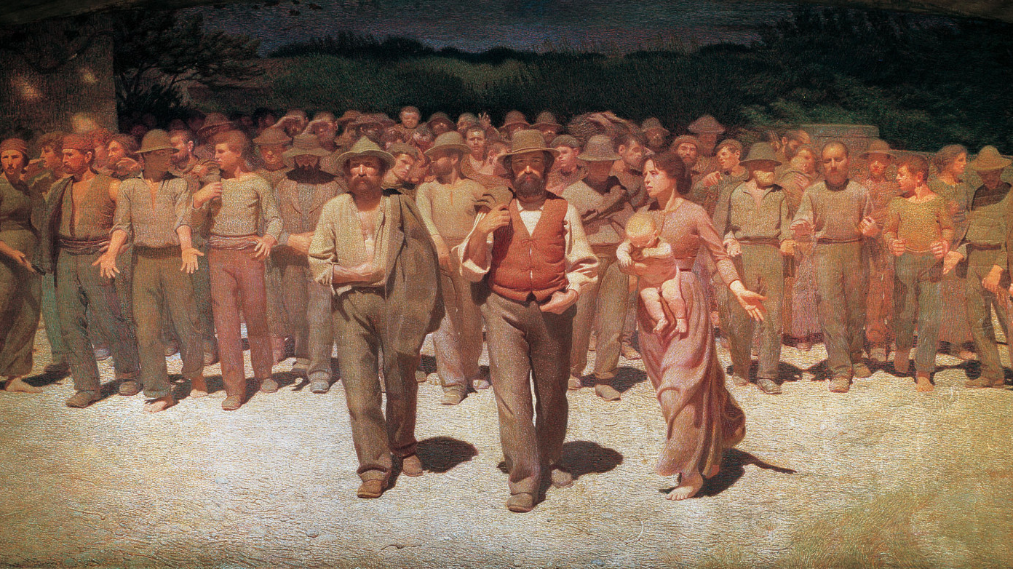

Occupational Diseases Analysis
Mussini Guido Giacomo
988273

Slide 2
Research Question
Understand and analyze the causal factors affecting the occupational diseases in Italy.
Study the limitations and complications of this type of analysis.

Slide 3
DATASET

Slide 4
Data
Downloaded from the INAIL website
Data on a semi-annual basis: July-December 2022
Topological Tables → Left JOINS
Delete useless Columns
Initially the dataset has:
282.118 observations
13 variables
17% of Missing Values

Slide 5
Dataset Manipulation
Generalize the nationality with the continent → Source
Rename the possible outcomes of some variable
Substitute the outcome ‘Non determinato’ with ‘NA’ in some variable to analyze the distribution of the missing values
Reduce the number of possible outcome of the variable Subsector_Work, based on the semantic.

Slide 6
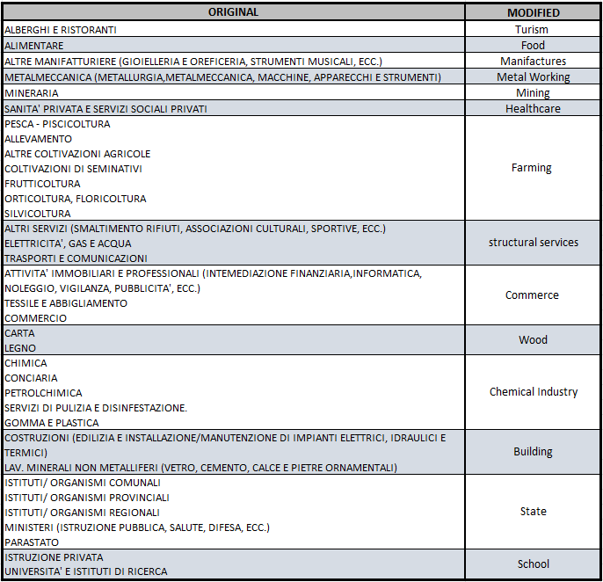
Subsector_work simplification

Slide 7
MISSING VALUES

Slide 8
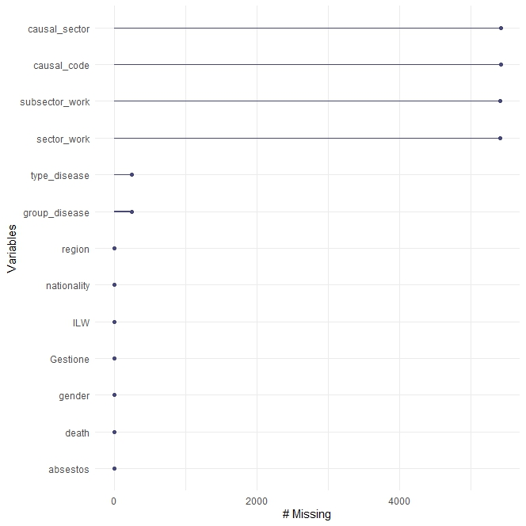
By Columns
Causal Sector\Code: 55% of NA
Sector\Subsector_Work: 54% of NA
Type\Group_Disease: 2.4% of NA

Slide 9
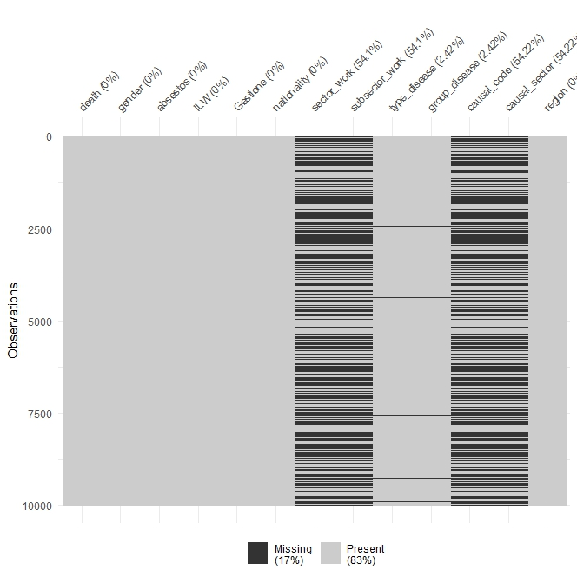
By Rows - 1
It appears that variables share rows with missing values

Slide 10
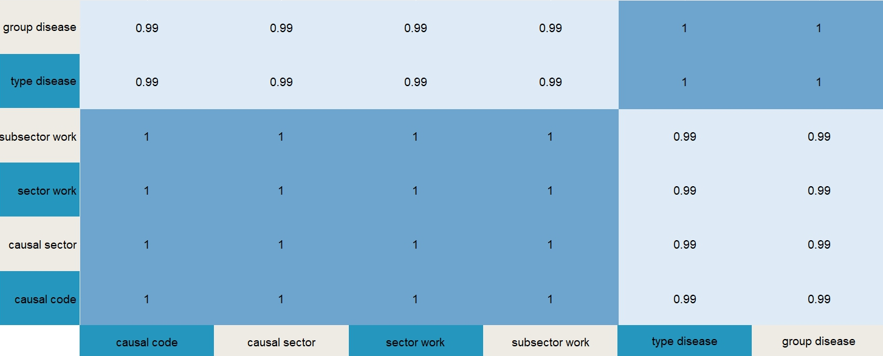
By Rows - 2
High correspondence between the missing values between the rows of all the variables

Slide 11
Imputation
Perfect match between:
Type_Disease, Group_Disease, Sector_Work and Subsector_Work
Causal Sector and Causal Code
They will be treated separately

Slide 12
Type_Disease and Group_Disease
Only 2.4% of missing values
Mostly shared with the other variables with NA
→They have been removed
Now the dataset has:
274966 observations

Slide 13
Sector_Work and SubSector_Work
54% of missing values
We can see Sector Work as a sort generalisation of Gestione and Subsector_Work as a generalisation of Sector_Work
GEN
GEN
GESTIONE:
A: Agricoltura
I: Industria\Servizi
S: Stato
SECTOR WORK:
ART: Artigianato
AGR: Agricoltura e pesca
IND: Industria
SER: Servizi
PA: Pubblica Amministrazione
SUBSECTOR WORK:
Building
Chemical Industry
Commerce
Farming
Food
Healthcare
Manifactures
Metal Working
Mining
School
State
Structural Services
Turism
Wood

Slide 14
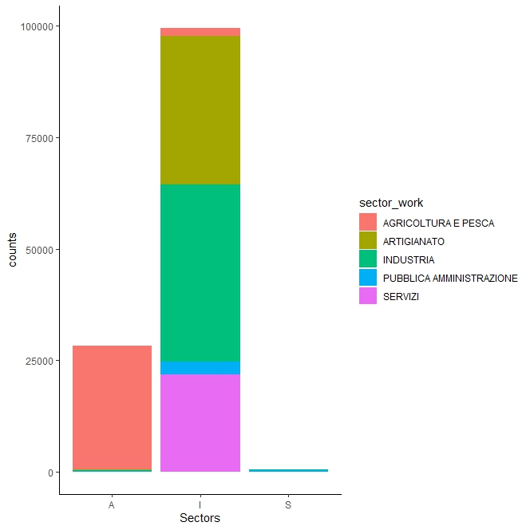
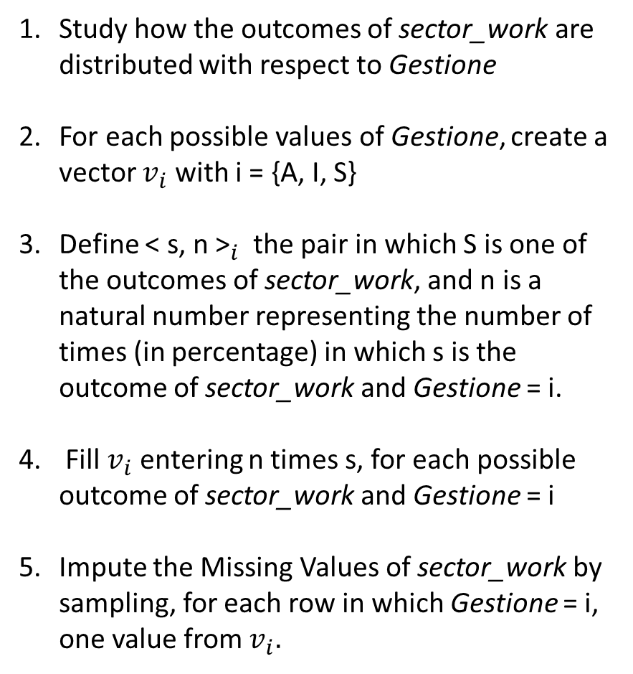
Gestione → Sector_Work
Study how the outcomes of sector_work are distributed with respect to Gestione
For each possible values of Gestione, create a vector $v_{i}$ with i = {A, I, S}
Define ${\text{< }\text{s}\text{, }\text{n}\text{ >}}_{i}$ the pair in which S is one of the outcomes of sector_work, and n is a natural number representing the number of times (in percentage) in which s is the outcome of sector_work and Gestione = i.
Fill $v_{i}$ entering n times s, for each possible outcome of sector_work and Gestione = i
Impute the Missing Values of sector_work by sampling, for each row in which Gestione = i, one value from $v_{i}.$

Slide 15
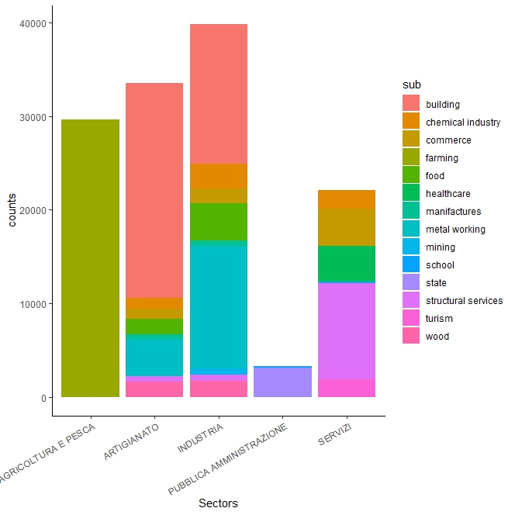
Sector_Work → SubSector_Work
Same process seen before to the pair sector_work, subsector_work

Slide 16
Causal Code and Causal Sector
Imputed using the missForest() function, from the R package of the same name
Based on a Random Forest
Having only categorical variables, it is computationally advantageous → Run Time ≈ 15min

Slide 17
BAYESIAN NETWORK

Slide 18
Dataset
After removing a few more variables, the situation is:
Variable | Type | # Levels
Gender | Factorial | 2
Nationality | Factorial | 6
Region | Factorial | 5
Work Sector | Factorial | 14
Disease | Factorial | 16
Injury Factor | Factorial | 6
Asbestos | Factorial | 2
Impairment Level | Factorial | 3
Death | Factorial | 2

Slide 19
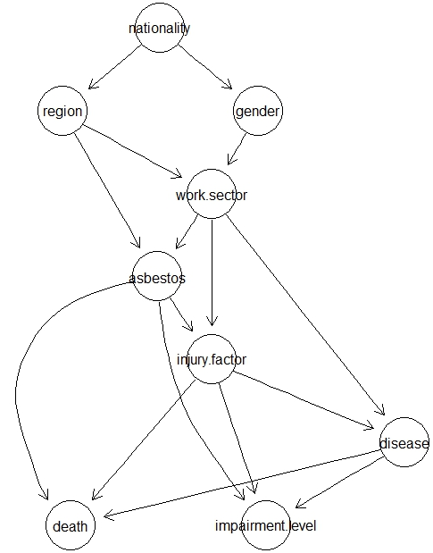
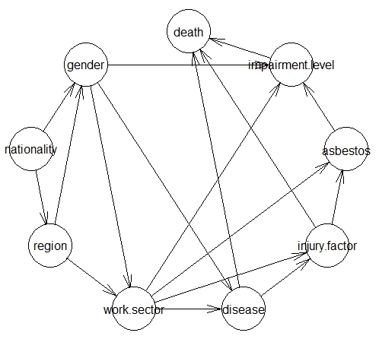
DAG
Graph after changing the structure
Result of the hc Algorithm

Slide 20
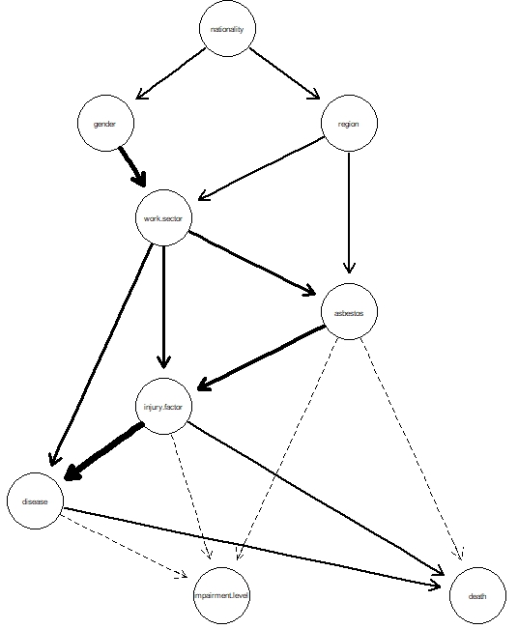
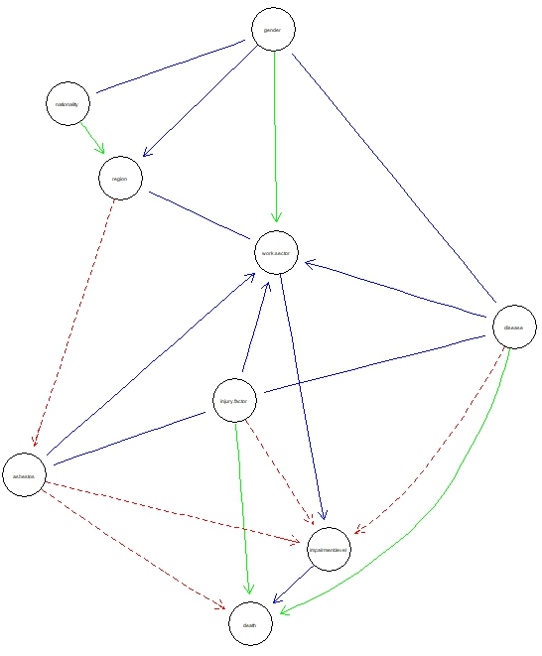
Arc Strength - 1
Measure of the strength of the probabilistic relationships between arcs
Comparison with the averaged network from bootstrap samples, with threshold >0.8

Slide 21
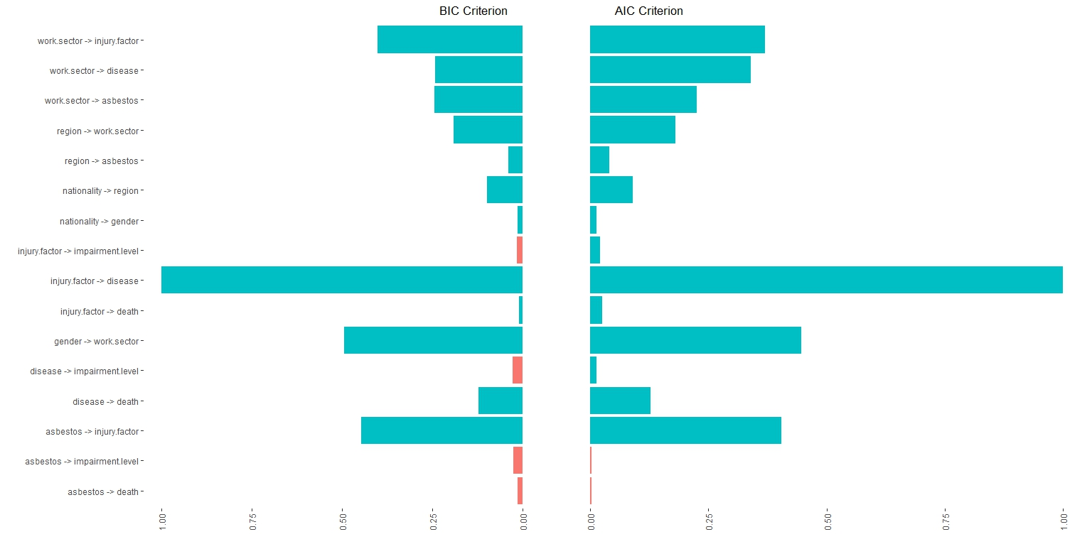
Arc Strength - 2
Comparison between 2 different metrics

Slide 22
Maximum a Posteriori Queries - 1
Find the configuration with the heighest posterior probability, given an hard evidence
MAP | Death = «Yes»:
MAP | Impairment Level = «High»:
Gender | Male
Nationality | Italy
Area | Sud
Work Sector | Metal Industry
Injury Factor | Material Factor
Disease | Cancer
Asbestos | Yes
Impairment Level | Low
Probability | 5.8%
Gender | Male
Nationality | Italy
Area | Sud
Work Sector | Metal Industry
Injury Factor | Material Factor
Disease | Cancer
Asbestos | Yes
Death | Yes
Probability | 6.8%

Slide 23
Maximum a Posteriori Queries - 2
Find the configuration with the heighest posterior probability, given an hard evidence
MAP | Injury Factor = «Material Factor»:
MAP | Injury Factor = «Chemical Agents»:
Death | No
Nationality | Italy
Work Sector | Metal Industry
Area | Sud
Disease | Respiratory System Disease
Gender | Male
Asbestos | Yes
Impairment Level | Low
Probability | 7.5%
Death | Yes
Nationality | Italy
Work Sector | Food
Area | Center
Disease | Cancer
Gender | Male
Asbestos | No
Impairment Level | Low
Probability | 5.5%

Slide 24
Conditional Probability Queries -1
Find the probability of an Event, given some evidences
What is the probability that a worker with cancer has worked in a certain industry?
What is the probability that a worker whose illness is caused by a physical agent has worked in a certain industry?
 | Food | Farming | Building | Metal Working | Structural Services | Chemical Industry | Commerce
1 | 0.46 | 0.19 | 0.14 | 0.06 | 0.04 | 0.02 | 0.02
2 | 0.02 | 0.25 | 0.35 | 0.15 | 0.12 | 0.02 | 0.02
 | State | HealthCare | Turism | Wood | Manifactures | Mining | School
1 | 0.02 | 0.01 | 0.01 | 0.01 | 0 | 0 | 0
2 | 0.02 | 0.01 | 0 | 0.02 | 0 | 0.01 | 0

Slide 25
Conditional Probability Queries -2
Find the probability of an Event, given some evidences
What is the probability that a manufacture-worker has a certain disease?
OsteoMuscolar System and Connective tissue Diseases | 0.62
Nervous System Diseases | 0.23
Cancer | 0.06
Hearing-Related Diseases | 0.05
Respiratory system Diseases | 0.02
Skin and subcutaneous system diseases | 0.01
Otherwise | 0

Slide 26
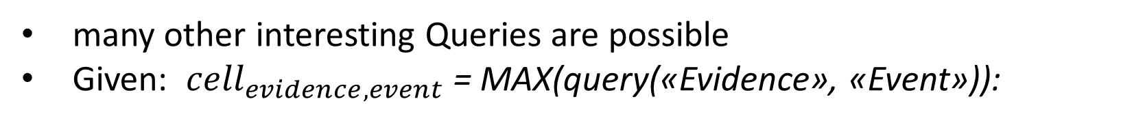
Conditional Probability Queries -3
many other interesting Queries are possible
Given: ${cell}_{evidence, event}$ = MAX(query(«Evidence», «Event»)):
 | Injury Factor | Disease | Work Sector
Death = «Yes» | Material Factor 65% | Cancer 87% | Food 30%
Injury Factor = «Material Factors» | - | Cancer 49% | Metal Working 44%
Work Sector = «Food» | Physiological Factor 99% | Muscolar system & Connective tissue 67% | -
Event
Evidence

Slide 27
Foreigners in Italy

Slide 28
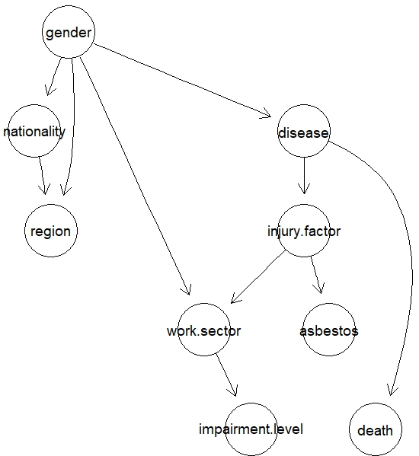
Foreigners in Italy - DAG
Removed all Italian workers from dataset
New Dataset has:
21957 rows
9 Variables (same as before)

Slide 29
Foreigners in Italy - MAP
foreigners in italy
MAP | Death = 1:
MAP | Impairment Level = «High»:
Gender | Male
Nationality | European
Work Sector | Food
Area | Nord-Est
Injury Factor | Physiological Factor
Disease | Cancer
Asbestos | No
Impairment Level | Low
Probability | 7.8%
Gender | Male
Nationality | European
Work Sector | Metal Industry
Area | Nord-Est
Injury Factor | Physiological Factor
Disease | OsteoMuscolar\Connective tissue disease
Asbestos | No
Death | No
Probability | 4.8%

Slide 30
For the Future
Analyze data on occupational injuries, which are stored separately, to compare results
Study the presence of latent variables, especially concerning health status and non-work-related physical conditions, that are likely to significantly impact outcomes
Try to extend the study to all people who work in Italy but whose data are not stored by INAIL, For example, to study the safety conditions of undocumented workers
Analyze data from other countries and compare it with Italian data

Slide 31
References
Data:
https://dati.inail.it/opendata/default/Daticadenzasemestralemp/index.html
http://www.globallaboratory.it/pit/TB_STATIESTERI1.htm
Theory:
https://dipartimenti.unicatt.it/scienze-statistiche-23-25-1-17ScutariSlides.pdf
https://www.unimi.it/it/corsi/insegnamenti-dei-corsi-di-laurea/2023/advanced-multivariate-statistics Slides and code
Map Function:
https://gauss.inf.um.es/umur/xjurponencias/talleres/J3.pdf

Slide 32
Thanks for the attention

