Slide 1



Slide 2
CHESS
ENGINE
Michele Bartesaghi
Guido Giacomo Mussini

Slide 3

Outline
Problem set
Linear algebraic representation
States
Actions
The Opponent: Stockfish

Slide 4
S(c)arsa-ʎ
Ɛ-greedy (Q,E,N)
Rewards
Weights
Results

Slide 5
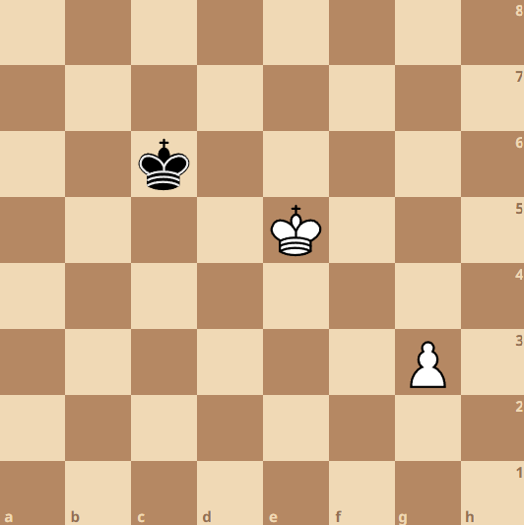






PROBLEM SET (1)
GOAL: Win the game against the computer in a limited number of moves
A game is a random walk between different states (a state is a location matrix)
p = 1: probability of moving from a state to another, having picked a certain action (deterministic)
To each action there is an associated reward
A game can be approximated by a Markov chain
The sequence of moves that led to the current location matrix is irrelevant: the only relevant aspect is performing the best move from current position.

Slide 6
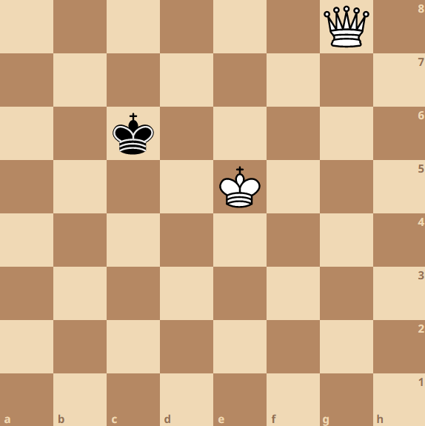
PROBLEM SET (2)
Winning position for white: if white agent plays a correct sequence of moves, it will win the game whatever the black does.
Easy to lose: if you let the black king get close enough to the white pawn.
How to win: reach the g8 square with the pawn.
How to lose:
let the pawn be captured.
not being able to win in 20 moves.

Slide 7
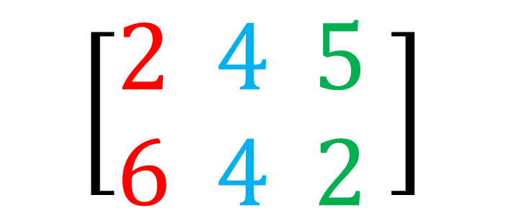
Linear algebraic representation (1)
Environment modelling from scratch with linear algebra
Location matrix L: storing the coordinates of the pieces on the chessboard
$$\left[\begin{aligned}2 4 5 \\ 6 4 2\end{aligned} \right]$$
Rows
Columns

Slide 8
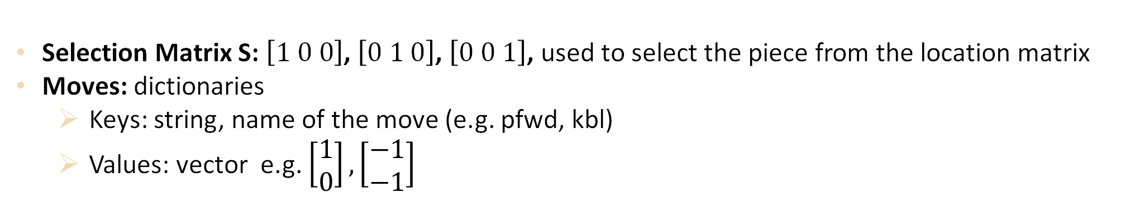
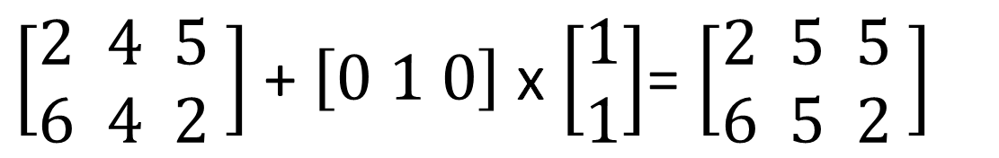
Linear algebraic representation (2)
Selection Matrix S: $\left[1 0 0\right]$, $\left[0 1 0\right]$, $\left[0 0 1\right]$, used to select the piece from the location matrix
Moves: dictionaries
Keys: string, name of the move (e.g. pfwd, kbl)
Values: vector e.g. $\left[\begin{aligned}1 \\ 0\end{aligned}\right], \left[\begin{aligned}−1 \\ −1\end{aligned}\right]$
$\left[\begin{aligned}2 4 5 \\ 6 4 2\end{aligned} \right]$ + $\left[0 1 0\right]$ x $\left[\begin{aligned}1 \\ 1\end{aligned}\right]$= $\left[\begin{aligned}2 5 5 \\ 6 5 2\end{aligned} \right]$
white king selection

Slide 9



States
Function to retrieve all the possible future locations after having performed an action (legal_state).
Algorithm:
Store location matrices as integers to save space and make it easier to check conditions
Reduced states: location matrix without black king, i.e. black king is considered part of the environment (influencing possible future states)
$$\left[\begin{aligned}2 4 5 \\ 6 4 2\end{aligned} \right]$$
$$\left[\begin{aligned}2 4 5 \\ 6 4 2\end{aligned} \right]$$
$$\left[\begin{aligned}2 4 \\ 6 4\end{aligned}\right]$$
245642
2464
array_to_int
reduce_array
array_to_int

Slide 10
Actions
Function to retrieve all the possible moves (actions) for the white agent starting from the current location matrix (legal_move).
Encoding pieces as numbers on the chessboard
Matrix/vector addition
Algorithm:
Store actions as pairs of reduced states in integer form.
'kfwd'
(2464, 2564)

Slide 11

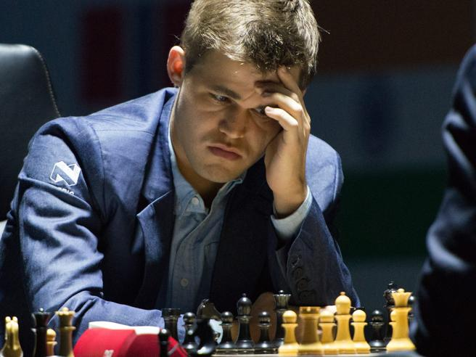
The Opponent: Stockfish
Black king: controlled by Stockfish 15.1, one of the strongest chess engines with an estimated ELO rating of 3620.
The highest ELO reached by a human is 2882, in 2014, by Magnus Carlsen.
White pieces: moved by our algorithm.
The agent decides at each turn whether to move the white king or the pawn.

Slide 12

S(c)arsa-ʎ
Why SARSA-ʎ?
On-policy vs off-policy: innumerable possible states and actions per state makes Q-learning a waste of time and resources
Change policy as the training goes on (vs observing several policies that may be suboptimal)
After a certain number of games the agent will perform the best move given its position
S(c)arsa-ʎ​
Input: Initial state (Starting location matrix)​
- Set Q, N, E = 0​
For Games: ​
- Draw an initial action (epsilon greedy)​
For Turns: ​
- White move ​
- Update N​
- Choose the move for the next turn (epsilon greedy) ​
- Black move​
- Assign the rewards​
- Compute Delta​
- Update Q, E

Slide 13
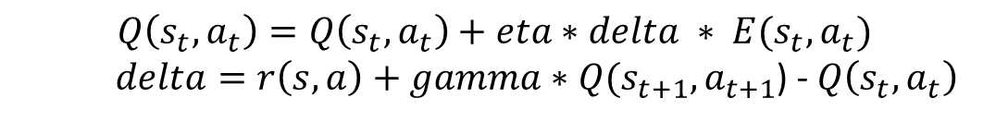
S(c)arsa-ʎ: Q, E, N
Q: storing
State in form of an integer (e.g. 245642)
Action as a pair of reduced states (e.g. (2464, 3464))
Value (e.g. 10)
Updated at the end of each game.
E (eligibility trace): same content as Q, but different update rule
Updated at the end of each game
N: storing
Reduced state in form of integer (e.g. 2464)
Number of visits to that state (once again, the black king is considered each time as part of the environment)
Updated after every white move
$$Q\left(s_{t}, a_{t}\right)=Q\left(s_{t}, a_{t}\right)+eta∗delta ∗ E(s_{t}, a_{t})$$
$delta=r\left(s, a\right)+gamma∗Q(s_{t+1}, a_{t+1}$) - $Q\left(s_{t}, a_{t}\right)$
$$E\left(s_{t}, a_{t}\right)=gamma ∗lambda ∗E(s_{t}, a_{t})$$

Slide 14

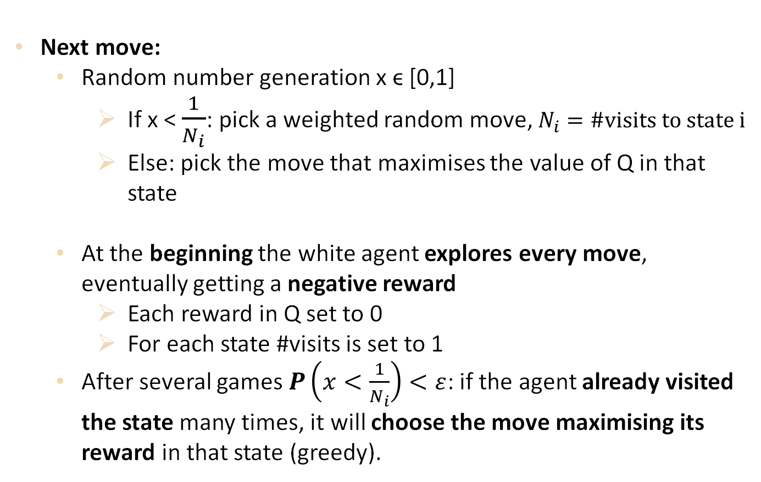
S(c)arsa-ʎ: ɛ-greedy
Next move:
Random number generation x ϵ [0,1]
If x < $\frac{1}{N_{i}}$: pick a weighted random move, $N_{i}=\#visits to state i$
Else: pick the move that maximises the value of Q in that state
At the beginning the white agent explores every move, eventually getting a negative reward
Each reward in Q set to 0
For each state #visits is set to 1
After several games $P\left(x<\frac{1}{N_{i}}\right)<ε$: if the agent already visited the state many times, it will choose the move maximising its reward in that state (greedy).
EXPLORE
REWARD

Slide 15
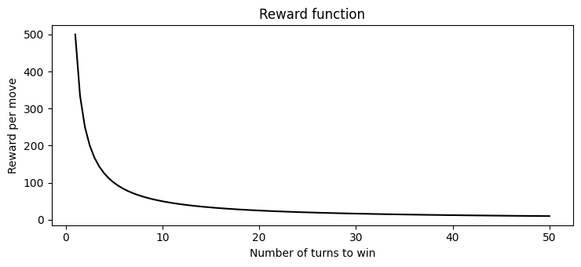
S(c)arsa-ʎ: Rewards
Rewards given to the single moves, at the end of each game.
Positive Rewards if the agent wins the game.
Higher rewards if the agent wins in a shorter number of moves, as shown in the figure.
Negative rewards if the Agent loses the game.

Slide 16



S(c)arsa-ʎ: Weights
When the algorithm explores, we weight the probability of choosing the piece to move.
At each move:
50% of chance of moving the pawn
fairly divide the remaing 50% among all the king possible moves.
Example:
Pawn: 1 possible move
King: 4 possible moves
Weights vector
[0.5 ; 0.125 ; 0.125 ; 0.125 ; 0.125]
Pawn move probability
King moves probabilities

Slide 17
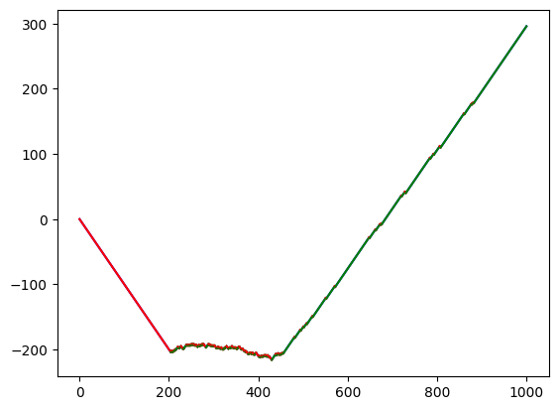
Results [1]
The graph represent the score obtained:
+ 1 if white agent wins the game
– 1 if white agent loses the game
3 main phases:
First: The algorithm is totally explorative, no winning sequence discovered.
Second: The algorithm starts to learn, but still explores new paths, that cause it to lose.
Third: The algorithm becomes (almost) totally greedy: it has learnt how to respond to the majority of the possible black moves.
1
2
3
Note that since the explorative phase has a random component, repeating the same experiment twice could provide different results (due to potentially different black response). Nonetheless, in the long run the algorithm will converge in any case

Slide 18
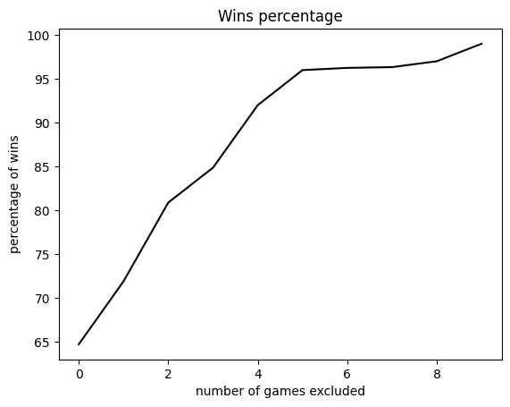
Results [2]
What is the slope of the learning?
Taking into account all the games, the algorithm has won 64,38% of the games
Let’s check how the win rate changes, (iteratively excluding 100 games)
The graph shows an almost linear growth in the win rate for the first 500 games
From game 500 to game 800 the win rate is stable at 95%.
After game 800 it starts increasing again (99.01% of win rate in the last 100 games).
0 200 400 600 800

Slide 19
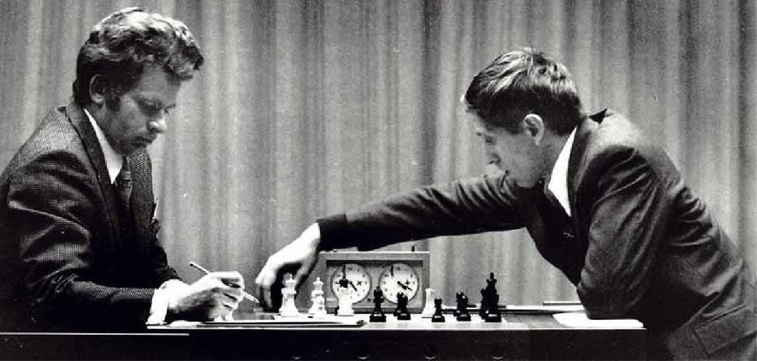
PLAY
AGAINST
US!

Slide 20

THANKS
FOR THE
ATTENTION

Slide 21
THANKS
FOR THE
ATTENTION
Quest
ons?

