Slide 1
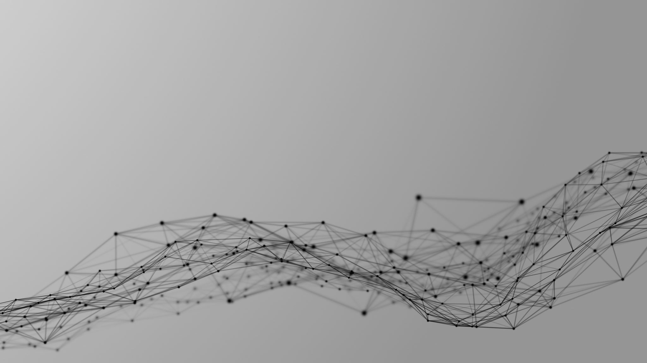

Slide 2
Social
Network
Algorithm
Guido Giacomo Mussini

Slide 3
Outline
Algorithm
Aims
Metrics
Results
Synthetic Images

Slide 4
Outline
Algorithm
Aims
Metrics
Results
Synthetic Images

Slide 5
Outline
Algorithm
Aims
Metrics
Results
Synthetic Images

Slide 6
Outline
Algorithm
Aims
Metrics
Results
Synthetic Images

Slide 7
Outline
Algorithm
Aims
Metrics
Results
Synthetic Images

Slide 8



Aims
Build an algorithm based on the transformation of sets in graphs
Binary classification and similarity algorithm
Generate synthetic observations using random graph theory

Slide 9


Aims
Build an algorithm based on the transformation of sets in graphs
Binary classification and similarity algorithm
Generate synthetic observations using random graph theory

Slide 10

Aims
Build an algorithm based on the transformation of sets in graphs
Binary classification and similarity algorithm
Generate synthetic observations using random graph theory

Slide 11
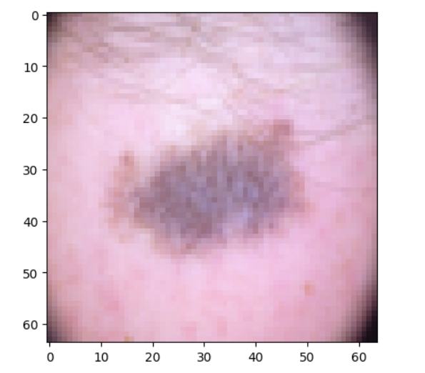
Algorithm – Pre-Processing
Take an Image

Slide 12
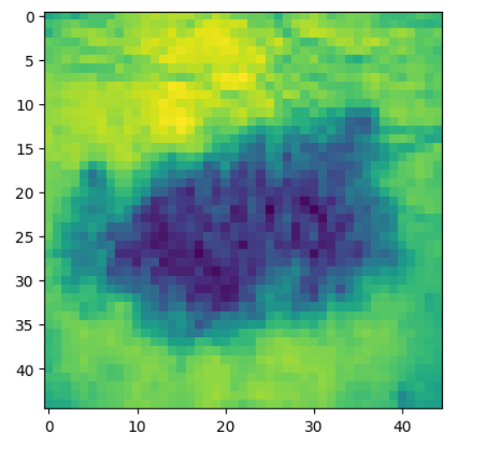
Algorithm – Pre-Processing
Crop and Greyscale

Slide 13
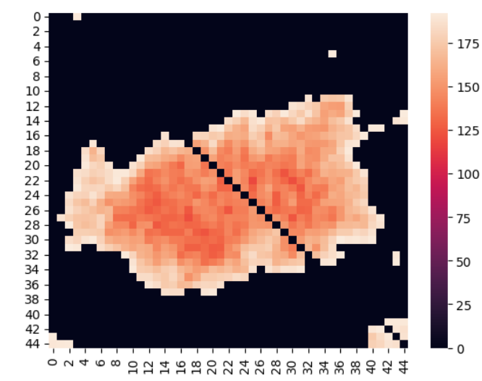
Algorithm – Pre-Processing
Adjacency Matrix main diagonal = 0

Slide 14
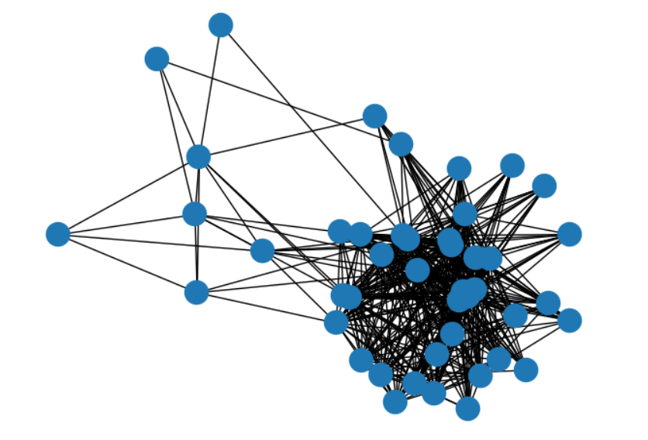
Algorithm – Pre-Processing
Network

Slide 15
Algorithm – Training
For each observation in the training set
Take the adjacency matrix
Transform in a network object
Derive the metrics
Update the mean based on the response variable
Define the tuples M and B for both the possible outcomes of the response variable and update each entry of the right tuple with the average of the corresponding metrics.

Slide 16
Algorithm – Training
For each observation in the training set
Take the adjacency matrix
Transform in a network object
Derive the metrics
Update the mean based on the response variable
Define the tuples M and B for both the possible outcomes of the response variable and update each entry of the right tuple with the average of the corresponding metrics

Slide 17
Algorithm – Testing
Take an adjacency matrix
Define the metrics and derive the tuple A
if d(A, B) < d(A, M)
if d(A, B) > d(A, M)
Assign to group B
Assign to group M

Slide 18
Metrics
WHY
Global Variables → Information on the whole network
Fast to compute → Computational efficiency
Network Order
Network Size
Density
Transitivity
Global clustering coefficient
Normalized degree centrality mean

Slide 19
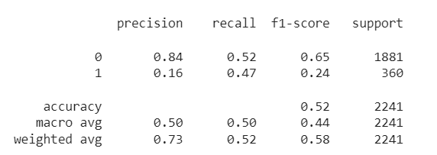
Results: Cancer dataset
Not meaningful results
Better results considering self loops - 58% Accuracy
Difficult prediction even with CNN - 67% Accuracy
Confusion Matrix | Benign Prediction | Malignant Prediction
Benign Label | 986 | 895
Malignant Label | 190 | 170

Slide 20
Results: Mnist
Big advantage of the approach: Position insensitive
CNN Struggles when they have to deal with the same image in different positions
Accuracy | SNA | CNN
Test Set | 60% | 98.12%
Horizontally projected test set | 59% | 39.12%

Slide 21
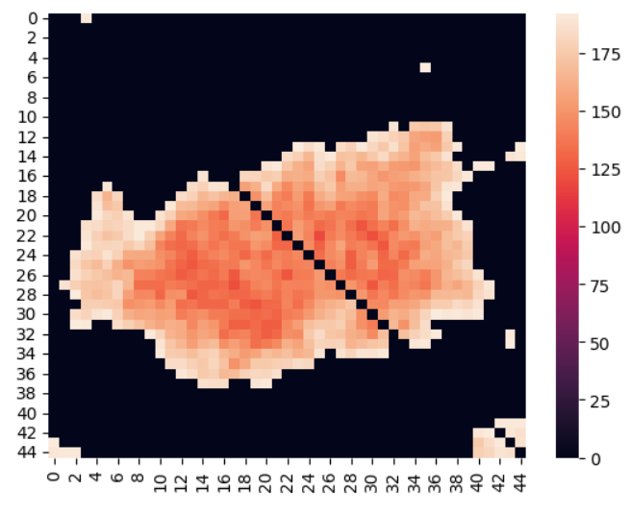
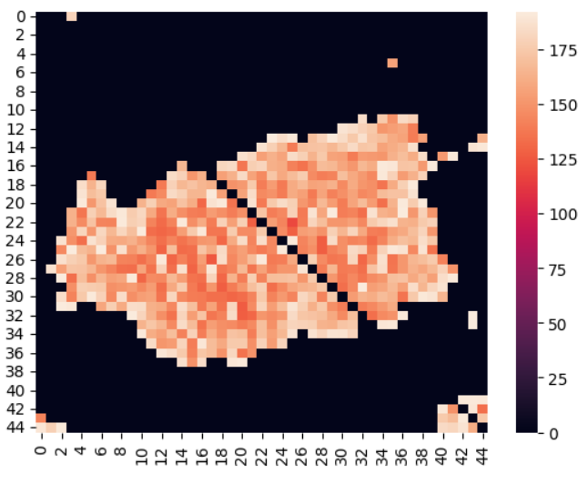
Synthetic Images
Method based on ER Random network to generate synthetic images
If the cell is 0 → 0. Else: there is a probability density-based of generate a link with random weight
ER

Slide 22
QUESTI
NS?
Thanks for the attention

Slide 23
QUESTI
NS?

