Slide 1


Slide 2
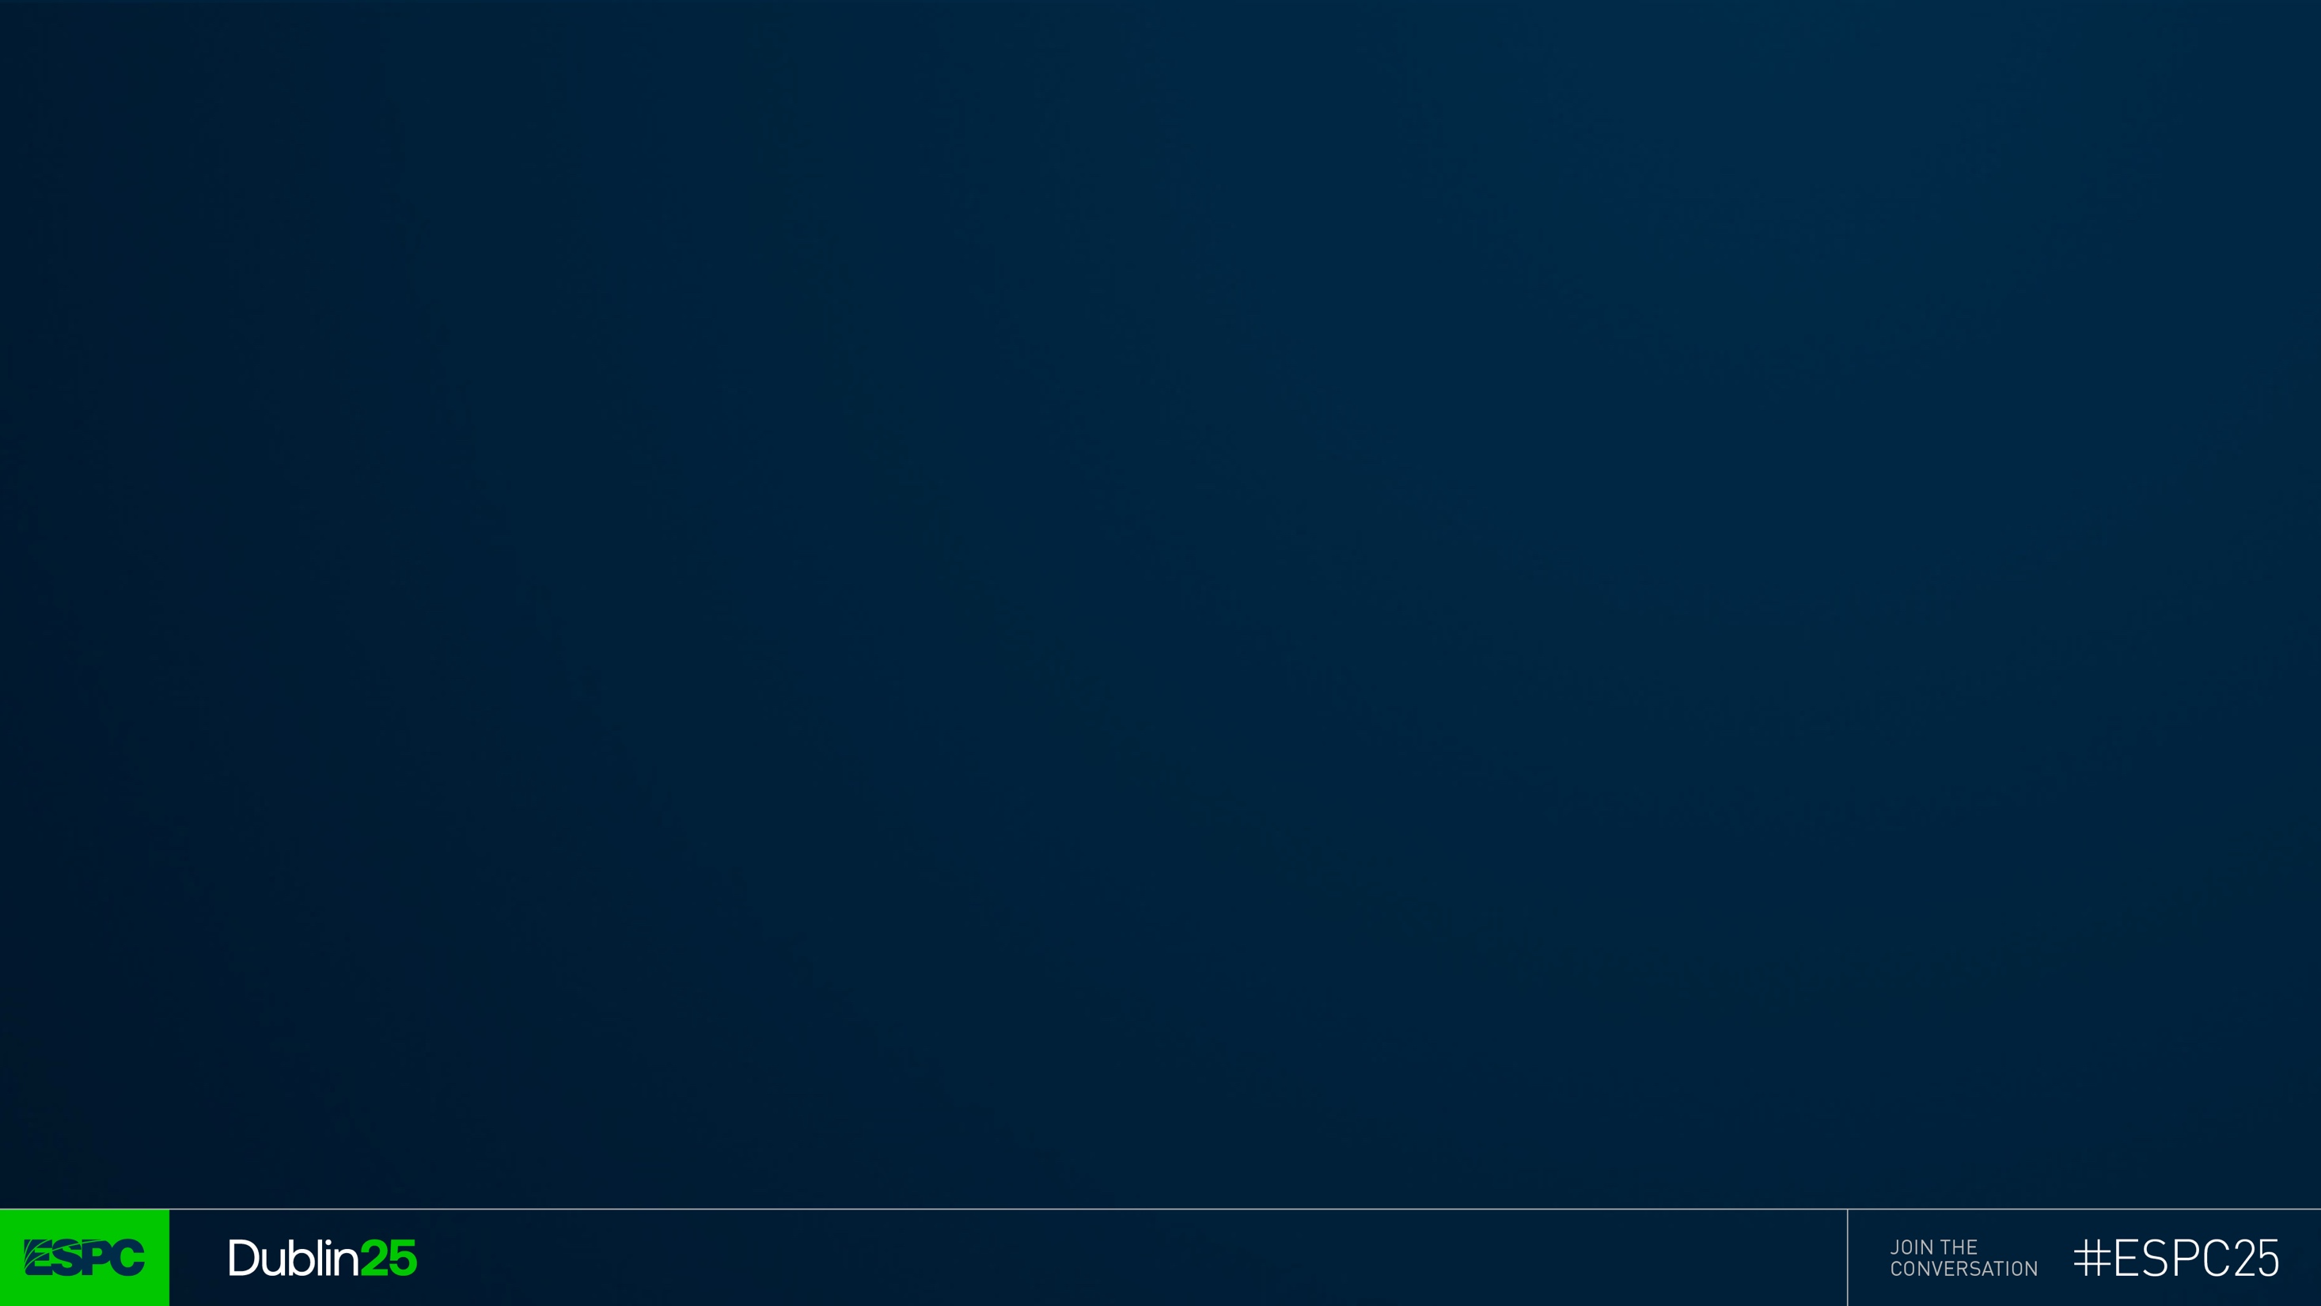

Developing, Testing, and Deploying SharePoint Framework Solutions with Success

Slide 3


Peter Paul Kirschner
MVP - ACP CUBIDO Digital Solutions GmbH, Austria​
Guido Zambarda​
MVP – SSD PiaSys.com, Italy

Slide 4
Introduction
& steps performed
Notes:
Ask audience questions like:
Do you use pipelines? You should, after the session go and create your own.
Do you package the solution on your own hardware?
Do you have different environment set up?
Who likes demo more than slides? ☺

Slide 5
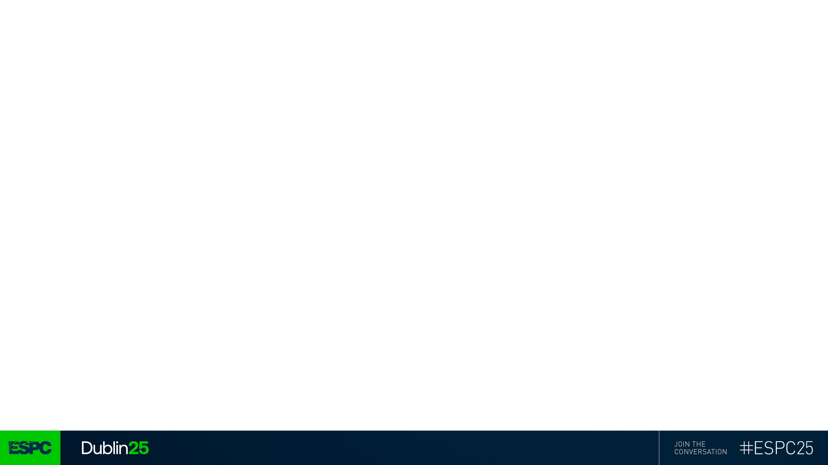
What is our idea
Company logics to manage customers
The creation of new customer can trigger multiple workflows
We're covering a small part of a bigger solution
Create a form for new customer data
Test it locally and on the cloud
Automatically deploy the solution
Notes:
New colleagues will have the best time putting their hands on the project for the first time

Slide 6
How we implemented it
Creating a new SharePoint Framework (SPFx) web part.
Defining a form component.
Using tenant settings to define the environment
Testing locally with Jest.
UI testing with Playwright.
Configuring GitHub actions for CI/CD.
Two different environments (TEST and PROD)
Three different branches on GitHub (DEV, TEST, and PROD)
Notes:
Web part over a list form customizer to allow data to be sent to external systems (e.g., SQL, CRM) and not just SharePoint.
Unit Testing: Unit tests are written for business logic, with a focus on conditions and validation. Peter Paul emphasized the importance of two-person review—one writes tests, another implements logic—to catch errors early.
UI Testing: Playwright is used for automated UI tests, checking DOM elements and visual layout, ensuring the user experience matches business requirements. Screenshots are used for visual regression.
Error Handling: Special attention is given to handling API errors (e.g., 429 errors), with mocking strategies for development and end-to-end tests.
CI/CD Pipeline: GitHub Actions automate environment setup, dependency installation, solution bundling, unit tests, packaging, deployment, and UI tests. Secrets and environment variables are managed for security.

Slide 7
Let’s see the form
Yes, it's a demo

Slide 8
Let’s explore the solution
Yes, it's a demo

Slide 9
Unit testing
Is the practice of testing individual, isolated units or components of software, such as a function or method, to verify they work correctly.
TLDR: check that the components works as expected.
Notes:
What is a component?
A component is a self-contained, reusable piece of software—such as a function, class, or UI element—that performs a specific role within an application.
More possible component types
Designing your system with a variety of component types allows for greater flexibility and adaptability.
Each component can be tested in isolation, ensuring reliability and easier maintenance.
Why more components is better than less
More components mean finer granularity in testing, making it easier to pinpoint issues and extend functionality.
Encourages modular design, which supports scalability and team collaboration.
Card example
Think of a "card" UI component: it’s a reusable structure that can display different types of content (text, images, actions).
Cards can be enhanced over time—add new features, styles, or behaviors—without affecting other parts of the system.

Slide 10
Unit testing
Business logic
Yes, it's a demo

Slide 11
e2e testing
Is the process of verifying that an application's user interface (UI) works correctly, is functional, and is user-friendly by testing the visual elements users interact with directly.
TLDR: check that the UI works as expected.
Notes:
What is e2e testing?
End-to-end testing verifies that the entire application flow works as expected, simulating real user scenarios from start to finish.
More possible user journeys
Designing for a variety of user journeys ensures your application is robust and can handle different real-world scenarios.
Each journey can be tested independently, helping to catch integration issues early.
Why more user journeys is better than less
More journeys mean broader coverage, reducing the risk of missed bugs in complex workflows.
Encourages thinking about edge cases and diverse user needs.
Card example
Consider a "card" UI component: e2e tests can verify how cards behave in different contexts (e.g., displaying various data, interacting with other components).
As cards evolve, e2e tests ensure enhancements don’t break existing flows.

Slide 12
e2e testing
Yes, it's a demo

Slide 13
GitHub actions
Is the continuous integration and continuous delivery (CI/CD) platform that allows you to automate your build, test, and deployment pipeline.
TLDR: performs automated operations.

Slide 14
GitHub actions
Yes, it's a demo
Notes:
How often do we use tests in our projects?
It depends on:
Budget
Timing
Customers says it's not needed
Giveaways
Unit tests saves can save our life and are responsible to have an expected behavior of your application over multiple deployments and changes.
Who writes the code should not test it but leave it to another person of the team

Slide 15
Now, let’s make a change!
Yes, it's a demo
Notes:
How often do we use tests in our projects?
It depends on:
Budget
Timing
Customers says it's not needed
Giveaways
Unit tests saves can save our life and are responsible to have an expected behavior of your application over multiple deployments and changes.
Who writes the code should not test it but leave it to another person of the team

Slide 16
Takeaways
Structure your environments
Use testing
It can save lives ☺
Devs should not test their own code
Source control
Automate your pipeline
Easier for new coworkers
!“It works on my machine”
Notes:
How often do we use tests in our projects?
It depends on:
Budget
Timing
Customers says it's not needed
Takeaways
Unit tests can save our life and are responsible to have an expected behavior of your application over multiple deployments and changes.
Who writes the code should not test it but leave it to another person of the team
Highlight the benefits:
If you're on vacation the coworkers are still able to fix bugs without having the dev environment installed
You should have different environments (DEV,TEST,STAGING,PROD)
You want your off-time to be really an off-time
Don't publish on friday :)

Slide 17
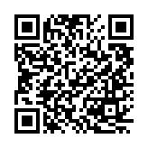
Give-Away
https://github.com/GuidoZam/espc-spfx-session-demo
Peter Paul Kirschner
MVP - ACP CUBIDO Digital Solutions GmbH, Austria​
Guido Zambarda​
MVP – SSD PiaSys.com, Italy

Slide 18
