Slide 1

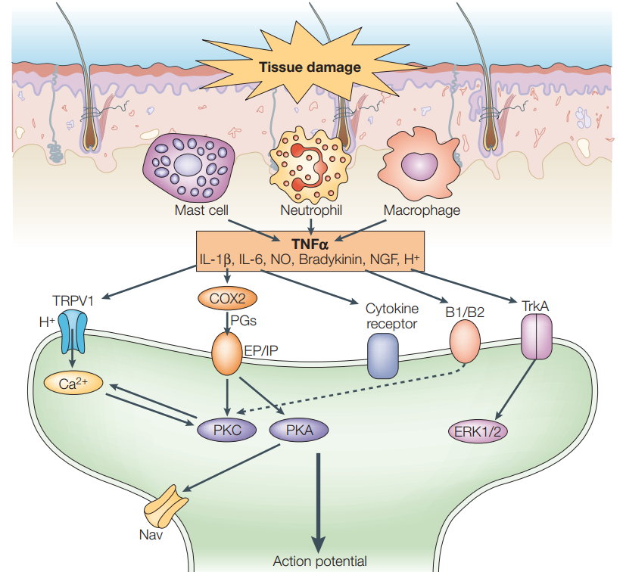
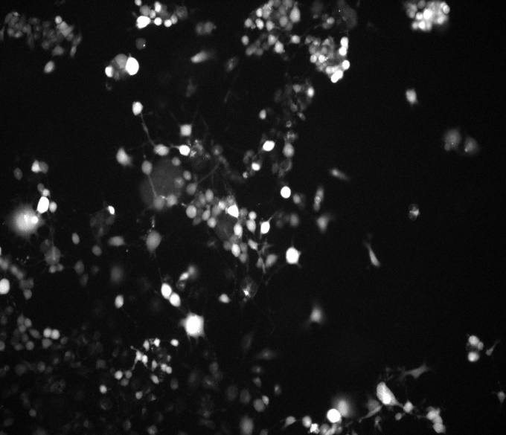
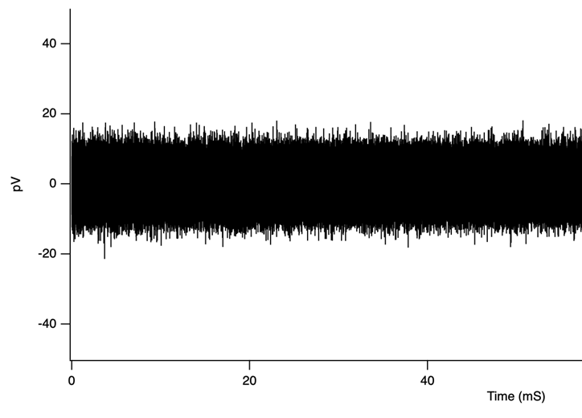
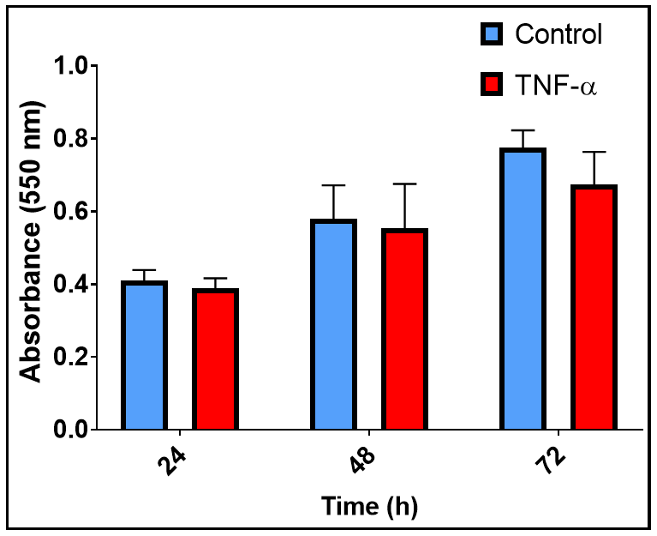
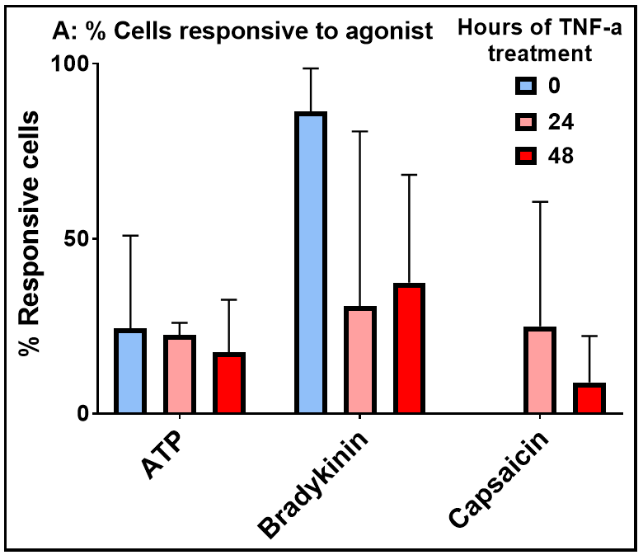
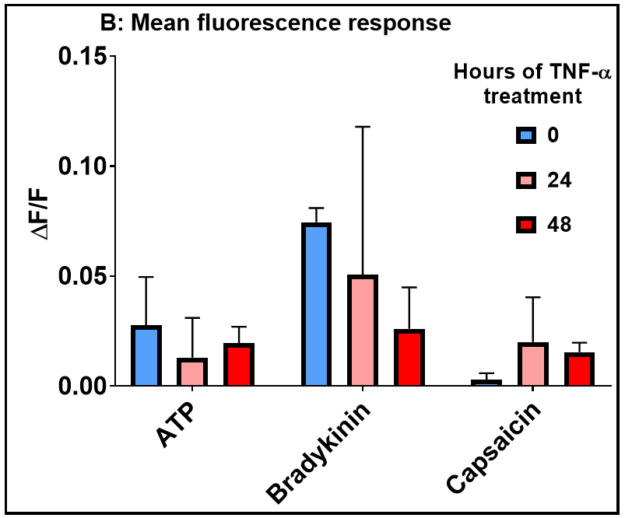
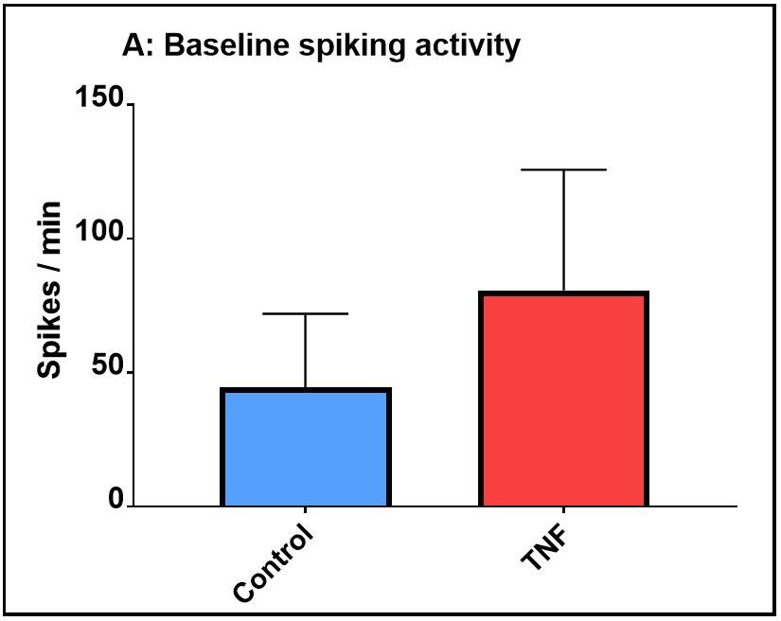
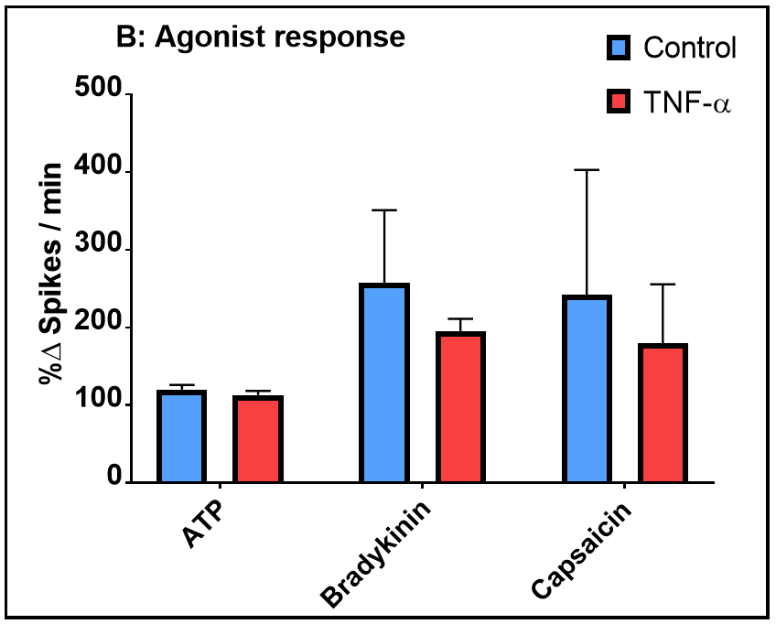
Modelling chronic pain in the F11 cell line
Guido Huisman
Department of Physiology
National University of Ireland, Galway
Introduction
Chronic inflammatory and neuropathic pain is thought to arise in part due to the peripheral sensitization of pain sensing DRG nociceptors. During injury and inflammation, activated immune cells release TNF-α and other inflammatory mediators¹ (Figure 1), that can sensitize nociceptors to pain stimuli by modulating the activity and expression of various (voltage-gated) ion channels and receptors (e.g. TRPV1), some of which signal through an increase in intracellular calcium. Cellular processes such as cell survival and axonal growth to peripheral targets are also affected. To study the underlying mechanisms of chronic pain, it is common to use DRG neurons extracted from animals. In such cultures, exogenous TNF-α induces apoptosis² and alters neurite outgrowth³. Moreover, TNF-α increases calcium influxes evoked by agonists⁴ and increases spontaneous⁵ and agonist induced firing. The objective of the current study is to elucidate if the DRG-derived F11 cell line responds similarly to an inflammatory environment evoked by TNF-α. If this were the case, then this validates the use of F11 cells in studying the underlying mechanisms of TNF-α mediated chronic pain. The cell line may then also be useful in high throughput studies of novel analgesics.
Hypothesis: TNF-α treatment in F11 cells was expected to reduce cell viability and neurite outgrowth, and increase spontaneous spiking activity and agonist induced spiking activity/Ca2+ influxes.
Figure 1. Nerve injury and inflammation leads to recruitment of immune cells, which release inflammatory mediators that sensitize nociceptors by sensitizing/upregulating ion channels and receptors.¹
Methods
Results 1: Cell viability & Neurite outgrowth
4 end points were measured in TNF-α (10 ng/ml) treated F11 cells (undifferentiated or forskolin (30 μM) differentiated). The agonists used were ATP (10uM), bradykinin (20uM) and capsaicin (100 uM).
Cell viability & Neurite outgrowth: : MTT assays were done 24, 48 & 72 hours after treatment. Daily microscopic images were captured and analysed with ImageJ + NeuronJ to quantify neurite outgrowths.
Calcium signalling: Fluorescent Ca2+ imaging using Fluo-4 was recorded in response to the agonists. Raw fluorescence was converted to ΔF/F to correct for baseline. Cells were considered responsive to an agonist if their peak fluorescence response exceeded a 10% change from baseline.
Electrical activity: Electrical activity was measured with a multi-electrode array (MEA). Activity at a given time was counted as a spike if it deviated 4 SD from the average activity of the preceding 4 miliseconds.
A
TNF-α treatment did not significantly affect cell viability in undifferentiated (not shown) or differentiated (Figure 2) F11 cells, although there was a slight reduction in cell viability in differentiated cells treated for 72 hours. TNF-α treatment significantly reduced mean neurite length (Table 1), but only in undifferentiated cells treated for 72 hours and differentiated cells treated for 24 hours.
B
Time (hour) | Condition | Mean neurite length (μm) ± SD of mean
 |  | Undifferentiated | Differentiated
0 | Control | 32.4 (± 4.9) | 94.5 (± 5.9)
 | TNF-α | 34.3 (± 6.3) | 93.5 (± 10.4)
24 | Control | 32.4 (± 4.9) | 93.8 (± 3.8)
 | TNF-α | 34.3 (± 6.3) | 79.9 (± 1.6)**
48 | Control | 39.7 (± 2.9) | 126 (± 5.5)
 | TNF-α | 39.7 (± 8.5) | 137.9 (± 26.5)
72 | Control | 38.3 (± 2.4) | 130.6 (± 20.7)
 | TNF-α | 31.6 (± 2.3*) | 124.9 (± 21.1)
Figure 1. Sample data
(A) Ca2+ imaging
(B) MEA
Figure 2. Cell viability (mean absorbance + SD)
Table 1. Neurite length
Results 2: Ca2+ imaging
Results 3: Electrical activity
TNF-α treatment did not significantly alter the % of F11 cells responsive to ATP, bradykinin or capsaicin, and had no effect on mean fluorescence response, average maximum response, the area under the curve or full width half maximum. However, both in undifferentiated (Figure 3, A) and differentiated (not shown) cells, the % of cells responsive to bradykinin was higher in untreated cultures and lower in treated cultures. The opposite trend was true for capsaicin, and this same pattern was also reflected in the mean fluorescence response in undifferentiated cells (B).
In differentiated F11 cells (Figure 4), TNF-α treatment increased baseline spiking activity (A), but not significantly. B shows spiking activity in response to the agonists, corrected for baseline activity seen in A. TNF-α did not affect ATP provoked spiking. TNF-α reduced bradykinin and capsaicin provoked spiking, but not significantly.
Figure 3. Ca2+ signalling. (A) % responsive cells (mean + SD)
(B) Mean fluorescence response (mean + SD)
Figure 4. Electrical activity (A) Baseline spiking activity (mean spikes/min + SD)
(B) Agonist spiking activity (mean %Δ spikes/minute + SD). 100% is baseline.
Conclusion
In the current study, TNF-α treatment in F11 cells did not significantly alter cell viability, agonist induced Ca2+ influxes or spontaneous and agonist induced firing. While there was some indication of increased Ca2+ response to capsaicin, TNF-α decreased, rather than increased, Ca2+ response to bradykinin. Moreover, while TNF-α increases spontaneous firing, it reduced bradykinin/capsaicin evoked firing. These results do not suggest TNF-α sensitized F11 cells to the agonists. TNF-α significantly reduced neurite length, but this effect was too inconsistent for strong conclusions to be drawn. The discrepancy between established TNF-α effects on DRG neurons and the TNF-α effects found on F11 cells in the current study suggests that the F11 cell line may not be an appropriate model in studying the underlying mechanisms of TNF-α mediated chronic pain. However, given the high response to bradykinin seen in this study and in others, F11 cells may be useful in studying drugs that modulate bradykinin receptors.
Marchand, F., Perretti, M. and McMahon, S. (2005). Role of the Immune system in chronic pain. Nature Reviews Neuroscience, 6(7), pp.521-532.
Zhang, K., Yang, S. and Luo, C. (2018). TNF-αlpha and TNF-R1 regulate bupivacaine-induced apoptosis in spinal cord dorsal root ganglion neuron. European Journal of Pharmacology, 833, pp.63-68.
Saleh, A., Smith, D., Balakrishnan, S., Dunn, L., Martens, C., Tweed, C. and Fernyhough, P. (2011). Tumor necrosis factor-α elevates neurite outgrowth through an NF-κB-dependent pathway in cultured adult sensory neurons: Diminished expression in diabetes may contribute to sensory neuropathy. Brain Research, 1423, pp.87-95.
Hensellek, S., Brell, P., Schaible, H., Bräuer, R. and Segond von Banchet, G. (2007). The cytokine TNFα increases the proportion of DRG neurones expressing the TRPV1 receptor via the TNFR1 receptor and ERK activation. Molecular and Cellular Neuroscience, 36(3), pp.381-391.
Zhang, J., Li, H., Liu, B. and Brull, S. (2002). Acute Topical Application of Tumor Necrosis Factor α Evokes Protein Kinase A-Dependent Responses in Rat SensoryNeurons. Journal of Neurophysiology, 88(3), pp.1387-1392.

