Slide 1
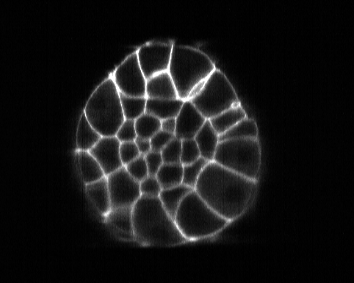
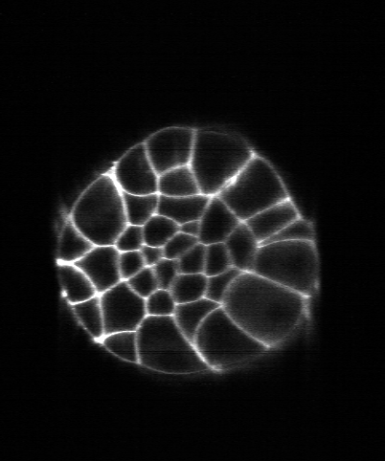
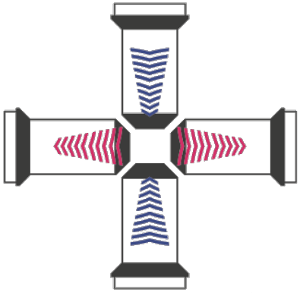
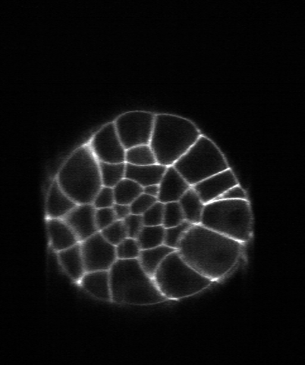
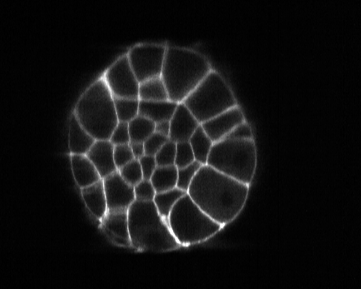
X
stack #1
left cam.
stack #0
left cam.
Z
Z
X
X
X
Z
stack #0
right cam.
stack #1
right cam.
Z

Slide 2
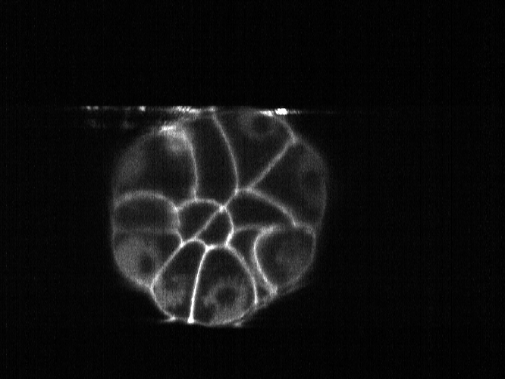
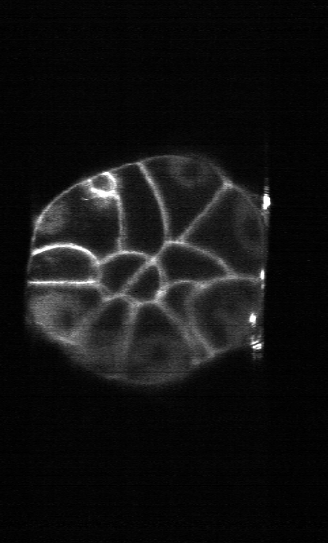
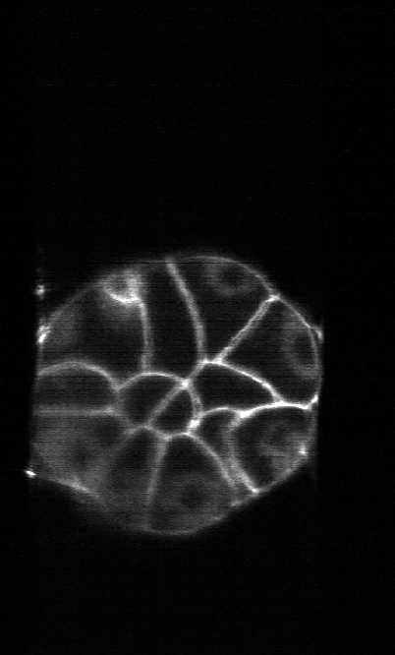
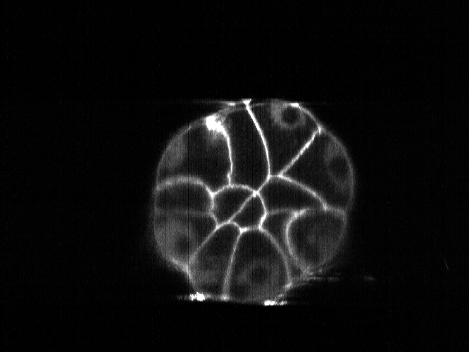
X
stack #1
left cam.
Z
stack #0
right cam.
Z
X
X
X
stack #0
left cam.
Z
stack #1
right cam.
Z

Slide 3
stack #1
left cam.
stack #0
left cam.
stack #0
right cam.
stack #1
right cam.

Slide 4
stack #1
left cam.
stack #0
left cam.
stack #0
right cam.
stack #1
right cam.

Slide 5
stack #0
left cam.
Z
X
X
Z
stack #0
right cam.

Slide 6
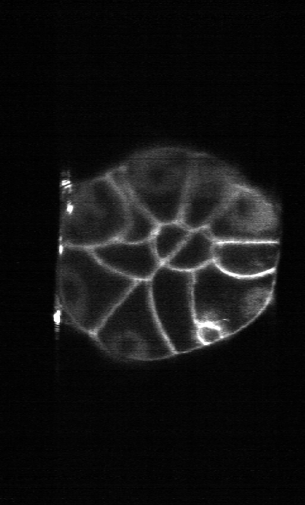
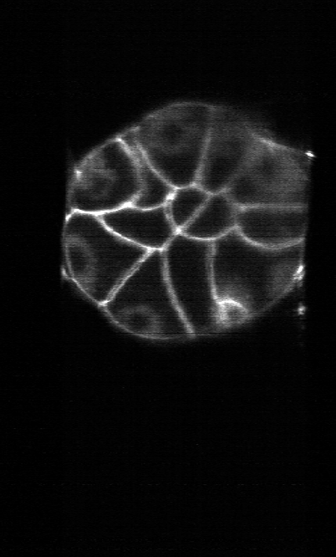
stack #0
left cam.
Z
X
X
Z
stack #0
right cam.

Slide 7
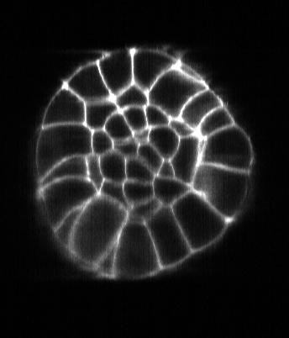
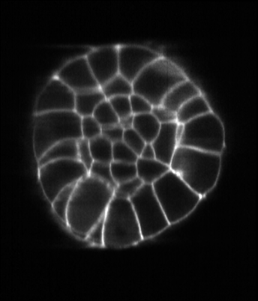
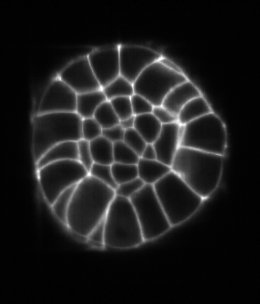
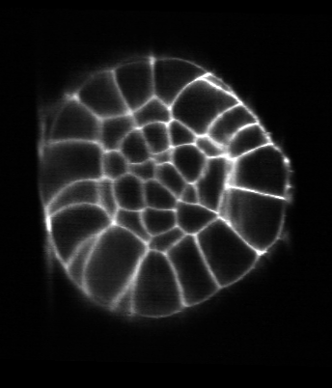
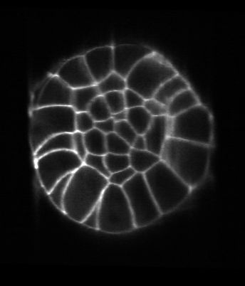
stack #0, left cam.
stack #0, right cam.
stack #1, left cam.
stack #1, right cam.

Slide 8





stack #0, left cam.
stack #0, right cam.
stack #1, left cam.
stack #1, right cam.

Slide 9


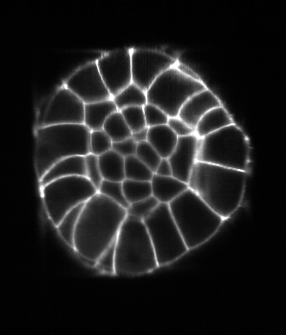


stack #0, left cam.
stack #0, right cam.
stack #1, left cam.
stack #1, right cam.

Slide 10
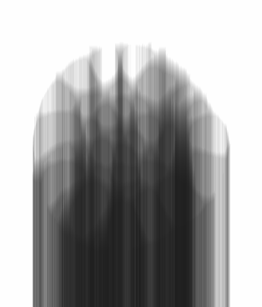
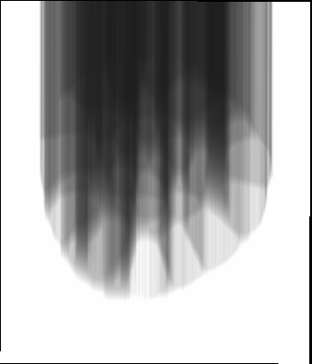
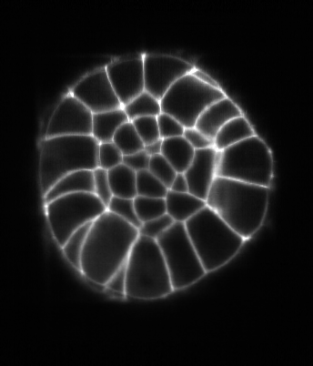
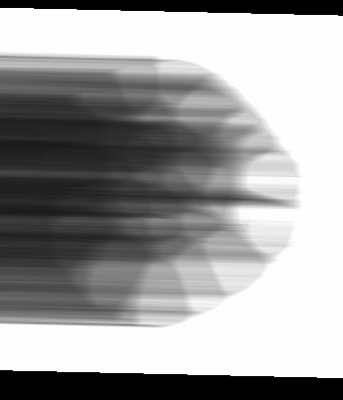
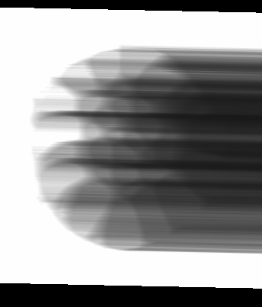
stack #0, left cam.
stack #0, right cam.
stack #1, left cam.
stack #1, right cam.

