Slide 1
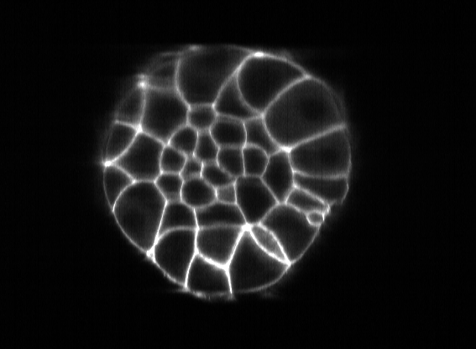
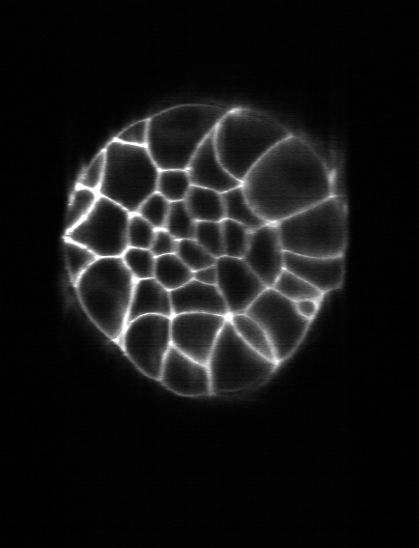
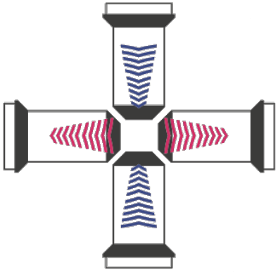
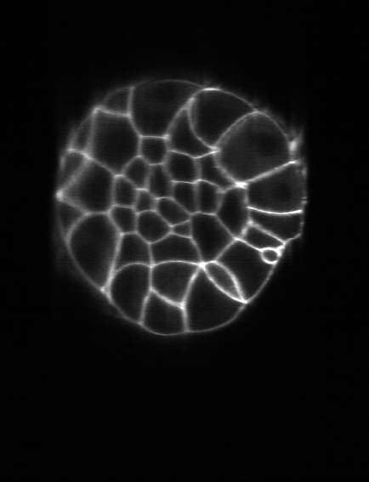
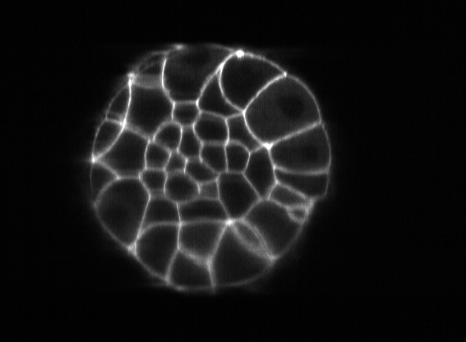
Left camera, stack#1
90º rotation
Left camera, stack #0
Right camera, stack #0
Right camera, stack #1

Slide 2
LC, S#1
LC, S#0
RC, S#0
RC, S#1

Slide 3
LC, S#1
LC, S#0
RC, S#0
RC, S#1

Slide 4
LC, S#1
LC, S#0
RC, S#0
RC, S#1

Slide 5
LC, S#1
LC, S#0
RC, S#0
RC, S#1

Slide 6
LC, S#1
LC, S#0
RC, S#0
RC, S#1

Slide 7
S#1
S#0

