Slide 1
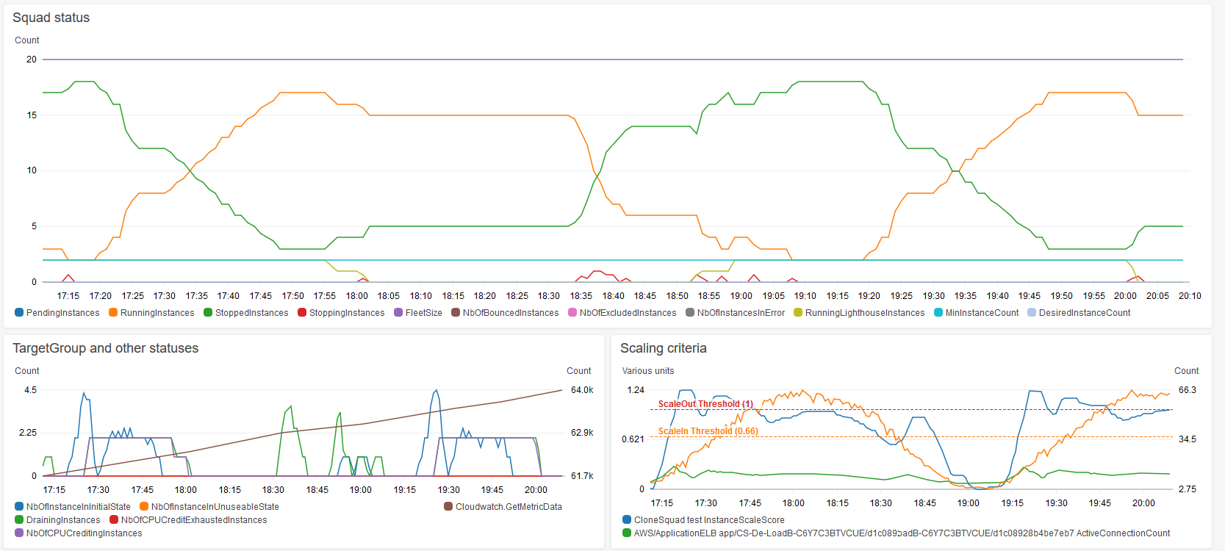
Extra Non-Lighthouse instances are started to replace the Lighthouse ones.
Lighthouse instances stop once they refueled their CPU Credit to the minimum required.
The generated load…
At each period, Lighthouse instances need to CPU Credit for a while before to shutdown as they are burstables
LoadBalancer Latency is kept below 350ms as requested.
The Autoscaler algorithms are continuously computing a scaling score to take decisions

