Slide 1

SLIMES

Slide 2

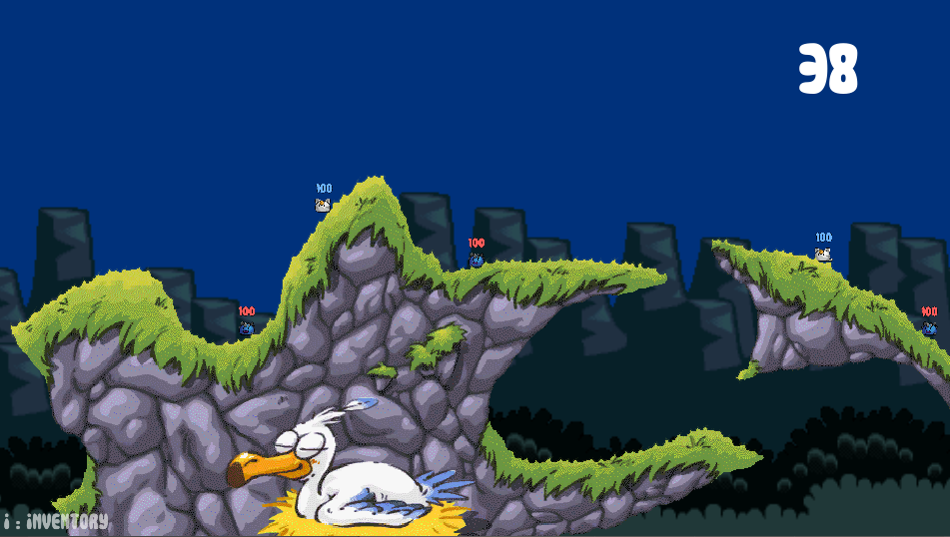

Introduction
Support :
Moteur :
Camera : 2D

Slide 3






Gameplay principal
Les slimes

Slide 4
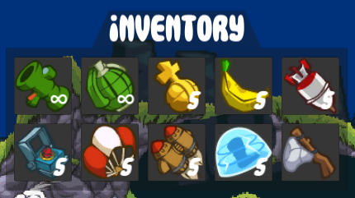
gameplay principal
Les armes

Slide 5
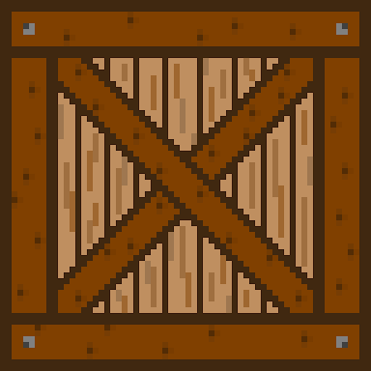
Gameplay principal
Les caisses

Slide 6
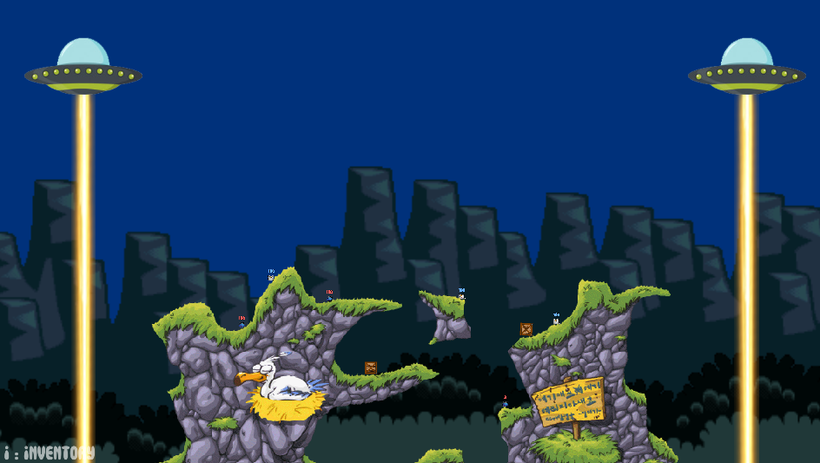
Gameplay principal
La mort subite

