Slide 1

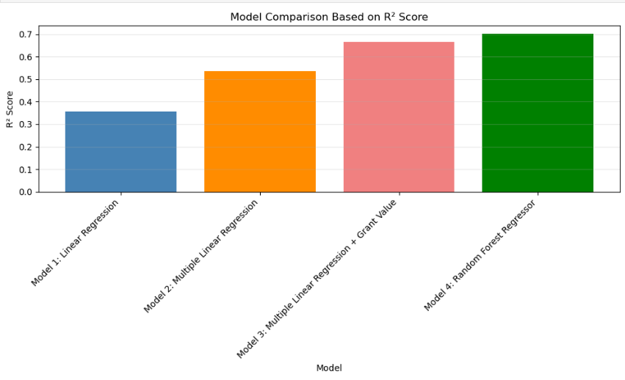
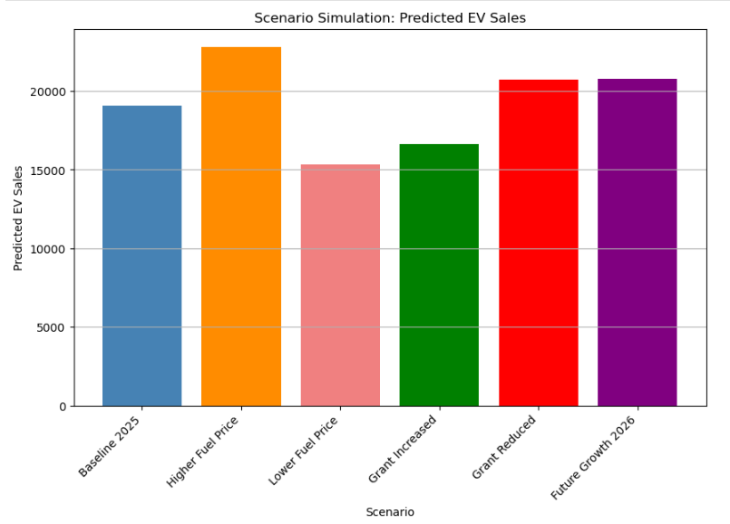
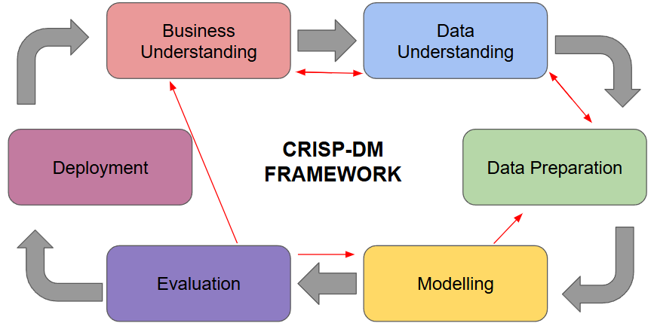
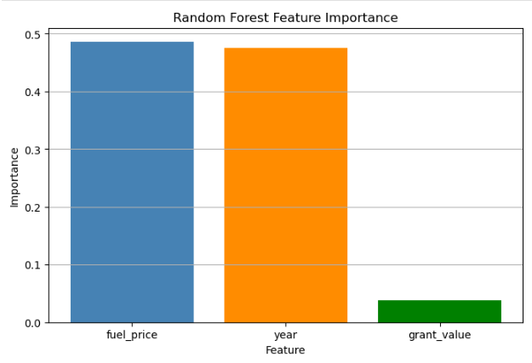
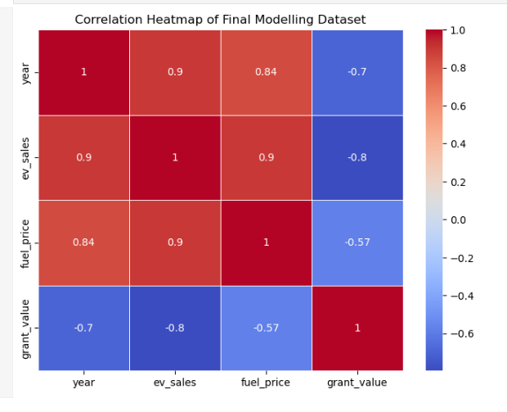
Predicting Electric Vehicle Adoption in Ireland
Guilherme Munhoz
Student Number 2022448
Capstone Project
Business Understanding
Data Preparation & Modelling
Deployment
Research Question: Can fuel prices, government grants, and time predict EV adoption in Ireland?
- Ireland targets significant EV growth by 2030
- Transport sector heavily dependent on petrol and diesel
- EV adoption influenced by fuel costs, grants, and market trends
- Project applies CRISP-DM framework and machine learning
- Dataset covers 2015–2024 annual observations
- Decision-support tool for policymakers and analysts
Data preparation:
IEA data filtered to Ireland, BEV cars, EV sales
Monthly fuel prices aggregated to yearly averages
Three features selected: fuel_price, year, grant_value
80/20 train/test split + 5-fold cross-validation
Prototype:
Scenario simulation tool built in Jupyter Notebook
Inputs: fuel_price, year, grant_value
Output: predicted annual BEV sales in Ireland
Evaluation
Future potential:
Streamlit web dashboard
Annual data updates
Additional features (charging infrastructure, electricity prices)
Model selected: Model 3 — Multiple Linear Regression
Chosen for interpretability over marginal accuracy gain vs Random Forest
R² = 0.665 | MSE = 30,209,100
K-fold MAE: Linear Regression ~2,794 | Random Forest ~2,311
Data Understanding
Conclusion
Data sources:
EA EV Data Explorer — annual BEV sales, Ireland
CSO CPM12 — monthly fuel prices, yearly average
SEAI Grants — annual grant values 2015–2024
CSO ETA02 — contextual only
What we found: EV adoption in Ireland is primarily driven by time and fuel prices — together accounting for ~96% of model predictive importance. Grant value had minimal predictive power (4%).
What the model shows: Fuel price had the strongest effect on predictions. A €0.20 fuel price increase predicts ~3,739 additional annual EV sales above baseline.
Why it matters: Ireland's 2030 EV target requires growth beyond the baseline trend. This scenario simulation tool allows policymakers to test whether adjusting fuel taxes or grants could accelerate adoption to close the gap.
Limitations & future work: Small dataset (10 rows) limits statistical reliability. Future work includes larger datasets, additional features, and time series modelling.
Key findings:
year & fuel price both correlate ~0.90 with ev_sales
grant_value: -0.80 — timing effect, not causation
10 clean rows, no missing values
Key findings:
fuel_price (49%) and year (48%) dominate predictions
grant_value contributes only 4% — weakest predictor
Grant paradox: grants decreased while sales rose — correlation, not causation
Negative R² in cross-validation reflects small dataset (10 rows)
Model captures trends, not direct causation
References:
Our Dedication.Your Journey.
www.cct.ie

