Slide 1
Convolução
1x1

Slide 2
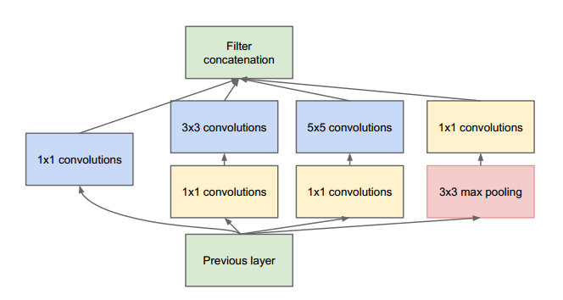
Inception

Slide 3
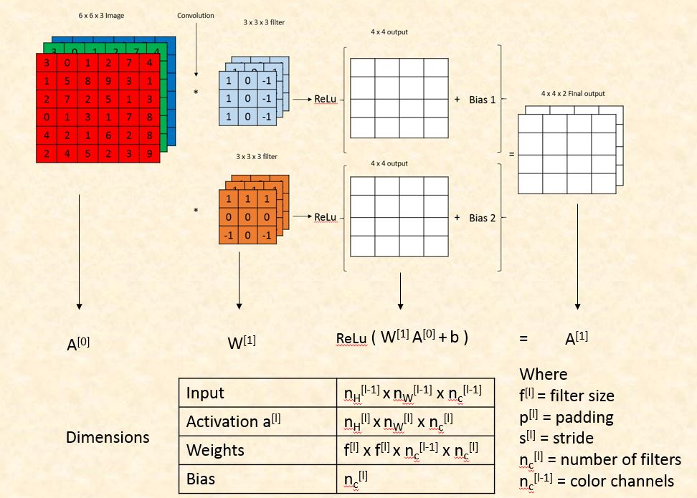
Convolução

Slide 4
Convolução

Slide 5
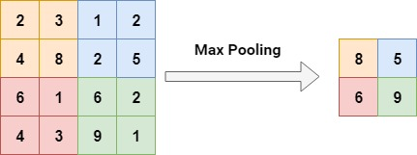
Custo computacional
Max Pooling
Avg Pooling

Slide 6
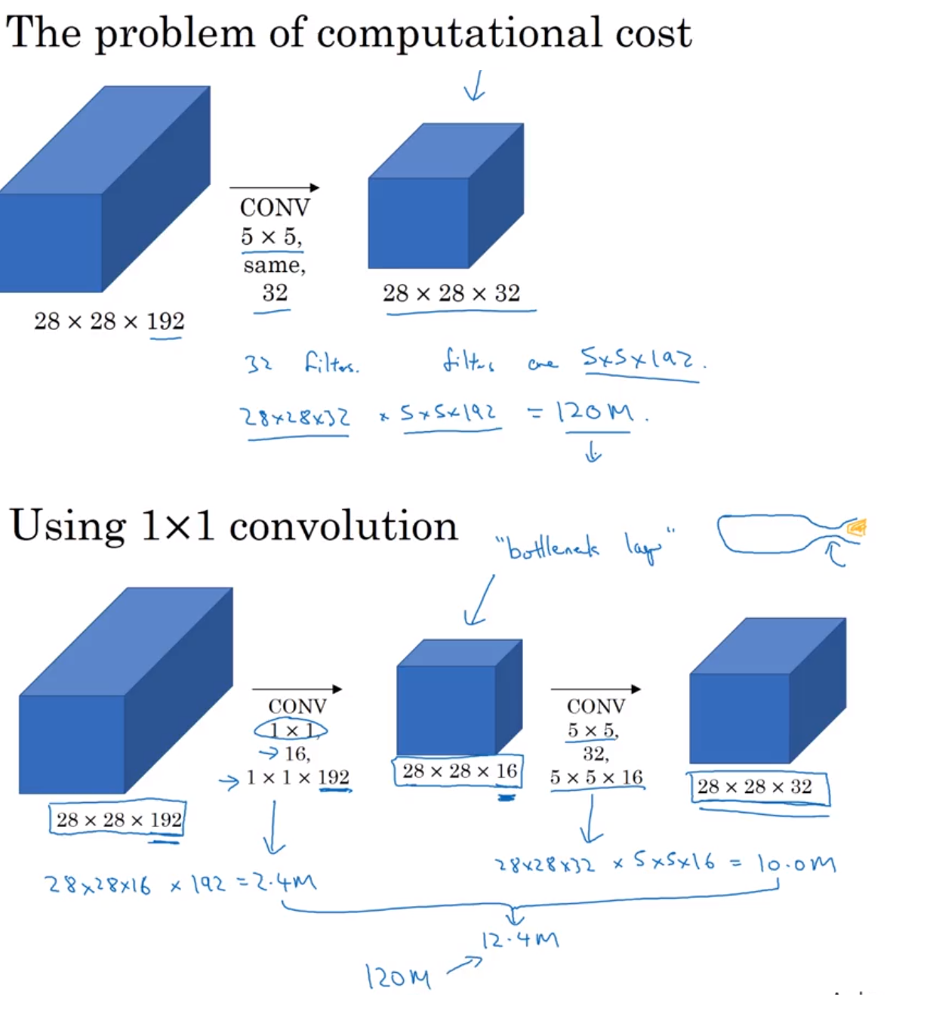
Custo computacional

Slide 7
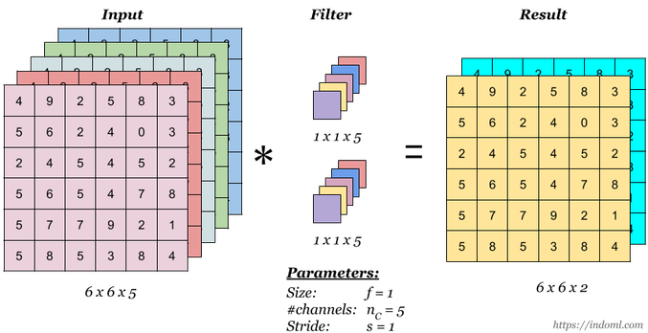
Filtros 1x1

Slide 8
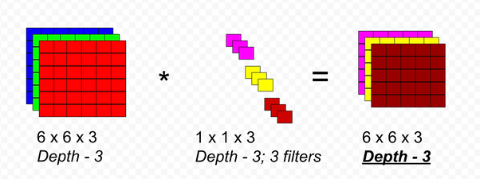
Filtros 1x1

Slide 9
Custo computacional

Slide 10
Referências
https://www.coursera.org/lecture/convolutional-neural-networks/networks-in-networks-and-1x1-convolutions-ZTb8x
https://www.arxiv-vanity.com/papers/1610.02357/
https://iamaaditya.github.io/2016/03/one-by-one-convolution/
https://machinelearninguru.com/computer_vision/basics/convolution/convolution_layer.html

Slide 11
Referências Imagéticas
Img1: https://www.researchgate.net/post/How_will_channels_RGB_effect_convolutional_neural_network
Img2: https://engmrk.com/wp-content/uploads/2018/09/Convolution-Layer-Dimensions.jpg
Gif: https://cdn-images-1.medium.com/max/1600/1*ciDgQEjViWLnCbmX-EeSrA.gif
Img6: https://www.quora.com/What-is-a-1X1-convolution

