Slide 1
OpenCV – Open Source Computer Vision Library
By Guilherme Rameh
Ilana Finger
Ananda

Slide 2
TABLE OF CONTENTS
01
02
03
04
05
06
Source Code and Technologies
OpenCV Purpose
License and Contributions
Financing and External Contributions
Documentation and Ease of Use
Governance and Support

Slide 3
OpenCV Purpose
Created to Provide
Helping People
License allows
a common infrastructure for computer vision applications and to accelerate the use of machine perception in commercial products
to build sophisticated vision applications quickly and collaboratively.
that any variation of the original product cad be used for personal or comercial uses

Slide 4
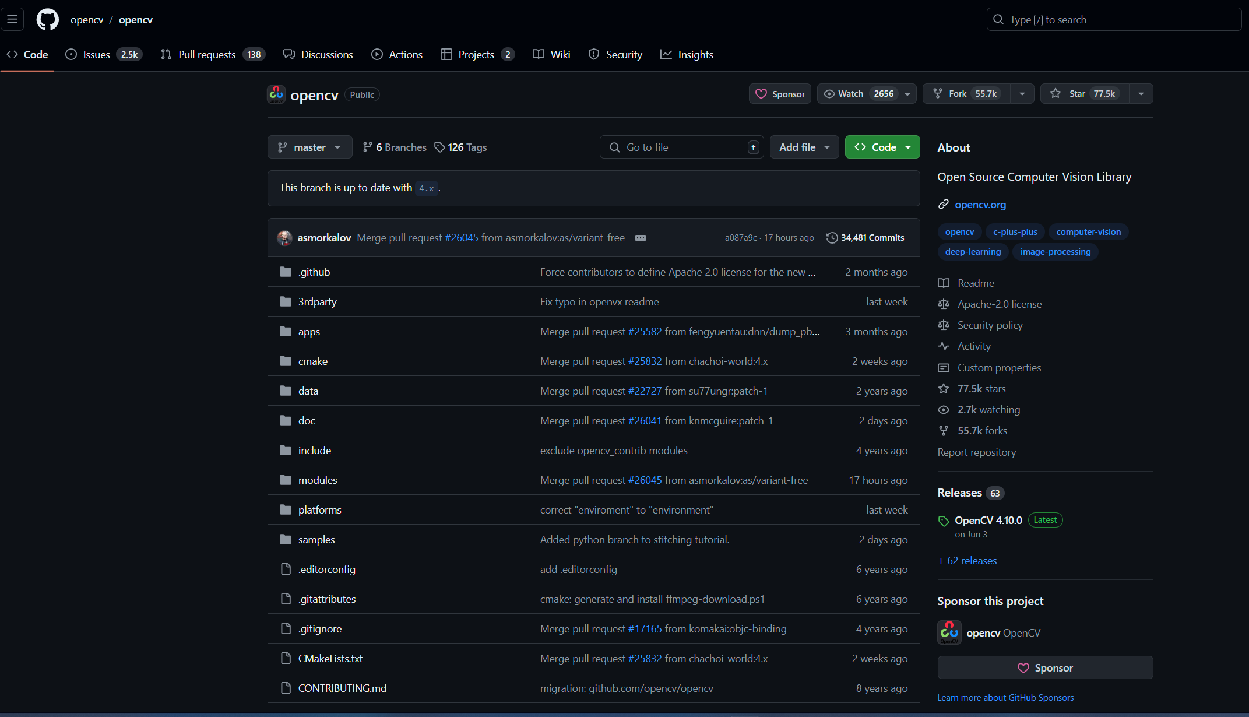
Source code and Technologies
The source code is available on Github
The main languages used are C++, C and Python OpenCV is compatible with various platforms and operational systems

Slide 5
License and Contribution Guidelines
BDS
Apache 2
OpenCV 4.4 and inferior
Basic redistribution license, with no significant commercial impact
OpenCV 4.5 and superior
Permissive license, with derivative projects having the freedom to choose their own license

Slide 6
Coding Standards
Maintenance
License and Contribution Guidelines
A high level of standards, style, and best practices is required to contribute to the project
This helps maintain consistency and makes the project easier to manage

Slide 7
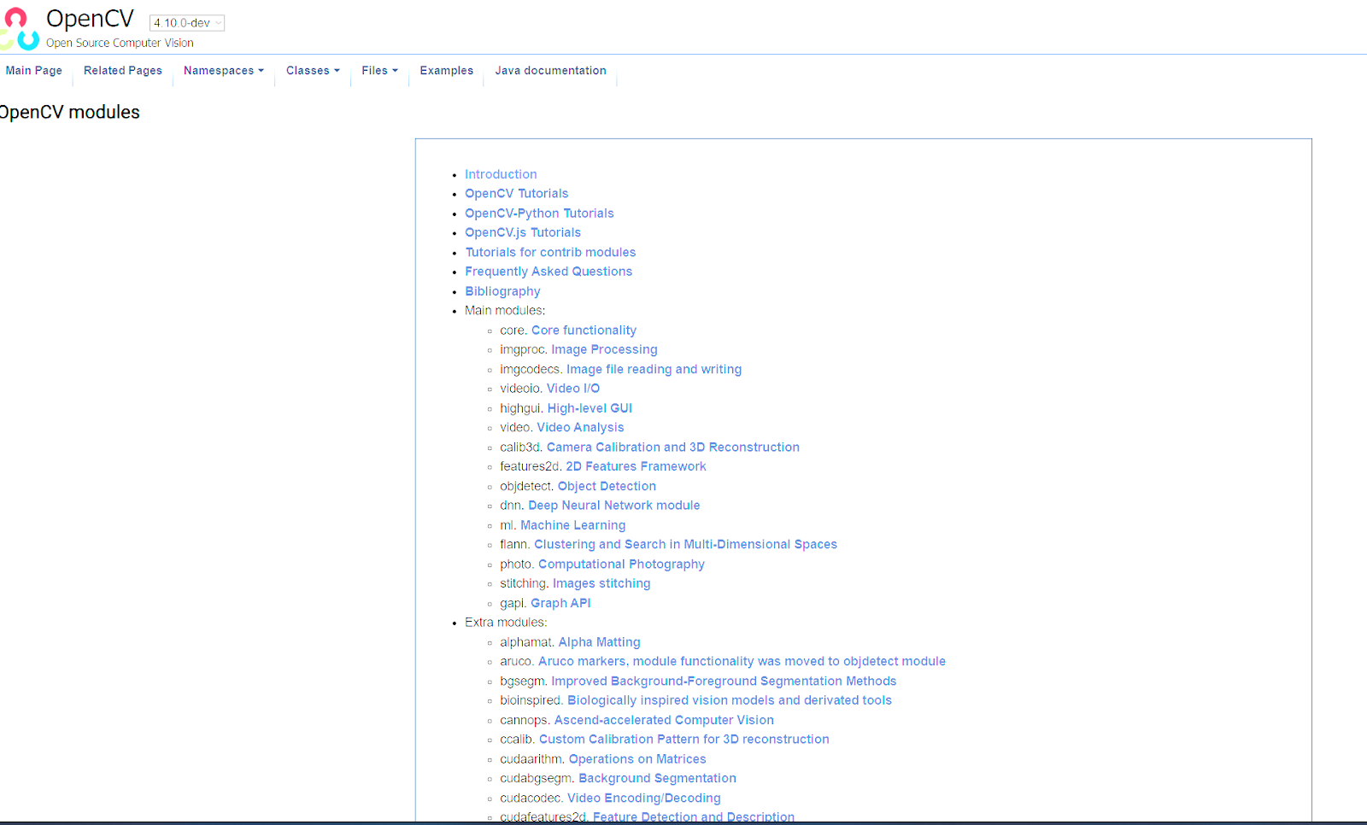
Documentation and Usage
Extense Documentation Available
Easy to Compile (plug and play)
Source code complexity is higher (C++ Coding Style)

Slide 8


Creator and Governance
Gary Bradsky
Open Source Vision Foundation
Non-profit organization currently responsible for managing OpenCV, with several developers responsible for maintaining the library
Creator of OpenCV, developed the library while working on Intel

Slide 9
OpenCV Community
Roadmap
External Contributions
Financial Decisions
Each year, a "roadmap" is created and published on GitHub, outlining the tasks to be accomplished that year
Contributions are made in the form of issues in the GitHub repository
Decisions are made by the developers responsible for OpenCV (as described in the documentation).
On the OpenCV website, there is a forum where anyone who needs help can ask questions. The community assists new users.

Slide 10

How it's mantained
The Open Source Vision Foundation is a non-profit organization, but it accepts donations of time and money to maintain OpenCV. There are no exact figures on how much they've raised, but it is known that they have secured contracts ranging from $6,000 to $100,000.

