Slide 1

GUILHERME SANTOS
TECHNICAL
IN
CYBER SYSTEMS FOR AUTOMATION
CYBERSECURITY ANALYST
DEVLOPER BACK-END

Slide 2

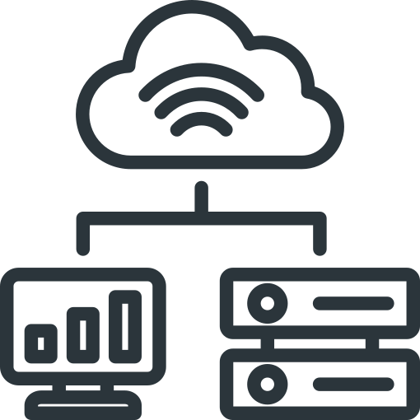
PROFESSIONAL GOAL
ABOUT ME
I am a professional dedicated to Cybersecurity, Software Development, and Industrial Automation, with a strong interest in using technology to solve complex problems and create efficient, secure, and scalable solutions. My journey began at the age of 16, when I started my technical education at SENAI, specializing in automation and cybersecurity. This experience introduced me to the intersection between technology, industrial automation, programming, and digital security, shaping the way I approach both technical challenges and innovation.
Currently, I work as an Automation Cyber-systems Technician at Consórcio Cantareira (involving projects such as Odbreath, Renea, and the Rodoanel reform), where I apply knowledge in automation, systems security, and industrial solutions development. This hands-on experience has reinforced my commitment to creating systems that automate processes, optimize workflows, and contribute to more reliable and intelligent work environments.
I believe that technology is most valuable when it goes beyond simply solving a problem — it should create better processes, stronger systems, and opportunities for continuous improvement. For this reason, I approach each project with a combination of technical knowledge, analytical thinking, creativity, and attention to detail. My goal is to continue expanding my knowledge and applying technology in increasingly innovative ways, developing solutions that are not only functional, but also secure, scalable, efficient, and capable of creating real impact.
ACHIEVEMENTS AND SKILLS
TECHNICAL SKILLS
My journey is marked by projects that combine theory and practice, with highlights including:
  Industrial Automation: Experience with PLCs, SCADA, and industrial systems integration, ensuring operational efficiency and security.
  Cybersecurity: Implementation of digital security best practices, data protection, and risk mitigation in technological environments.
  Software Development: Creation of tools and systems that solve real-world problems, with a focus on scalability and usability.
  Project Management: Ability to lead and execute technical projects, aligning expectations and delivering results within deadlines.
  Programming Languages: Python, C#, C++, SQL.
  Automation and Control: PLCs (Siemens, Allen-Bradley), SCADA, HMI.
  Cybersecurity: Vulnerability analysis, system hardening, industrial network protection.
  Tools and Platforms: Git/GitHub, Docker, Linux, Windows Server, Microsoft 365, Google Workspace.
  Soft Skills: Analytical thinking, problem-solving, technical communication, teamwork.

Slide 3
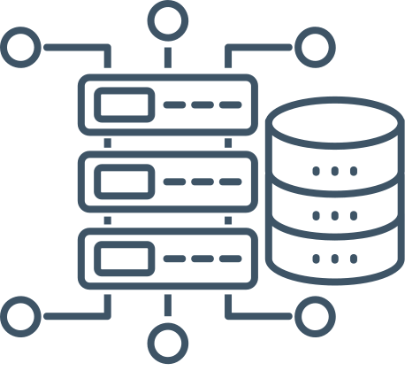

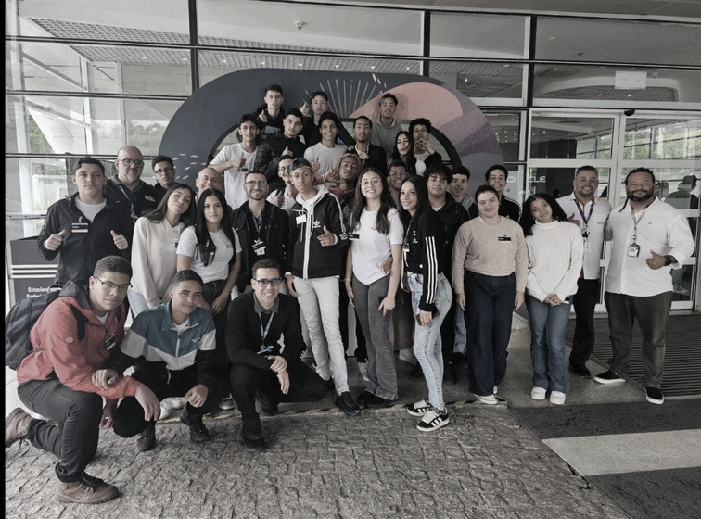
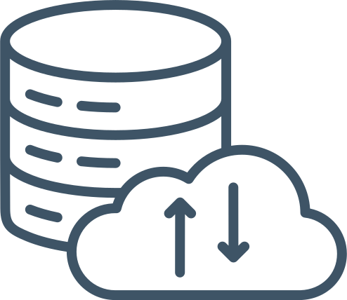
ACADEMIC TRAINING
HERMENEGILDO CAMPOS DE ALMEIDA 2025 - 2026
Software Engineer specializing in backend architecture and the convergence of Information Technology (IT) and Operational Technology (OT). I design and build secure, scalable backend systems that integrate industrial automation, communication protocols, and operational technologies with modern applications and relational databases.
My technical focus spans backend development, secure coding, application security (AppSec), database optimization, system hardening, and cybersecurity, with an emphasis on delivering reliable software that operates safely across both IT and industrial environments. I prioritize performance, maintainability, observability, and security throughout the software development lifecycle.
I am particularly interested in architecting scalable, resilient, and fault-tolerant systems—using clear boundaries, well-defined interfaces, and automation—to reduce complexity and increase reliability. I approach each project with a security-first mindset, combining analytical thinking, creativity, and attention to detail to deliver robust solutions.
Currently, I am continuously expanding my expertise in software engineering, backend architecture, cybersecurity, and industrial systems, aiming to progress toward a Senior Software Engineer role and contribute to high-impact, secure, and scalable technological solutions.
Conhecendo a empresa Oracle, São Paulo, 2 semestre do CT

Slide 4




CONTACT ME
REDES SOCIAIS
https://www.linkedin.com/in/gui-santos05092008/
@Sant_winner
https://github.com/GuilhermeSANT29
contate.guilherme.santos@gmail.com

