Slide 1
Comprehensive Development Project
Presented by: Guilherme Trentini

Slide 2
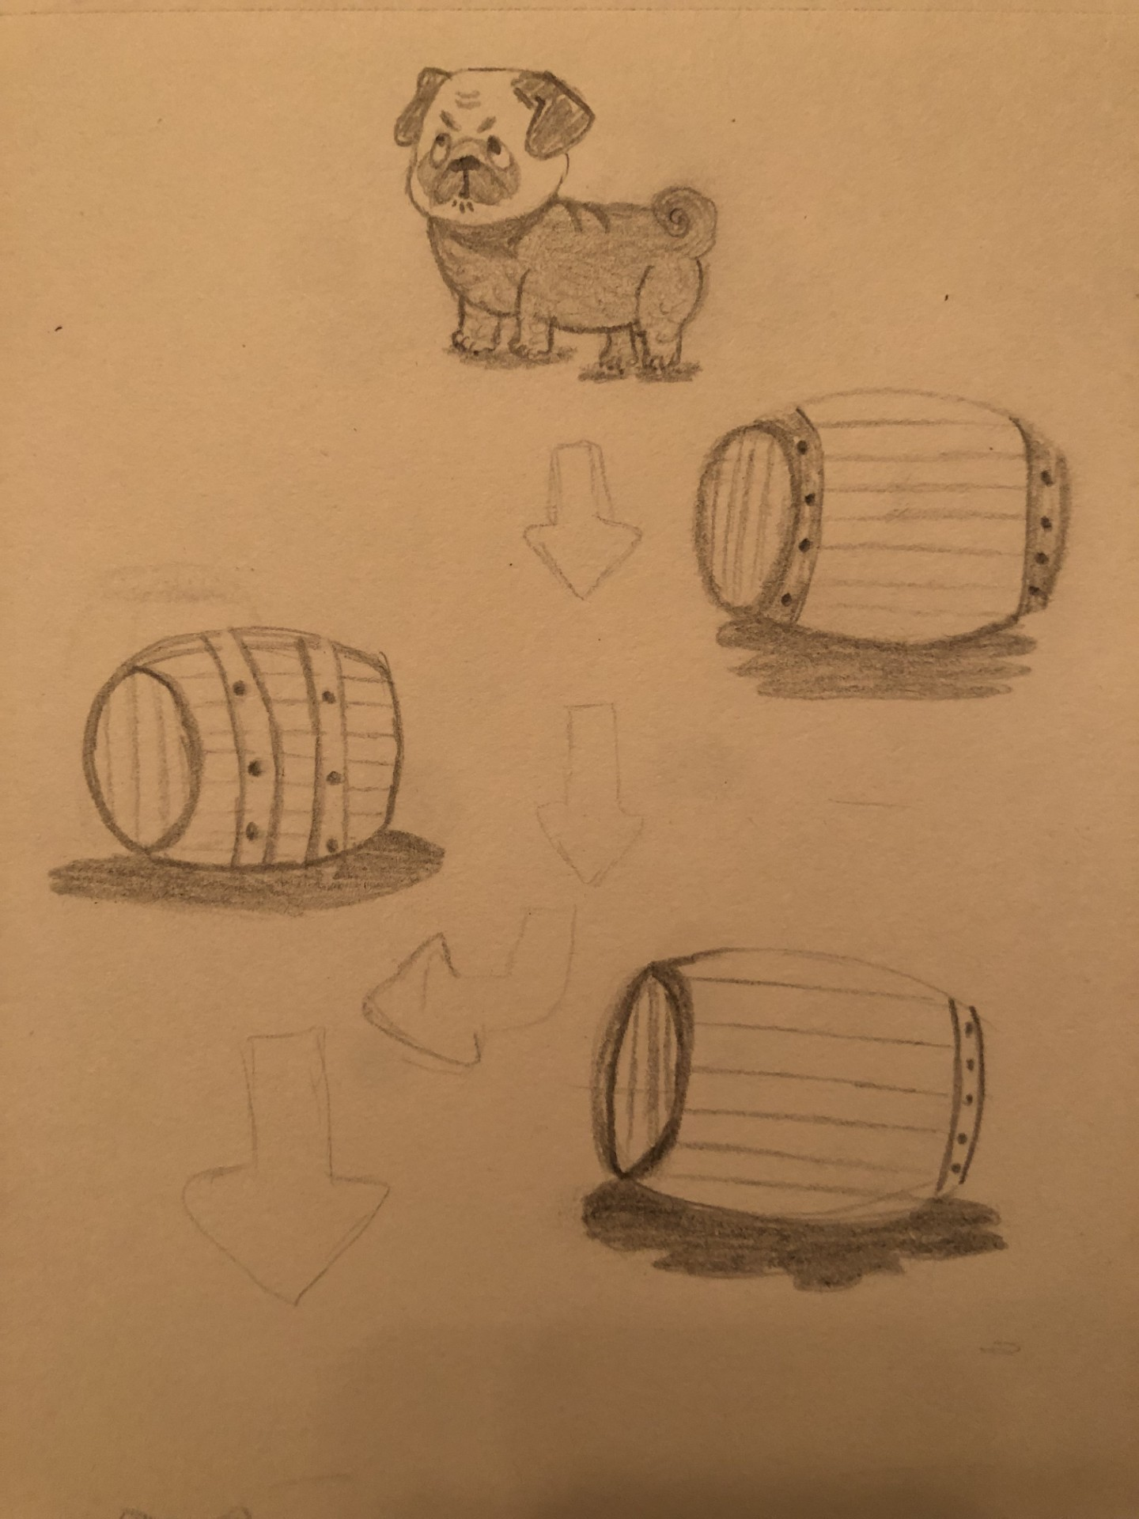
How to Train My Pug?
Control a pug in a fun and competitive race.
Use items like treats for speed boosts.
Dodge obstacles like rolling barrels.
Navigate dynamic tracks to win.

Slide 3
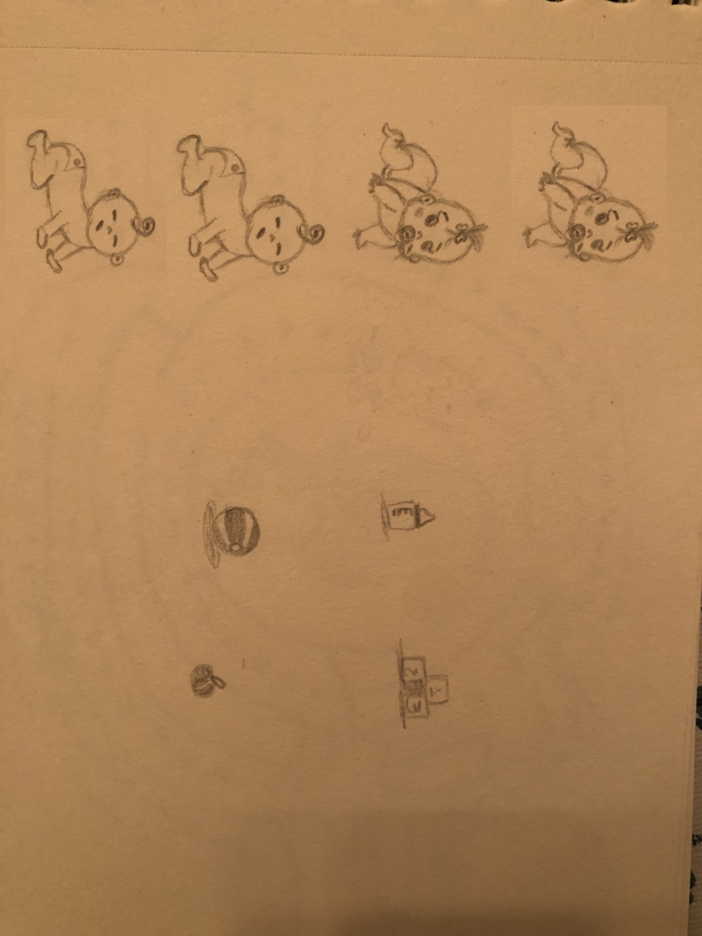
Baby Racer
Race as a crawling baby in playful tracks.
Collect items like bottles for speed boosts.
Dodge toy obstacles and reach the finish line.
Colorful and lighthearted environments.

Slide 4
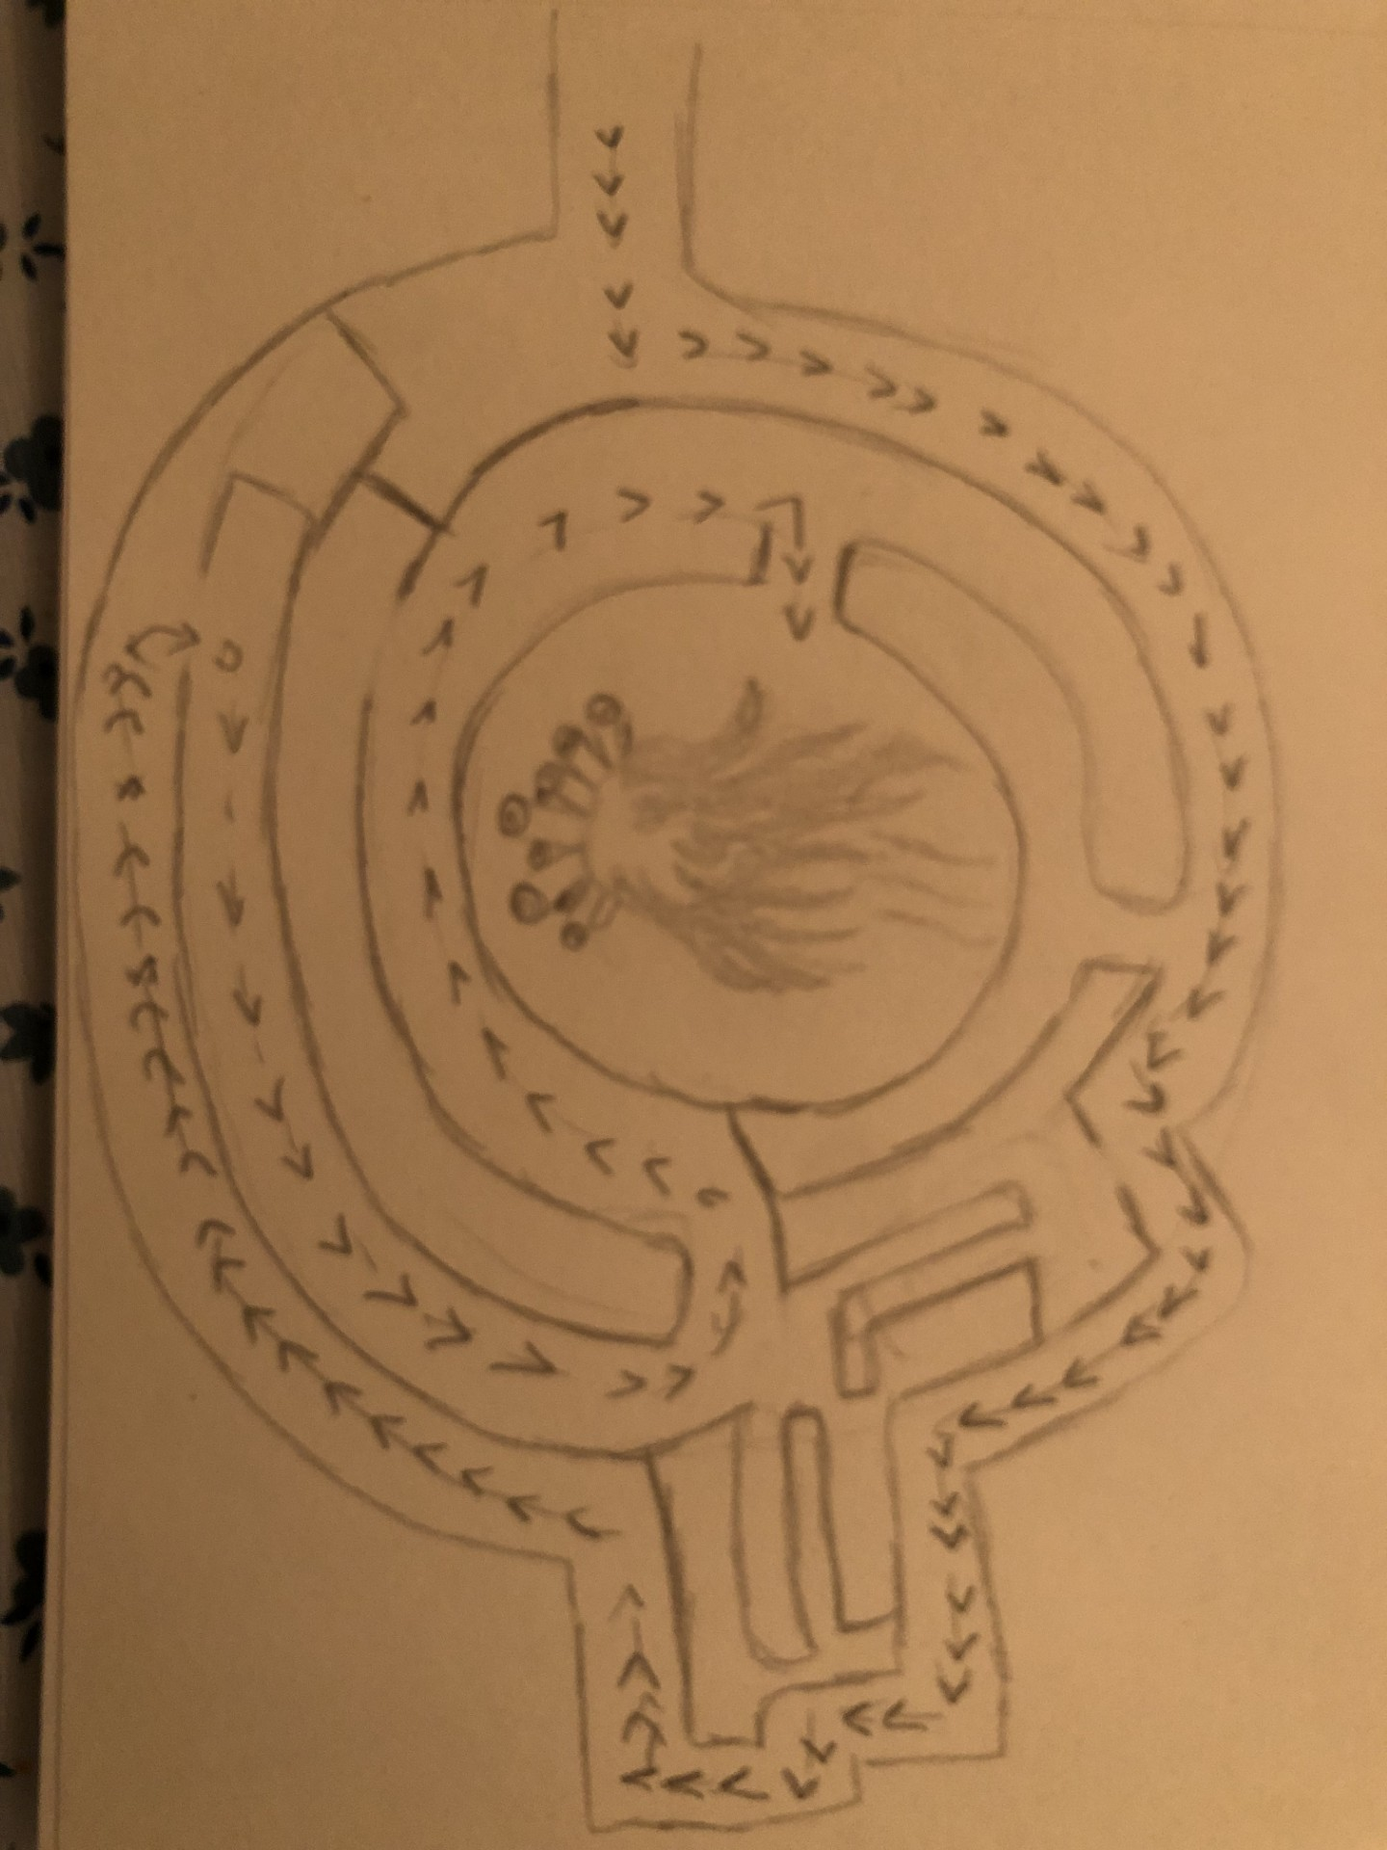
Festa Junina Defender
Protect a Festa Junina celebration.
Use creative defenses like candy apples and fireworks.
Fend off waves of party crashers.
Combine strategy and humor in gameplay.

Slide 5
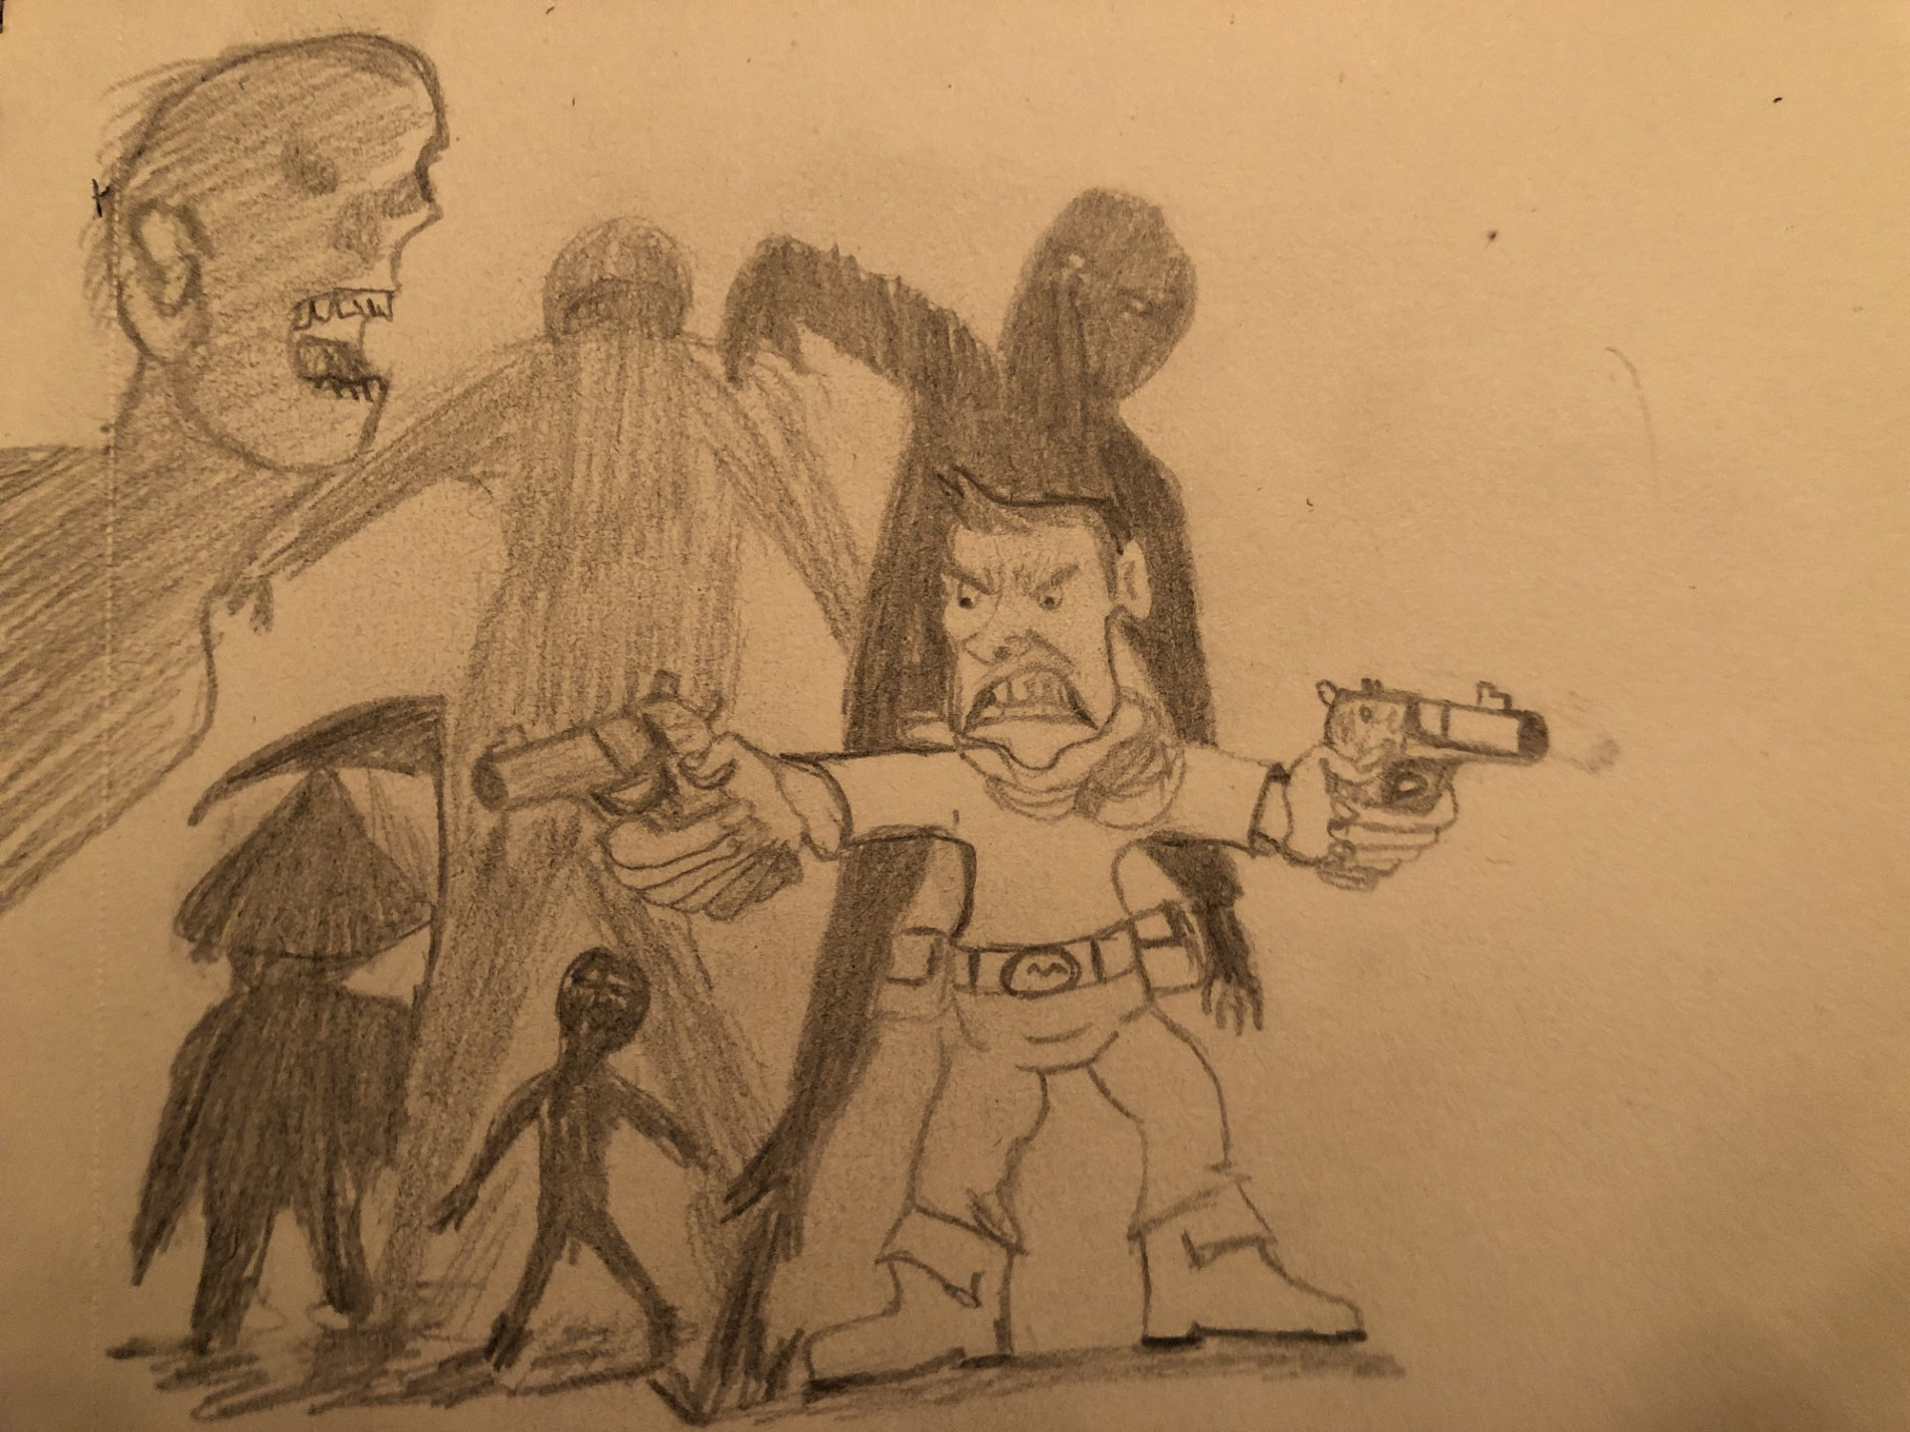
Zombie Apocalypse
Survive endless waves of zombies.
Start with basic weapons and upgrade as you go.
Collect drops like health packs and stronger guns.
Fast-paced and intense survival gameplay.

Slide 6
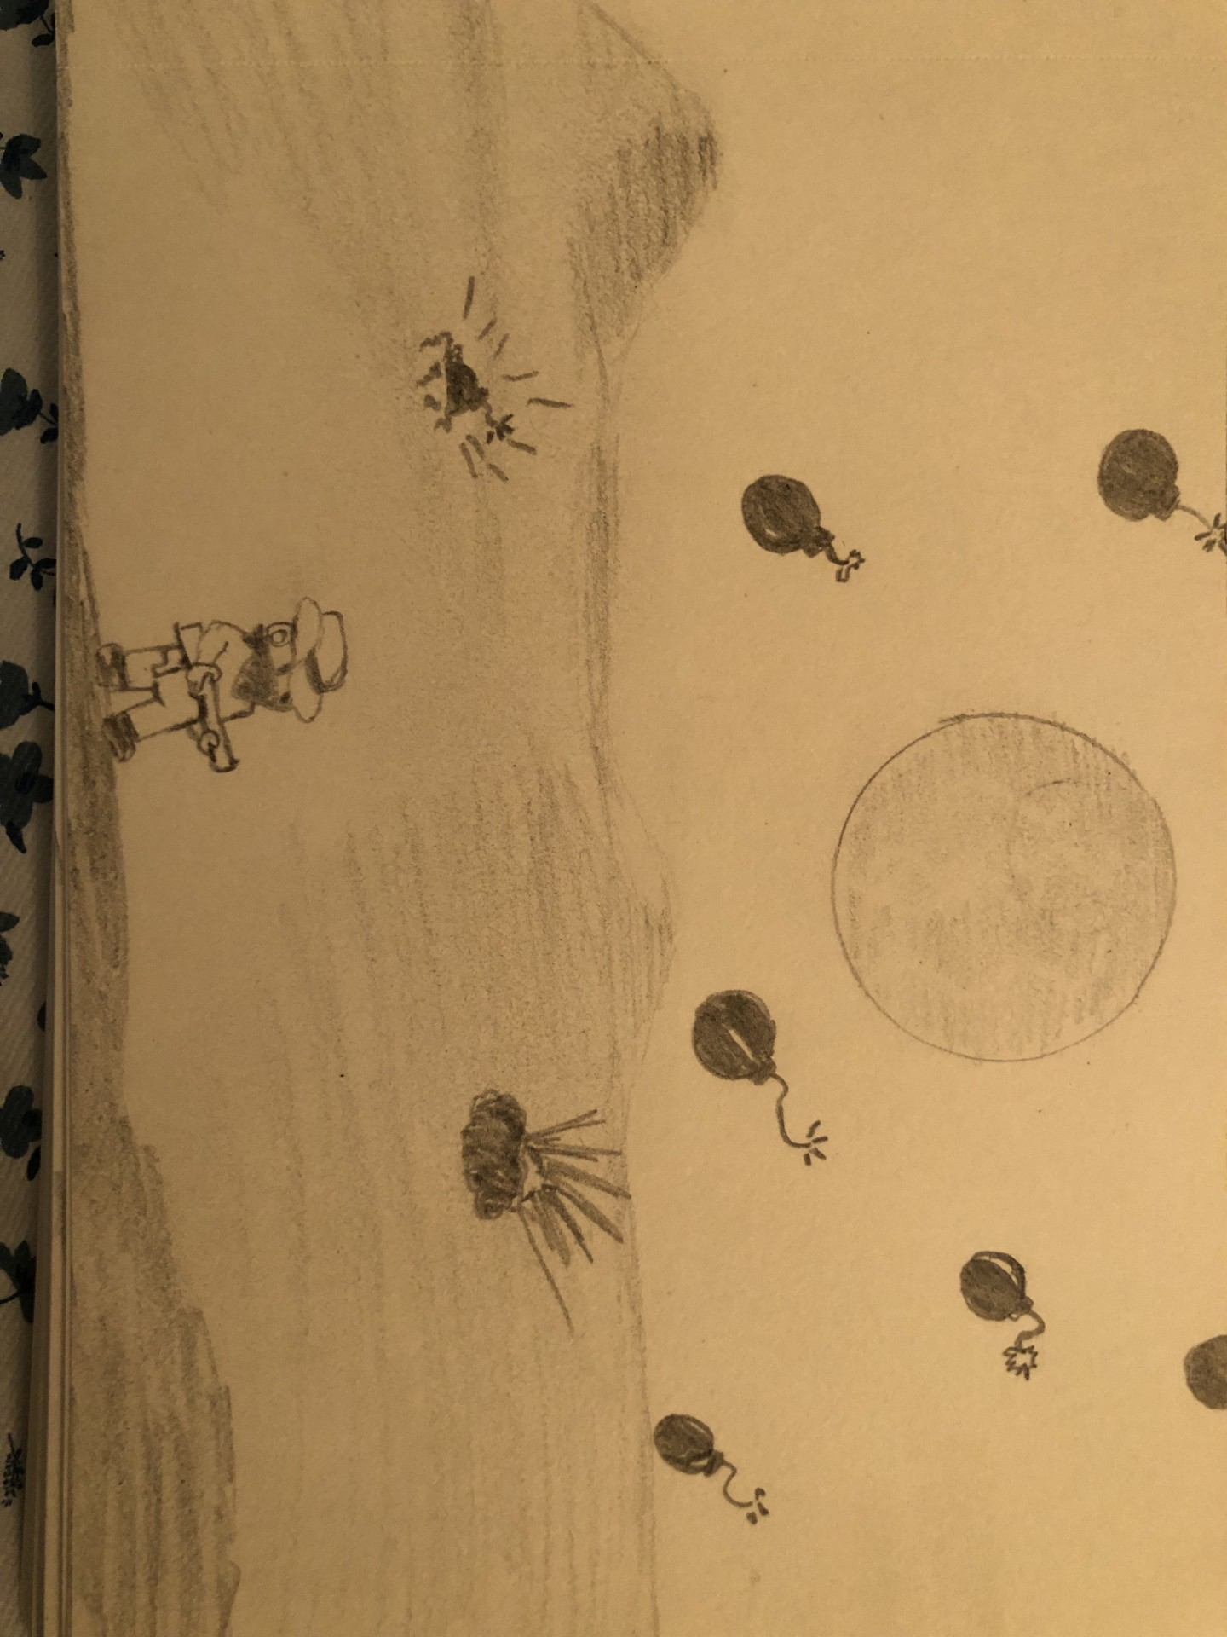
Shooter in the Desert
- Avoid and destroy falling bombs in the desert.
- Collect health pickups to stay alive.
- Bombs become more unpredictable over time.
- Aim for high scores in an action-packed setting.

