Slide 1

LISBON PARKING

Slide 2
Economic interest
Parking lots are highly stable business characterized by low volatility and long term cash flow visibility.
For companys managing the parking lots in Lisbon is crucial to understand the dynamics between the price/hour implemented and the percentage of occupancy during the day. The ideal is high rotation of cars and maximum level of occupancy .
To try to understand if there are other factors in place that could affect the economic return, it was created a database with several features that could be ancilliary of the maximum profit that a company can get from a parking lot

Slide 3
Data
It was collected a sample of 25 cars from 4 different parking lots, composed of several features, in different areas of Lisbon.
One of the parking lots is managed by the company EMEL and the other three by the company EMPARK.
Notes:
EMEL is a company that manages the public parking in Lisbon and they have some parking lots.
EMPARK manages parking facilities in key areas of Lisbon

Slide 4
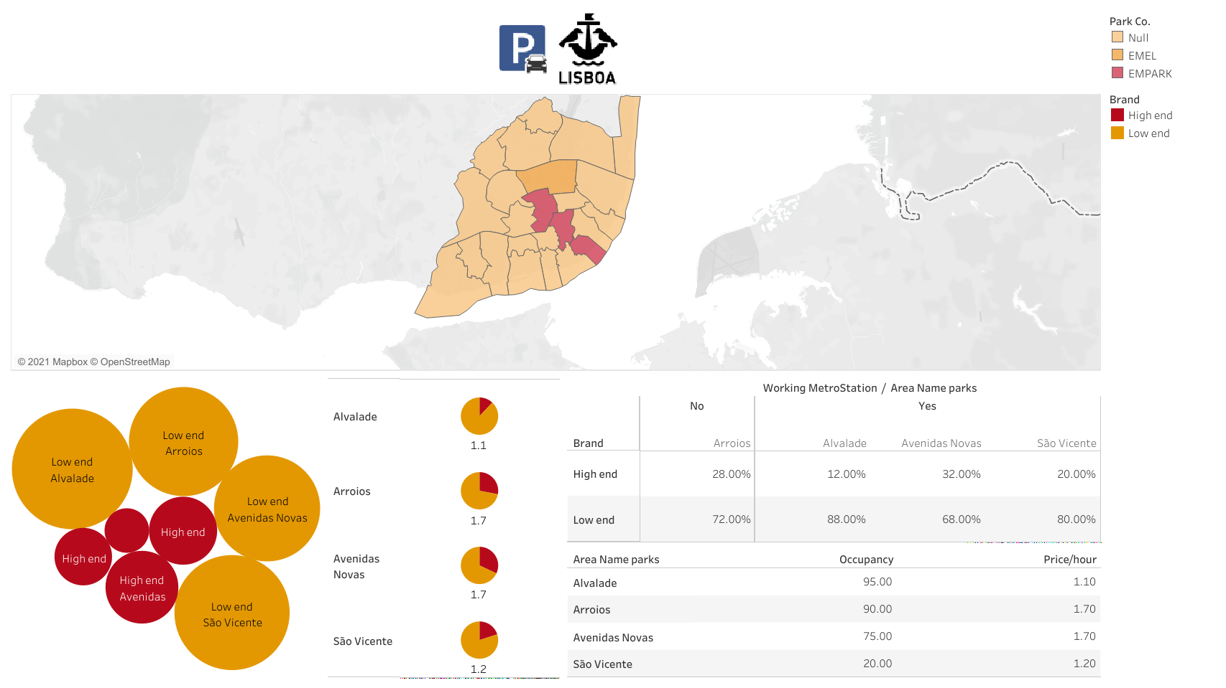
Data Visualization
https://public.tableau.com/app/profile/guilherme7272/viz/LisbonParking/Dashboard1

Slide 5
Questions ?
Is there an independent relation between the price and the type of cars (low-end and high-end brands) ?
Is there an independent relation between the price and high or low occupancy?
Does proximity to a working metro station influence the type of cars (low-end and high-end brands) that park in the parking lot?

Slide 6
Statistical analysis/answers
There is no statistically significance to conclude that:
There is an independent relation between the price and the type of cars (low-end and high-end brands).
There is an independent relation between the price and high or low occupancy.
The proximity to a working metro station influence the type of cars (low-end and high-end brands) that park in the parking lot.

Slide 7
Future improvements/sugestions
Formulation of other hypothesis
Enrichment of the dataset
Use of other methods to study the problematic

Slide 8

THANK YOU FOR YOUR TIME

