Slide 1
Latent Representations for Players in Sports Data
Oliver Schulte and Guiliang Liu

Slide 2
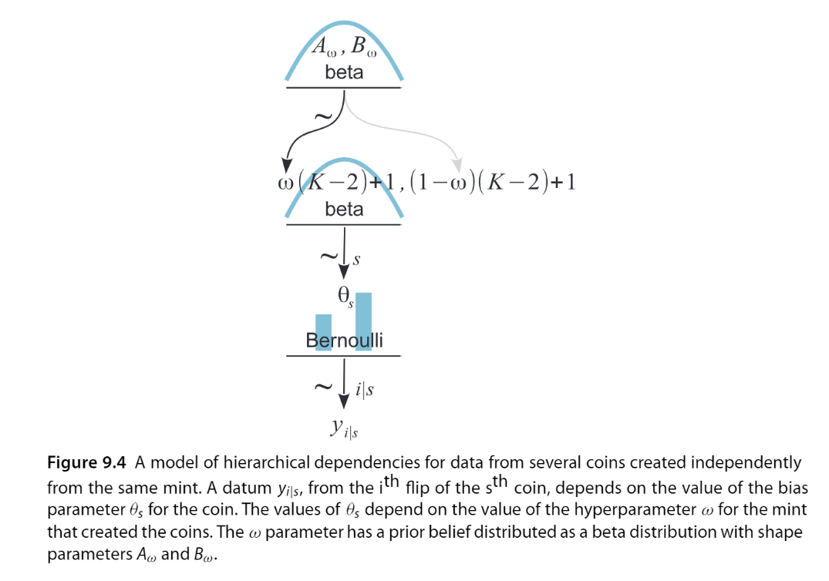
Hierarchical Model
Shrinkage Effect in Hierarchical Model:
The estimates of low-level parameters are pulled closer together than they would be if there were not a higher-level distribution.
In general, shrinkage in hierarchical models causes low-level parameters to shift toward the modes of the higher-level distribution.
The shrinkage effect is commonly used in statistics to capture similarities among a group of individuals, by ``shrinking" the differences between different parameter vectors for each individual.
Notes:
For example, if each individual is represented by a weight vector in a linear model, a shrinkage model may regularize the individual weight vectors towards a common mean. In a Bayesian shrinkage model, a distribution over the individual parameters can be defined as a posterior distribution given the individual data drawn from a prior that is common to the group.

Slide 3




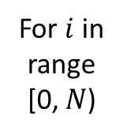








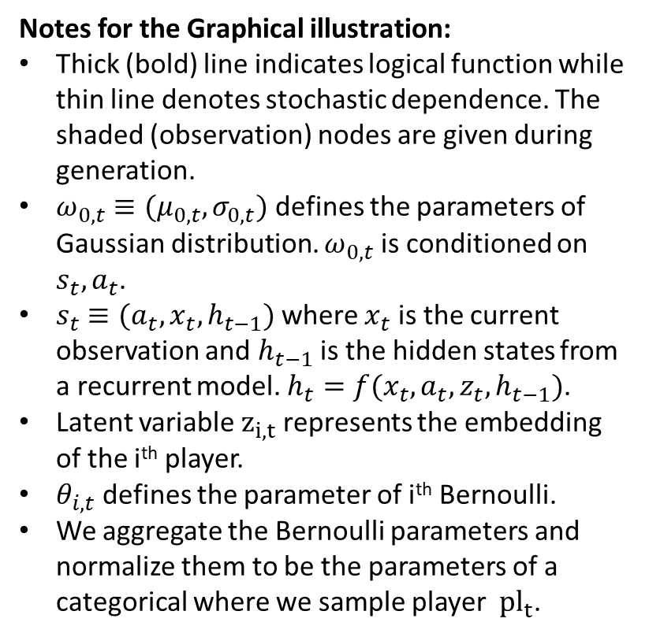



Hierarchical Model
Notes for the Graphical illustration:
Thick (bold) line indicates logical function while thin line denotes stochastic dependence. The shaded (observation) nodes are given during generation.
$ω_{0,t}≡(μ_{0,t},σ_{0,t})$ defines the parameters of Gaussian distribution. $ω_{0,t}$ is conditioned on $s_{t},a_{t}$.
$s_{t}$ $≡{(a}_{t},{x_{t},h}_{t−1})$ where $x_{t}$ is the current observation and $h_{t−1}$ is the hidden states from a recurrent model. $h_{t}=f(x_{t},a_{t},z_{t},h_{t−1})$.
Latent variable $z_{i,t}$ represents the embedding of the i^{th} player.
$θ_{i,t}$ defines the parameter of i^{th} Bernoulli.
We aggregate the Bernoulli parameters and normalize them to be the parameters of a categorical where we sample player${ pl}_{t}$.
$$ω_{0,t}$$
$$s_{t}$$
$$h_{t−1}$$
$$z_{i,t}\sim 𝒩(ω_{0,t})$$
$${ z}_{t}$$
$$a_{t}$$
$$x_{t}$$
For $i$ in
range
[0, $N$)
Recurrence Model
$$θ_{i,t}$$
$$h_{t}$$
$$x_{t}$$
$${pl}_{t}\sim Cat(θ_{1,t}…θ_{N,t})$$
$${ pl}_{t}$$
$$h_{t−1}$$
$${ z}_{t}$$
$$a_{t}$$

Slide 4
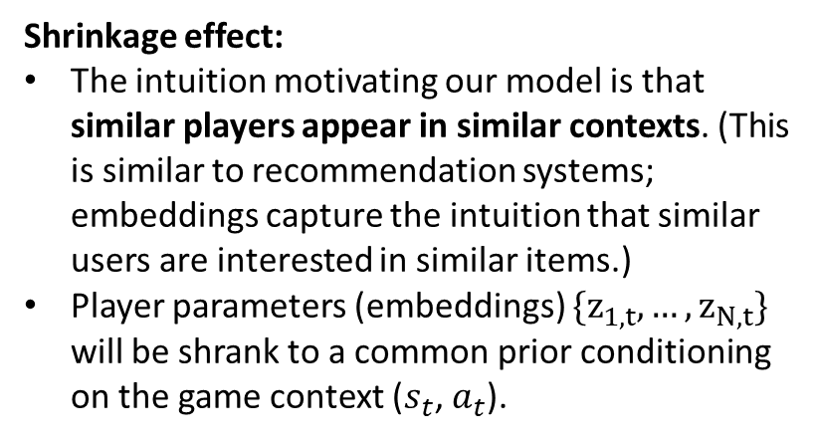
Hierarchical Model
Shrinkage effect:
The intuition motivating our model is that similar players appear in similar contexts. (This is similar to recommendation systems; embeddings capture the intuition that similar users are interested in similar items.)
Player parameters (embeddings) $\{z_{1,t},…,z_{N,t}\}$ will be shrank to a common prior conditioning on the game context ($s_{t}$, $a_{t}$).
Notes:
In this graph, we only model the priors (not posteriors)
To compute the posteriors and all the parameters in this model, we implement variational inference, which resembles VAE.

Slide 5



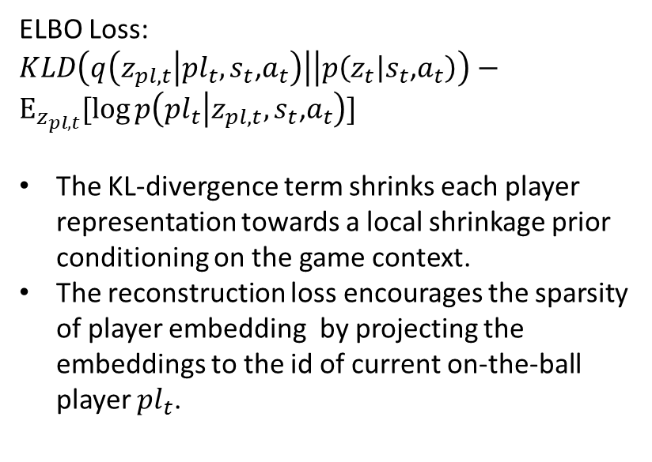

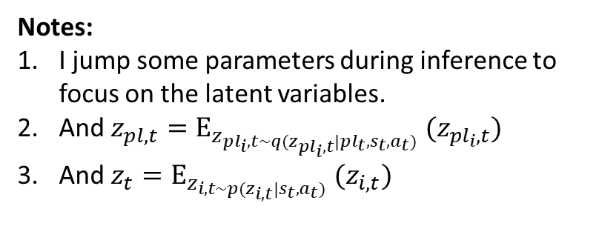




Variational Inference
ELBO Loss:
$KLD\left(q\left(z_{pl,t} | {pl}_{t},s_{t}\text{,}a_{t}\right)\right|\left|p\left(z_{t} | s_{t}\text{,}a_{t}\right)\right)−$ $E_{z_{pl,t}}[\log{p\left({pl}_{t} | {z_{pl,t},s}_{t}\text{,}a_{t}\right)}]$
The KL-divergence term shrinks each player representation towards a local shrinkage prior conditioning on the game context.
The reconstruction loss encourages the sparsity of player embedding by projecting the embeddings to the id of current on-the-ball player ${pl}_{t}$.
ELBO Loss
Validation Loss
$${pl}_{t}$$
$$V_{t}$$
Generator
Validation model
Reconstruction
$$h_{t−1}$$
$$z_{t}$$
$$z_{pl,t}$$
LSTM Cell
$$h_{t}$$
KLD
Prior
Posterior
Notes:
I jump some parameters during inference to focus on the latent variables.
And $z_{pl,t}=E_{z_{{pl}_{i},t\sim q(z_{{pl}_{i},t}|{pl}_{t},s_{t},a_{t})}} (z_{{pl}_{i},t})$
And $z_{t}=E_{z_{i,t\sim p(z_{i,t}|s_{t},a_{t})}} (z_{i,t})$
$s_{t}$,$a_{t}$
$${pl}_{t}$$

Slide 6









Variational Inference
Variational Inference
Validation Model
$${pl}_{t}$$
$$V_{t}$$
$$\sim$$
Generator
Validation model
Reconstruct
$$h_{t−1}$$
$$z_{t}$$
LSTM Cell
$$h_{t}$$
$$\sim$$
KLD
Prior
Posterior
$s_{t}$,$a_{t}$
$${pl}_{t}=i$$

Slide 7





Variational Inference
$${pl}_{t}$$
$${pl}_{t}$$
$$V_{t}$$
Posterior
Validation model
Generator
$$z_{t}$$
LSTM Cell
$$h_{t}$$
$$h_{t−1}$$
Prior
$s_{t}$,$a_{t}$

Slide 8

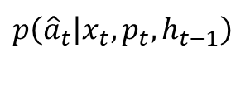


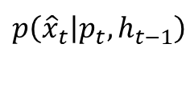






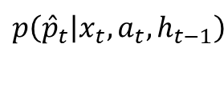
Probabilistic Graph
State Action Generation Model
Player Generation Model
$$p\left({\hat{x}}_{t} | p_{t},h_{t−1}\right)$$
$$p\left({\hat{a}}_{t} | {x_{t}, p}_{t},h_{t−1}\right)$$
$$p\left({\hat{p}}_{t} | {x_{t}, a}_{t},h_{t−1}\right)$$
$$x_{t}$$
$$a_{t}$$
$${\hat{p}}_{t}$$
$$h_{t−1}$$
$${\hat{p}}_{t}$$
$$h_{t−1}$$
$$x_{t}$$
$$a_{t}$$
$$h_{t−1}=(x_{<t},a_{<t})$$
Notes:
The ideal state action generation model can be used to learn a deterministic embedding for each player, using Yu-dong’s model.

Slide 9
Deterministic Player Embedding

Slide 10
Yu-dong’s Model for deterministic player embedding
N players
K latent dimensions
Embedding matrix W_{KxN}
[i] = one-hot player embedding of player i. Dimension = Nx1
W[i] = embedding of player i. Dimension = Kx1
Probabilistic model “player2vec” p(x_{t},a_{t}|p_{t},h_{t-1}) becomes p(x_{t},a_{t}|Wp_{t},h_{t-1})

Slide 11
Triple Embedding
For interpretability and modelling power, we can decompose the information about a player into 3 components (chain rule): p(r_{t},x_{t},a_{t}|p_{t},h_{t-1}) = p(r_{t}|x_{t},a_{t},p_{t},h_{t-1}) x p(a_{t}|x_{t},p_{t},h_{t-1}) x p(x_{t}|p_{t},h_{t-1})
Goal scoring ability
policy
“style”, position, role
We could have three separate embedding matrixes W_{r}, W_{a}, W_{x}.

Slide 12





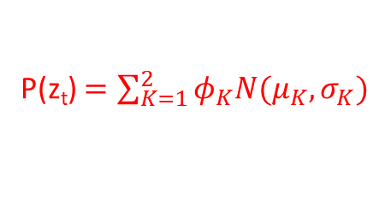




Ideal State Action Generation Model
Can also consider encoding states and actions
Gaussian Mixture Model
P(z_{t}) $=\sum_{K=1}^{2}{φ_{K}N(μ_{K},σ_{K})}$
$$z_{t}$$
$${\hat{x}}_{t}$$
$${\hat{a}}_{t}$$
Decoder
Decoder
$$z_{t,state}$$
$$z_{t,action}$$
Encoder
Encoder
$$p_{t}$$
$$x_{t}$$
$$h_{t−1}$$
$$a_{t}$$
Notes:
See Michael’s notes, bitbucket and http://proceedings.mlr.press/v97/gelada19a/gelada19a.pdf

Slide 13
Motivations:
Current player evaluation models are not be able to consider a player’s individual feature.
Most of the works (e.g. our ice hockey paper, Luke‘s basketball) build a model for all the players. In evaluating a shot, they assign the same value for a game context, no matter who is making that shot
Several works do input the player_id into the model. But they have not seriously studied the influence of the ids in model output .
(One interesting finding is that despite we have inputted the player_id to model, the model assigns very small weight to the ids during training. During testing, changing the player_id won’t influence model output.)

Slide 14
Player Generation Model

Slide 15






Player Generation Model
$${\hat{p}}_{t}$$
Decoder
$$z_{t}$$
Encoder
$$h_{t−1}$$
$$x_{t}$$
$$a_{t}$$
$$p_{t}$$

Slide 16
Our model:
Applying a Conditional Variational Recurrent Neural Network to generate a embedding for a player in a game context.
Our embeddings depends on the game context (conditional). For a selected player, our model will provide different embeddings for different game contexts.
Input the embedding to a Deep Q Network and generate Q values conditioning on players.

Slide 17
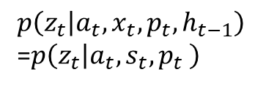


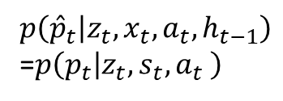











Conditional Variational Recurrent Neural Network
$${\hat{p}}_{t}$$
$${\hat{p}}_{t+1}$$
$$p\left({\hat{p}}_{t} | z_{t}, x_{t},a_{t},h_{t−1}\right)$$
=$p\left(p_{t} | {z_{t}, s}_{t},a_{t} \right)$
Decoder
Decoder
g$\left(h_{t} | z_{t}, x_{t},a_{t} ,h_{t−1}\right)$
$$h_{t−1}$$
$$z_{t}$$
LSTM Cell
$$h_{t}$$
$$z_{t+1}$$
$$p\left(z_{t} | a_{t}, x_{t},p_{t},h_{t−1}\right)$$
=$p\left(z_{t} | a_{t}, s_{t},p_{t} \right)$
Encoder
Encoder
$$x_{t}$$
$$a_{t}$$
$$p_{t}$$
$$x_{t+1}$$
$$a_{t+1}$$
$$p_{t+1}$$

Slide 19






















TD Loss (rewards are applied)
$${\hat{Q}}_{t}$$
$${\hat{Q}}_{t+1}$$
Hidden Layer
ELBO Loss (KLD + reconstruction loss)
$$h_{t−1}$$
LSTM Cell
$$h_{t}$$
LSTM Cell
$${\hat{p}}_{t}$$
$${\hat{p}}_{t+1}$$
$$a_{t+1}$$
$$s_{t+1}$$
$$a_{t}$$
$$s_{t}$$
Decoder
Decoder
$$h_{t−1}$$
$$z_{0,t}$$
$$z_{p,t}$$
LSTM Cell
$$h_{t}$$
$$z_{0,t+1}$$
$$z_{p,t+1}$$
Prior
Encoder
Prior
Encoder
$$s_{t}$$
$$a_{t}$$
$$p_{t}$$
$$s_{t+1}$$
$$a_{t+1}$$
$$p_{t+1}$$
Notes:
Conditional Variational Recurrent Neural Network + Deep Q network

Slide 20













Validation Loss
ELBO Loss (KLD + reconstruction loss)
$$V_{t}$$
Validation model
$${pl}_{t}$$
$${pl}_{t+1}$$
Generator
Generator
$$h_{t−1}$$
$$z_{t}$$
$$z_{pl,t}$$
LSTM Cell
$$h_{t}$$
$$z_{pl,t+1}$$
$$z_{t+1}$$
Prior
Posterior
Prior
Posterior
$$c_{t}$$
$$c_{t+1}$$
$${pl}_{t+1}$$
$${pl}_{t}$$
Notes:
Conditional Variational Recurrent Neural Network + Deep Q network

Slide 21





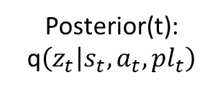

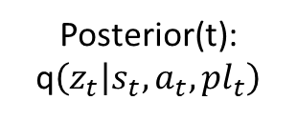


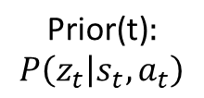








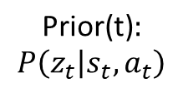
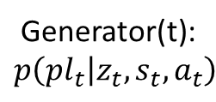


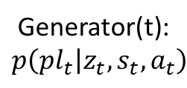




$$p\left(z_{t} | s_{t},a_{t},{pl}_{t}\right)=\frac{p\left({pl}_{i} | z_{t},s_{t},a_{t}\right)P\left(z_{t} | s_{t},a_{t}\right)}{p\left({pl}_{i} | s_{t},a_{t}\right)}$$
$$p\left(z_{t} | s_{t},a_{t},{pl}_{t}\right)∝p\left({pl}_{t} | z_{t},s_{t},a_{t}\right)P\left(z_{t} | s_{t},a_{t}\right)$$
$$\text{Prior}\text{(}\text{t}\text{)}:$$
$$P\left(z_{t} | s_{t},a_{t}\right)$$
$$Nr(μ_{0,t},σ_{0,t})$$
$$h_{t−1}$$
$$\text{Prior}\text{(}\text{t}\text{)}:$$
$$P\left(z_{t} | s_{t},a_{t}\right)$$
$$z_{t}\sim Nr(μ_{0,t},σ_{0,t})$$
$$h_{t−1}$$
$$\sim$$
$$\text{KLD}$$
$$z_{t}$$
$$\text{KLD}$$
Posterior(t):
q$\left(z_{t} | s_{t},a_{t},{pl}_{t}\right)$
$$z_{t}\sim Nr(μ_{z,t},σ_{z,t})$$
$$s_{t},a_{t}$$
Posterior(t):
q$\left(z_{t} | s_{t},a_{t},{pl}_{t}\right)$
$${pl}_{t}$$
$$Nr(μ_{z,t},σ_{z,t})$$
$$s_{t},a_{t}$$
$$\sim$$
$$z_{pl,t}$$
Generator(t):
$$p\left({pl}_{t} | z_{t},s_{t},a_{t}\right)$$
$${pl}_{t}\sim Cat(p_{1},…{,p}_{K})$$
$$h_{t}$$
Generator(t):
$$p\left({pl}_{t} | z_{t},s_{t},a_{t}\right)$$
$$Cat(p_{1},…{,p}_{K})$$
$$h_{t}$$
$$\sim$$
$${pl}_{t}$$
……
Notes:
Conditional Variational Recurrent Neural Network + Deep Q network

Slide 22











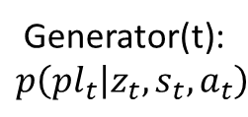

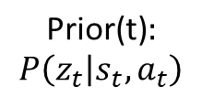



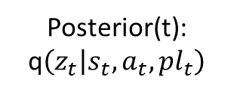

$$p\left(z_{t} | s_{t},a_{t},{pl}_{t}\right)=\frac{p\left({pl}_{i} | z_{t},s_{t},a_{t}\right)P\left(z_{t} | s_{t},a_{t}\right)}{p\left({pl}_{i} | s_{t},a_{t}\right)}$$
$$p\left(z_{t} | s_{t},a_{t},{pl}_{t}\right)∝p\left({pl}_{t} | z_{t},s_{t},a_{t}\right)P\left(z_{t} | s_{t},a_{t}\right)$$
$$N(\left|pl\right|)$$
$${ z}_{pl,t}$$
$$h_{t}$$
Posterior(t):
q$\left(z_{t} | s_{t},a_{t},{pl}_{t}\right)$
$$\sim$$
$${ pl}_{t}$$
$$\text{KLD}$$
$$μ_{pl,t},σ_{pl,t}$$
$$\text{Prior}\text{(}\text{t}\text{)}:$$
$$P\left(z_{t} | s_{t},a_{t}\right)$$
$$\sim$$
$${ z}_{t}$$
$$μ_{0,t},σ_{0,t}$$
$$s_{t},a_{t}$$
Generator(t):
$$p\left({pl}_{t} | z_{t},s_{t},a_{t}\right)$$
$${\{p_{k,t}\}}_{1}^{K}$$
$$\sim$$
$$h_{t−1}$$
$${\hat{pl}}_{t}$$
Notes:
Conditional Variational Recurrent Neural Network + Deep Q network

Slide 23



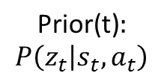



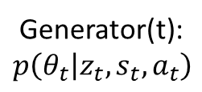

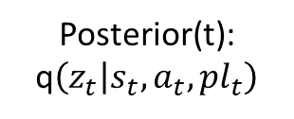





$$p\left(z_{t} | s_{t},a_{t},{pl}_{t}\right)=\frac{p\left({pl}_{i} | z_{t},s_{t},a_{t}\right)P\left(z_{t} | s_{t},a_{t}\right)}{p\left({pl}_{i} | s_{t},a_{t}\right)}$$
$$p\left(z_{t} | s_{t},a_{t},{pl}_{t}\right)∝p\left({pl}_{t} | z_{t},s_{t},a_{t}\right)P\left(z_{t} | s_{t},a_{t}\right)$$
$$\text{Prior}\text{(}\text{t}\text{)}:$$
$$P\left(z_{t} | s_{t},a_{t}\right)$$
$${ z}_{t}$$
$$ω_{0,t}$$
$$h_{t−1}$$
$$\text{KLD}$$
$$Pl$$
Posterior(t):
q$\left(z_{t} | s_{t},a_{t},{pl}_{t}\right)$
$${ z}_{pl,t}$$
$$ω_{pl,t}$$
$$s_{t},a_{t}$$
$$N(\left|pl\right|)$$
Generator(t):
$$p\left(θ_{t} | z_{t},s_{t},a_{t}\right)$$
$$θ_{t}$$
$$h_{t}$$
$${ pl}_{t}$$
Notes:
Conditional Variational Recurrent Neural Network + Deep Q network

Slide 24









$$ω_{0,t}$$
$$s_{t}$$
$$h_{t−1}$$
$$x_{t}$$
$${ z}_{pl,t}$$
$$a_{t}$$
$$N(\left|pl\right|)$$
$$θ_{pl,t}$$
$${ pl}_{t}$$
Notes:
Conditional Variational Recurrent Neural Network + Deep Q network

Slide 25


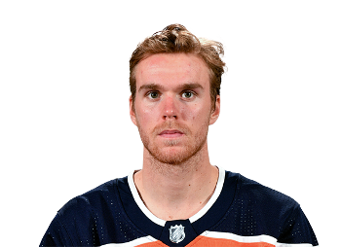




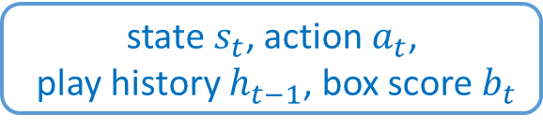


Alexander Ovechkin
Sidney Crosby
Connor McDavid
Taylor Hall
0.6
0.2
0.2
state$s_{t}$, action $a_{t}$,
play history $h_{t−1}$, box score $b_{t}$
$$0.2∗z_{t,3}$$
$$0.6∗z_{t,1}$$
$$0.2∗z_{t,2}$$
Notes:
Conditional Variational Recurrent Neural Network + Deep Q network

Slide 26
Difficulty:
Too many players in a league (over 1k) while only several of them will appear into a single match.

Slide 27
Potential solution 1: cluster the players
Position C
Position LW
C1
C2
Cn
...
LW1
LW2
...
LWn
Cluster Id:
Id:1
Id: 2
Id: n
Id:n+1
Id:n+2
Id: n+n
Player ID | Player Position | Goal | Assist | Penalty | Cluster ID
526 | C | 9 | 5 | 2 | 1
139 | C | 1 | 0 | 0 | 2
… | … | … | … | … | …
1001 | C | 10 | 6 | 3 | 1
Cluster the Centre players according to their stats.
Cluster Id will replace player Id.

Slide 28
Difficulty:
Too many players in a league (over 1k) while only several of them will appear into a single match.
Potential solution 1: cluster the players and input cluster id to neural network.
Potential solution 2: local player ids, where we maintain a local id pool for a match according to player position or statistics.
Position C
Position LW
C1
C2
Cn
LW1
LW2
LWn
Cluster Id:1
Id:2
Id: n
Id:n+1
Id:n+2
Id: n+n

Slide 29
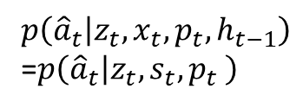


Conditional Variational Recurrent Neural Network
$${\hat{a}}_{t}$$
$${\hat{a}}_{t+1}$$
$$p\left({\hat{a}}_{t} | z_{t}, x_{t},p_{t},h_{t−1}\right)$$
=$p\left({\hat{a}}_{t} | {z_{t}, s}_{t},p_{t} \right)$
Decoder
Decoder
g$\left(h_{t} | z_{t}, x_{t},a_{t} ,h_{t−1}\right)$
$$h_{t−1}$$
$$z_{t}$$
LSTM Cell
$$h_{t}$$
$$z_{t+1}$$
$$p\left(z_{t} | a_{t}, x_{t},p_{t},h_{t−1}\right)$$
=$p\left(z_{t} | a_{t}, s_{t},p_{t} \right)$
Encoder
Encoder
$$x_{t}$$
$$a_{t}$$
$$p_{t}$$
$$x_{t+1}$$
$$a_{t+1}$$
$$p_{t+1}$$

Slide 30

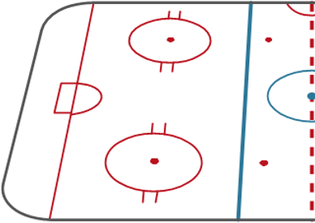





Game
Features
Player
Contextualized Player
Representation
$${pl}_{t}$$
Context
$$a_{t}$$
…
$$s_{t}$$
$$p(z_{t}|s_{t},a_{t},{pl}_{t})$$

