Slide 1
First-Order Bayesian Networks
Note: change to parent = drama(M)?

Slide 2
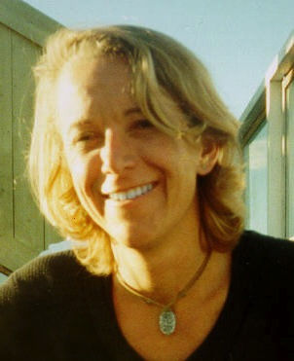
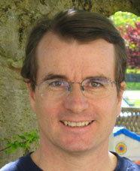
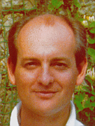
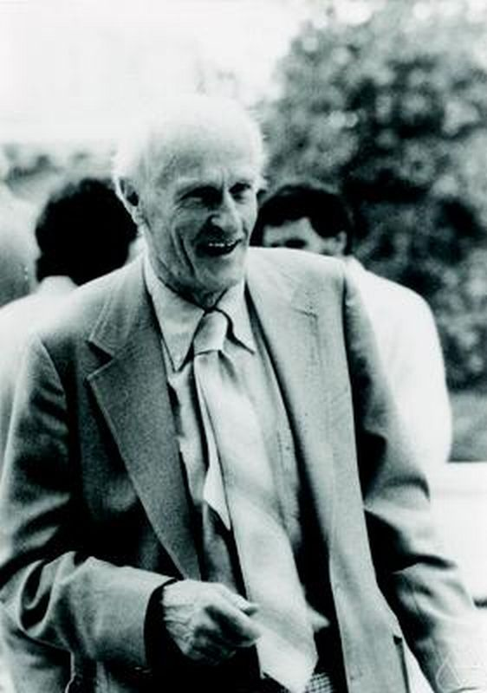
Relational Data and Logic
Lise Getoor
David Poole
Stuart Russsell
Stephen Kleene
Poole, D. (2003), First-order probabilistic inference, 'IJCAI’. Getoor, L. & Grant, J. (2006), 'PRL: A probabilistic relational language', Machine Learning 62(1-2), 7-31.
Russell, S. & Norvig, P. (2010), Artificial Intelligence: A Modern Approach, Prentice Hall.
Stephen Kleene, (1952). Introduction to Metamathematics.
Notes:
There are different formalism for describing relational data and relational models. I follow the approach developed by Poole, Russell Getoor. My learning algorithm work for others as well. Basically, for any formalism basedon first-order logic. I’m also trying to show that we are in review mode.

Slide 3
First-Order Logic
An expressive formalism for specifying relational conditions.
database theory
relational learning
First-Order Logic
Query language
Pattern Language
Notes:
Remind them that I use equational logic

Slide 4
First-Order Logic: Terms
A constant refers to an individual
“Fargo”
A first-order variable refers to a class of individuals
“Movie” refers to Movies
Terms
A constant or first-order variable is a term.
The result of applying a functor to a term is a term.
contains first-order variables?
first-order term e.g. salary(Actor, Movie)
ground term e.g. salary(UmaThurman, Fargo)
Notes:
could also build nested terms
values of ground terms are the smallest unit of information
fundamental split leads to two kinds of probabilities
cite Kleene?

Slide 5
Relational Random Variables
First-order random variable = First-order term + probabilistic semantics (Wang et al. 2008)
Ground random variable = ground term + probabilistic semantics (Kimmig et al. 2014)
Both complex terms and complex random variables are built by function application
Statistics | Logic
Apply function to random variable(s) ➔ new random variable | Apply function to term(s) ➔ new term
Notes:
One of Kleene’s and Goedel’s motivation was to reflect mathematical practice

Slide 6
Formulas
A (conjunctive) formula is a joint assignment term₁ = value₁,...,term_{n}=value_{n}
e.g., ActsIn(Actor, Movie) = T, gender(Actor) = W
A ground formula contains only constants
e.g., ActsIn(UmaThurman, KillBill) = T, gender(UmaThurman) = W
Notes:
The value_i are constants.
Maybe say something about more complex formulas.

Slide 7
Relational Frequencies
Probabilistic Semantics for First-Order Random Variables

Slide 8
Applications of Relational Frequency Modelling
Knowledge discovery/ rule learning “women users like movies with women actors”
Strategic Planning “increase SAT requirements to decrease student attrition”
Query Optimization (Getoor, Taskar, Koller 2001) Class-level queries support selectivity estimation ➔ optimal evaluation order for SQL query

Slide 9
Relational Frequencies
Database probability of a first-order formula = number of satisfying instantiations/ number of possible instantiations
Examples:
P_{D}(gender(Actor) = W) = 2/4
P_{D}(gender(Actor) = W, ActsIn(Actor,Movie) = T) = 2/8

Slide 10
The Grounding Table
P(gender(Actor) = W, ActsIn(Actor,Movie) = T) = 2/8
frequency = #of rows where the formula is true/# of all rows
Logical Variable
Single data table that correctly represents relational frequencies Schulte 2011, Riedel, Yao, McCallum (2013)
Actor | Movie | gender(Actor) | ActsIn(Actor,Movie) | genre(Movie)
Brad_Pitt | Fargo | M | F | Action
Brad_Pitt | Kill_Bill | M | F | Action
Lucy_Liu | Fargo | W | F | Action
Lucy_Liu | Kill_Bill | W | T | Action
Steve_Buscemi | Fargo | M | T | Action
Steve_Buscemi | Kill_Bill | M | F | Action
Uma_Thurman | Fargo | W | F | Action
Uma_Thurman | Kill_Bill | W | T | Action
Notes:
single data table that correctly represents relational frequencies
universal schema Riedel, Yao, McCallum (2013)

Slide 11
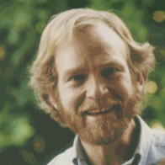
Random Selection Semantics
Logical Variable ➔ Random Variable P(Movie = Fargo) = 1/2
Prob | Actor | Movie | gender(Actor) | ActsIn(Actor,Movie) | genre(Movie)
1/8 | Brad_Pitt | Fargo | M | F | Action
1/8 | Brad_Pitt | Kill_Bill | M | F | Action
1/8 | Lucy_Liu | Fargo | W | F | Action
1/8 | Lucy_Liu | Kill_Bill | W | T | Action
1/8 | Steve_Buscemi | Fargo | M | T | Action
1/8 | Steve_Buscemi | Kill_Bill | M | F | Action
1/8 | Uma_Thurman | Fargo | W | F | Action
1/8 | Uma_Thurman | Kill_Bill | W | T | Action
Notes:
single data table that correctly represents relational frequencies
Schulte, O. (2011), A tractable pseudo-likelihood function for Bayes Nets applied to relational data, in 'SIAM SDM', pp. 462-473.
Raedt, L. D. (1998), Attribute-Value Learning Versus Inductive Logic Programming: The Missing Links (Extended Abstract), in David Page, ed., 'ILP', Springer, , pp. 1-8.
Riedel, S.; Yao, L. & McCallum, A. (2013), 'Latent Relation Representations for Universal Schemas', CoRR abs/1301.4293.

Slide 12

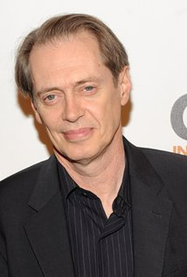

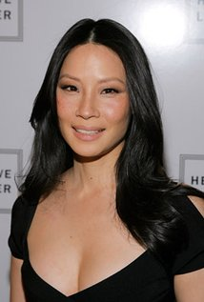


Random Selection Semantics
Population Actors
Population variables
First-Order Random Variables
Actor Random Selection from Actors. P(Actor = brad_pitt) = 1/4
gender(Actor) Gender of selected actor. P(gender(Actor) = W) = ½
ActsIn(Actor,Movie) = T if selected actor appears in selected movie, F otherwise P(ActsIn(Actor,Movie) = T) = 3/8
Movies
Movie Random Selection from Movies. P(Movie = fargo) = ½
genre(Movie) Genre of selected movie. P(genre(Movie)=Action) = 1
Notes:
probabilities are examples

Slide 13
Two-Variable Examples
P(rating(User,Movie) = 4| HasRated(User,Movie) = true) = ?
If we randomly select a user and a movie, and the user has rated the movie, what is the probability that the rating is 4?
P(continent(Country1) = Europe|continent(Country2)= Europe, Borders(Country1, Country2)) = ?
If we randomly select two countries that border each other, and the second one is in Europe, what is the chance that the first one is in Europe?
Notes:
Given that a randomly selected user has rated a randomly selected movie, what is the chance that the rating is 4?
Need to check if continent is a function or relation
Go to demos
Maybe make audience exercise for database queries.
Trump’s homicide example?

Slide 14
Single-Variable Example
Percentage of Flying Birds = 90%
P(Flies(Bird)) = 90%
Halpern: Probability that a typical or random bird flies is 90%
Notes:
TODO: change example

Slide 15
Bayesian Network Models for Relational Statistics
Statistical-Relational Models (SRMs) Random Selection Semantics for Bayesian Networks

Slide 16
Bayesian networks for relational data
A first-order Bayesian network is a Bayesian network whose nodes are first-order terms
(Wang et al. 2008)
AKA parametrized Bayesian network (Poole 2003, Kimmig et al. 2014)
gender(A)
genre(M)
ActsIn(A,M)
Notes:
Bayesian networks are close to rules (Kersting and deRaedt)
parametrized BNs not a frequency model
Demo.
First-order Random variables = terms.

Slide 17
Random Selection Semantics for First-Order Bayesian Networks
P(gender(Actor) = W, ActsIn(Actor,Movie) = T, genre(Movie) = Action) = 2/8
“if we randomly select an actor and a movie, the probability is 2/8 that the actor appears in the movie, the actor is a woman, and the movie is an action movie”
Demo
gender(A)
genre(M)
ActsIn(A,M)
Notes:
These frequencies are interesting in themselves!
could also be typical or normal individuals.

Slide 18
Bayesian Networks are Excellent Estimators of Relational Frequencies
Queries Randomly Generated
Example: P(gender(A) = W|ActsIn(A,M) = true, genre(M) = drama)?
Learn Bayesian network and test on entire database as in Getoor et al. 2001

Slide 19
Summary: Relational Frequencies
The frequency of a conjunctive formula in a possible world = number of satisfying instantiations/ number of possible instantiations.
First-order Bayesian networks represent frequencies of conjunctive formulas very well.
visualize correlations
answer frequency queries using BN inference, not data access

