Slide 1
Structure Learning
Lattice Search
Notes:
TODO: make separate sets of slides?!

Slide 2
Overview: Upgrading Structure Learning
Algorithm: Learn-and-Join Lattice Search
Score/Objective Function: Normalized Gain

Slide 3
Upgrading IID Bayesian Network Learners
Learn and Join Algorithm

Slide 4
Learning a Bayesian Multi-Net
Learn a Bayesian network for each relationship chain using a single-table Bayesian network learner.
Nodes and edges are propagated from shorter chains to smaller chains
Demo.
ActsIn(A,M), HasRated(U,M)
ActsIn(A,M)
HasRated(U,M)
Actors A
Movies M
Users U
Notes:
Preservesmodel search complexity at each level.
TODO: refine score discussion

Slide 5
Contingency Table for Movies
insert table

Slide 6
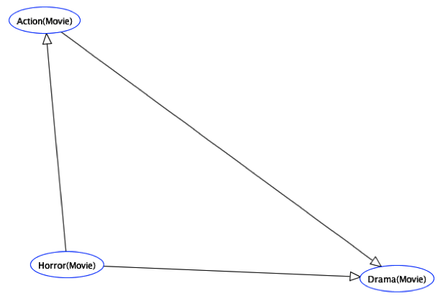
Learning a DAG for Movies
Apply existing Bayesian network learning for IID data to Movies contingency table

Slide 7
Contingency Table for Users

Slide 8
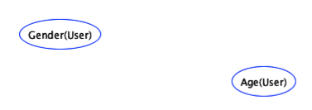
Learning a DAG for Users
Apply existing Bayesian network learning to Users table

Slide 9
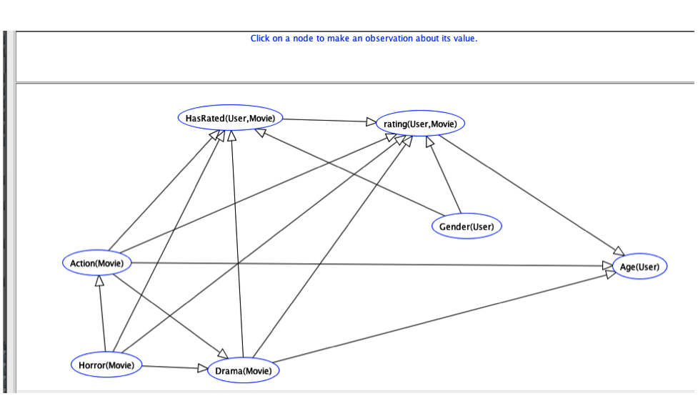
Learning a DAG for Users + Movies
Apply existing Bayesian network learning to join of Users, Movie, Ratings table
Notes:
TODO: make fonts bigger

Slide 10
Fast Structure Learning
Dataset | # Predicates | # tuples | RDN_Boost | MLN_Boost | Lattice
UW | 14 | 612 | 15±0.3 | 19±0.7 | 1±0.0
Mondial | 18 | 870 | 27±0.9 | 42±1.0 | 102±6.9
Hepatitis | 19 | 11,316 | 251±5.3 | 230±2.0 | 286±2.9
Mutagenesis | 11 | 24,326 | 118±6.3 | 49±1.3 | 1±0.0
MovieLens(0.1M) | 7 | 83,402 | 44±4.5 min | 31±1.87 min | 1±0.0
MovieLens(1M) | 7 | 1,010,051 | >24 hours | >24 hours | 10±0.1
Imdb(1.5M) | 17 | 1,538,400 | >24 hours | >24 hours | 549
Standard deviations are shown for cross-validation.
Units are seconds/predicate or function
Notes:
show system running
MovieLens 1M takes only 9 sec more because counting in RDBMS scales really well.
DNs are only learned for predicates for both MLN-Boost and RDN_Boost (two possible values only).
IMDB is evaluated only on unary predicates, for all methods. IMDB evaluated only on one fold.
We report the average per node.
good at finding long relationship chains.
Hepatitis has a complex schema: longer to learn single model than learn independently.
--------------------
IMDB = 540 x 17 = 2.5 hrs.

Slide 11


Learned Structure Example IMDB_3R
UserID | Occupation | Age | gender
UserID | MovieID | Rating
RDN-Boost
MovieID | Time
🎥
Model | Target | Markov Blanket
RDN-Boost | gender(U) | Occupation(U), Age(U)
RDN-Bayes | gender(U) | Occupation(U), Age(U), Rating(U,M), RunningTime(M), CastMember(M,X), AGender(X)
RDN- Bayes
ActorID | MovieID
ActorID | AGender
Notes:
RDN-Boost stays within the original target table. RDN-Bayes finds predictive features that are 2 links away.

Slide 12
Consistency Preservation
Statistical Consistency: As the amount of available data increases, the graphical model learner converges to a graphical structure that is correct for the data generating mechanism.
Theorem If a Bayesian network structure learner is consistent for IID data, then upgrading the learner with the learn-and-join algorithm produces is consistent for relational data.
[cite STarai, Xiang and Neville]
Notes:
ugrading objective function is discussed in starai paper

Slide 13
Conclusion
Structure Learning: Structure search using the lattice of relationship chains
Apply iid Bayes net learner to each point in the lattice
Propagate correlations from lower levels to higher levels, dynamic programming style
fast structure learning
complex correlations along long relationship chains

