Slide 1
First-Order Bayesian Networks
Section 2
Tutorial on Learning Bayesian Networks for Complex Relational Data

Slide 2
Bayesian Networks for i.i.d. data
Directed Acyclic Graph, where nodes = random variables
Parameters = probability of child node given parent nodes
Represents joint distribution of random variables
Supports probabilistic frequency queries, visualizes correlations

Slide 3
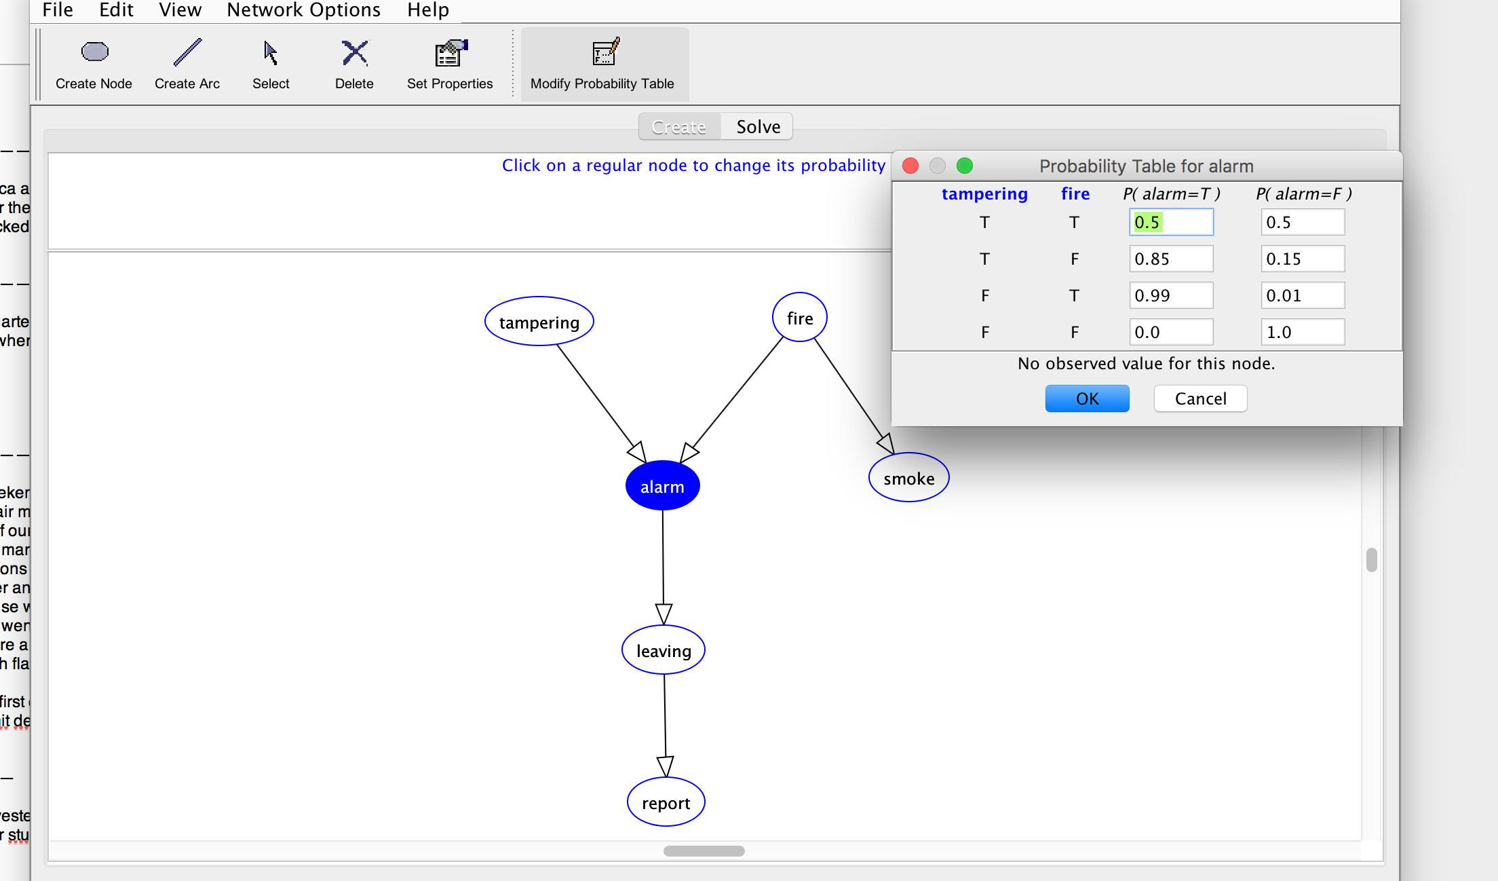
Bayesian Network Demo
Notes:
http://aispace.org/bayes

Slide 4
Extending Bayesian Network Models for Relational Data
Need to extend the following concepts:
relational random variable
joint distribution of relational random variables

Slide 5

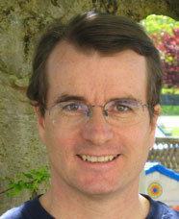
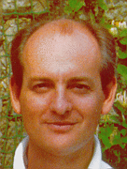
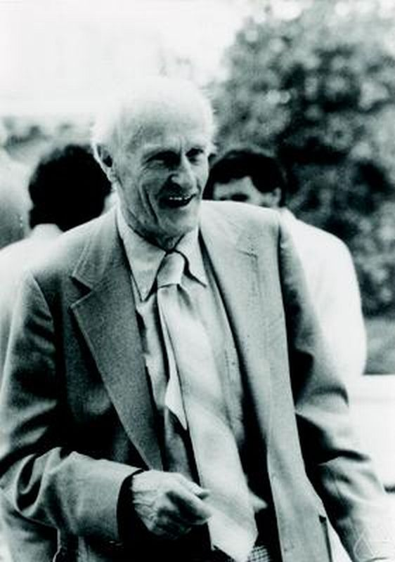
Relational Data and Logic
Lise Getoor
David Poole
Stuart Russsell
Stephen Kleene
Poole, D. (2003), First-order probabilistic inference, 'IJCAI’. Getoor, L. & Grant, J. (2006), 'PRL: A probabilistic relational language', Machine Learning 62(1-2), 7-31.
Russell, S. & Norvig, P. (2010), Artificial Intelligence: A Modern Approach, Prentice Hall.
Stephen Kleene, (1952). Introduction to Metamathematics.
Notes:
There are different formalisms for describing relational data and relational models. I follow the approach developed by Poole, Russell Getoor. The learning algorithms work for others as well. Basically, for any formalism based on first-order logic.

Slide 6
First-Order Logic
An expressive formalism for specifying relational conditions.
database theory
relational learning
First-Order Logic
Query language
Pattern Language
Notes:
Remind them that I use equational logic

Slide 7
First-Order Logic: Terms
A constant refers to an individual
“Fargo”
A first-order variable refers to a class of individuals
“Movie” refers to Movies
Terms
A constant or first-order variable is a term.
The result of applying a functor to a term is a term.
contains first-order variables?
first-order term e.g. salary(Actor, Movie)
ground term e.g. salary(UmaThurman, Fargo)
Notes:
could also build nested terms
values of ground terms are the smallest unit of information
fundamental split leads to two kinds of probabilities.
First-order probabilities are treated in this section
Instance/ground level probabilities are treated in section 5

Slide 8
Relational Random Variables
First-order random variable = First-order term + probabilistic semantics (Wang et al. 2008)
Ground random variable = ground term + probabilistic semantics (Kimmig et al. 2014)
Both complex terms and complex random variables are built by function application
Statistics | Logic
Apply function to random variable(s) ➔ new random variable | Apply function to term(s) ➔ new term
Notes:
One of Kleene’s motivations was to reflect mathematical practice

Slide 9
Formulas
A (conjunctive) formula is a joint assignment term₁ = value₁,...,term_{n}=value_{n}
e.g., ActsIn(Actor, Movie) = T, gender(Actor) = W
A ground formula contains only constants
e.g., ActsIn(UmaThurman, KillBill) = T, gender(UmaThurman) = W
Notes:
The value_i are constants.
Maybe say something about more complex formulas.

Slide 10
Notation
We use standard notation for relational random variables.
Concept | Notation
First-order random variable | X, X_{i}
Ground-random variable | X*
k-th value of random variable | x_{k}, x_{ik}
Parents of node i | Pa_{i}
j-th configuration of node i’s parents | pa_{ij}

Slide 11
Relational Frequencies
Probabilistic Semantics for First-Order Random Variables

Slide 12
Applications of Relational Frequency Modelling
Knowledge discovery/ rule learning “women users like movies with women actors”
Strategic Planning “increase SAT requirements to decrease student attrition”
Query Optimization (Getoor, Taskar, Koller 2001) Class-level queries support selectivity estimation ➔ optimal evaluation order for SQL query

Slide 13
Relational Frequencies
Database probability of a first-order formula = number of satisfying instantiations/ number of possible instantiations
Examples:
P_{D}(gender(Actor) = W) = 2/4
P_{D}(gender(Actor) = W, ActsIn(Actor,Movie) = T) = 2/8

Slide 14
The Grounding Table
P(gender(Actor) = W, ActsIn(Actor,Movie) = T) = 2/8
frequency = #of rows where the formula is true/# of all rows
Logical Variable
Single data table that correctly represents relational joint frequencies Schulte (2011), Riedel, Yao, McCallum (2013)
Actor | Movie | gender(Actor) | ActsIn(Actor,Movie)
Brad_Pitt | Fargo | M | F
Brad_Pitt | Kill_Bill | M | F
Lucy_Liu | Fargo | W | F
Lucy_Liu | Kill_Bill | W | T
Steve_Buscemi | Fargo | M | T
Steve_Buscemi | Kill_Bill | M | F
Uma_Thurman | Fargo | W | F
Uma_Thurman | Kill_Bill | W | T
Notes:
single data table that correctly represents relational frequencies
Riedel, S.; Yao, L.; McCallum, A. & Marlin, B. M. (2013), Relation Extraction with Matrix Factorization and Universal Schemas, in 'Human Language Technologies-NAACL', pp. 74--84.
Schulte, O. (2011), A tractable pseudo-likelihood function for Bayes Nets applied to relational data, in 'SIAM SDM', pp. 462-473.
Raedt, L. D. (1998), Attribute-Value Learning Versus Inductive Logic Programming: The Missing Links (Extended Abstract), in David Page, ed., 'ILP', Springer, , pp. 1-8

Slide 15

Random Selection Semantics
Logical Variable ➔ Random Variable
Prob | Actor | Movie | gender(Actor) | ActsIn(Actor,Movie)
1/8 | Brad_Pitt | Fargo | M | F
1/8 | Brad_Pitt | Kill_Bill | M | F
1/8 | Lucy_Liu | Fargo | W | F
1/8 | Lucy_Liu | Kill_Bill | W | T
1/8 | Steve_Buscemi | Fargo | M | T
1/8 | Steve_Buscemi | Kill_Bill | M | F
1/8 | Uma_Thurman | Fargo | W | F
1/8 | Uma_Thurman | Kill_Bill | W | T
P(Movie = Fargo, Actor=Brad_Pitt) =1/2 x 1/4 = 1/8
Notes:
Population Variables are uniformly and independently distributed

Slide 16

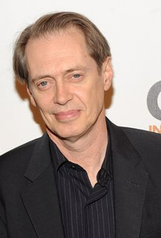

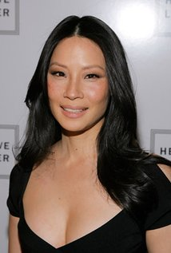


Random Selection Semantics
Population Actors
Population variables
First-Order Random Variables
Actor Random Selection from Actors. P(Actor = brad_pitt) = 1/4
gender(Actor) Gender of selected actor. P(gender(Actor) = W) = 1/2
ActsIn(Actor,Movie) = T if selected actor appears in selected movie, F otherwise P(ActsIn(Actor,Movie) = T) = 3/8
Movies
Movie Random Selection from Movies. P(Movie = Fargo) = 1/2
Drama(Movie) Is the selected movie a drama? P(Drama(Movie)=T) = 1/2
Notes:
probabilities are examples

Slide 17
Bayesian Network Models for Relational Statistics
Statistical-Relational Models (SRMs) Random Selection Semantics for Bayesian Networks

Slide 18
Bayesian networks for relational data
A first-order Bayesian network is a Bayesian network whose nodes are first-order terms
(Wang et al. 2008)
AKA parametrized Bayesian network (Poole 2003, Kimmig et al. 2014)
gender(A)
Drama(M)
ActsIn(A,M)
Notes:
Bayesian networks are close to rules (Kersting and deRaedt)
parametrized BNs not a frequency model
Demo.
First-order Random variables = terms.

Slide 19
Random Selection Semantics for First-Order Bayesian Networks
P(gender(Actor) = W, ActsIn(Actor,Movie) = T, Drama(Movie) = F) = 2/8
“if we randomly select an actor and a movie, the probability is 2/8 that the actor appears in the movie, the actor is a woman, and the movie is a drama”
gender(A)
Drama(M)
ActsIn(A,M)
Notes:
Random or typical or normal individuals

Slide 20
IMDb Data Format
data with two relationships

Slide 21
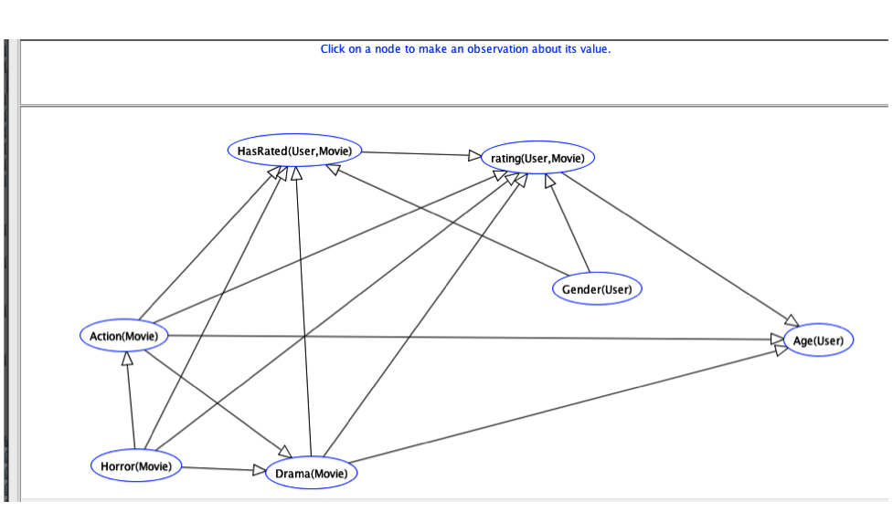
Learned Bayes Net for IMDb
With 1 relationship HasRated(User,Movie).
Notes:
IMDb_1R.xml

Slide 22
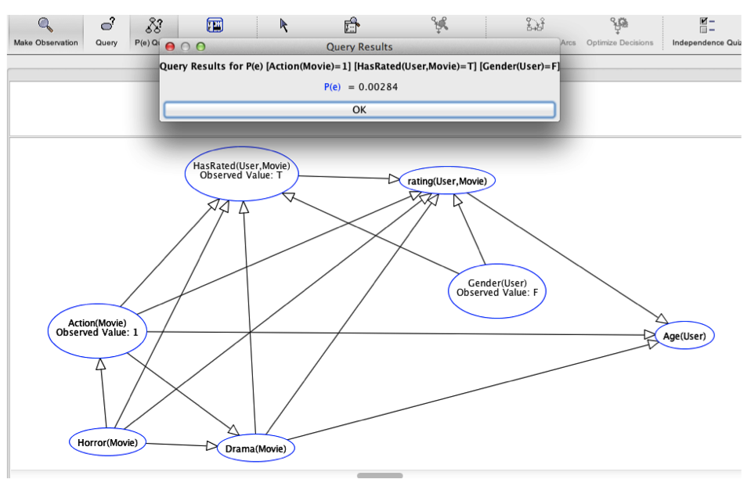
Bayes Net Query
Notes:
todo: would be nice to make this W instead of F.

Slide 23
Data Query
Num Movies | 3883
Num Users | 6039
Num Movie-User Pairs | 3883 x 6039 = 23449437
movie-user pairs with action movie, woman user
Action(Movie) = T, HasRated(User,Movie) = T, gender(User) = W | 66642
Frequency | 66642/23449437= 0.0028
More Examples in spreadsheet on website

Slide 24
Mondial Data Format

Slide 25
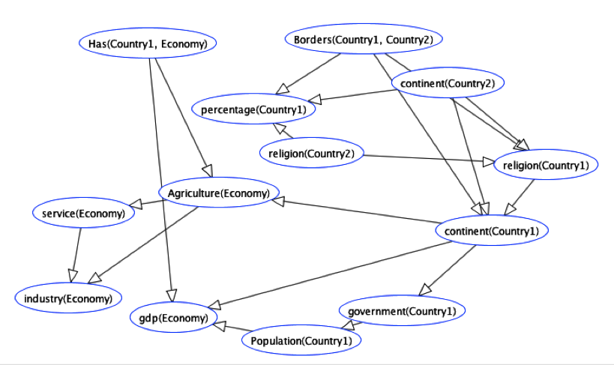
Learned Bayes Net for Mondial
Notes:
Mondial.xml

Slide 26
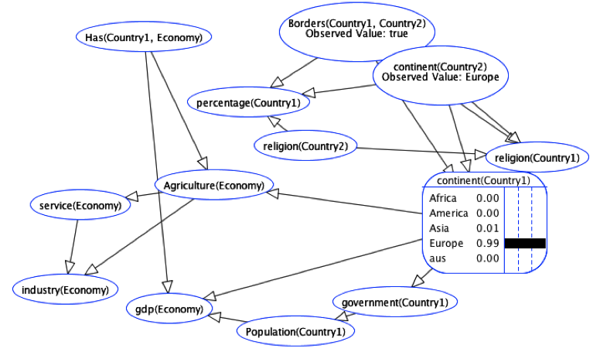
Bayes Net query
Notes:
Mondial.xml

Slide 27
Data Query
Num Movies | 3883
Num Users | 6039
Num Movie-User Pairs | 3883 x 6039 = 23449437
movie-user pairs with action movie, woman user
Action(Movie) = T, HasRated(User,Movie) = T, gender(User) = W | 66642
Frequency | 66642/23449437= 0.0028
More Examples in spreadsheet on website

Slide 28
Data Query
Number of Europe-Europe Borders | 124
Number of *-Europe Borders | 126
P(continent(country1) = Eu|Borders(country1,country2) = T,continent(country2=Eu)) | 124/126= 98.41%
More Examples in spreadsheet on website
Notes:
exercise: query what the probability is of a country being in America given that it has a neighbour in America?

Slide 29
Bayesian Networks are Excellent Estimators of Relational Frequencies
Queries Randomly Generated
Example: P(gender(A) = W|ActsIn(A,M) = true, Drama(M)=T)?
Learn Bayesian network and test on entire database as in Getoor et al. 2001

Slide 30
Summary: Relational Frequencies
The frequency of a conjunctive formula in a possible world = number of satisfying instantiations/ number of possible instantiations.
First-order Bayesian networks represent frequencies of conjunctive formulas very well.
visualize correlations
answer frequency queries using BN inference, not data access

