Slide 1
DESIGN A NOTIFICATION SYSTEM
A notification alerts a user with important information like breaking news, product updates, events, offerings, etc.
Three types of notification formats are: mobile push notification, SMS message, and Email.
Notes:
Notifications are indispensable because they keep us posted with important information. It
could be a push notification about your favorite movie on Netflix, an email about discounts
on new products, or a message about your online shopping payment confirmation.

Slide 2
Step 1 - Understand the problem and establish design scope
1: What types of notifications does the system support? ➔Push notification, SMS message, and email.
2: Is it a real-time system? ➔Let us say it is a soft real-time system. We want a user to receive notifications as soon as possible. However, if the system is under a high workload, a slight delay is acceptable.
3: What are the supported devices? ➔ iOS devices, android devices, and laptop/desktop.
4:What triggers notifications ?➔Notifications can be triggered by client applications. They can also be scheduled on the server-side.
5: Will users be able to opt-out?➔Yes, users who choose to opt-out will no longer receive notifications.
6: How many notifications are sent out each day?➔ 10 million mobile push notifications, 1 million SMS messages, and 5 million emails.

Slide 3
Step 2 - Propose high-level design and get buy-in
• Different types of notifications
• Contact info gathering flow
• Notification sending/receiving flow

Slide 4
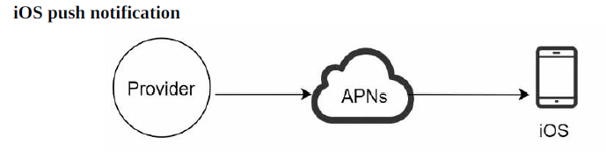
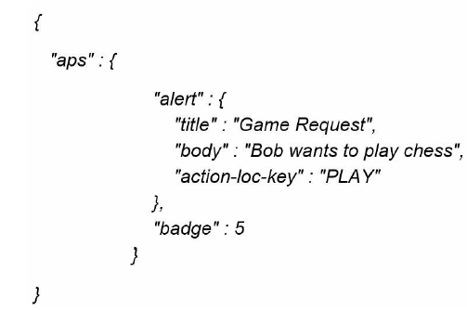
Different types of notifications
APNS: Apple Push Notification Service This is a remote service provided by Apple to propagate push notifications to iOS devices.
Provider. A provider builds and sends notification requests to APNS. To construct a push notification, the provider provides the following data:
1: Device token: This is a unique identifier used for sending push notifications.
2: Payload: This is a JSON dictionary that contains a notification’s payload.

Slide 5
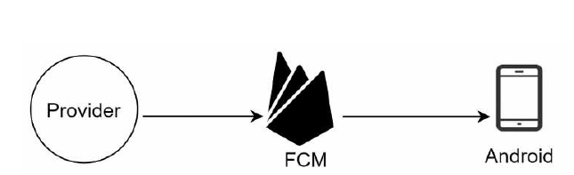
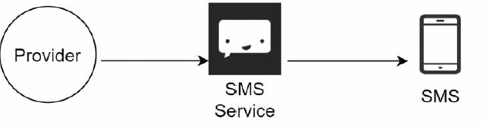
Different types of notifications
Firebase Cloud Messaging
(FCM) is commonly used to send push notifications to android devices.
For SMS messages, third party SMS services like Twilio [1], Nexmo [2], and many others are commonly used. Most of them are commercial services.

Slide 6
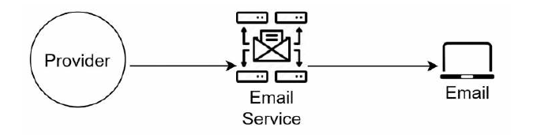
Different types of notifications
Although companies can set up their own email servers, many of them opt for commercial
email services. Sendgrid [3] and Mailchimp [4] are among the most popular email services,
which offer a better delivery rate and data analytics.

Slide 7
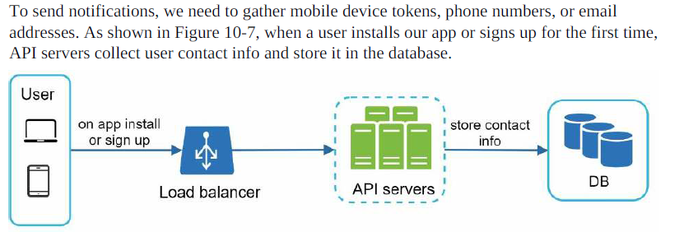
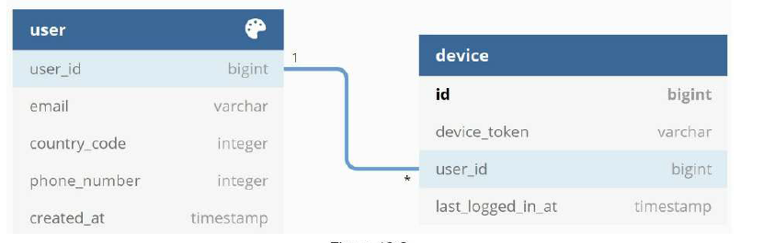
Contact info gathering flow

Slide 8
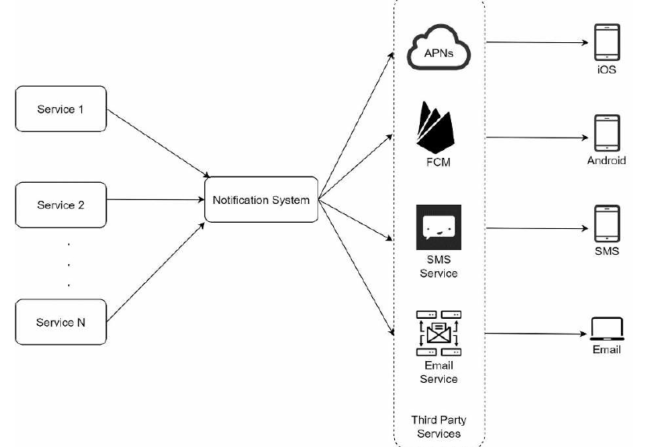
Notification sending/receiving flow
Notes:
1: Notification System provides APIs for services 1 to N, and builds notification payloads for third party services. 2: A third-party service might be unavailable in new markets or in the future. For instance, FCM is unavailable in China. Thus, alternative third-party services such as Jpush, PushY, etc are used there.

Slide 9
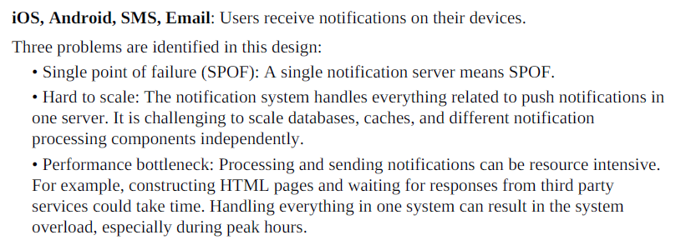

Slide 10
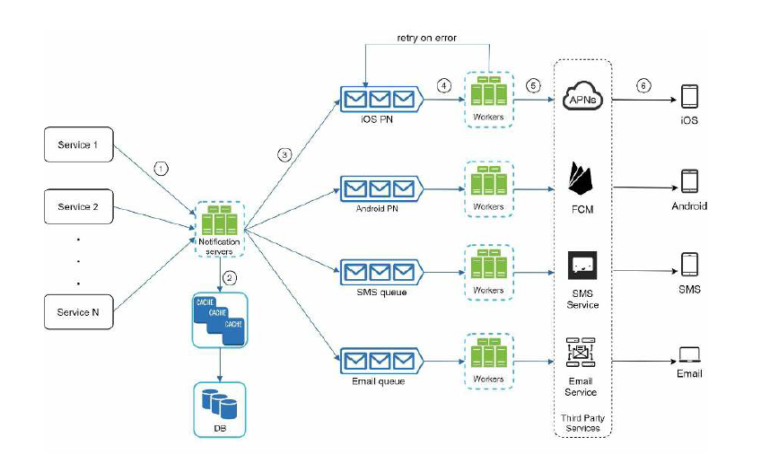
High-level design (improved)
Notes:
1. A service calls APIs provided by notification servers to send notifications.
2. Notification servers fetch metadata such as user info, device token, and notification setting from the cache or database.
3. A notification event is sent to the corresponding queue for processing. For instance, an iOS push notification event is sent to the iOS PN queue.
4. Workers pull notification events from message queues.
5. Workers send notifications to third party services.
6. Third-party services send notifications to user devices.

Slide 11
Step 3 - Design deep dive
• Reliability.
• Additional component and considerations: notification template, notification settings, rate limiting, retry mechanism, security in push notifications, monitor queued notifications and event tracking.
• Updated design.

Slide 12
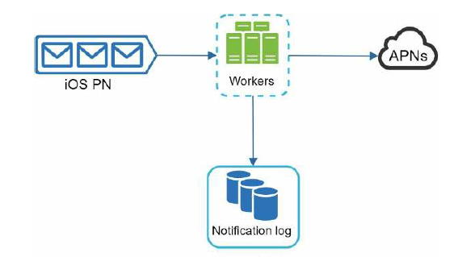
How to prevent data loss?
Notifications can usually be delayed or re-ordered, but never lost. To satisfy this requirement, the notification system persists notification data in a database and implements a retry mechanism. The notification log database is included for data persistence, as shown in Figure

Slide 13
Will recipients receive a notification exactly once?
When a notification event first arrives, we check if it is seen before by checking the event ID.
If it is seen before, it is discarded. Otherwise, we will send out the notification. For interested readers to explore why we cannot have exactly once delivery, refer to the reference material
Notes:
In a distributed system, we try to guarantee the delivery of a message by waiting for an acknowledgement that it was received, but all sorts of things can go wrong. Did the message get dropped? Did the ack get dropped? Did the receiver crash? Are they just slow? Is the network slow? Am I slow?

Slide 14
Additional components and considerations
template reusing, notification settings, event tracking, system monitoring, rate limiting, etc.

Slide 15
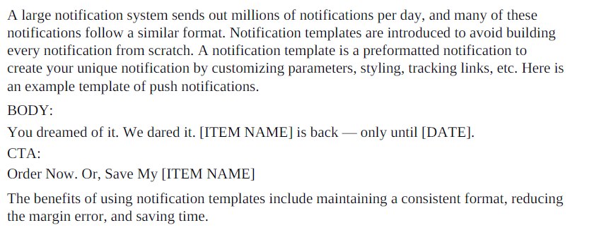
Template reusing

Slide 16
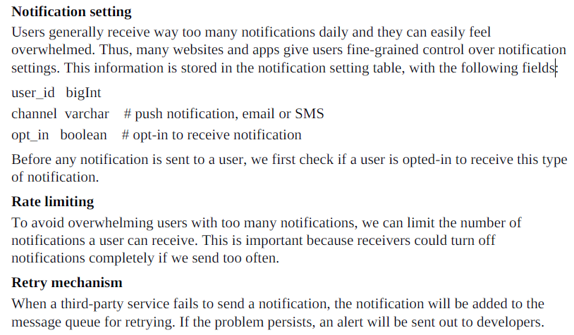

Slide 17
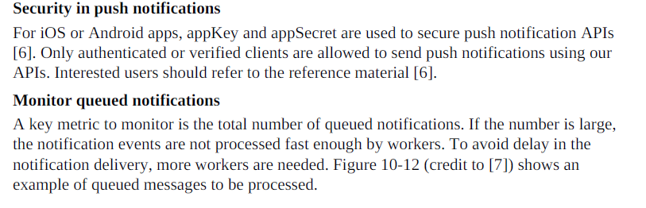
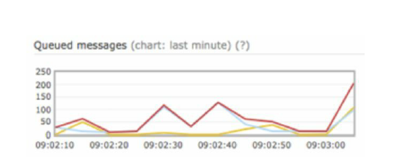

Slide 18
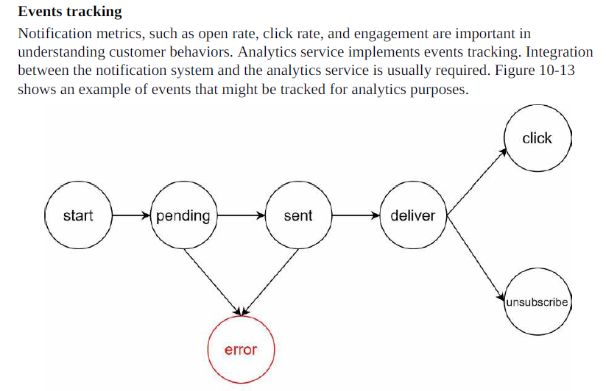

Slide 19
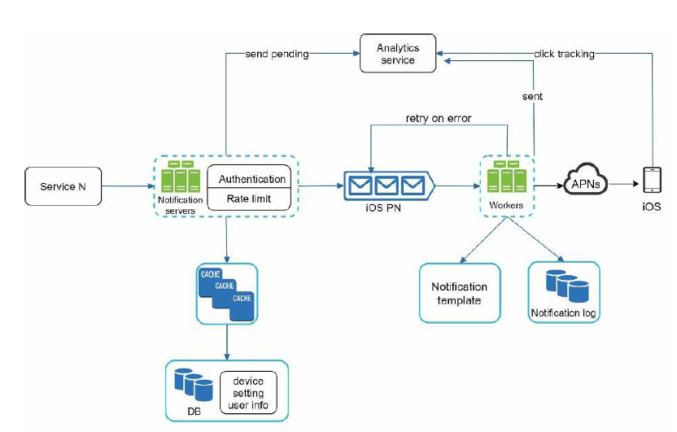
Updated design

Slide 20
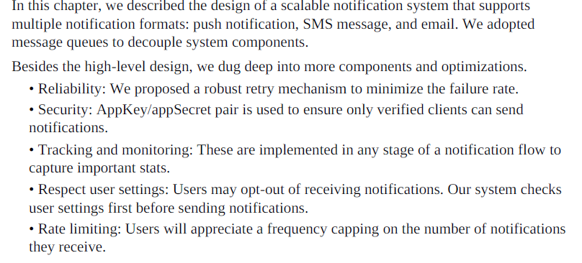
Step 4 - Wrap up

