Slide 1
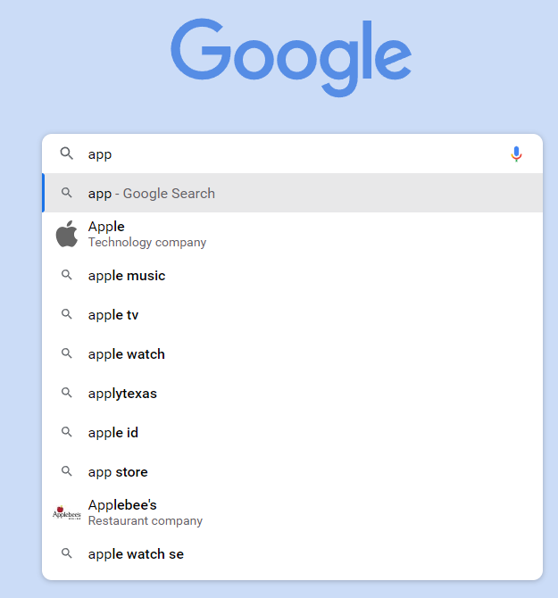
DESIGN A SEARCH AUTOCOMPLETE SYSTEM

Slide 2
Typeahead.js 是 Twitter 开源的一个前端插件支持输入一个前缀后，返回匹配这个前缀的 items
Google Suggestion 是搜索时提供的 Query 建议 是一个后端的系统
Design top k most searched queries
Is the matching only supported at the beginning of a search query or in the middle as well?
How many autocomplete suggestions should the system return?
How does the system know which 5 suggestions to return?
How many users use the product?
Fast response time；Relevant；Sorted；Scalable；Highly available
• ~24,000 query per second (QPS) = 10,000,000 users * 10 queries / day * 20 characters /
24 hours / 3600 seconds.
• Peak QPS = QPS * 2 = ~48,000
• Assume 20% of the daily queries are new. 10 million * 10 queries / day * 20 byte per
query * 20% = 0.4 GB. This means 0.4GB of new data is added to storage daily.

Slide 3
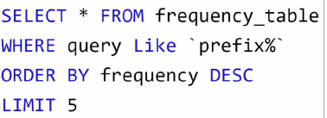
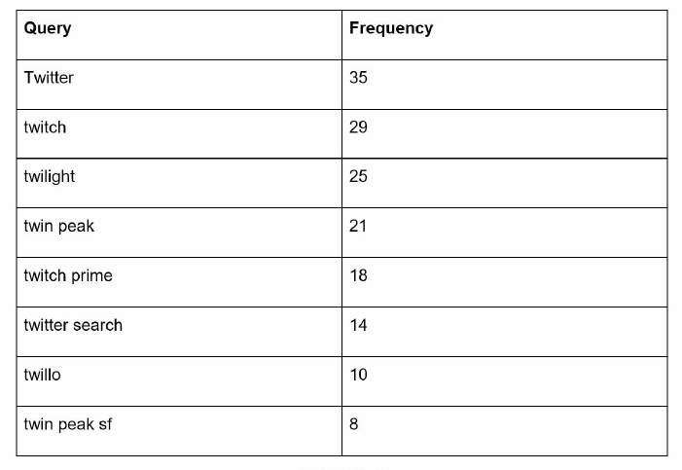

Slide 4
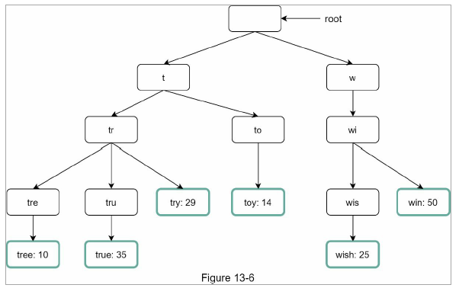
Trie data structure

Slide 5
Step 1: Find the prefix node “tr”.
Step 2: Traverse the subtree to get all valid children. In this case, nodes [tree: 10], [true: 35], [try: 29] are valid.
Step 3: Sort the children and get top 2. [true: 35] and [try: 29] are the top 2 queries with prefix “tr”.
O(p) + O(c) + O(clogc)
p: length of a prefix; c: number of children of a given node
1. Limit the max length of a prefix
2. Cache top search queries at each node

Slide 6
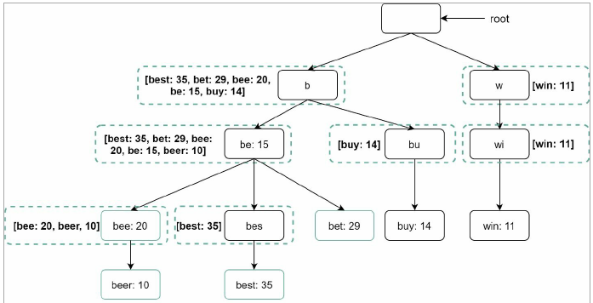

Slide 7
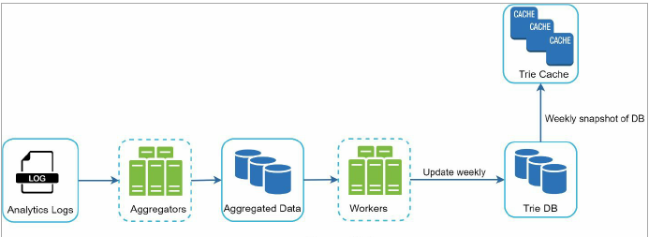
Data gathering service

Slide 8
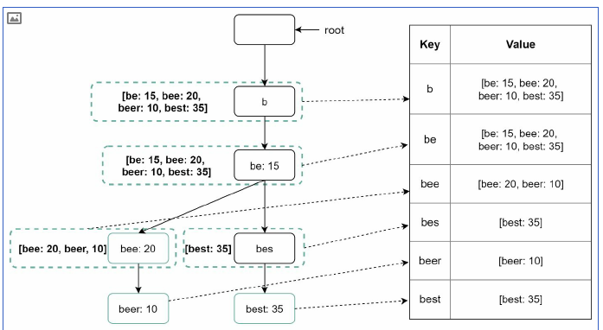
Document store + Key-value store

Slide 9
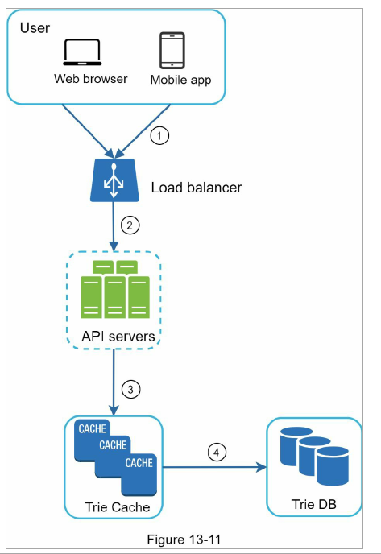

Slide 10
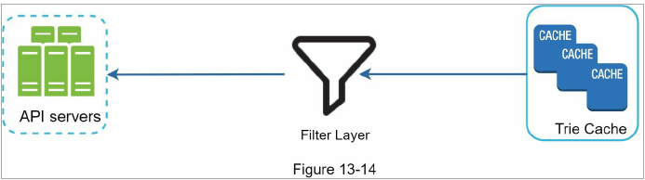
optimizations:
AJAX request: does not refresh the whole web page
Browser caching: “max-age=3600” means the cache is valid for 3600 seconds, aka, an hour.
Data sampling: if get_random(10000) == 0
Filter:

Slide 11
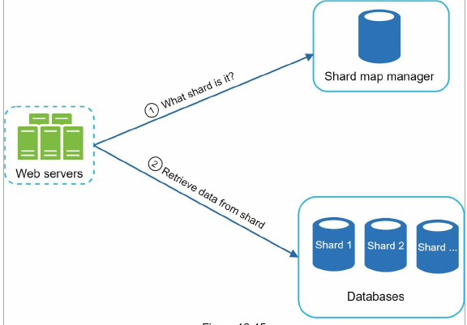
Sharding data imbalance：we can maintain two shards: one for ‘s’ and one for ‘u’ to ‘z’.

Slide 12
用户输入速度很快怎么办？
在 frontend 设置一个 delay 当用户停止输入超过 200ms 时，才发送请求
预加载 Pre-fetch
如用户在输入 ap 以后，极有可能想要搜索的是以 app 开头的 query
因此可以假设用户之后会输入 app 的情况下先将 app 的 top 10 queries 也一起返回到前端并 cache 起来
CDN

