Slide 1
Partitioning
Partition called a shard in MongoDB, Elasticsearch, and SolrCloud; region in HBase, a tablet in Bigtable, a vnode in Cassandra and Riak, and a vBucket in Couchbase
You have so much data a single machine is no longer feasible
The goal of partitioning is to spread the data and query load evenly across multiple machines, avoiding hot spots.

Slide 2
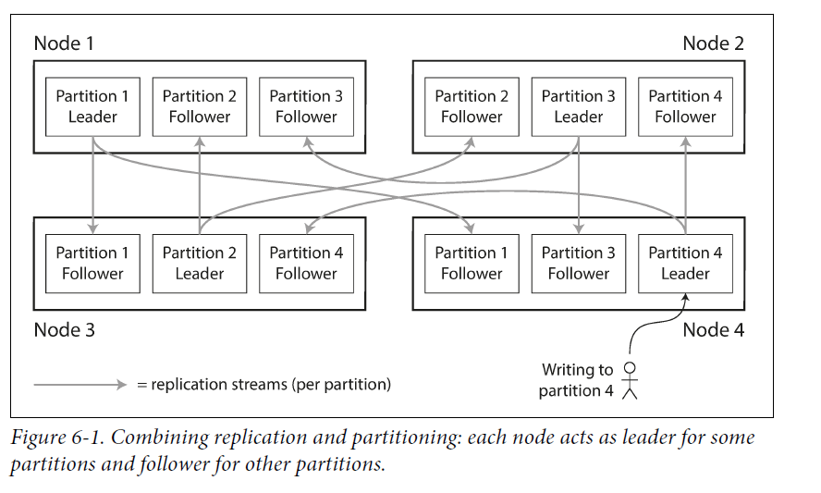
Partitioning is usually combined with replication so that copies of each partition are stored on multiple nodes.

Slide 3
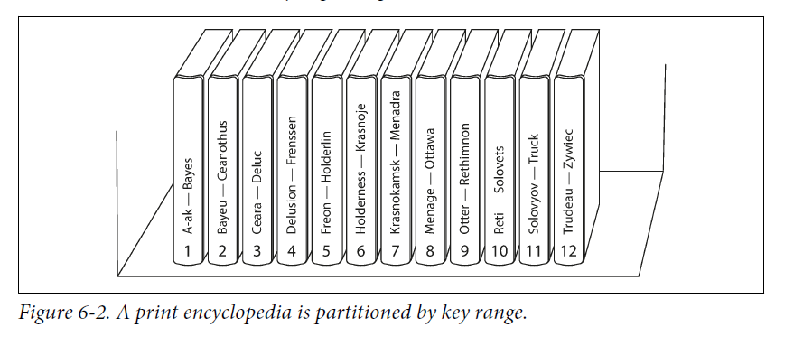
1: Partitioning by Key Range

Slide 4
The ranges of keys are not necessarily evenly spaced, because your data may not be evenly distributed.
Manually or automatically
Within each partition, we can keep keys in sorted order
However, certain access patterns can lead to hot spots.(like timestamp)
Example: You can prefix each timestamp with the sensor name

Slide 5
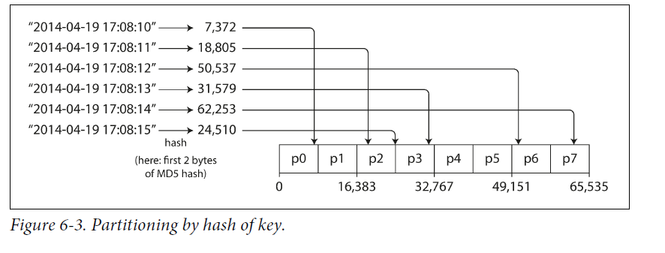
2: Partitioning by Hash of Key
Because of this risk of skew and hot spots, many distributed datastores use a hash function to determine the partition for a given key.
Consistent hashing actually doesn’t work very well for databases, so it is rarely used in practice.
However, by using the hash of the key for partitioning we lose a nice property of key-range partitioning: the ability to do efficient range queries.

Slide 6
Skewed Workloads and Relieving Hot Spots
Hashing a key still have cases where all reads and writes are for the same key.
A celebrity user with millions of followers may cause a storm of activity when they do something.(明星效应)
Can add a random number to the beginning or end of the hot key. But reads now have to do additional work to combine it.

Slide 7
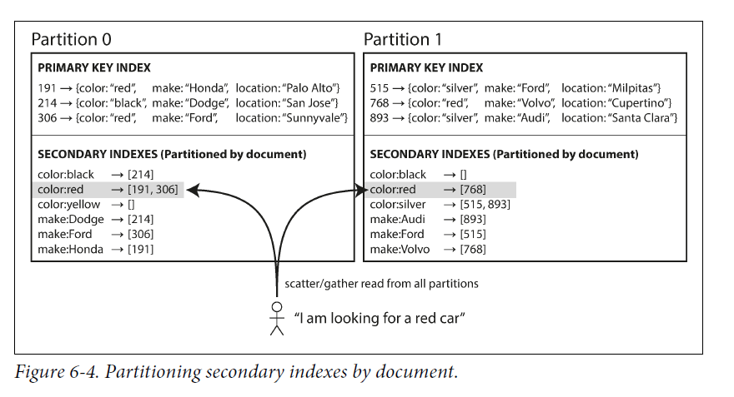
Partitioning and Secondary Indexes
1: Partitioning Secondary Indexes by Document

Slide 8
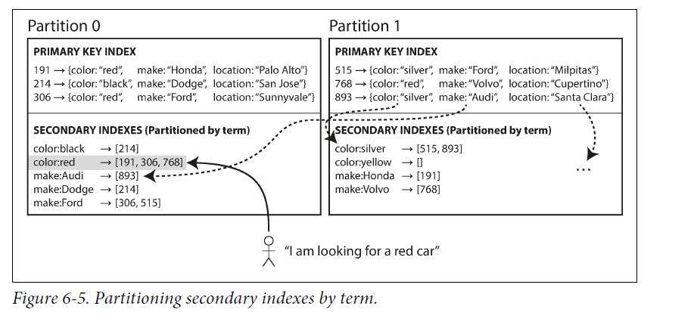
2: Partitioning Secondary Indexes by Term
Rather than each partition having its own secondary index (a local index), we can construct a global index that covers data in all partitions. global index must also be partitioned, but it can be partitioned differently from the primary key index.

Slide 9
Rebalancing Partitions
The query throughput increases.
The dataset size increases.
A machine fails.
The load be shared fairly between the nodes in the cluster.
While rebalancing is happening, the database should continue accepting reads and writes.(Kafka?)

Slide 10
Strategies for Rebalancing
Fixed number of partitions. Create many more partitions than there are nodes, and assign several partitions to each node.
Dynamic partitioning. Good for both key range–partitioned data and hash-partitioned data.
Partitioning proportionally to nodes
Operations: Automatic or Manual Rebalancing

Slide 11
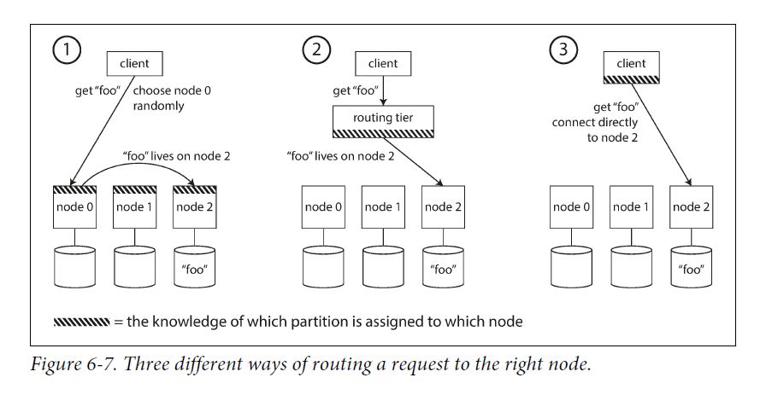
Request Routing
When a client wants to make a request, how does it know which node to connect to?

Slide 12
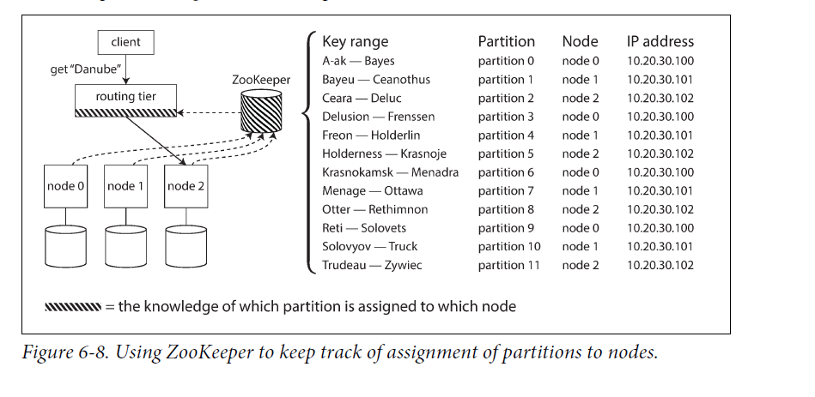
Many distributed data systems rely on a separate coordination service such as Zoo‐ Keeper to keep track of metadata

