Slide 1
DESIGN A WEB CRAWLER

Slide 2
It is widely used by search engines to discover new or updated content on the web. Content can be a web page, an image, a video, a PDF file, etc. A web crawler starts by collecting a few web pages and then follows links on those pages to collect new content.

Slide 3
A crawler is used for many purposes:
1, Search engine indexing: This is the most common use case. A crawler collects web pages to create a local index for search engines. For example, Googlebot is the web crawler behind the Google search engine.
2, Web archiving: This is the process of collecting information from the web to preserve data for future uses. For instance, many national libraries run crawlers to archive web sites. Notable examples are the US Library of Congress [1] and the EU web archive [2].
3, Web mining: The explosive growth of the web presents an unprecedented opportunity for data mining. Web mining helps to discover useful knowledge from the internet. For example, top financial firms use crawlers to download shareholder meetings and annual
reports to learn key company initiatives.
4,Web monitoring. The crawlers help to monitor copyright and trademark infringements
over the Internet. For example, Digimarc [3] utilizes crawlers to discover pirated works
and reports.
The complexity of developing a web crawler depends on the scale we intend to support

Slide 4
Step 1 - Understand the problem and establish design scope
1: What is the main purpose of the crawler? Is it used for search engine indexing,
data mining, or something else? ➔Search engine indexing.
2: How many web pages does the web crawler collect per month?➔ 1 billion pages.
3: What content types are included? HTML only or other content types such as
PDFs and images as well?➔HTML only.
4: Shall we consider newly added or edited web pages?➔ Yes, we should consider the newly added or edited web pages.
5: Do we need to store HTML pages crawled from the web?➔ Yes, up to 5 years
6: How do we handle web pages with duplicate content?➔ Pages with duplicate content should be ignored.

Slide 5
Understand the requirements and establish design scope
• Scalability: The web is very large. There are billions of web pages out there. Web crawling should be extremely efficient using parallelization.
• Robustness: The web is full of traps. Bad HTML, unresponsive servers, crashes, malicious links, etc. are all common. The crawler must handle all those edge cases.
• Politeness: The crawler should not make too many requests to a website within a short time interval.
• Extensibility: The system is flexible so that minimal changes are needed to support new content types. For example, if we want to crawl image files in the future, we should not need to redesign the entire system.

Slide 6
Assume 1 billion web pages are downloaded every month.
• QPS: 1,000,000,000 / 30 days / 24 hours / 3600 seconds = ~400 pages per second.
• Peak QPS = 2 * QPS = 800
• Assume the average web page size is 500k.
• 1-billion-page x 500k = 500 TB storage per month. If you are unclear about digital wstorage units, go through “Power of 2” section in Chapter 2 again.
• Assuming data are stored for five years, 500 TB * 12 months * 5 years = 30 PB. A 30 PB storage is needed to store five-year content.

Slide 7
Step 2 - Propose high-level design and get buy-in
Notes:
A web crawler uses seed URLs as a starting point for the crawl process
whatismyip.com/dns-lookup/

Slide 8
Seed URLs A web crawler uses seed URLs as a starting point for the crawl process. To crawl the entire web: a). The general strategy is to divide the entire URL space into smaller ones. The first proposed approach is based on locality as different countries may have different popular websites. b). Another way is to choose seed URLs based on topics; for example, we can divide URL space into shopping, sports, healthcare, etc.
Seed URL selection is an open-ended question. You are not expected to give the perfect answer. Just think out loud.

Slide 9
URL Frontier
Most modern web crawlers split the crawl state into two: to be downloaded (URL Frontier) and already downloaded.
HTML Downloader
The HTML downloader downloads web pages from the internet. Those URLs are provided by the URL Frontier.
DNS Resolver
To download a web page, a URL must be translated into an IP address. The HTML Downloader calls the DNS Resolver to get the corresponding IP address for the URL.

Slide 10
Content Parser After a web page is downloaded, it must be parsed and validated because malformed web pages could provoke problems and waste storage space. Implementing a content parser in a crawl server will slow down the crawling process. Thus, the content parser is a separate component. Content Seen? It helps to detect new content previously stored in the system.
How to compare two HTML documents? we can compare them character by character. Or hash values of the two web pages

Slide 11
Content Storage It is a storage system for storing HTML content. The choice of storage system depends on factors such as data type, data size, access frequency, life span, etc. Both disk and memory are used.
• Most of the content is stored on disk because the data set is too big to fit in memory.
• Popular content is kept in memory to reduce latency.

Slide 12
URL Extractor
URL Extractor parses and extracts links from HTML pages. Figure 9-3 shows an example of a link extraction process. Relative paths are converted to absolute URLs by adding the “https://en.wikipedia.org” prefix.

Slide 13
URL Filter The URL filter excludes certain content types, file extensions, error links and URLs in “blacklisted” sites.
URL Seen?
“URL Seen?” is a data structure that keeps track of URLs that are visited before or already in the Frontier.
How to check? URL Storage
URL Storage stores already visited URLs.
Notes:
Bloom filter and hash table are common techniques to implement the “URL Seen?” component

Slide 14
Web crawler workflow

Slide 15
Step 3 - Design deep dive
• Depth-first search (DFS) vs Breadth-first search (BFS)
• URL frontier
• HTML Downloader
• Robustness
• Extensibility
• Detect and avoid problematic content

Slide 16
DFS vs BFS
Impolite :When the crawler tries to download web pages in parallel, Wikipedia servers will be flooded with requests
Does not take the priority of a URL into consideration. we may want to prioritize URLs according to their page ranks, web traffic, update frequency, etc.

Slide 17
URL frontier
The URL frontier is an important component to ensure politeness,URL prioritization, and freshness
Sending too many requests is considered as “impolite” or even treated as denial-of-service (DOS) attack.
Politeness
The general idea of enforcing politeness is to download one page at a time from the same
host. A delay can be added between two download tasks.

Slide 18
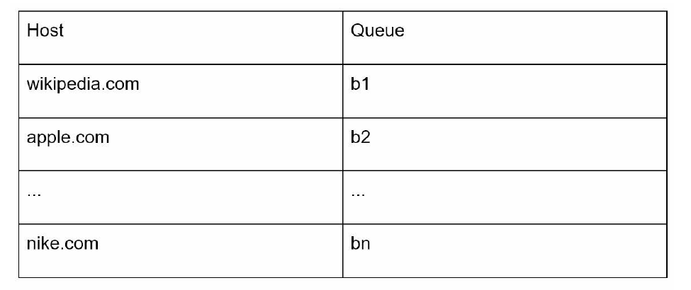
• Queue router: It ensures that each queue (b1, b2, … bn) only contains URLs from the same host.
Mapping table: It maps each host to a queue.
• FIFO queues b1, b2 to bn: Each queue contains URLs from the same host.
• Queue selector: Each worker thread is mapped to a FIFO queue, and it only downloads URLs from that queue. The queue selection logic is done by the Queue selector.
• Worker thread 1 to N. A worker thread downloads web pages one by one from the same host. A delay can be added between two download tasks.

Slide 19
Priority
We prioritize URLs based on usefulness, which can be measured by PageRank [10], website traffic, update frequency, etc. “Prioritizer” is the component that handles URL prioritization
• Prioritizer: It takes URLs as input and computes the priorities.
• Queue f1 to fn: Each queue has an assigned priority. Queues with high priority are selected with higher probability.
• Queue selector: Randomly choose a queue with a bias towards queues with higher priority.

Slide 20
• Front queues: manage prioritization
• Back queues: manage politeness

Slide 21
Freshness
Web pages are constantly being added, deleted, and edited. A web crawler must periodically recrawl downloaded pages to keep our data set fresh. Recrawl all the URLs is timeconsuming and resource intensive. Few strategies to optimize freshness are listed as follows:
• Recrawl based on web pages’ update history.
• Prioritize URLs and recrawl important pages first and more frequently.

Slide 22
Storage for URL Frontier
In real-world crawl for search engines, the number of URLs in the frontier could be hundreds of millions
The majority of URLs are stored on disk, so the storage space is not a problem. To reduce the cost of reading from the disk and writing to the disk, we maintain buffers in memory for enqueue/dequeue operations. Data in the buffer is periodically written to the disk.

Slide 23
HTML Downloader
The HTML Downloader downloads web pages from the internet using the HTTP protocol. Before discussing the HTML Downloader, we look at Robots Exclusion Protocol first.
Robots.txt, called Robots Exclusion Protocol, is a standard used by websites to communicIt specifies what pages crawlers are allowed to download. Before attempting to crawl a web site, a crawler should check its corresponding robots.txt first and follow its rules.ate with crawlers.
To avoid repeat downloads of robots.txt file, we cache the results of the file. The file is downloaded and saved to cache periodically.
Notes:
https://www.youtube.com/robots.txt

Slide 24
Besides robots.txt, performance optimization is another important concept we will cover for the HTML downloader. Performance optimization 1. Distributed crawl 2. Cache DNS Resolver 3. Locality 4. Short timeout
To achieve high performance, crawl jobs are distributed into multiple servers, and each server
runs multiple threads. The URL space is partitioned into smaller pieces; so, each downloader
is responsible for a subset of the URLs.

Slide 25
2. Cache DNS Resolver
DNS Resolver is a bottleneck for crawlers because DNS requests might take time due to the synchronous nature of many DNS interfaces. DNS response time ranges from 10ms to 200ms. Once a request to DNS is carried out by a crawler thread, other threads are blocked until the first request is completed. Maintaining our DNS cache to avoid calling DNS frequently is an effective technique for speed optimization. Our DNS cache keeps the domain name to IP address mapping and is updated periodically by cron jobs.

Slide 26
3. Locality
Distribute crawl servers geographically. When crawl servers are closer to website hosts, crawlers experience faster download time. Design locality applies to most of the system components: crawl servers, cache, queue, storage, etc.
4. Short timeout
Some web servers respond slowly or may not respond at all. To avoid long wait time, a maximal wait time is specified. If a host does not respond within a predefined time, the crawler will stop the job and crawl some other pages

Slide 27
Robustness
• Consistent hashing: This helps to distribute loads among downloaders. A new downloader server can be added or removed using consistent hashing.
• Save crawl states and data: To guard against failures, crawl states and data are written to a storage system. A disrupted crawl can be restarted easily by loading saved states and data.
• Exception handling: Errors are inevitable and common in a large-scale system. The crawler must handle exceptions gracefully without crashing the system.
• Data validation: This is an important measure to prevent system errors.

Slide 28
Extensibility
• PNG Downloader module is plugged-in to download PNG files.
• Web Monitor module is added to monitor the web and prevent copyright and trademark infringements.

Slide 29
Detect and avoid problematic content
1. Redundant content
As discussed previously, nearly 30% of the web pages are duplicates. Hashes or checksums help to detect duplication
2. Spider traps
A spider trap is a web page that causes a crawler in an infinite loop. For instance, an infinite deep directory structure is listed as follows:
www.spidertrapexample.com/foo/bar/foo/bar/foo/bar/…
3. Data noise
Some of the contents have little or no value, such as advertisements, code snippets, spam URLs, etc. Those contents are not useful for crawlers and should be excluded if possible.
Notes:
Such spider traps can be avoided by setting a maximal length for URLs.
It is hard to develop automatic algorithms to avoid spider traps; however, a user can manually
verify and identify a spider trap, and either exclude those websites from the crawler or apply
some customized URL filters.

Slide 30
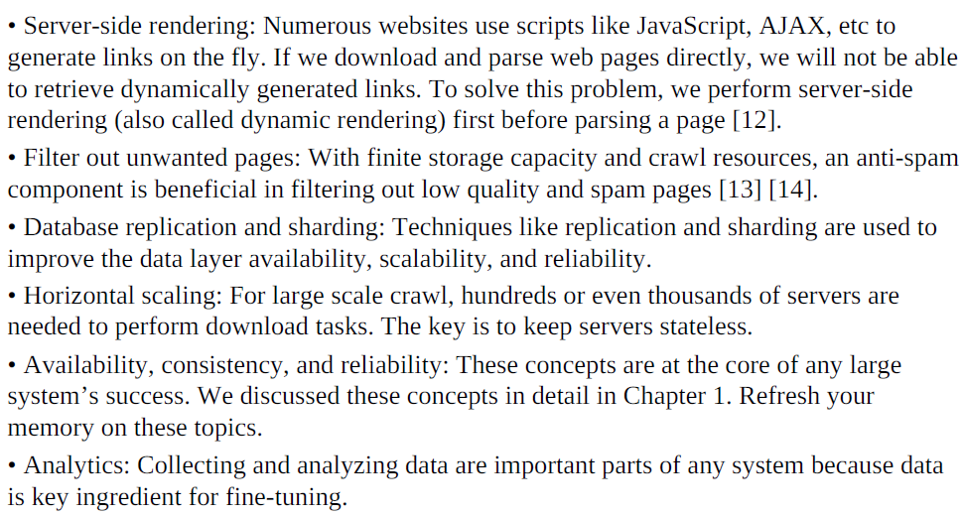
Step 4 - Wrap up
The characteristics of a good crawler: scalability, politeness, extensibility, and robustness.

Slide 31
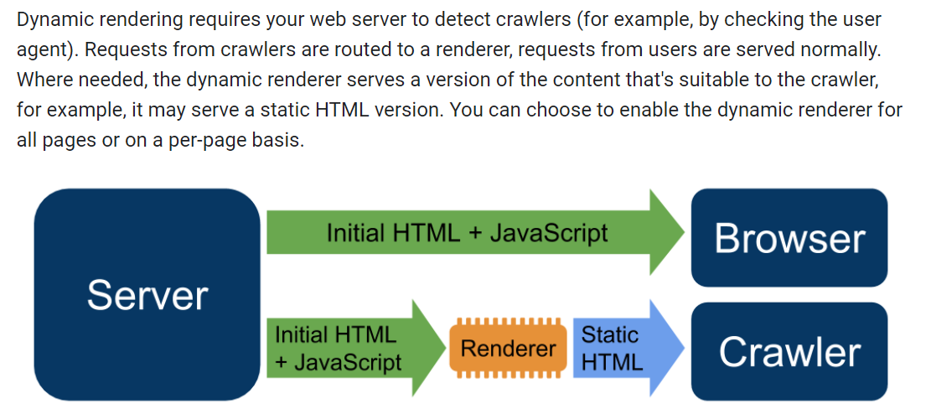
Understand how dynamic rendering works
Notes:
https://developers.google.com/search/docs/crawling-indexing

