Slide 1
CHAPTER 5: DESIGN CONSISTENT HASHING CHAPTER 6: DESIGN A KEY-VALUE STORE

Slide 2
DESIGN CONSISTENT HASHING
To achieve horizontal scaling, it is important to distribute requests/data efficiently and evenly across servers. Consistent hashing is a commonly used technique to achieve this goal.
The rehashing problem
If you have n cache servers, a common way to balance the load is to use the following hash
method:
serverIndex = hash(key) % N, where N is the size of the server pool.

Slide 3
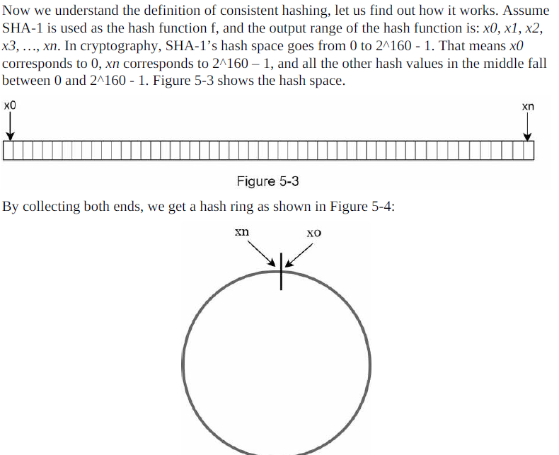
Quoted from Wikipedia: "Consistent hashing is a special kind of hashing such that when a hash table is re-sized and consistent hashing is used, only k/n keys need to be remapped on average, where k is the number of keys, and n is the number of slots. In contrast, in most traditional hash tables, a change in the number of array slots causes nearly all keys to be remapped ”.
Hash space and hash ring

Slide 4
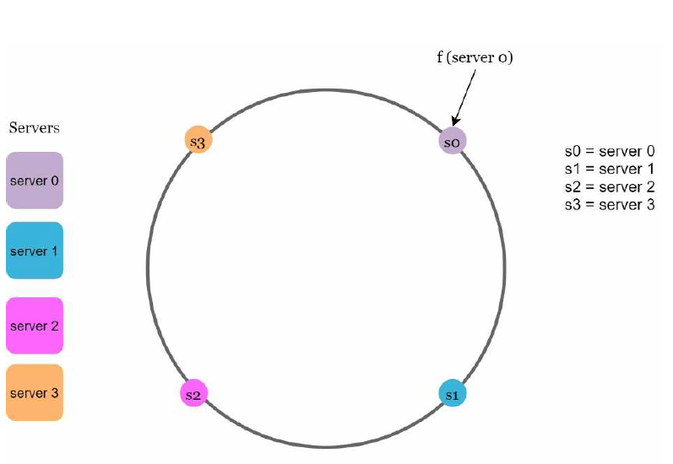
Hash servers Using the same hash function f, we map servers based on server IP or name onto the ring.

Slide 5
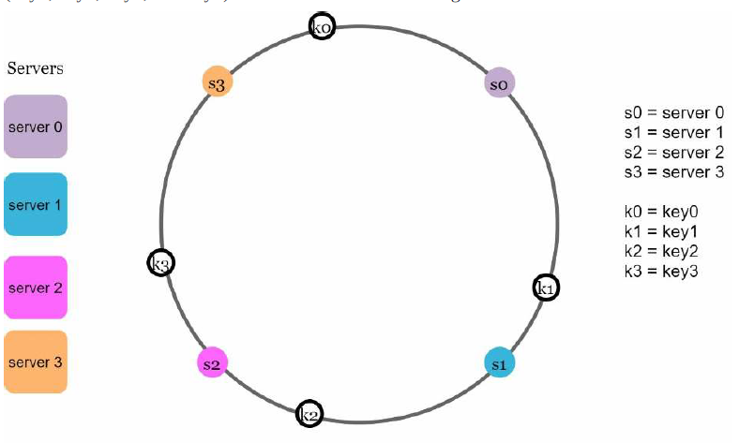
Hash keys One thing worth mentioning is that hash function used here is different from the one in “the rehashing problem,” and there is no modular operation.

Slide 6
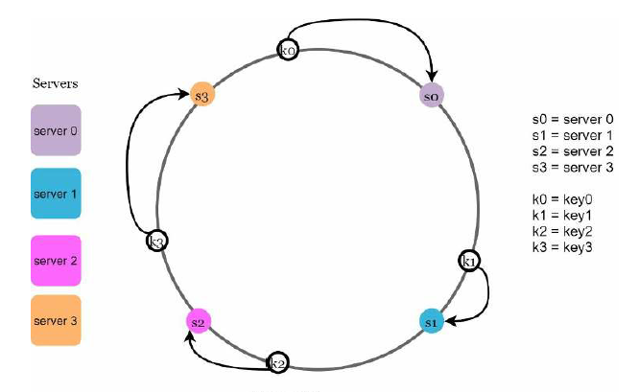
Server lookup To determine which server a key is stored on, we go clockwise from the key position on the ring until a server is found.

Slide 7
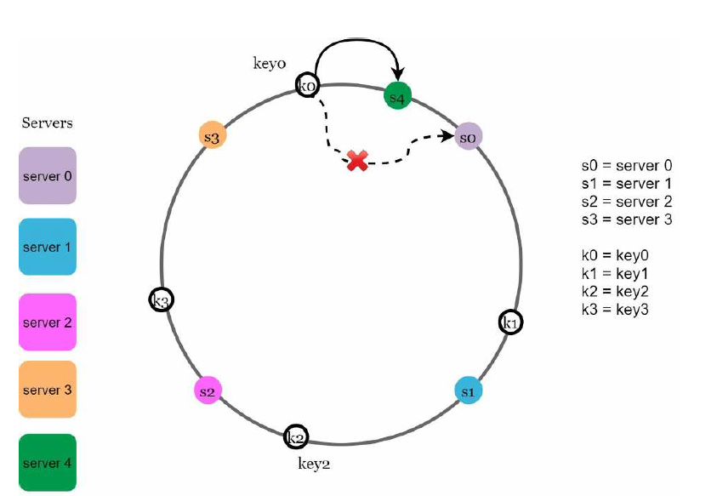
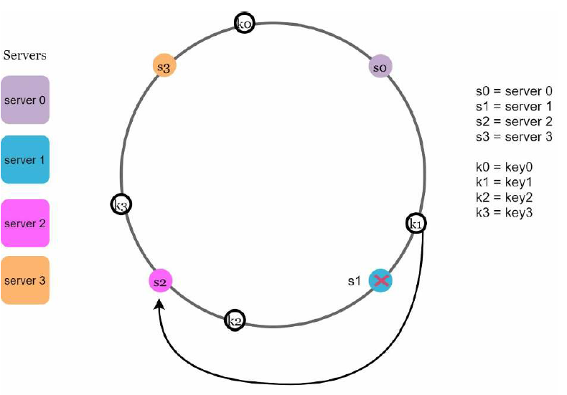
Add a server & Remove a server

Slide 8
Two issues in the basic approach
1:it is impossible to keep the same size of partitions on the ring for all servers considering a server can be added or removed. A partition is the hash space between adjacent servers. It is possible that the size of the partitions on the ring assigned to each server is very small or fairly large
2: it is possible to have a non-uniform key distribution on the ring.

Slide 9
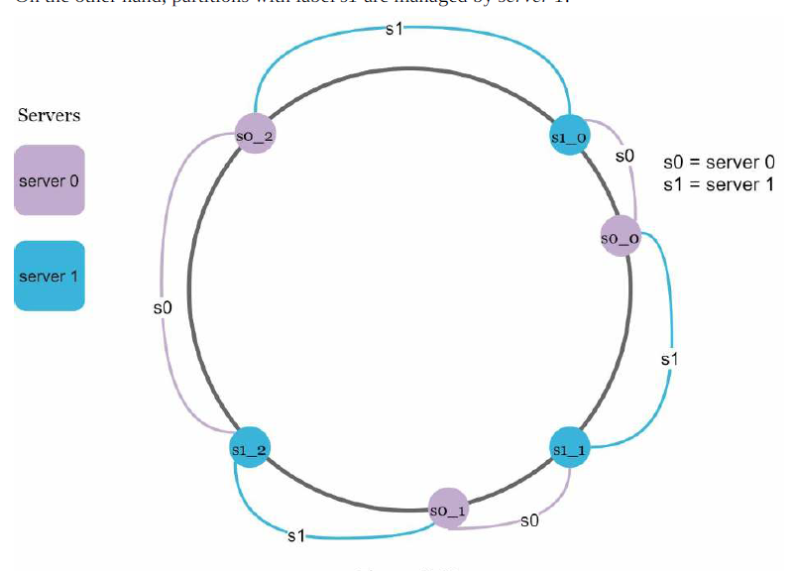
Virtual nodes A virtual node refers to the real node, and each server is represented by multiple virtual nodes on the ring
The 3 is
arbitrarily chosen; and in real-world systems, the number of virtual nodes is much larger.

Slide 10
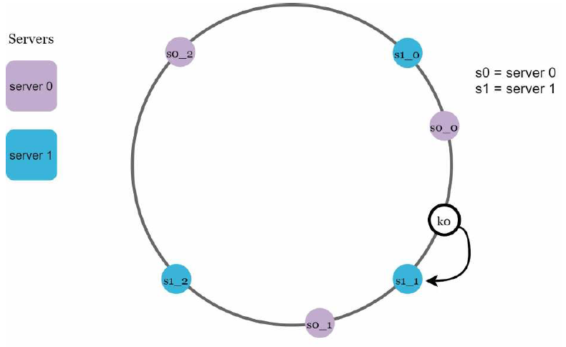
The standard deviation will be smaller when we increase the number of virtual nodes. However, more spaces are needed to store data about virtual nodes.
This is a tradeoff, and we can tune the number of virtual nodes to fit our system requirements.
As the number of virtual nodes increases, the distribution of keys becomes more balanced.
This is because the standard deviation gets smaller with more virtual nodes, leading to balanced data distribution.

Slide 11
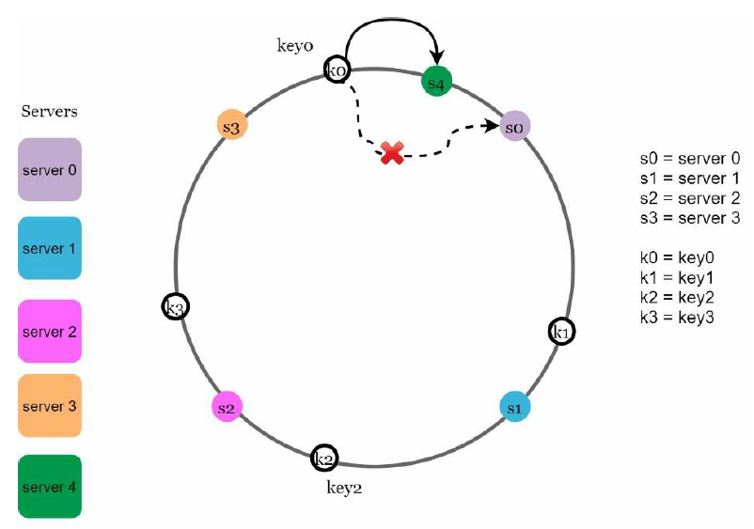
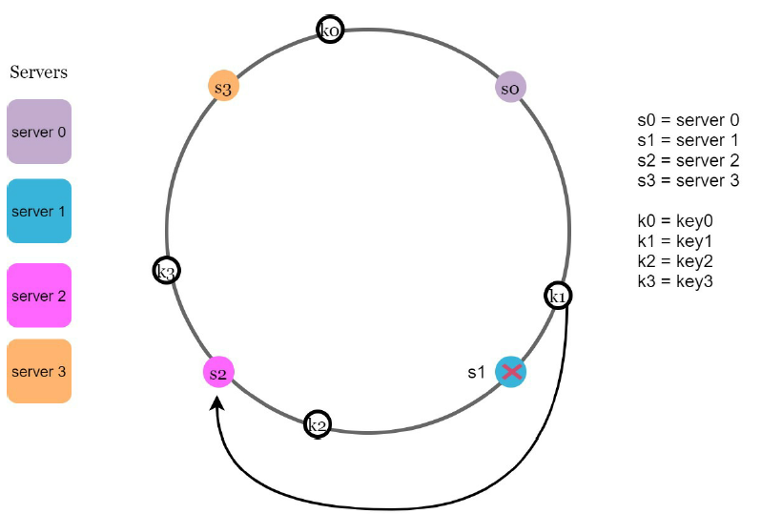
Find affected keys

Slide 12
Wrap up
The benefits of consistent hashing include:
• Minimized keys are redistributed when servers are added or removed.
• It is easy to scale horizontally because data are more evenly distributed.
• Mitigate hotspot key problem. Excessive access to a specific shard could cause server overload. Imagine data for Katy Perry, Justin Bieber, and Lady Gaga all end up on the same shard. Consistent hashing helps to mitigate the problem by distributing the data more evenly.

Slide 13
Consistent hashing is widely used in real-world systems, including some notable ones:
• Partitioning component of Amazon’s Dynamo database
• Data partitioning across the cluster in Apache Cassandra
• Discord chat application
• Akamai content delivery network
• Maglev network load balancer

Slide 14
DESIGN A KEY-VALUE STORE

