Slide 1
Design a rate limiter

Slide 2
What is rate limiter
In a network system, a rate limiter is used to control the rate of traffic sent by client or a service.
Eg: 1: a user can write no more than 2 posts per second.
2: user can create a maximum of 10 accounts per day from the same IP address.

Slide 3
What is the benefit of user an api rate limiter
Prevent resource starvation caused by Dos attack.
Reduce cost. When use 3rd party api.
Prevent servers from being overloaded. Filter out excess requests caused by bots or uers’ misbehavior.

Slide 4
Step1 – Understand the problem and establish design scope
1: client-side or server-side rete limtter ➔ server-side
2: base on Ip, userid or other properties ➔flexible enough
3: the scale of the system? Small startup or big company.
4: in a distributed environment?
5: a separate service or be implemented in application code.
6: do we need to inform users
summary requirements 1: Accurately limit 2: low latency. Should not slow down http response time 3: use as little memory as possible. 4: distributed rate limiting an be shared cross multiple servers or processes. 5: exception handling. 6: high fault tolerance.

Slide 5
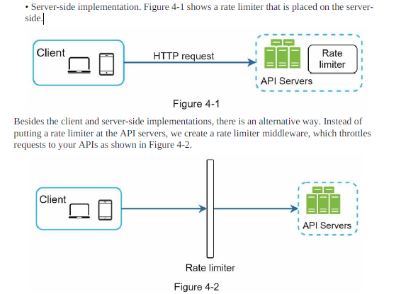
Step2 – Propose high-level design and get buy-in
Intuitively, you can implement a rate limiter at either the client or server-side.
• Client-side implementation. Generally speaking, client is an unreliable place to enforce
rate limiting because client requests can easily be forged by malicious actors. Moreover,
we might not have control over the client implementation.
Notes:
Api Gateway: rate limiting, SSL termination, authentication, IP whitelisting. Servicing static content.

Slide 6
Algorithms for rate limiting
1: Token bucket
2: Leaking bucket
3: Fixed window counter
4: Sliding window log
5: Sliding window counter

Slide 7
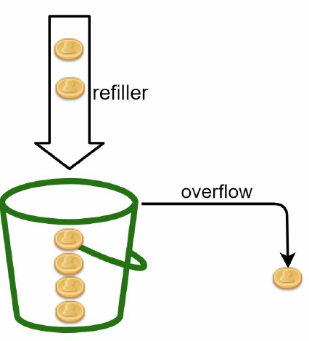
1: Token bucket (widely used, simple, well understood and commonly used, amazon, stripe)
A token bucket is a container that has pre-defined capacity
Once the bucket is full, extra tokens will overflow.
Bucket size: the maximum number of tokens allowed in the bucket
• Refill rate: number of tokens put into the bucket every second

Slide 8
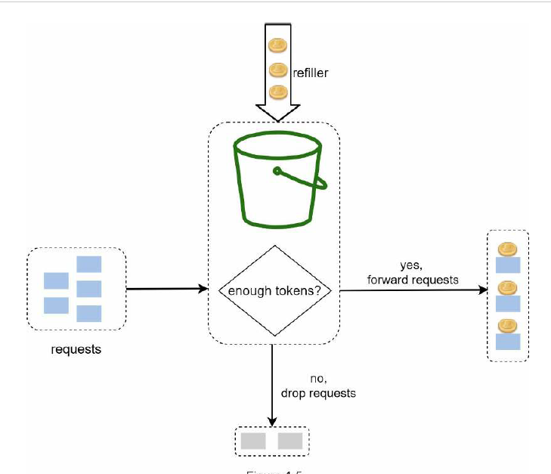

Slide 9
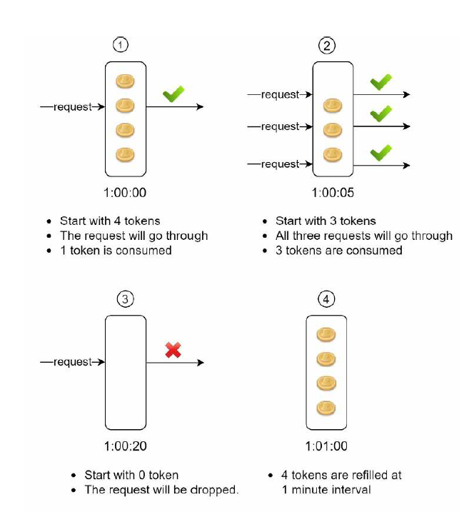
how token consumption, refill, and rate limiting logic work. In this
example, the token bucket size is 4, and the refill rate is 4 per 1 minute.
How many buckets do we need?
Notes:
This varies, and it depends on the rate-limiting rules. Here
are a few examples.
• It is usually necessary to have different buckets for different API endpoints. For instance,
if a user is allowed to make 1 post per second, add 150 friends per day, and like 5 posts per
second, 3 buckets are required for each user.
• If we need to throttle requests based on IP addresses, each IP address requires a bucket.
• If the system allows a maximum of 10,000 requests per second, it makes sense to have a
global bucket shared by all requests.

Slide 10
Pros:
• The algorithm is easy to implement.
• Memory efficient.
• Token bucket allows a burst of traffic for short periods. A request can go through as long
as there are tokens left.
Cons:
• Two parameters in the algorithm are bucket size and token refill rate. However, it might
be challenging to tune them properly.

Slide 11
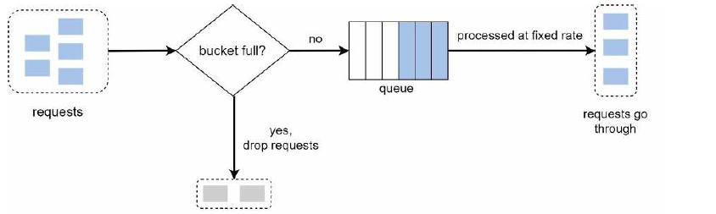
2: Leaking bucket algorithm (Shopify) similar to the token bucket except that requests are processed at a fixed rate.
• When a request arrives, the system checks if the queue is full. If it is not full, the request
is added to the queue. Otherwise, the request is dropped.
• Requests are pulled from the queue and processed at regular intervals.
Bucket size, and processed rate

Slide 12
Pros:
• Memory efficient given the limited queue size.
• Requests are processed at a fixed rate therefore it is suitable for use cases that a stable outflow rate is needed.
Cons:
• A burst of traffic fills up the queue with old requests, and if they are not processed in time, recent requests will be rate limited.
• There are two parameters in the algorithm. It might not be easy to tune them properly.

Slide 13
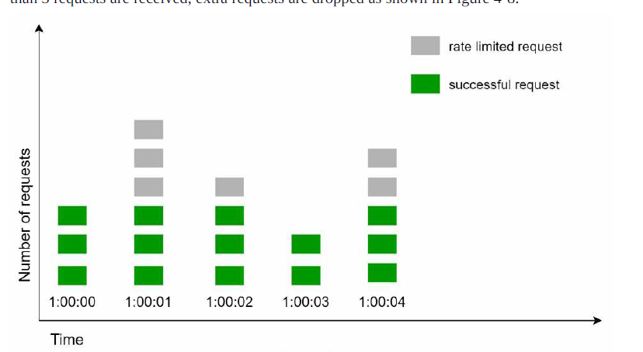
3: Fixed window counter algorithm
• The algorithm divides the timeline into fix-sized time windows and assign a counter for
each window.
• Each request increments the counter by one.
• Once the counter reaches the pre-defined threshold, new requests are dropped until a new
time window starts.
Notes:
the time unit is 1 second and the system allows a maximum of 3 requests per second

Slide 14
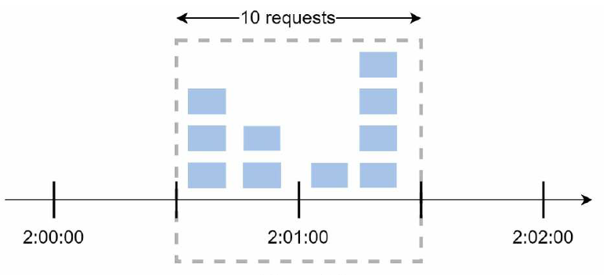
Pros:
• Memory efficient.
• Easy to understand.
• Resetting available quota at the end of a unit time window fits certain use cases.
Cons:
• Spike in traffic at the edges of a window could cause more requests than the allowed
quota to go through.

Slide 15
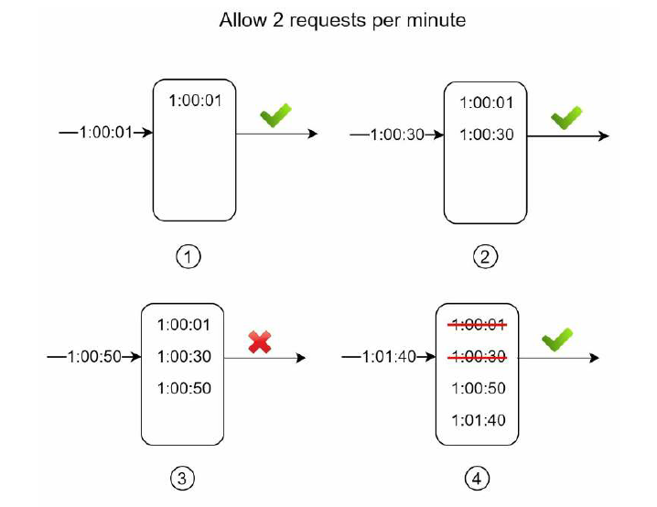
4: Sliding window log algorithm
• The algorithm keeps track of request timestamps. Timestamp data is usually kept in cache, such as sorted sets of Redis
• When a new request comes in, remove all the outdated timestamps. Outdated timestamps are defined as those older than the start of the current time window.
• Add timestamp of the new request to the log.
• If the log size is the same or lower than the allowed count, a request is accepted.
Otherwise, it is rejected.
Notes:
1:00:50 reject 1:01:40 accept
1:01:41

Slide 16
Pros:
• Rate limiting implemented by this algorithm is very accurate. In any rolling window, requests will not exceed the rate limit.
Cons:
• The algorithm consumes a lot of memory because even if a request is rejected, its timestamp might still be stored in memory.

Slide 17
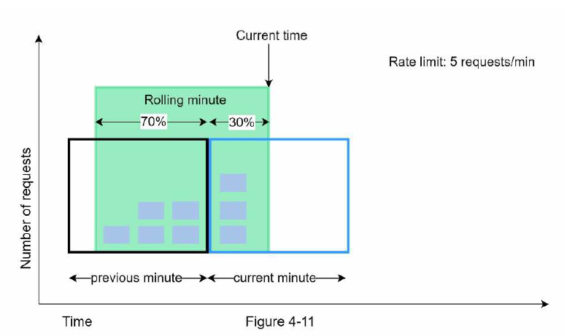
5:Sliding window counter algorithm
Assume the rate limiter allows a maximum of 7 requests per minute, and there are 5 requests in the previous minute and 3 in the current minute. For a new request that arrives at a 30%
position in the current minute, the number of requests in the rolling window is calculated using the following formula:
• Requests in current window + requests in the previous window * overlap percentage of the rolling window and previous window
• Using this formula, we get 3 + 5 * 0.7% = 6.5 request. Depending on the use case, the number can either be rounded up or down. In our example, it is rounded down to 6.
Since the rate limiter allows a maximum of 7 requests per minute, the current request can go through. However, the limit will be reached after receiving one more request

Slide 18
Pros
• It smooths out spikes in traffic because the rate is based on the average rate of the previous window.
• Memory efficient.
Cons
• It only works for not-so-strict look back window. It is an approximation of the actual rate because it assumes requests in the previous window are evenly distributed. However, this problem may not be as bad as it seems. According to experiments done by Cloudflare [10], only 0.003% of requests are wrongly allowed or rate limited among 400 million requests.

Slide 19
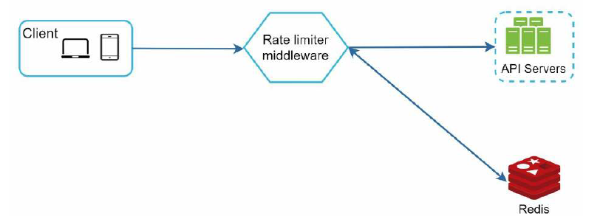
High-level architecture (we need a counter to keep track of how many requests are sent from the same user, IP address, etc. If the counter is larger than the limit, the request is disallowed.)
• If the limit is reached, the request is rejected.
• If the limit is not reached, the request is sent to API servers. Meanwhile, the system
increments the counter and saves it back to Redis.
• How are rate limiting rules created? Where are the rules stored?
• How to handle requests that are rate limited?

Slide 20
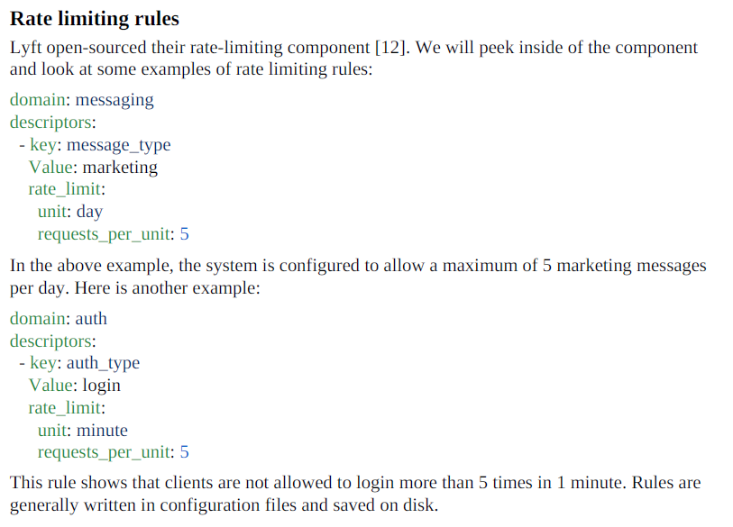

Slide 21
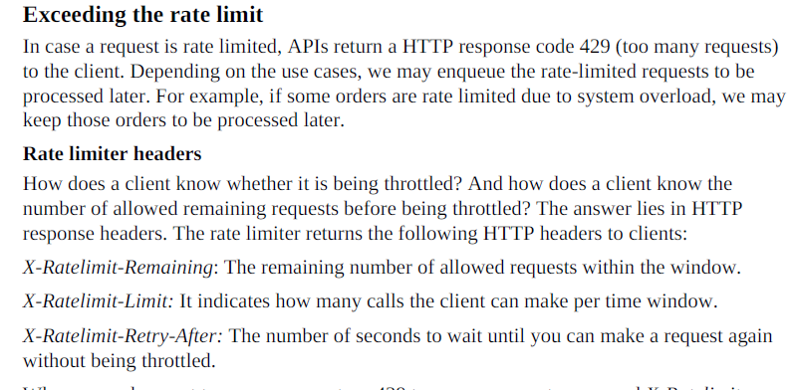

Slide 22
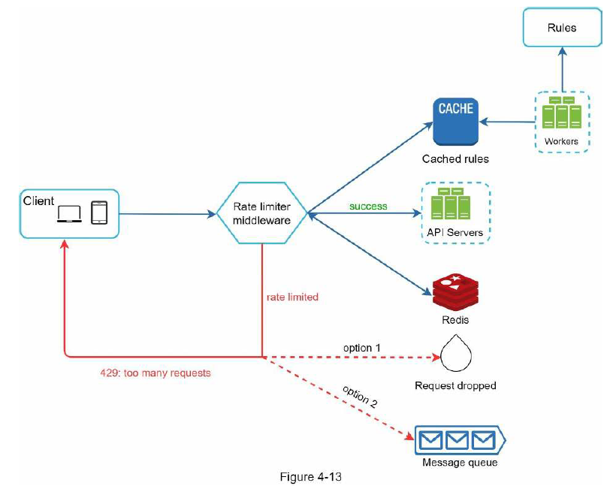
Detailed design
Notes:
Rules are stored on the disk. Workers frequently pull rules from the disk and store them
in the cache.
• When a client sends a request to the server, the request is sent to the rate limiter
middleware first.
• Rate limiter middleware loads rules from the cache. It fetches counters and last request
timestamp from Redis cache. Based on the response, the rate limiter decides:
• if the request is not rate limited, it is forwarded to API servers.
• if the request is rate limited, the rate limiter returns 429 too many requests error to
the client. In the meantime, the request is either dropped or forwarded to the queue.

Slide 23
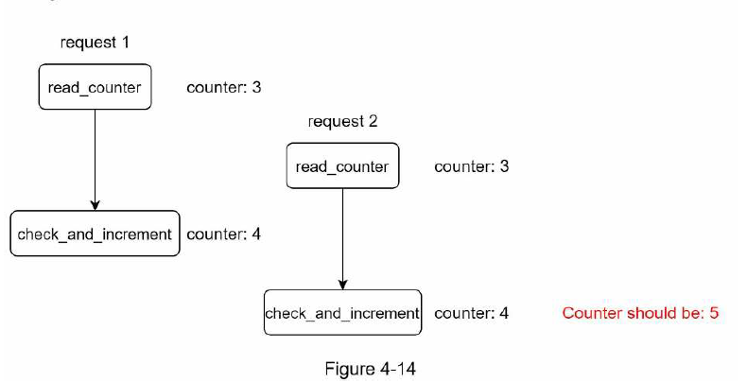
Rate limiter in a distributed environment
There are two challenges:
• Race condition
• Synchronization issue
Notes:
use centralized data stores like Redis to solve synchronization issue

Slide 24
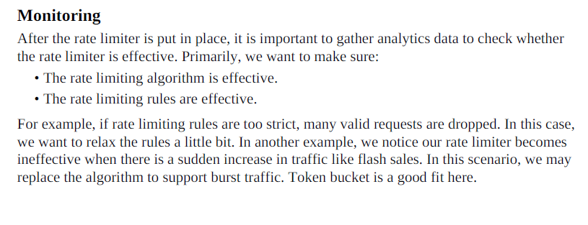

Slide 25
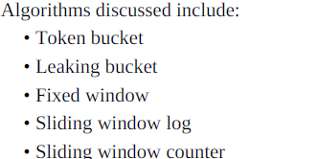
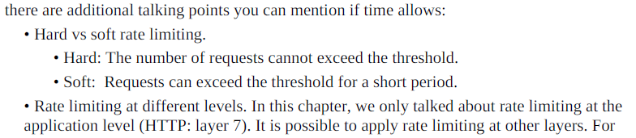
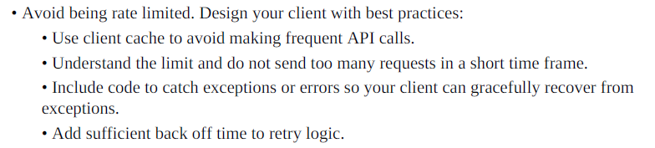
Step 4 - Wrap up

Slide 26
From Isabella
Millions of users —> Millions of buckets? == >Remove unused buckets and re-create them when needed

