Slide 1
Design a Unique Id Generator in distributed systems.

Slide 2
Step1- Understand the problem and establish design scope
Asking clarification questions is the first step to tackle any system design interview question!
1: What are the characteristics of unique Ids? ➔ unique and sortable. 2: For each new record, does Id increment by 1? ➔ Id increments by time but not necessarily only increments by 1. 3: Do Ids only contain numerical value? ➔ Yes
4: What is the Id length requirements? ➔ fit into 64-bit 5: What the scale of the system. ➔ able to generate 10,000 Ids per second. Summary : unique 64-bit number , increased by datetime. And generate scale is more than 10,000 Ids /s
Notes:
Question: Can we use a primary key with the auto_increment attribute in a traditional database. Why

Slide 3
Step2 – Propose hight-level design and get buy-in
Options we considered for generating unique ids are :
1: Multi-master replication 2: Universally unique identifier(UUID) 3: Ticket server 4: Twitter snowflake approach

Slide 4
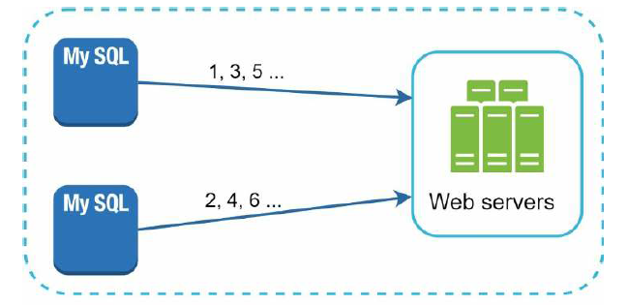
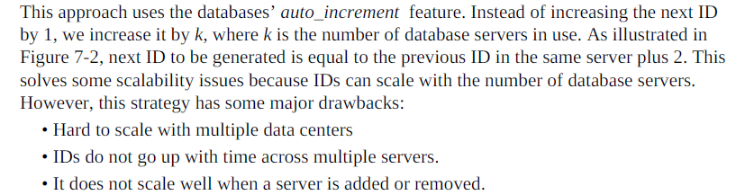
Multi-master replication
This approach uses the databases’ auto_increment feature. Instead of increasing the next ID by 1,
we increase it by k, where k is the number of database servers in use. As

Slide 5
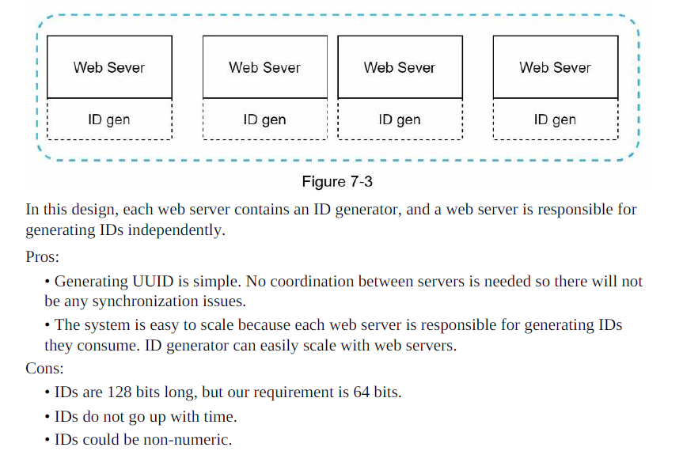
UUID

Slide 6
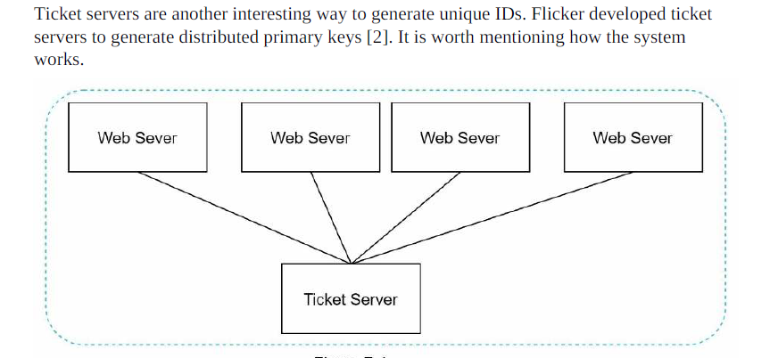
Ticket Server
Pros:
• Numeric IDs.
• It is easy to implement, and it works for small to medium-scale applications.
Single point of failure. Single ticket server means if the ticket server goes down, all
systems that depend on it will face issues. To avoid a single point of failure, we can set up
multiple ticket servers. However, this will introduce new challenges such as data
synchronization.

Slide 7
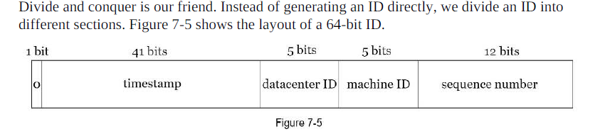
Twitter snowflake approach
• Sign bit: 1 bit. It will always be 0. This is reserved for future uses. It can potentially be
used to distinguish between signed and unsigned numbers. • Timestamp: 41 bits. Milliseconds since the epoch or custom epoch. We use Twitter
snowflake default epoch 1288834974657, equivalent to Nov 04, 2010, 01:42:54 UTC.
• Datacenter ID: 5 bits, which gives us 2 ^ 5 = 32 datacenters.
• Machine ID: 5 bits, which gives us 2 ^ 5 = 32 machines per datacenter.
• Sequence number: 12 bits. For every ID generated on that machine/process, the sequence
number is incremented by 1. The number is reset to 0 every millisecond.

Slide 8
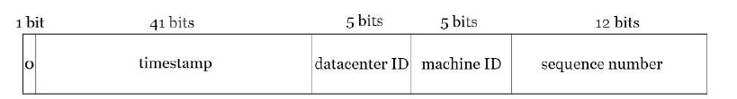
Step 3 - Design deep dive
Datacenter IDs and machine IDs are chosen at the startup time, generally fixed once the
system is up running. Any changes in datacenter IDs and machine IDs require careful review
since an accidental change in those values can lead to ID conflicts.
Timestamp and sequence numbers are generated when the ID generator is running.

Slide 9
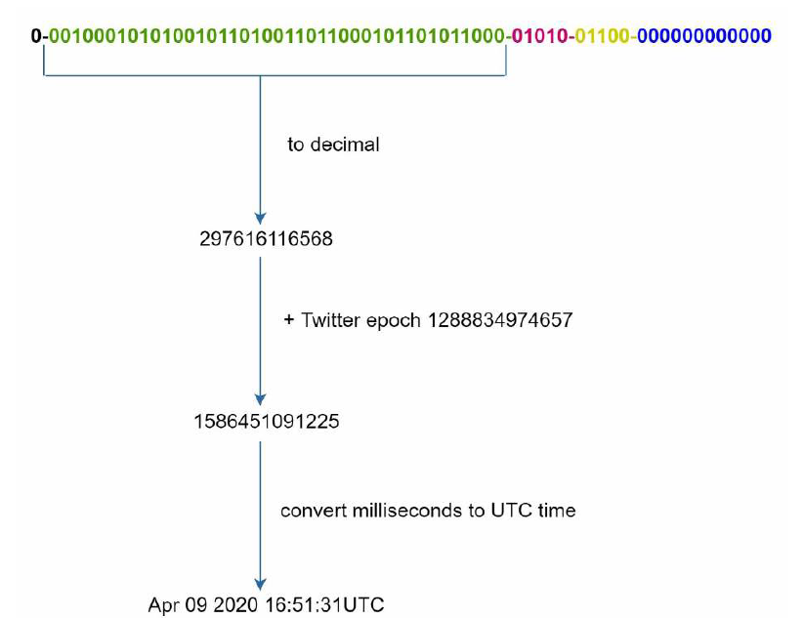
The most important 41 bits make up the timestamp section.
As timestamps grow with time, IDs are sortable by time.
An example of how binary representation is converted to UTC. You can also convert UTC back to binary representation using a similar method.
2 ^ 41 - 1 = 2199023255551 milliseconds (ms), which gives us: ~ 69 years = 2199023255551 ms / 1000 seconds / 365 days / 24 hours/ 3600 seconds.
This means the ID generator will work for 69 years and having a custom epoch time close to today’s date delays the overflow time. After

Slide 10
Sequence number
Sequence number is 12 bits, which give us 2 ^ 12 = 4096 combinations. This field is 0 unless
more than one ID is generated in a millisecond on the same server. In theory, a machine can
support a maximum of 4096 new IDs per millisecond.

Slide 11
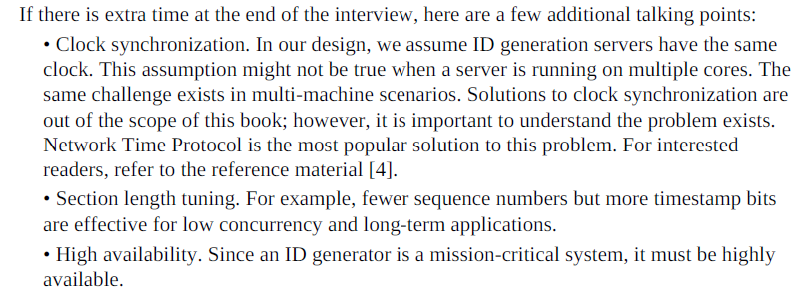
Step 4 - Wrap up
Multimaster replication,
UUID,
Ticket server,
Twitter snowflake-like unique ID generator.

Slide 12
CHAPTER 8: DESIGN A URL SHORTENER

Slide 13
Step 1 - Understand the problem and establish design scope
System design interview questions are intentionally left open-ended. To design a well-crafted
system, It is critical to ask clarification questions.
1: Can you give an example of how a URL shortener work?
➔Assume URL https://www.systeminterview.com/q=chatsystem&c=loggedin&v=v3&l=long is the original URL. Your service creates an alias with shorter length: https://tinyurl.com/y7keocwj. If you
click the alias, it redirects you to the original URL.
2: What is the traffic volume? ➔ 100 million URLs are generated per day.
3: How long is the shortened URL? ➔ As short as possible
4: What characters are allowed in the shortened URL?➔combination of numbers (0-9) and characters (a-z, AZ).
5:Can shortened URLs be deleted or updated?➔For simplicity, let us assume shortened URLs cannot be deleted or updated.
Here are the basic use cases:
1.URL shortening: given a long URL => return a much shorter URL
2.URL redirecting: given a shorter URL => redirect to the original URL
3.High availability, scalability, and fault tolerance considerations

Slide 14
Back of the envelope estimation
• Write operation: 100 million URLs are generated per day.
• Write operation per second: 100 million / 24 /3600 = 1160
• Read operation: Assuming ratio of read operation to write operation is 10:1, read
operation per second: 1160 * 10 = 11,600
• Assuming the URL shortener service will run for 10 years, this means we must support
100 million * 365 * 10 = 365 billion records.
• Assume average URL length is 100.
• Storage requirement over 10 years: 365 billion * 100 bytes * 10 years = 365 TB

Slide 15
Step 2 - Propose high-level design and get buy-in
In this section, we discuss the API endpoints, URL redirecting, and URL shortening flows.
API Endpoints
1.URL shortening.
POST api/v1/data/shorten
• request parameter: {longUrl: longURLString}
• return shortURL
Status code: ?
2.URL redirecting.
GET api/v1/shortUrl
• Return longURL for HTTP redirection
Status code:?

Slide 16
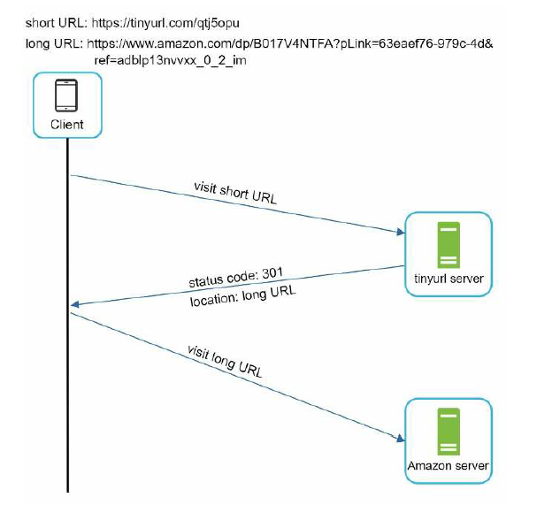
301 redirect. A 301 redirect shows that the requested URL is “permanently” moved to the
long URL. Sinceit is permanently redirected, the browser caches the response, and subsequent requests for the same URL will not be sent to the URL shortening service.
Instead, requests are redirected to the long URL server directly.
302 redirect. A 302 redirect means that the URL is “temporarily” moved to the long URL, meaning that subsequent requests for the same URL will be sent to the URL shortening service first. Then, they are redirected to the long URL server.
Which one is better?

Slide 17
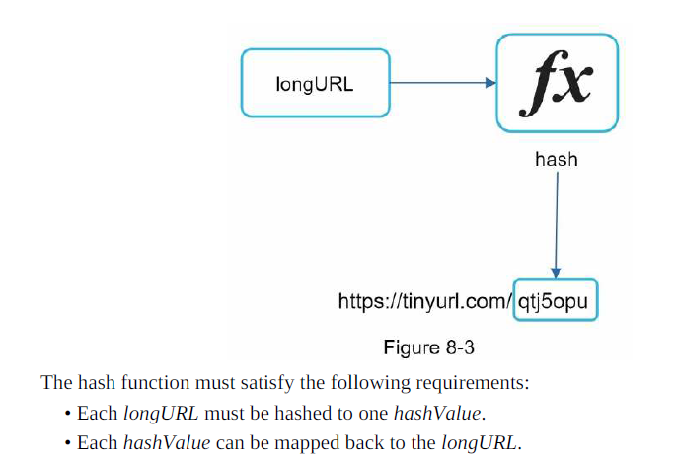

Slide 18
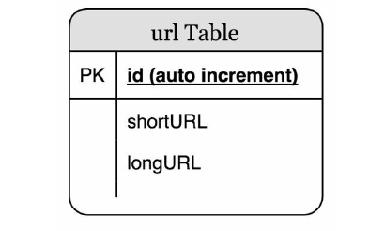
Step 3 - Design deep dive
Data model
Hash function
Hash function is used to hash a long URL to a short URL, also known as hashValue.
Hash value length ?
The hashValue consists of characters from [0-9, a-z, A-Z], containing 10 + 26 + 26 = 62
possible characters. To figure out the length of hashValue, find the smallest n such that 62^n
≥ 365 billion.
Notes:
N = 7

Slide 19
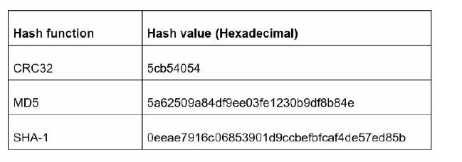
Hash functions hash +collision resolution and base 62 onversion

Slide 20
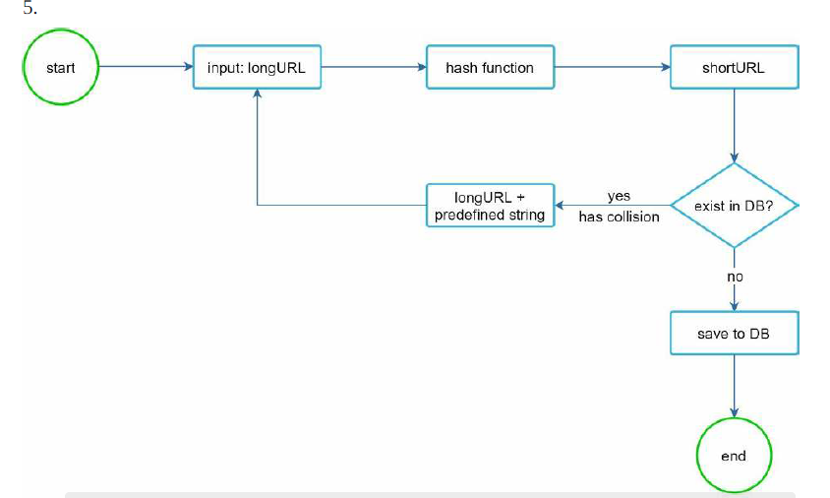
hash collisions.
It is expensive to query the database to check, if a shortURL exists for every request. How to improve performance.

Slide 21
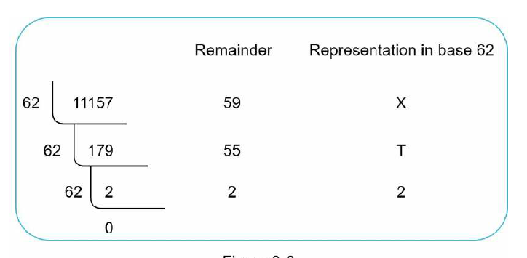
Base 62 conversion
• From its name, base 62 is a way of using 62 characters for encoding. The mappings are:
0-0, ..., 9-9, 10-a, 11-b, ..., 35-z, 36-A, ..., 61-Z, where ‘a’ stands for 10, ‘Z’ stands for 61,etc.
• 1115710 = 2 x 622 + 55 x 621 + 59 x 620 = [2, 55, 59] -> [2, T, X] in base 62 representation.
Thus, the short URL is https://tinyurl.com /2TX

Slide 22
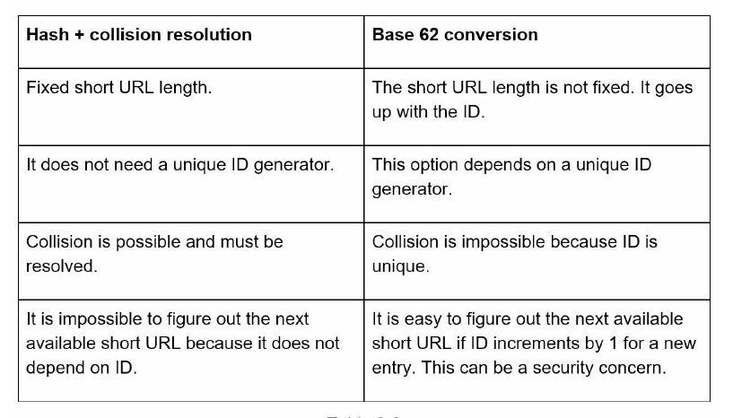
Comparison of the two approaches

Slide 23
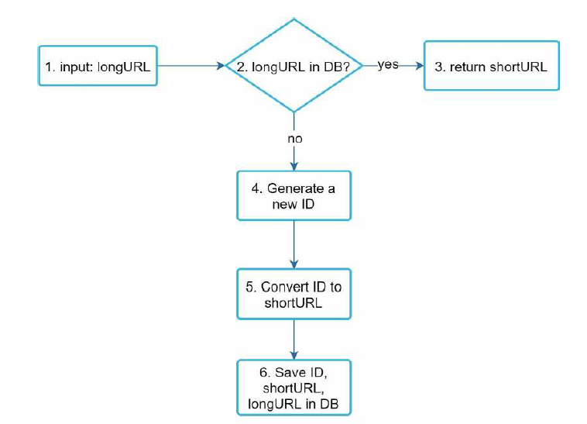
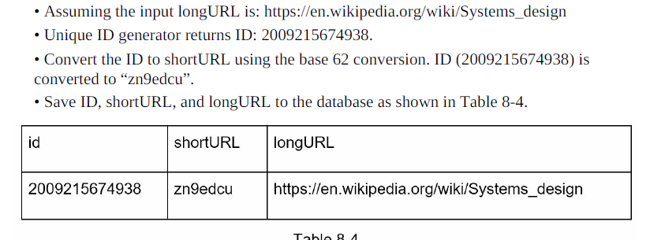
URL shortening deep dive

Slide 24
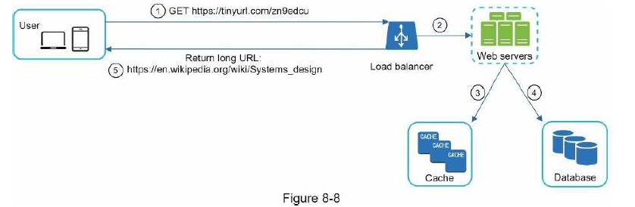

Slide 25
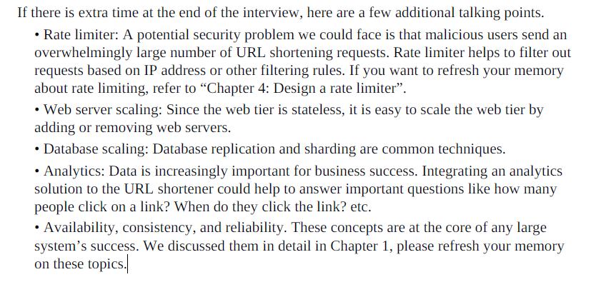
Step 4 - Wrap up
We talked about the API design, data model, hash function, URL shortening, and URL redirecting.

