Slide 1
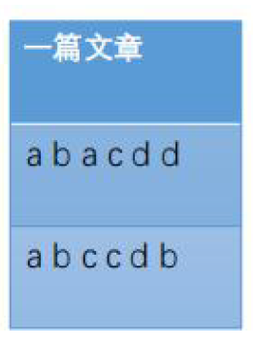
Why Map reduce
方法一 For循环
HashMap<String,int> wordcount;
• for each word in webpage :
• wordcount[word]++
• 有什么优缺点？
• 优点：简单 缺点：只有一台机器——慢、内存大小受限

Slide 2
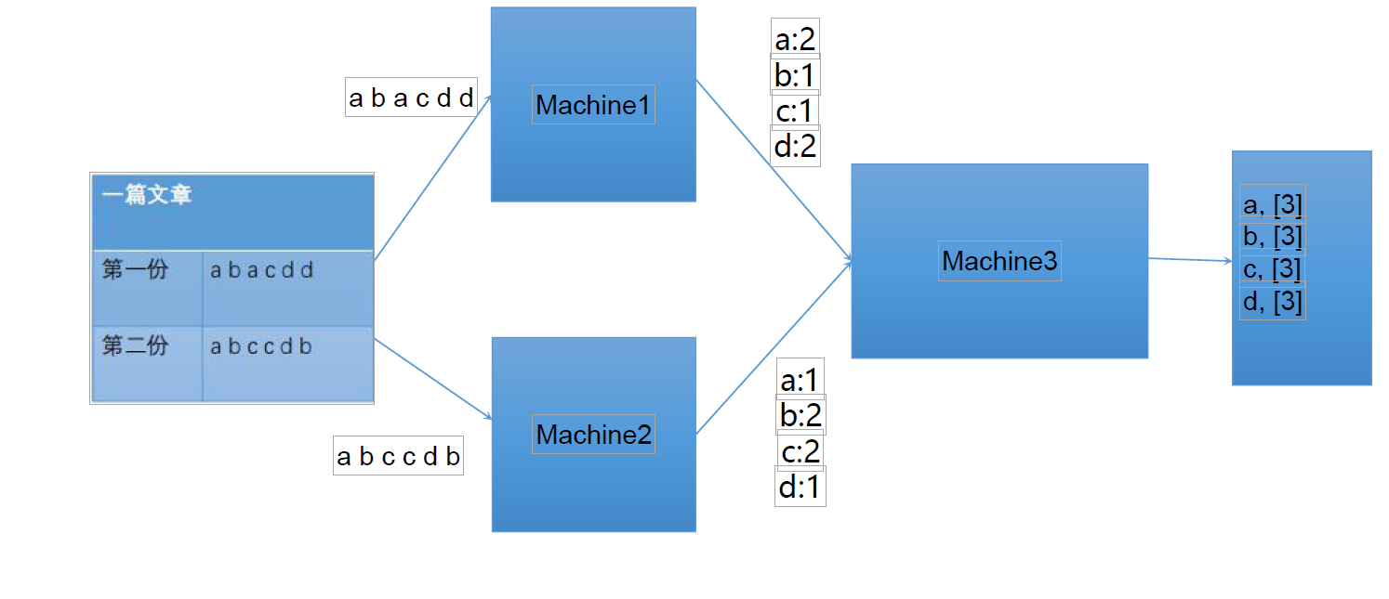
方法二 多台机器For循环

Slide 3
合并的时候是Bottle Neck
合并是否也可以并行？
以什么标准来划分？机器 or key？
机器： 依赖关系， 增加系统复杂度。

Slide 4
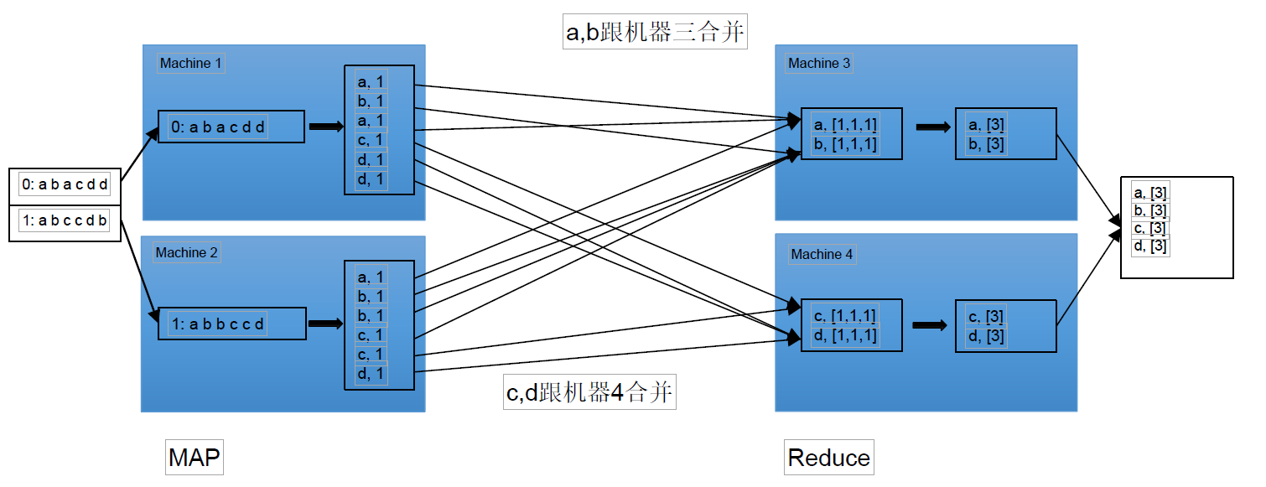
方法三：Map Reduce

Slide 5
Map把文章拆分单词的过程
Reduce把单词次数合并在一起的过程
谁来负责把文章拆分为一小段一小段？
中间传输整理谁来负责？比如怎么知道把a放在机器3还是机器4？
依靠Map Reduce的框架实现

Slide 6
Step1 Input
Step2 Split
Step3 Map
Step4 Partition sort
Step5 Fetch + Merge Sort
Step6 Reduce
Step7 Output
我们只要写 Map 函数 和 Reduce 函数

Slide 7
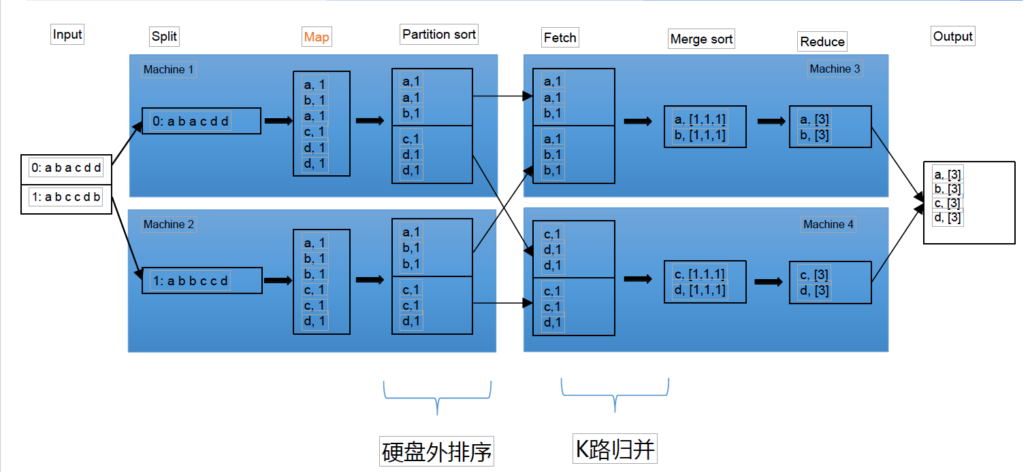

Slide 9
Group Anagram
Given an array of strings strs, group the anagrams together. You can return the answer in any order.
An Anagram is a word or phrase formed by rearranging the letters of a different word or phrase, typically using all the original letters exactly once.
Example 1:
Input: strs = ["eat","tea","tan","ate","nat","bat"]
Output: [["bat"],["nat","tan"],["ate","eat","tea"]]

Slide 10
Group Anagram
public List<List<String>> groupAnagrams(String[] strs) { if (strs == null || strs.length == 0) return new ArrayList<>(); Map<String, List<String>> map = new HashMap<>(); for (String s : strs) { char[] ca = new char[26]; for (char c : s.toCharArray()) ca[c - 'a']++; String keyStr = String.valueOf(ca); if (!map.containsKey(keyStr)) map.put(keyStr, new ArrayList<>()); map.get(keyStr).add(s); } return new ArrayList<>(map.values()); }

Slide 11
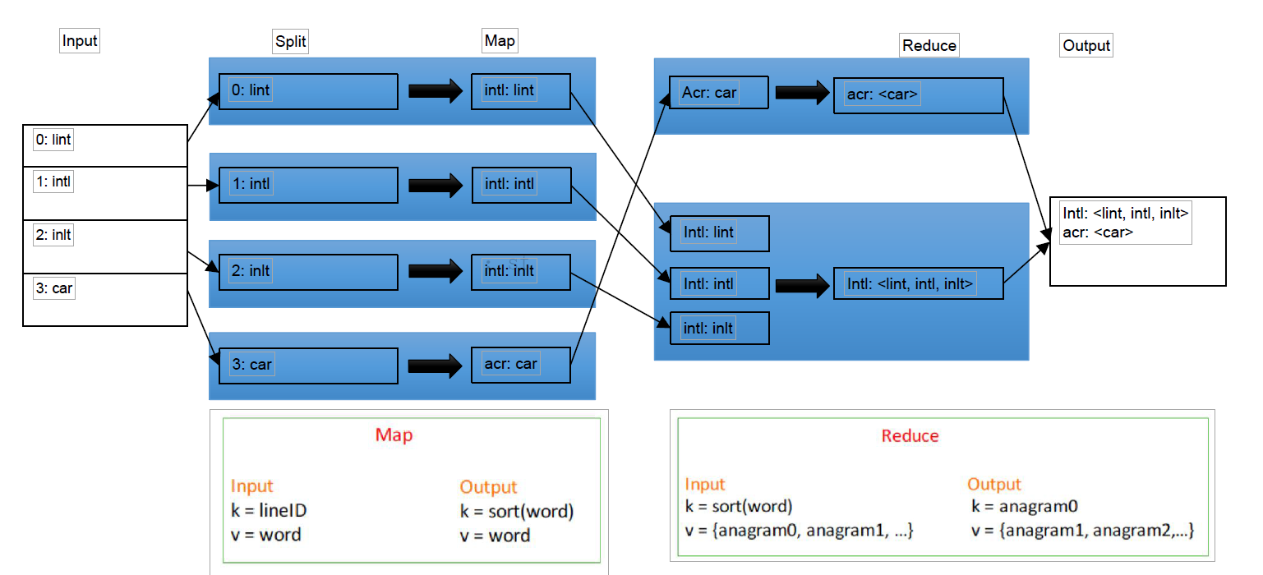
Group Anagram - Map Reduce

Slide 12
public class Anagram { public static class Map{ public void map(String key, String value, OutputCollector<String,String> output){ StringTokenizer tokenizer = new StringTokenizer(value); while(tokenizer.hasMoreTokens()){ String word = tokenizer.nextToken(); char[] sc = word.toCharArray(); Arrays.sort(sc); output.collect(new String(sc), word); } } } public static class Reduce{ public void reduce (String key, Iterator<String> values, OutputCollector<String, List<String>> output){ List<String> results = new ArrayList<>(); while(values.hasNext()){ results.add(values.next()); } output.collect(key, results); } } }

Slide 13
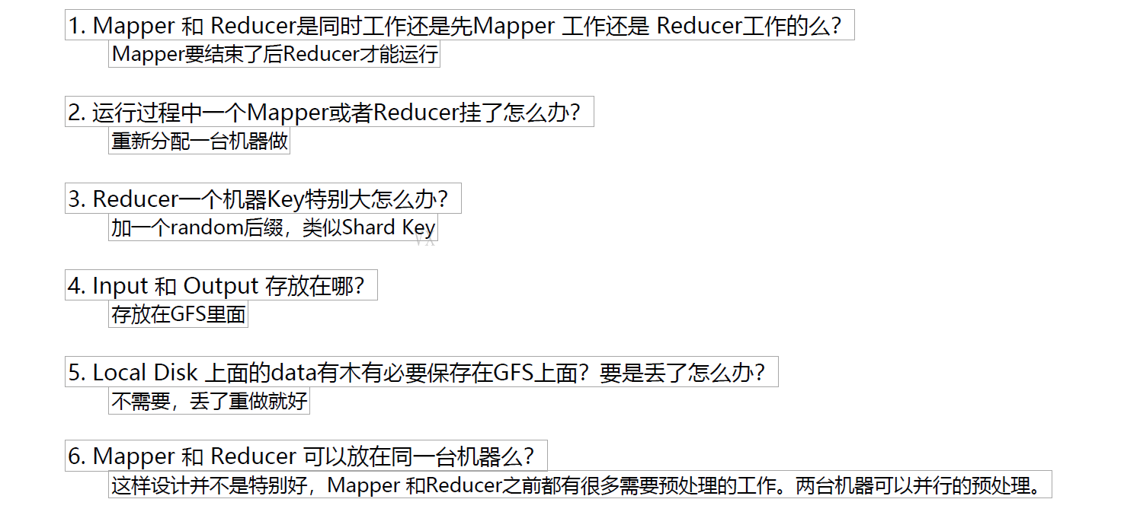

Slide 14
