Slide 1
Design news feed system
“News feed is the constantly updating list of stories in the middle of
your home page. News Feed includes status updates, photos, videos, links, app activity, and likes from people, pages, and groups that you follow on Facebook”

Slide 2
Step 1 - Understand the problem and establish design scope
1 Is this a mobile app? Or a web app? Or both? ➔ Both
2 What are the important features? ➔ A user can publish a post and see her friends’ posts on the news feed page.
3 Is the news feed sorted by reverse chronological order or any particular order
such as topic scores? For instance, posts from your close friends have higher scores.
➔To keep things simple, let us assume the feed is sorted by reverse chronological order.
4: How many friends can a user have? ➔ 5000
5: What is the traffic volume?➔10 million DAU (Daily Active Users)
6: Can feed contain images, videos, or just text?➔ It can contain media files, including both images and videos.
Notes:
Facebook news feed, Instagram feed, Twitter timeline,

Slide 3
Step 2 - Propose high-level design and get buy-in
The design is divided into two flows: feed publishing and news feed building
Feed publishing API
To publish a post, a HTTP POST request will be sent to the server. The API is shown below:
POST /v1/me/feed
Params:
• content: content is the text of the post.
• auth_token: it is used to authenticate API requests.
Newsfeed retrieval API
The API to retrieve news feed is shown below:
GET /v1/me/feed
Params:
• auth_token: it is used to authenticate API requests.

Slide 4
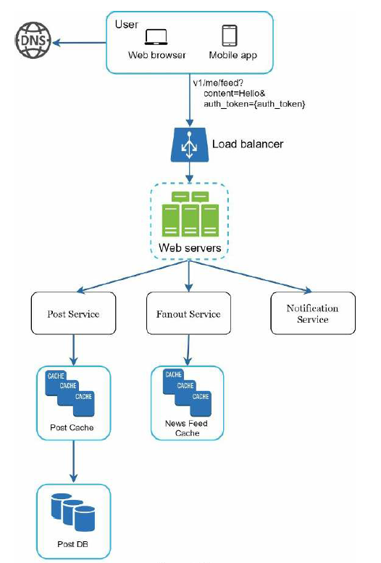
Feed publishing

Slide 5
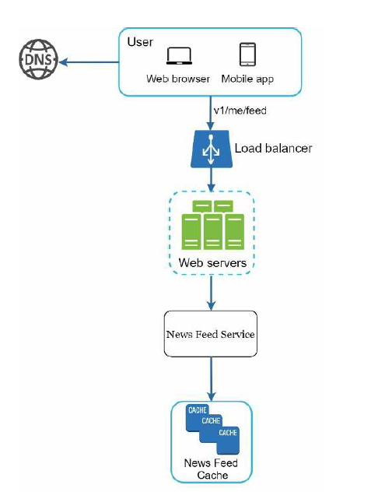
Newsfeed building

Slide 6
Step 3 - Design deep dive
Notes:
Only users signed in with valid auth_token are allowed to make posts. The system limits the
number of posts a user can make within a certain period, vital to prevent spam and abusive
content.

Slide 7
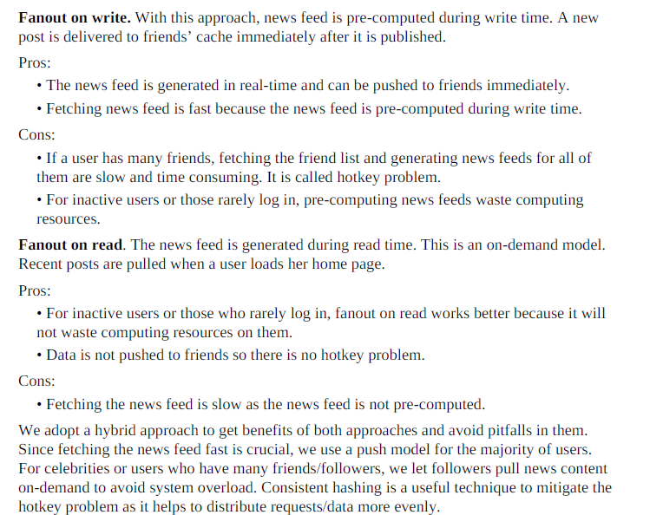
fanout on write (also called push model) and fanout on read (also called pull model).

