Slide 1

Replication
single-leader,
multi-leader,
leaderless replication.

Slide 2
Single-leader
leader-based replication
When clients want to write to the database, they must send their requests to the leader, which first writes the new data to its local storage.
Whenever the leader writes new data to its local storage, it also sends the data change to all of its followers as part of a replication log or change stream.
When a client wants to read from the database, it can query either the leader or any of the followers. However, writes are only accepted on the leader
PostgreSQL, MySQL, Oracle Data Guard, MongoDB, RethinkDB, Kafka and RabbitMQ.

Slide 3
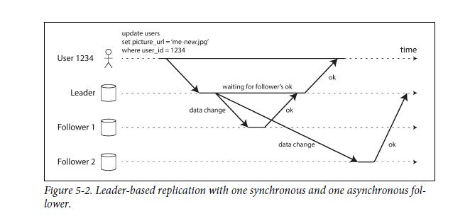
Synchronous Versus Asynchronous Replication
semi-synchronous.
advantage/disadvantage?
completely asynchronous.
advantage/disadvantage?

Slide 4
Setting Up New Followers
Take a consistent snapshot of the leader’s database
Copy the snapshot
requests all the data changes that have happened since the snapshot was taken
caught up.

Slide 5
Handling Node Outages
Follower failure: Catch-up recovery
Leader failure: Failover

Slide 6
If asynchronous replication is used, the new leader may not have received all the writes from the old leader before it failed
Discarding writes is especially dangerous if other storage systems outside of the database need to be coordinated with the database contents
split brain
Right timeout before the leader is declared dead
For this reason, some operations teams prefer to perform failovers manually

Slide 7
How does leader-based replication work
Statement-based replication
Write-ahead log (WAL) shipping
Logical (row-based) log replication
Trigger-based replication

Slide 8
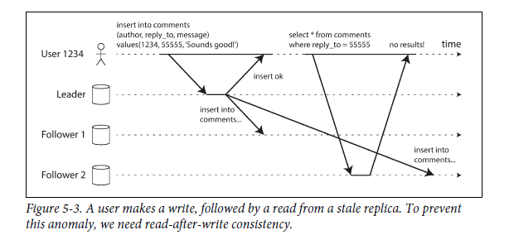
Problems with Replication Lag
Reading Your Own Writes
Modified data read it from the leader; otherwise, read it from a follower
If most things in the application are potentially editable by the user?
Timestamp

Slide 9
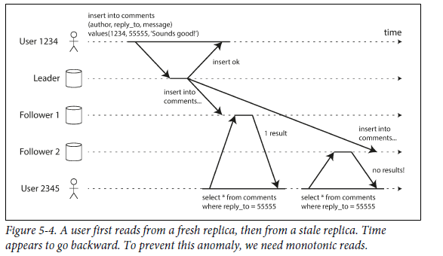
Monotonic Reads
Monotonic reads is a guarantee that this kind of anomaly does not happen.
reads is to make sure that each user always makes
their reads from the same replica

Slide 10
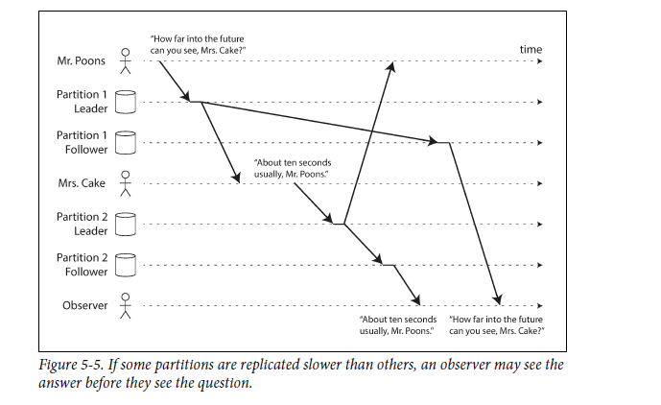
Consistent Prefix Reads
consistent prefix reads
This guarantee says that if a sequence of writes happens in a certain order, then anyone reading those writes will see them appear in the same order

Slide 11
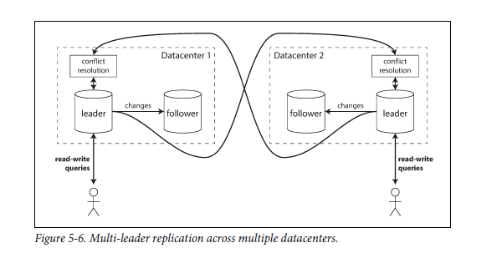
Multi-Leader Replication
Allow more than one node to accept writes.
Multi-datacenter operation
Performance (can be processed in the local datacenter and is replicated asynchronously to the other datacenters)
Tolerance of datacenter outages
Tolerance of network problems
Downside: the same data may be concurrently modified in two different datacenters, and those write conflicts must be resolved

Slide 12
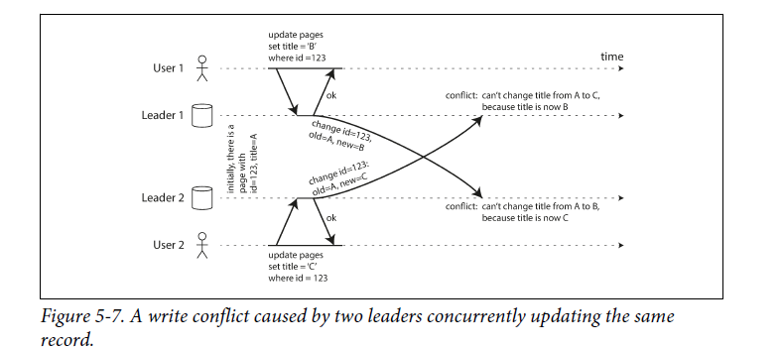
Handling Write Conflicts
wait for the write to be replicated to all replicas before telling the user that the write was successful.(Lost main advantage of multi-leader replication)
Conflict avoidance: EX: you can ensure that requests from a particular user are always routed to the same datacenter and use the leader in that datacenter for reading and writing
Converging toward a consistent state
1: last write wins
2:Give each replica a unique ID (high > low)
3:Somehow merge the values together(B/C)
4: Application code resolves the conflict at later time

Slide 13
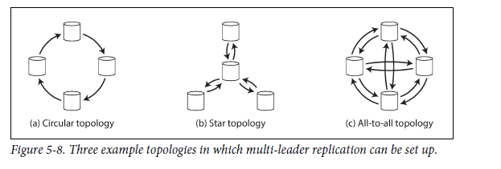
Multi-Leader Replication Topologies

Slide 14
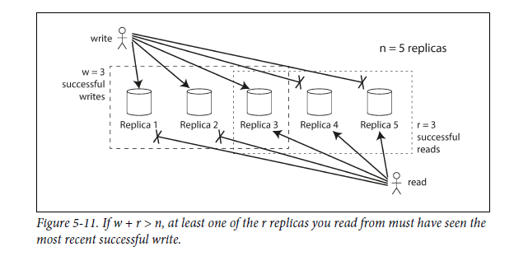
Leaderless Replication
In some leaderless implementations, the client directly sends its writes to several replicas, while in others, a coordinator node does this on behalf of the client.
Quorums for reading and writing
w + r > n
With n = 5, w = 3, r = 3 we can tolerate two unavailable nodes.

Slide 15
Limitations of Quorum Consistency
If w + r <= n?
Even if w + r > n:
1: Sloppy quorum
2: If two writes occur concurrently, it is not clear which one happened first.
3: If a write happens concurrently with a read.
4: If a write succeeded on some replicas but failed on others(< w) even if a write was reported as failed, subsequent reads may or may not return the value from that write
Sloppy Quorums and hinted handoff
return errors to all requests if w + r <= n? OR
Writes and reads still require w and r successful responses, but those may include nodes that are not among the designated n “home” nodes for a value.
Once the network interruption is fixed, any writes that one node temporarily accepted on behalf of another node are sent to the appropriate “home” nodes.(hinted handoff)
Sloppy quorums are particularly useful for increasing write availability but no guarantee that a read of r nodes will see it until the hinted handoff has completed.

Slide 16
Conflict resolution
Last write wins (discarding concurrent writes) – Cassandra. The only safe way of using a database with LWW is to ensure that a key is only written once and thereafter treated as immutable.
The “happens-before” relationship and concurrency. Capturing the happens-before relationship
Merging concurrently written values
Version vectors

