Slide 1
Design news feed system
“News feed is the constantly updating list of stories in the middle of
your home page. News Feed includes status updates, photos, videos, links, app activity, and likes from people, pages, and groups that you follow on Facebook”

Slide 2
Step 1 - Understand the problem and establish design scope
1 Is this a mobile app? Or a web app? Or both? ➔ Both
2 What are the important features? ➔ A user can publish a post and see her friends’ posts on the news feed page.
3 Is the news feed sorted by reverse chronological order or any particular order
such as topic scores? For instance, posts from your close friends have higher scores.
➔To keep things simple, let us assume the feed is sorted by reverse chronological order.
4: How many friends can a user have? ➔ 5000
5: What is the traffic volume?➔10 million DAU (Daily Active Users)
6: Can feed contain images, videos, or just text?➔ It can contain media files, including both images and videos.
Notes:
Facebook news feed, Instagram feed, Twitter timeline,

Slide 3
Step 2 - Propose high-level design and get buy-in
The design is divided into two flows: feed publishing and news feed building
Feed publishing API
To publish a post, a HTTP POST request will be sent to the server. The API is shown below:
POST /v1/me/feed
Params:
• content: content is the text of the post.
• auth_token: it is used to authenticate API requests.
Newsfeed retrieval API
The API to retrieve news feed is shown below:
GET /v1/me/feed
Params:
• auth_token: it is used to authenticate API requests.

Slide 4
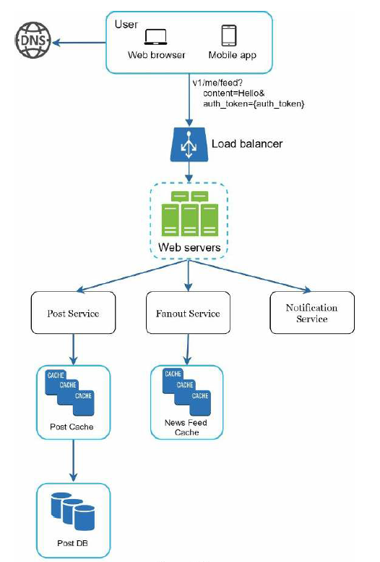
Feed publishing

Slide 5
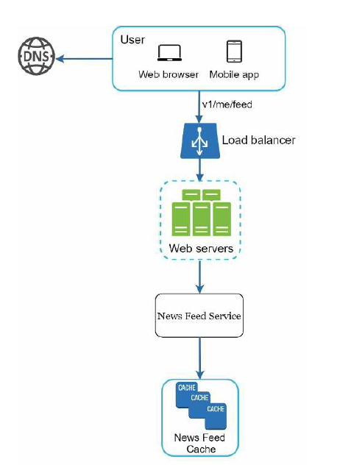
Newsfeed building

Slide 6
Step 3 - Design deep dive
Notes:
Only users signed in with valid auth_token are allowed to make posts. The system limits the
number of posts a user can make within a certain period, vital to prevent spam and abusive
content.

Slide 7
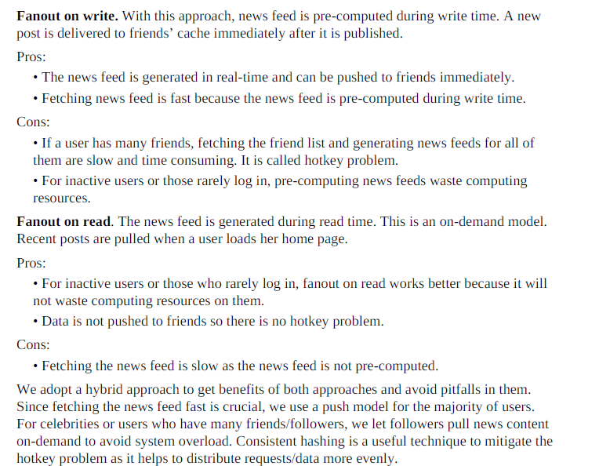
fanout on write (also called push model) and fanout on read (also called pull model).

Slide 8
Since fetching the news feed fast is crucial, we use a push model for the majority of users.
For celebrities or users who have many friends/followers, we let followers pull news content on-demand to avoid system overload.
Consistent hashing is a useful technique to mitigate the hotkey problem as it helps to distribute requests/data more evenly.

Slide 9
Get friends info from the user cache. The system then filters out friends based on user settings. For example, 1: hide some friends. 2: not available to some friends
Store <post_id, user_id > in news feed cache

Slide 10
Newsfeed retrieval deep dive
A user’s news feed is more than just a list of feed IDs. It contains username, profile
picture, post content, post image, etc. Thus, the news feed service fetches the complete
user and post objects from caches (user cache and post cache) to construct the fully
hydrated news feed.

Slide 11
Cache architecture

Slide 12
Step 4 - Wrap up
Our design contains two flows: feed publishing and news feed retrieval.
Like any system design interview questions, there is no perfect way to design a system. Understanding the tradeoffs of your design and technology choices are important.

Slide 13
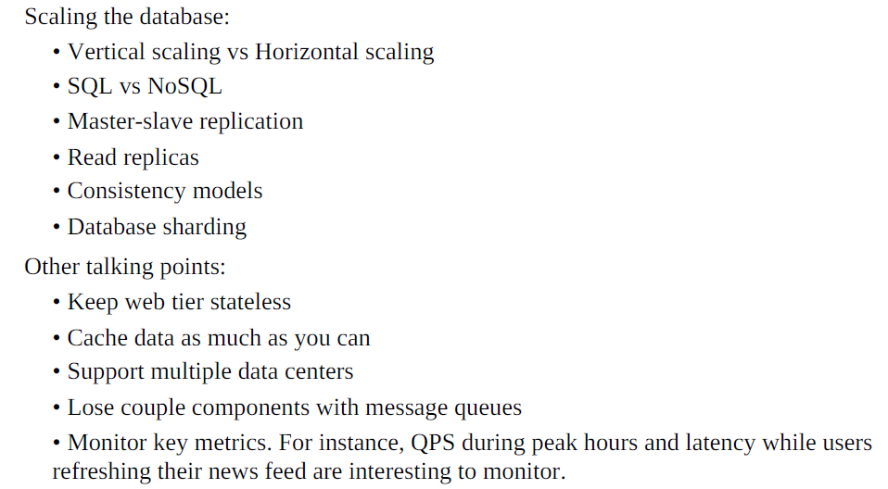
high-level talking points

