Slide 1
Design Rate Limiter

Slide 2
Requirements
Functional:
Limit the number of requests an entity can send to an API within a time window
The APIs are accessible through a cluster, so the rate limit should be considered across different servers.
Non-Functional:
low latency
accurate
scalable

Slide 3
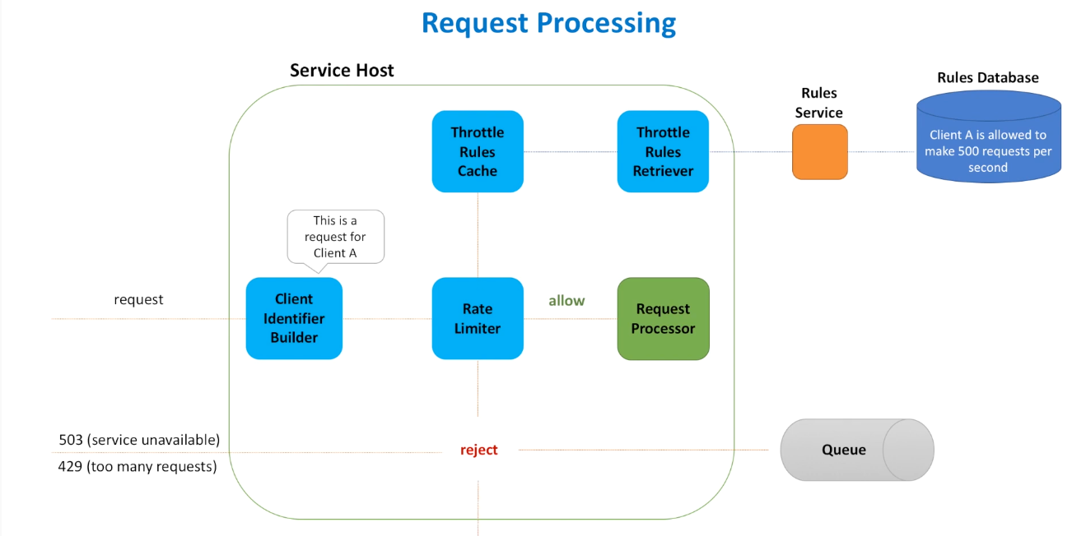
Drop request
Notes:
Rule Service: create/update/delete
Rules Retriever is a background process that polls rules periodically and store rules in memory.
Client Identifier Builder: generate a unique key for the user

Slide 4
Rate Limiter Algorithm
Token Bucket Algorithm
Fixed Window Algorithm
Rolling Window Algorithm

Slide 5
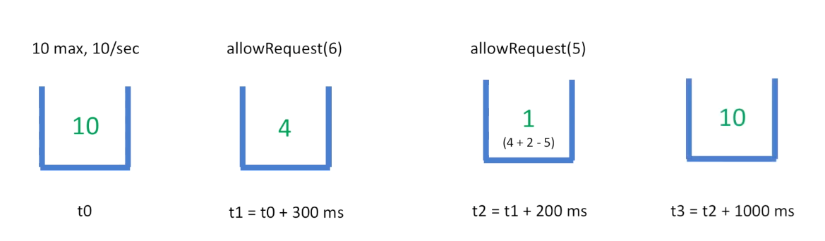
Token Bucket

Slide 6
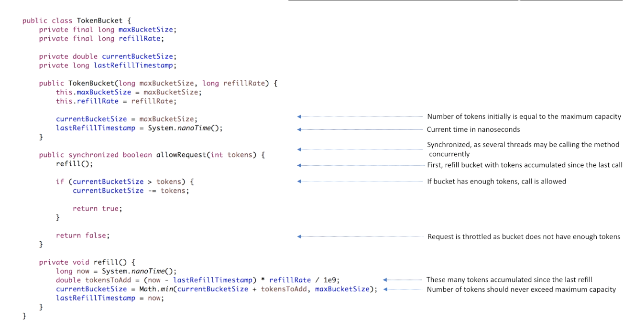
Implementation

Slide 7
Work across multiple machines?
Hosts need to talk to each other and share how many tokens they consumed all together
But communication between hosts takes time
We should expect that sometimes our system may be processing more requests than we expected

Slide 8
Message Broadcasting
Tell everyone everything: not scalable
Gossip Protocol Host A Host B
Random peer selection
Host C Host D
Distributed Cache
In memory store (e.g. Redis) shared by all hosts
Coordination Service
Coordination service helps to choose a leader
The leader receives all the messages and then calculates and sends back the final result
Random Leader Selection
May ended up in multiple leaders but it won’t be a problem (causing a little overhead)

Slide 9
How hosts talk to each other
TCP vs UDP
TCP: guarantee the delivery of data and the order of the packets
UDP: doesn’t guarantee delivery and order, but it’s faster
Tradeoff: accuracy vs faster
Notes:
UDP throws all the error checking stuff out, so it’s faster

Slide 10
Millions of users —> Millions of buckets?
Remove unused buckets and re-create them when needed

Slide 11
What should clients do when their requests are throttled?
Queue such requests and re-send them later
Retry throttled requests: exponential backoff and jitter
exponential backoff: Retries request exponentially, increasing the waiting time
Jitter: add randomness to retry intervals to spread out the load

