Slide 1
DESIGN YOUTUBE
designing a video sharing platform such as Netflix and Hulu.

Slide 2
Step 1 - Understand the problem and establish design scope
1: What features are important? ➔ Ability to upload a video and watch a video.
2: What clients do we need to support?➔ Mobile apps, web browsers, and smart TV.
3: How many daily active users do we have?➔5 million
4: What is the average daily time spent on the product?➔ 30 minutes.
5: Do we need to support international users?➔Yes, a large percentage of users are international users.
6:What are the supported video resolutions?➔The system accepts most of the video resolutions and format 7:Is encryption required?➔ Yes
8:Any file size requirement for videos?➔Our platform focuses on small and medium-sized videos. The maximum
allowed video size is 1GB.
9: Can we leverage some of the existing cloud infrastructures provided by Amazon, Google, or Microsoft?
➔That is a great question. Building everything from scratch is unrealistic for most
companies, it is recommended to leverage some of the existing cloud services.

Slide 3
• Ability to upload videos fast
• Smooth video streaming
• Ability to change video quality
• Low infrastructure cost
• High availability, scalability, and reliability requirements
• Clients supported: mobile apps, web browser, and smart TV

Slide 4
Back of the envelope estimation
The following estimations are based on many assumptions, so it is important to communicate
with the interviewer to make sure she is on the same page.
• Assume the product has 5 million daily active users (DAU).
• Users watch 5 videos per day.
• 10% of users upload 1 video per day.
• Assume the average video size is 300 MB.
• CDN cost.
Total daily storage space needed: 5 million * 10% * 300 MB = 150TB When cloud CDN serves a video, you are charged for data transferred out of the CDN.
Let us use Amazon’s CDN CloudFront for cost estimation (Figure 14-2) [3]. Assume 100% of traffic is served from the United States. The average cost per GB is $0.02.
For simplicity, we only calculate the cost of video streaming. 5 million * 5 videos * 0.3GB * $0.02 = $150,000 per day.
We will discuss ways to reduce CDN costs in deep

Slide 5
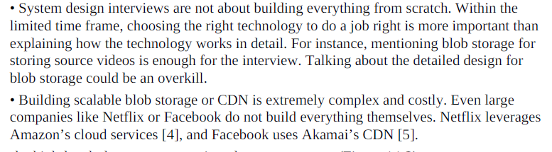
Step 2 - Propose high-level design and get buy-in
This includes
feed recommendation, generating video upload URL, updating metadata database and cache, user signup, etc.
Video uploading flow
Video streaming flow

Slide 6
Video uploading flow
BLOB
• Completion handler: This consists of a list of workers that pull event data from the completion queue and update metadata cache and database.
Transcoding servers: Video transcoding is also called video encoding. It is the process of
converting a video format to other formats (MPEG, HLS, etc), which provide the best
video streams possible for different devices and bandwidth capabilities.
It is a blob storage that stores transcoded video files.
Videos are cached in CDN. When you click the play button, a video is streamed
from the CDN.
Notes:
A Binary Large Object (BLOB) is a
collection of binary data stored as a single entity in a database management system

Slide 7
a. Upload the actual video.
b. Update video metadata. Metadata contains information about video URL, size, resolution, format, user info, etc.

Slide 8
Flow a: upload the actual video
1. Videos are uploaded to the original storage.
2. Transcoding servers fetch videos from the original storage and start transcoding.
3. Once transcoding is complete, the following two steps are executed in parallel:
3a. Transcoded videos are sent to transcoded storage.
3b. Transcoding completion events are queued in the completion queue.
3a.1. Transcoded videos are distributed to CDN.
3b.1. Completion handler contains a bunch of workers that continuously pull event data
from the queue.
3b.1.a. and 3b.1.b. Completion handler updates the metadata database and cache when
video transcoding is complete.
4. API servers inform the client that the video is successfully uploaded and is ready for
streaming.

Slide 9
Flow b: update the metadata
While a file is being uploaded to the original storage, the client in parallel sends a request to update the video metadata as shown in Figure 14-6. The request contains video metadata,
including file name, size, format, etc. API servers update the metadata cache and database.

Slide 10
Video streaming flow
Streaming protocol. This is a standardized way to control data transfer for video streaming. Popular streaming protocols are:
• MPEG–DASH. MPEG stands for “Moving Picture Experts Group” and DASH stands for "Dynamic Adaptive Streaming over HTTP".
• Apple HLS. HLS stands for “HTTP Live Streaming”.
• Microsoft Smooth Streaming.
• Adobe HTTP Dynamic Streaming (HDS).
You do not need to fully understand or even remember those streaming protocol names as
they are low-level details that require specific domain knowledge The important thing here is
to understand that different streaming protocols support different video encodings and playback players. When we design a video streaming service, we have to choose the right streaming protocol to support our use cases

Slide 11
Step 3 - Design deep dive
Video transcoding is important for the following reasons:
Raw video consumes large amounts of storage space. An hour-long high definition video
recorded at 60 frames per second can take up a few hundred GB of space.
• Many devices and browsers only support certain types of video formats. Thus, it is
important to encode a video to different formats for compatibility reasons.
• To ensure users watch high-quality videos while maintaining smooth playback, it is a
good idea to deliver higher resolution video to users who have high network bandwidth
and lower resolution video to users who have low bandwidth.
• Network conditions can change, especially on mobile devices. To ensure a video is
played continuously, switching video quality automatically or manually based on network
conditions is essential for smooth user experience.

Slide 12
Many types of encoding formats are available; however, most of them contain two parts:
• Container: This is like a basket that contains the video file, audio, and metadata. You can tell the container format by the file extension, such as .avi, .mov, or .mp4.
• Codecs: These are compression and decompression algorithms aim to reduce the video size while preserving the video quality. The most used video codecs are H.264, VP9, and HEVC.

Slide 13
Directed acyclic graph (DAG) model
Inspection: Make sure videos have good quality and are not malformed.
Thumbnails can either be uploaded by a user or automatically generated by the system.
Watermark: An image overlay on top of your video contains identifying information
about your video.
Video encodings: Videos are converted to support different resolutions, codec, bitrates, etc. Figure 14-9 shows an example of video encoded files.

Slide 14
Video encodings: Videos are converted to support different resolutions, codec, bitrates, etc.

Slide 15
Video transcoding architecture

Slide 16
Preprocessor
The preprocessor has 4 responsibilities:
1. Video splitting. Video stream is split or further split into smaller Group of Pictures (GOP)
alignment. GOP is a group/chunk of frames arranged in a specific order. Each chunk is an
independently playable unit, usually a few seconds in length.
2. Some old mobile devices or browsers might not support video splitting. Preprocessor can’t split videos by GOP alignment for old clients.
3. DAG generation. The processor generates DAG based on configuration files client
programmers write. Figure 14-12 is a simplified DAG representation which has 2 nodes and
1 edge:

Slide 17
This DAG representation is generated from the two configuration files below (Figure 14-13)
4. Cache data. The preprocessor is a cache for segmented videos. For better reliability, the
preprocessor stores GOPs and metadata in temporary storage. If video encoding fails, the
system could use persisted data for retry operations.

Slide 18
DAG scheduler
The DAG scheduler splits a DAG graph into stages of tasks and puts them in the task queue in the resource manager. Figure 14-15 shows an example of how the DAG scheduler works.

Slide 19
Resource manager & Task workers
Task workers run the tasks which are defined in the DAG. Different task workers may run
different tasks as shown in Figure 14-19.
• Task queue: It is a priority queue that contains tasks to be executed.
• Worker queue: It is a priority queue that contains worker utilization info.
• Running queue: It contains info about the currently running tasks and workers running
the tasks.
• Task scheduler: It picks the optimal task/worker, and instructs the chosen task worker to
execute the job.

Slide 20
Temporary storage
Multiple storage systems are used here. The choice of storage system depends on factors like data type, data size, access frequency, data life span, etc. For instance, metadata is frequently
accessed by workers, and the data size is usually small. Thus, caching metadata in memory is a good idea. For video or audio data, we put them in blob storage. Data in temporary storage is freed up once the corresponding video processing is complete.

Slide 21
Encoded video
Encoded video is the final output of the encoding pipeline. Here is an example of the output: funny_720p.mp4 .
System optimizations 1: parallelize video uploading 2: place upload centers close to users 3: parallelism everywhere
Safety optimization: 1: pre-signed upload URL 2: protect your videos
Cost-saving optimization

Slide 22
Speed optimization: parallelize video uploading
Uploading a video as a whole unit is inefficient. We can split a video into smaller chunks by
GOP alignment as shown in Figure 14-22.
This allows fast resumable uploads when the previous upload failed. The job of splitting a
video file by GOP can be implemented by the client to improve the upload speed as shown in Figure 14-23.

Slide 23
Speed optimization: place upload centers close to users
Another way to improve the upload speed is by setting up multiple upload centers across the globe (Figure 14-24). To achieve this, we use CDN as upload centers.

Slide 24
Speed optimization: parallelism everywhere

Slide 25
Let us use an example to explain how message queues make the system more loosely coupled. • Before the message queue is introduced, the encoding module must wait for the output of the download module. • After the message queue is introduced, the encoding module does not need to wait for the output of the download module anymore. If there are events in the message queue, the encoding module can execute those jobs in parallel.

Slide 26
Safety optimization: pre-signed upload URL
Safety is one of the most important aspects of any product. To ensure only authorized users
upload videos to the right location, we introduce pre-signed URLs as shown in Figure 14-27.
1. The client makes a HTTP request to API servers to fetch the pre-signed URL, which gives the access permission to the object identified in the URL. The term pre-signed URL is used by uploading files to Amazon S3. Other cloud service providers might use a
different name. For instance, Microsoft Azure blob storage supports the same feature, but call it “Shared Access Signature” [10].
2. API servers respond with a pre-signed URL.
3. Once the client receives the response, it uploads the video using the pre-signed URL.

Slide 27
Safety optimization: protect your videos
Many content makers are reluctant to post videos online because they fear their original
videos will be stolen. To protect copyrighted videos, we can adopt one of the following three safety options:
• Digital rights management (DRM) systems: Three major DRM systems are Apple
FairPlay, Google Widevine, and Microsoft PlayReady.
• AES encryption: You can encrypt a video and configure an authorization policy. The
encrypted video will be decrypted upon playback. This ensures that only authorized users
can watch an encrypted video.
• Visual watermarking: This is an image overlay on top of your video that contains
identifying information for your video. It can be your company logo or company name.
The Advanced Encryption Standard (AES)

Slide 28
Cost-saving optimization
1. Only serve the most popular videos from CDN and other videos from our high capacity storage video servers 2. For less popular content, we may not need to store many encoded video versions. Short videos can be encoded on-demand.
3. Some videos are popular only in certain regions. There is no need to distribute these videos to other regions.
4. Build your own CDN like Netflix and partner with Internet Service Providers (ISPs).
Building your CDN is a giant project; however, this could make sense for large streaming companies. An ISP can be Comcast, AT&T, Verizon, or other internet providers. ISPs are located all around the world and are close to users. By partnering with ISPs, you can improve the viewing experience and reduce the bandwidth charges.

Slide 29
Error handling
• Recoverable error. For recoverable errors such as video segment fails to transcode, the general idea is to retry the operation a few times. If the task continues to fail and the system believes it is not recoverable, it returns a proper error code to the client.
• Non-recoverable error. For non-recoverable errors such as malformed video format, the system stops the running tasks associated with the video and returns the proper error code to the client.

Slide 30
Typical errors for each system component are covered by the following playbook:
• Upload error: retry a few times. • Split video error: if older versions of clients cannot split videos by GOP alignment, the entire video is passed to the server. The job of splitting videos is done on the server-side.
• Transcoding error: retry.
• Preprocessor error: regenerate DAG diagram.
• DAG scheduler error: reschedule a task.
• Resource manager queue down: use a replica.
• Task worker down: retry the task on a new worker.
• API server down: API servers are stateless so requests will be directed to a different API server.
• Metadata cache server down: data is replicated multiple times. If one node goes down, you can still access other nodes to fetch data. We can bring up a new cache server to replace the dead one.
• Metadata DB server down: 1: Master is down, promote one of the slaves to act as the new master. 2: Slave is down. If a slave goes down, you can use another slave for reads and bring up another database server to replace the dead one.

Slide 31
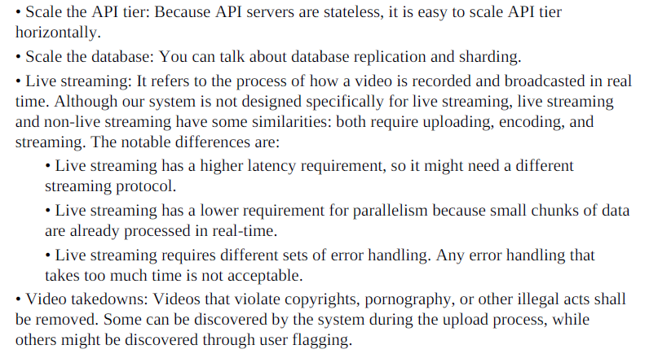
Step 4 - Wrap up

