Slide 1
DESIGN GOOGLE DRIVE

Slide 2
Step 1 - Understand the problem and establish design scope
What are the most important features? ➔ Upload and download files, file sync, and notifications.
Is this a mobile app, a web app, or both?➔ Both.
What are the supported file formats?➔ Any file type.
Do files need to be encrypted?➔ Yes, files in the storage must be encrypted.
Is there a file size limit?➔ Yes, files must be 10 GB or smaller.
How many users does the product have?➔ 10M DAU.
• Add files. The easiest way to add a file is to drag and drop a file into Google drive.
• Download files.
• Sync files across multiple devices. When a file is added to one device, it is automatically synced to other devices.
• See file revisions.
• Share files with your friends, family, and coworkers
• Send a notification when a file is edited, deleted, or shared with you.

Slide 3
it is important to understand non-functional requirements:
• Reliability. Reliability is extremely important for a storage system. Data loss is unacceptable.
• Fast sync speed. If file sync takes too much time, users will become impatient and abandon the product.
• Bandwidth usage. If a product takes a lot of unnecessary network bandwidth, users will be unhappy, especially when they are on a mobile data plan.
• Scalability. The system should be able to handle high volumes of traffic.
• High availability. Users should still be able to use the system when some servers are offline, slowed down, or have unexpected network errors.
Back of the envelope estimation
• Assume the application has 50 million signed up users and 10 million DAU.
• Users get 10 GB free space.
• Assume users upload 2 files per day. The average file size is 500 KB.
• 1:1 read to write ratio.
• Total space allocated: 50 million * 10 GB = 500 Petabyte
• QPS for upload API: 10 million * 2 uploads / 24 hours / 3600 seconds = ~ 240
• Peak QPS = QPS * 2 = 480

Slide 4
Step 2 - Propose high-level design and get buy-in
Instead of showing the high-level design diagram from the beginning, we will use a slightly different approach. We will start with something simple: build everything in a single server.
Then, gradually scale it up to support millions of users.
Let us start with a single server setup as listed below:
• A web server to upload and download files.
• A database to keep track of metadata like user data, login info, files info, etc.
• A storage system to store files. We allocate 1TB of storage space to store files.

Slide 6
APIs upload a file, download a file, and get file revisions.
1. Upload a file to Google Drive
Two types of uploads are supported:
• Simple upload. Use this upload type when the file size is small.
• Resumable upload. Use this upload type when the file size is large and there is high chance of network interruption.
Here is an example of resumable upload API: https://api.example.com/files/upload?uploadType=resumable
Params:
• uploadType=resumable
• data: Local file to be uploaded.
A resumable upload is achieved by the following 3 steps [2]:
• Send the initial request to retrieve the resumable URL.
• Upload the data and monitor upload state.
• If upload is disturbed, resume the upload.

Slide 7
2. Download a file from Google Drive
Example API: https://api.example.com/files/download
Params:
• path: download file path.
Example params:
{
"path": "/recipes/soup/best_soup.txt"
}
3. Get file revisions Example API: https://api.example.com/files/list_revisions
Params:
• path: The path to the file you want to get the revision history.
• limit: The maximum number of revisions to return.
Example params:
{
"path": "/recipes/soup/best_soup.txt",
"limit": 20
}

Slide 8
Move away from single server
As more files are uploaded, eventually you get the space full alert.
The first solution comes to mind is to shard the data, so it is stored on multiple storage servers.
But Potential data losses in case of storage server outage.
Netflix and Airbnb use Amazon S3 for storage. “Amazon Simple Storage Service (Amazon S3) is an object storage service that offers industry-leading scalability, data availability, security, and performance” Amazon S3 supports same-region and cross-region replication.

Slide 9
Amazon S3

Slide 10
Sync conflicts
the first version that gets processed wins, and the version that gets processed later receives a conflict.
How can we resolve the conflict for user 2? ➔Our system presents both copies of the same file: user 2’s local copy and the latest version from the server (Figure 15-9). User 2 has the option to merge both files or override one version with the other.

Slide 11
High-level design
notification
service notifies relevant clients when a file is added/edited/removed elsewhere so they can
pull the latest changes.
Block servers: A file can be split into several blocks, each with a unique hash value, stored in our metadata
database. Each block is treated as an independent object and stored in our storage system (S3). To reconstruct a file, blocks are joined in a particular order. As for the block size, we use Dropbox as a reference: it sets the maximal size of a block to 4MB [6].
Offline backup queue: If a client is offline and cannot pull the latest file changes, the offline backup queue stores the info so changes will be synced when the client is online.
Cold storage: Cold storage is a computer system designed for storing inactive data, meaning
files are not accessed for a long time.
Metadata database: It stores metadata of users, files, blocks, versions, etc. Please note that
files are stored in the cloud and the metadata database only contains metadata.

Slide 12
Step 3 - Design deep dive
Block servers allow us to save network traffic by providing delta sync and compression.
Notes:
Two optimizations are proposed to minimize the amount of network traffic
being transmitted:
• Delta sync. When a file is modified, only modified blocks are synced instead of the whole file using a sync algorithm [7] [8].
• Compression.

Slide 13
High consistency requirement
Memory caches adopt an eventual consistency model by default, which means different
replicas might have different data. To achieve strong consistency, we must ensure the
following:
• Data in cache replicas and the master is consistent.
• Invalidate caches on database write to ensure cache and database hold the same value. (delete from cache before write to db)
ACID

Slide 14
Metadata database
Notes:
This is a highly simplified version as it only includes the most important tables and interesting fields.

Slide 15
Upload flow
Two requests are sent in parallel: add file metadata and upload the file to cloud storage.

Slide 16
Download flow
Download flow is triggered when a file is added or edited elsewhere
Notes:
How does a client know if a file is added or edited by another client?
• If client A is online while a file is changed by another client, notification service will inform client A that changes are made somewhere so it needs to pull the latest data.
• If client A is offline while a file is changed by another client, data will be saved to the cache. When the offline client is online again, it pulls the latest changes.

Slide 17
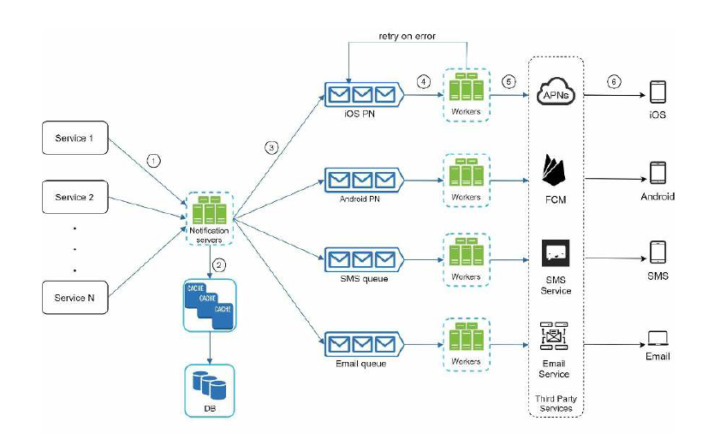
From notification chapter

Slide 18
Notification service To maintain file consistency, any mutation of a file performed locally needs to be informed to other client to reduce conflicts
• Long polling. Dropbox uses long polling [10].
• WebSocket. WebSocket provides a persistent connection between the client and the
server. Communication is bi-directional.
Even though both options work well, we opt for long polling for the following two reasons:
• Communication for notification service is not bi-directional. The server sends
information about file changes to the client, but not vice versa.
• WebSocket is suited for real-time bi-directional communication such as a chat app. For
Google Drive, notifications are sent infrequently with no burst of data .

Slide 19
Save storage space
1: De-duplicate data blocks. Eliminating redundant blocks at the account level is an easy way to save space. Two blocks are identical if they have the same hash value (SHA256, AES Hash)
2: Adopt an intelligent data backup strategy. Two optimization strategies can be applied:
• Set a limit: We can set a limit for the number of versions to store. If the limit is
reached, the oldest version will be replaced with the new version.
• Keep valuable versions only: Some files might be edited frequently. For example,
saving every edited version for a heavily modified document could mean the file is
saved over 1000 times within a short period. To avoid unnecessary copies, we could
limit the number of saved versions. We give more weight to recent versions.
Experimentation is helpful to figure out the optimal number of versions to save.
3: Moving infrequently used data to cold storage. Cold data is the data that has not been
active for months or years. Cold storage like Amazon S3 glacier is much cheaper than SS3.
Notes:
To support file version history and ensure reliability, multiple versions of the same file are
stored across multiple data centers. Storage space can be filled up quickly with frequent
backups of all file revisions.

Slide 20
Failure Handling
• Load balancer failure: If a load balancer fails, the secondary would become active and pick up the traffic. Load balancers usually monitor each other using a heartbeat, a periodic signal sent between load balancers. A load balancer is considered as failed if it has not sent a heartbeat for some time.
• Block server failure: If a block server fails, other servers pick up unfinished or pending jobs.
• Cloud storage failure: S3 buckets are replicated multiple times in different regions. If files are not available in one region, they can be fetched from different regions.
• API server failure: It is a stateless service. If an API server fails, the traffic is redirected
to other API servers by a load balancer.
• Metadata cache failure: Metadata cache servers are replicated multiple times. If one node goes down, you can still access other nodes to fetch data. We will bring up a new cache server to replace the failed one.

Slide 21
• Metadata DB failure.
1 Master down: If the master is down, promote one of the slaves to act as a new master
and bring up a new slave node.
2 Slave down: If a slave is down, you can use another slave for read operations and
bring another database server to replace the failed one.
• Notification service failure: Every online user keeps a long poll connection with the
notification server. Thus, each notification server is connected with many users. According
to the Dropbox talk in 2012 [6], over 1 million connections are open per machine. If a
server goes down, all the long poll connections are lost so clients must reconnect to a
different server. Even though one server can keep many open connections, it cannot
reconnect all the lost connections at once. Reconnecting with all the lost clients is a
relatively slow process.
• Offline backup queue failure: Queues are replicated multiple times. If one queue fails,
consumers of the queue may need to re-subscribe to the backup queue.

Slide 22
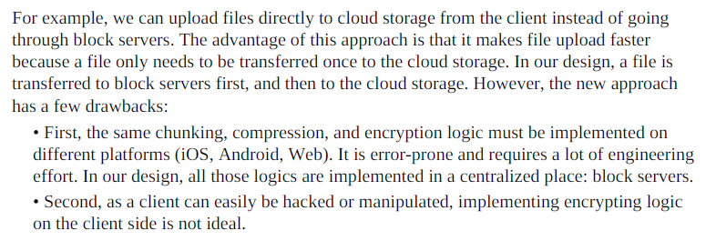
Step 4 - Wrap up
there is no perfect solution. Every company has its unique constraints and you must design a system to fit those constraints.
Knowing the tradeoffs of your design and technology choices are important.
Another interesting evolution of the system is moving online/offline logic to a separate
service. Let us call it presence service. By moving presence service out of notification
servers, online/offline functionality can easily be integrated by other services.

