Slide 1
Design Snapchat/Instagram Stories
Isabella 12/26/2021

Slide 2
Requirements
Content Delivery
24 hr expiry

Slide 3
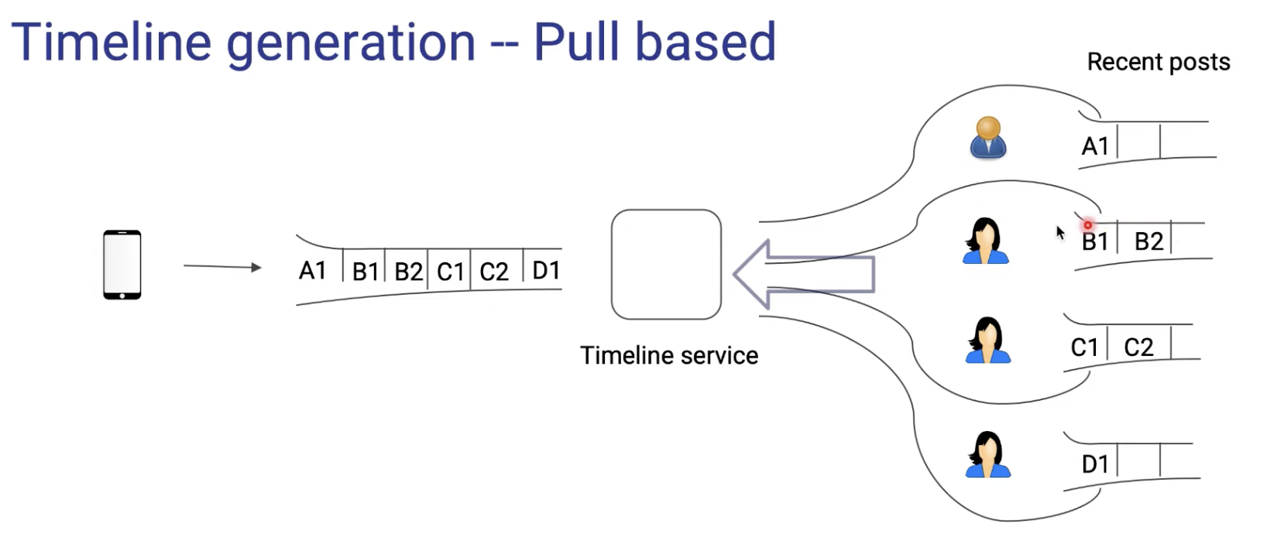
Timeline Generation
Time consuming; solution: pre-generate the timeline
For read-heavy system, users read much more frequently than write
polling usually results in empty responses, waste of time to making calls

Slide 4
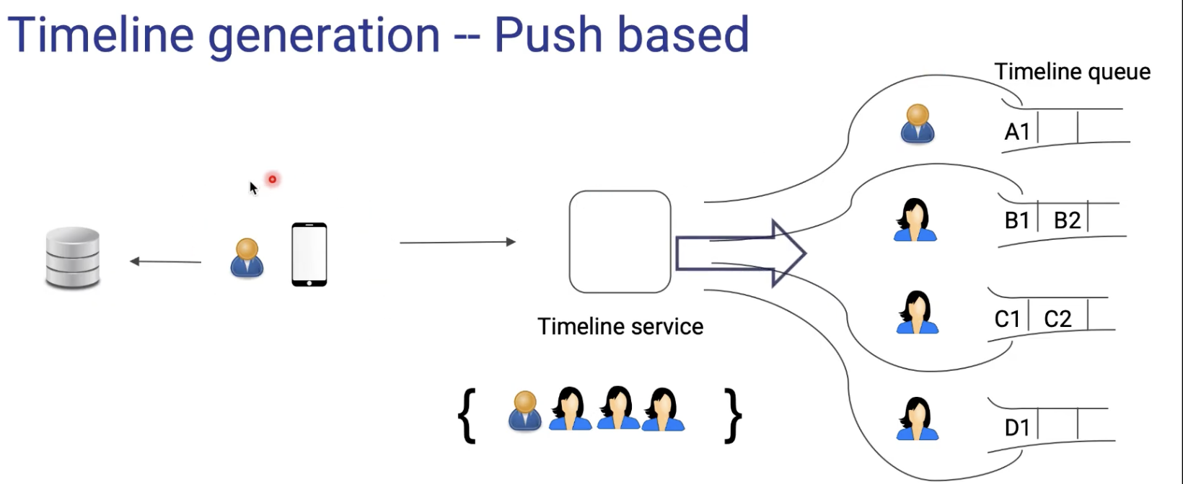
Pros: Making calls only when users are posting something
Cons: celebrity user

Slide 5
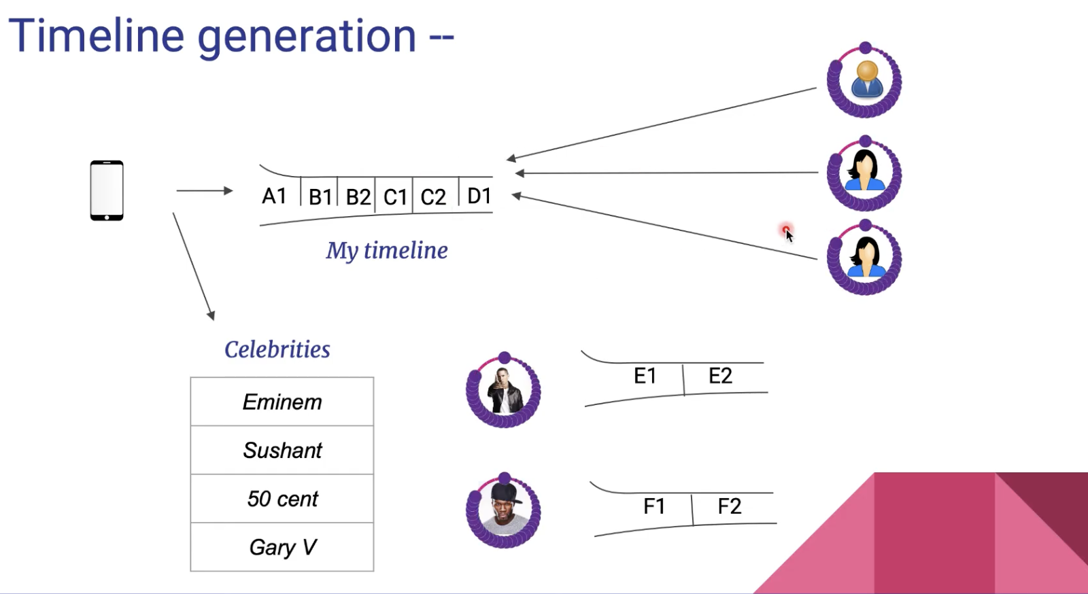
Hybrid Approach

Slide 6
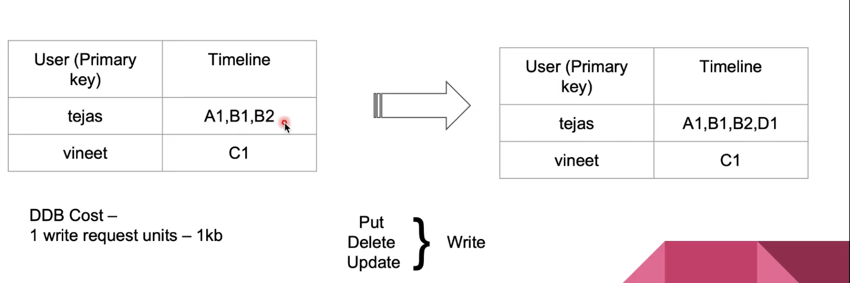
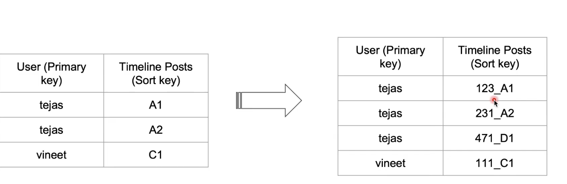
Database Schema
Dynamo DB
Approach 1: timeline: comma separate post ids
  Update is costly; Delete and Put instead: 7 writes units
Approach 2:
  Add one row for new posts
  Add timestamp in front of the post id; easy to give the latest post by sorting

Slide 7
Auto Expiry
DynamoDB/Redis TTL — Time to live
For each entry (row) in the db, we can pre-configure the time for it to get expired
TTL: 24 hours or 32 hours (Snapchat)

Slide 8
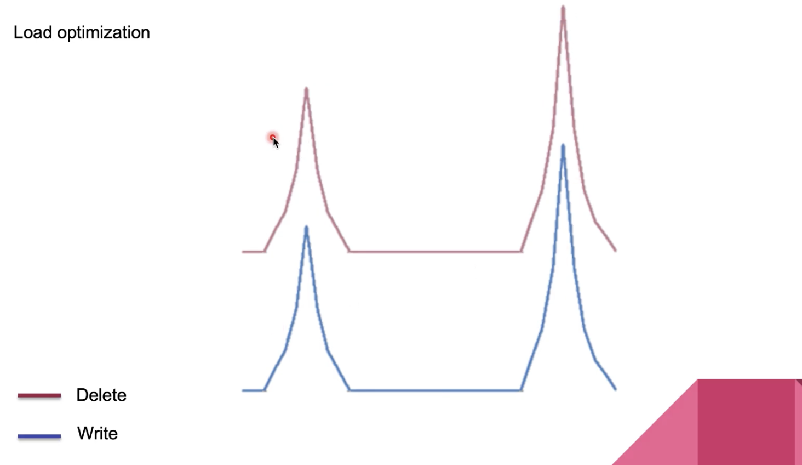
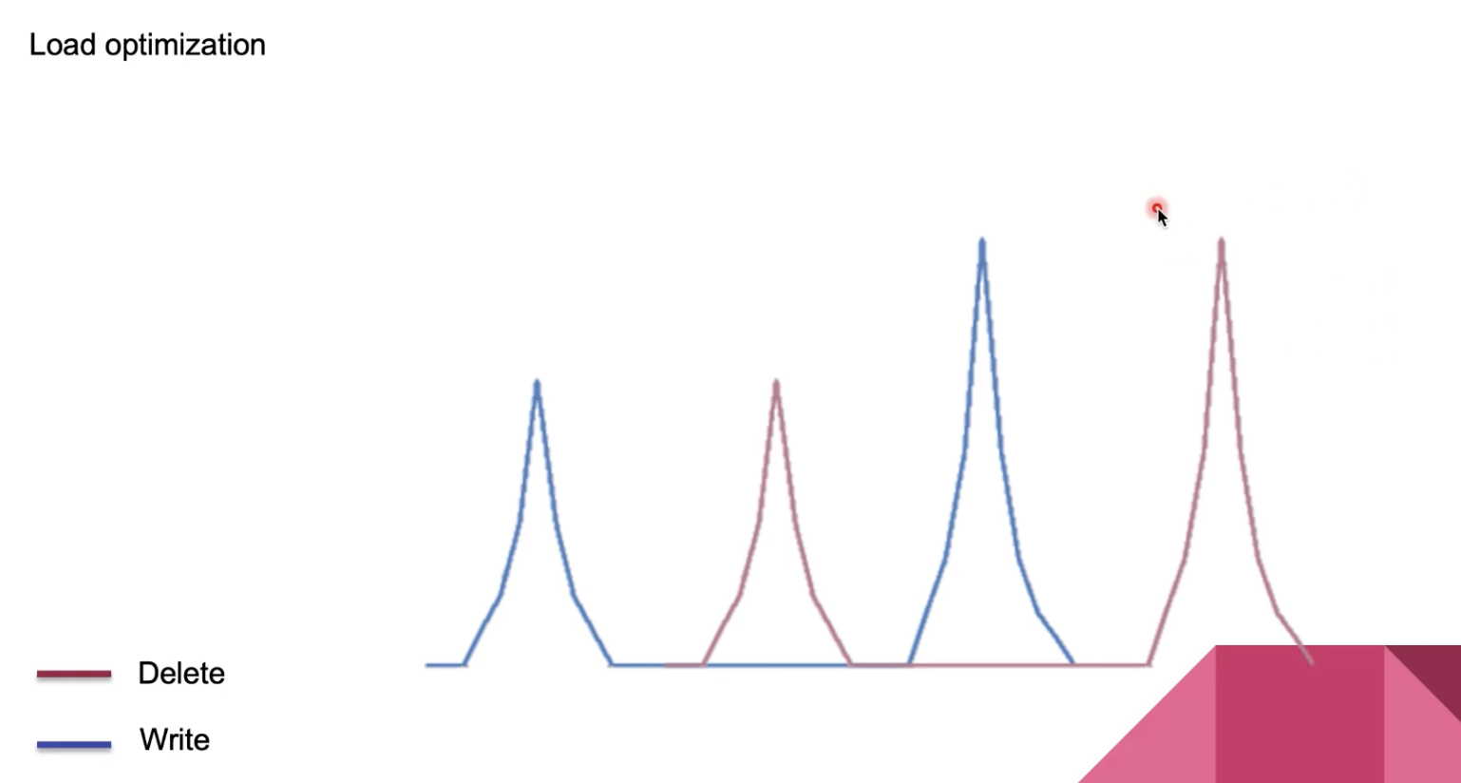
Load Optimization
24 hours vs 32 hours

Slide 9
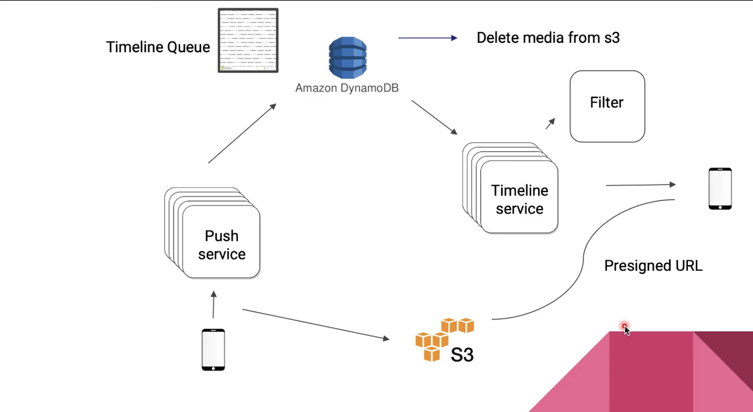
High Level Design
Filter: filter out post > 24 but < 32
Capture the delete event from DynamoDB—> trigger delete in S3 as well (or we can keep posts in S3 forever, as what Instagram did)
Pre-signed URL: another layer of secure; add an expiry to the link; though the post has not been deleted from S3 after 24 hours, other users cannot see it because the URL is expired

