Slide 1

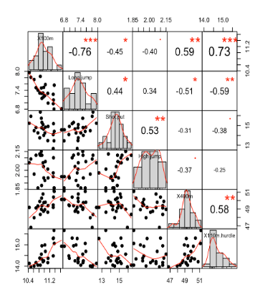
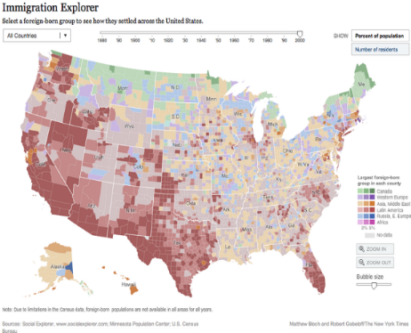
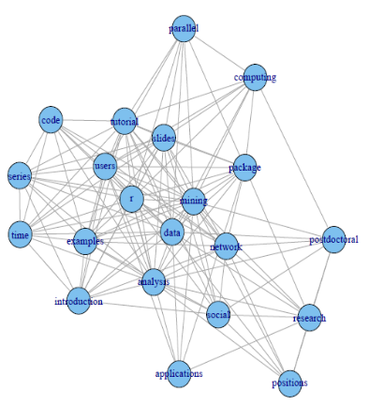
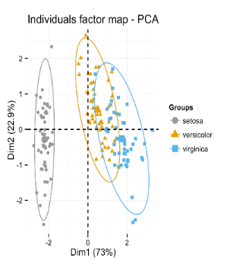
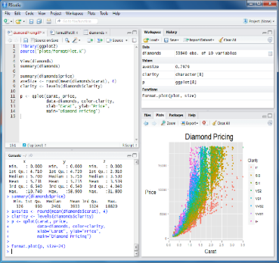
R for beginners training course Guillaume Bal & Yves Reecht 17th & 19th of October 2016

Slide 2
1. About R and this course
This section will tell you about the aim of the course, why you should use R and the R language history

Slide 3
Why inline commands software
More powerful data manipulation
Easier automation
Faster computation
It reads any type of data
Easier project organization
It supports larger data sets
Reproducibility (important for detecting errors)
Easier to find and fix errors
Advanced Statistics capabilities

Slide 4
What’s R ?
Statistical programming language derived from S
First version from 1993
Developed by the Bell Labs and John Chalmers
Available at https://www.r-project.org/

Slide 5


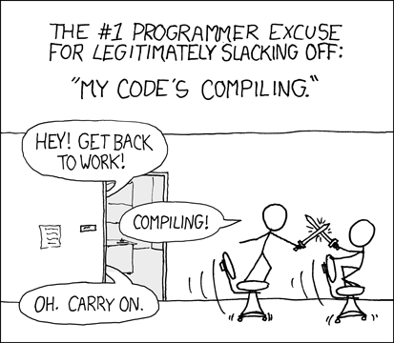
R cons & pros
Steep learning curve
Memory usage
Not always the fastest
Not automatic update
Minimal GUI
A few syntactical curiosities
Does not compile
Easy to install
Supports 64 bits configurations
‘fairly easy to program’
Developed for data oriented problems
High quality analysis
Fortran, C (C++), python wrappers
Open source & cross platform
Free
Huge community (millions users)
100s of packages
Loads of resources (online, books)
Help forum, mailing lists

Slide 6


Aim of the course
Get you started on that journey with R
You will
learn how to successfully install and run R
learn how to do most common data manipulating and viewing tasks
be given general tips and suggestions about how to program in R
be introduced quickly a few common analyses (well, maybe)
You will be able to keep going alone

Slide 7





Graphical User Interfaces
They make
R More user Friendly
you more productive
Because they are IDE (Integrated Development Environment), i.e. incorporate tools to speed up development
text editor (syntax highlighter, parenthesis checking …),
R command line completion
Data visualization tools …
The following are free
NppToR in Notepad++
Tinn-R
JGR
Emacs (for programming freaks)
Rstudio

Slide 8
Started in 2011
Why ? Well because of
Graphical workspace
cross-platform interface
tab-completion of filenames, function names and arguments
seamless Rmarkdown and knitr integration for reports
Integrates Shiny for online reports
User friendly, clear, loads of options, cross language…
Updated regularly

Slide 9
Built in help
If you want help on a specific function, e.g. plot()
help(plot)
?plot
If you want to search by keyword in all the functions documentations
help.search('generalized linear model')
?? ('generalized linear model')
Will open a html browser
help.start()

Slide 10
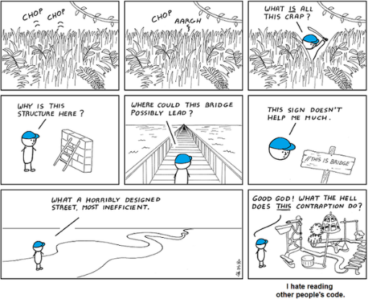
Good coding practices
Use one instruction per line
Use meaningful names
Comment our code
Use # in front of comments
Be descriptive
Indent it too ! (Ctrl + I in RStudio)

Slide 11
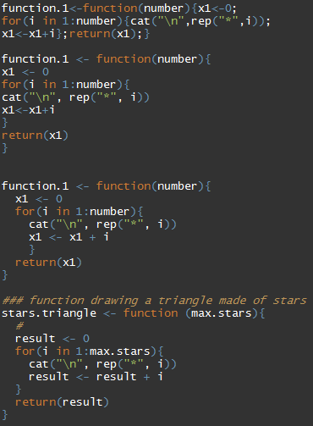
Good coding practices

Slide 12
2. R language basic structure
This section will tell you about the basic elements the R language relies upon

Slide 13



2.1 Concepts and conventions
Console
Comments (to be used extensively in scripts):
Prompt: console available
“Waiting” prompt: incomplete command (closing bracket)

Slide 14


2.1 Concepts and conventions
Variable declaration/assignment:
Assignment with “ <- ” or “ = “:
Names: letter or “.” followed by letters, digits, “.” and/or “_”
Case sensitive myvar ≠ myVar
Avoid all other characters ($%&{[]}@+*\/…): special meanings.

Slide 15




2.1 Concepts and conventions
Functions
<function_name>(<arg_name1> = <argument1> , <arg_name2> = <argument2> , ...)
Information on a function?
Argument names can be ignored… with caution!
Named arguments
Parameters
Returned value
Examples
…
≠

Slide 16


2.1 Concepts and conventions
Working directory
Query with getwd()
Set with setwd("<path>")
double the \ (windows only) or
use / <- use this one for compatibility.

Slide 17
2.2 Data types and structure
Types (modes) of data
Functions mode(), typeof()
Main modes:
numeric: 1, 3.14,… NaN (Not a Number; e.g. 0 / 0) -Inf, Inf (∞) …is the mode reported for types integer and double.
character: "Hello world", 'c\'est la vie',…
logical: TRUE, FALSE
complex: 1 + 2i,…
NA : Not Available (any type).
NULL: ~ empty (e.g. declaration of an empty variable)

Slide 18

2.2 Data types and structure
Structure (class)
Function: class()
Main classes:
vector: very important, this is the base structure. Even a variable with one element is a vector… notice the [1] (pos. of 1st element on the line) The function class() return the mode! (the same for all elements of a same vector) Every type of data has its own function to create a vector of a given length:
double(<length>), integer(…), numeric(…)
character(<length>)
…
Function concatenate c(…)

Slide 19

2.2 Data types and structure
Main classes (continued…)
factor: a integer vector with a “levels” (names) attribute! extensively used but very confusing (behave either as a numeric or a character… depending on the context)! !!! Plenty of implicit conversions in R
Two more classes that behave like vectors (numeric vectors + attributes to be interpreted as temporal information)
Date:
POSIXct/POSIXlt: date-time.

Slide 20
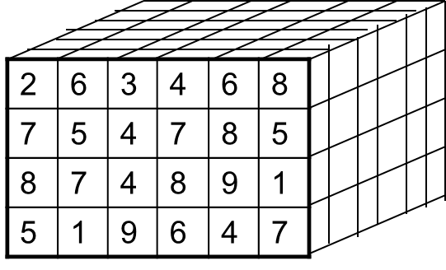
2.2 Data types and structure
Main classes (continued…)
matrix: any mode suitable for a vector + 2 dimensions.
dimensions can be named
matrix algebra fully supported in R.
created by matrix(…), cbind(…), rbind(…)
array: ~ same as matrix but not limited in dimensions.

Slide 21
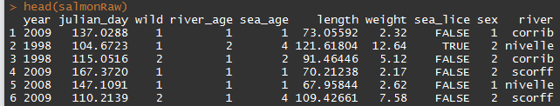
2.2 data types and structure
Main classes (continued…)
list: catchall structure.
Each element can be of any class or NULL.
The elements can be named.
data.frame: table with different types of data
a type of list (all elements have the same length) 1 column ≈ 1 vector.
two dimensions (rows x cols).
extensively used for ecological data.
!!! characters systematically converted in factors by default!

Slide 22
2.2 Data types and structure
Accessing some attributes
 | 1 dimension (vector, list,…) | 2 dimensions (matrix, data.frame,…)
Number of elements | length(x) | dim(x) (both dim at the same time) nrow(x) ncol(x)
Names of elements | names(x) | dimnames(x) (both dim at the same time) colnames(x) row.names(x)
Levels (factors) | levels(x) nlevels(x)

Slide 23


2.3 Vectors’ arithmetic
Basic arithmetic operators and functions:
Fully vectorised: allows avoiding most of loops
Operators: + - / * ^
Arithmetic functions: exp(), log(), log10(), sqrt(), abs(), …

Slide 24
2.4 Matrices’ algebra
R is well suited for matrix computations.
Several dedicated operators and functions … see examples

Slide 25

Exercises
Create a vector ‘a’ containing the values 10, 5, 4.1 and 100. (function c)
Which is its class? Its mode?
Calculate its log in base 10 (use the help if needed).
Use ‘a’ to create a matrix ‘b’ with two columns.
… print the number of rows of ‘b’.
Create a vector of two elements with today and yesterday date (use Sys.Date)

Slide 26
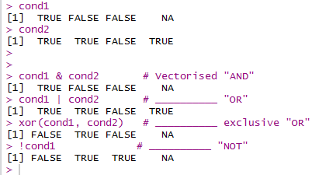
2.5 Logical operators
Fully vectorised… as usual & (AND), | (OR), xor (excl. OR) and ! (NOT)
Among elements of a vector:
any() at least one of the elements is TRUE
all() the elements are TRUE

Slide 27
2.5 Logical operators
Not vectorised
||, && and isTRUE()
Mainly used for programming control-flow (if clauses in particular). See examples.
isTRUE() returns TRUE if the condition is true, FALSE in all other cases… …regardless it is NA or any other indefinite value.

Slide 28
2.6 Comparisons and tests
operators (guess what… vectorised!)
== (equal): anything that can be compared, character strings, logical, integers, doubles (!!! machine precision).
!= (not equal): anything that can be compared as well.
<, <=, >, >= : numeric, date-time.
Testing for indefinite values:
is.na(), is.null(), is.nan(), is.finite()
sets
is.element(<elements>, <set>) identical to <elements> %in% <set>
which(), match(),
See also ?union

Slide 29
Exercises
Create a random vector “x” of length 10, with values comprised between 0 and 10 (function runif(…), use the help).
Which elements of this vector are greater than 5?
Test if sqrt(x)^2 equals x in all cases.
Can you show that sqrt(x)^2 equals x ± the machine precision (use sqrt(.Machine$double.eps) as precision)?

Slide 30

2.7 Sequences / repetitions
Very useful for optimising the use of vectorisation.
seq(…)
works with any combination of (arguments): from=, to=, by= (increment), length.out=, along.with= (vector of same length).
all argument defaults at 1.
shortcuts:
(from)“:” (to)
seq_len(<length>), seq_along(<vector>)

Slide 31


2.7 Sequences / repetitions
rep(…): repetition of patterns, sequences,…
rev(…): reverse a vector

Slide 32


2.8 Operators’ precedence
R complies with the usual precedence rules (* / over + -,…)
Some tricky operators (e.g. : )
=> Always use (…) when you have a doubt

Slide 33
Exercises
Create a sequence (function seq)
from 2,
with the length of the vector x (from exercises 1.7 – assume you don’t know its actual length)
with an increment of 1
in two different ways … of which one using “:”!
Create the same sequence using seq_along().
Reverse x and store it in x2.
Create a sequence from 100 to 0 by an increment of 5

Slide 34
3. Data manipulation
This section will give you the basics for manipulating data in R

Slide 35









Data loading
In a nutshell you can load everything you want !
Flat files (simple text files) : read.table() & read.csv() functions
Excel files : packages readxl, gdata, XLConnect, xlsx
https://www.datacamp.com/community/tutorials/r-tutorial-read-excel-into-r?tap_a=5644-dce66f&tap_s=10907-287229
Other statistical softwares: packages haven or foreign (+ Systat and Weka)
Relational data base : package RMySQL, RpostgreSQL, Roracle, DBI
Data from the web : TwittR2Mongo

Slide 36

Data loading, read.table()
to read flat file (.txt and .csv)
Import them as data.frame
Quite a lot of arguments (?read.table)
File name, can include location, even online adress
Is the first line of your table variables names ?
Field separator character
Decimal separator character
a character vector of strings which are to be interpreted as NA

Slide 37

Data saving, write.table()
to save your data, quite similar to read.table()
outputs are .txt or .csv. files
Quite a lot of arguments (?write.table)
x, the data you want to save
file name, can include location
field separator character
decimal separator character
row names specification

Slide 38


File location
R does not support \ in addresses
Instead use ‘\\’ or ‘/’
Recommended

Slide 39


Course dataset
Data are salmons caught in traps
from 5 rivers of the Franco-Irish observatory
from 1995-2015 the period
with records including
River of capture
Day and year of capture
Marine and river age of the fish
Length and weight
Infection by sea lice

Slide 40
Exercises
Import the salmonRaw.txt file in R
as a data.frame called ‘salmonRaw’
the file is located on the public drive in the ‘0_r_training’ folder
Display a few rows to check everything is alright
Look at the dimension of the table
Save the data in your folder as ‘salmonRawYourName.txt’

Slide 41



3.2 Indexing vector data
How to access/extract a subset of a variable?
several ways, operator […]
position
logical indexation
by name

Slide 42




Indexing data with several dimensions
operators […]as well
dimensions separated by “,”
order: rows, columns,…

Slide 43



Indexing data, matrices
Different methods can be combined
R usually try to simplify by default:
Problem: when programming you not necessarily know a priori the # row or col selected and the behaviour change if only one. => option drop = FALSE.

Slide 44
Indexing data, lists
Extracting one element
with the position: [[<i>]]
with its name: [["<element_name>"]] or $<element_name>
range of element (!!! returns a list): […] Works just as for a vector: by position, name, logical indexation.

Slide 45
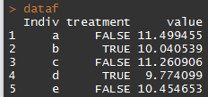

Indexing data, data.frames
data.frames: lists in which every element is a column… + 2 (possibly named) dimensions
2 things to remember
column = vector Dimensions are used just as for matrices:

Slide 46
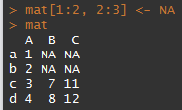
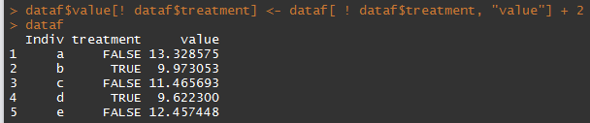
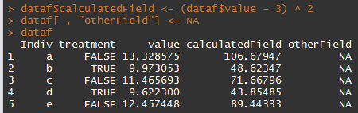
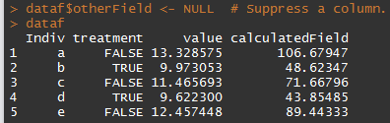
Modifying data
General rule: “you modify as you access”:
<object>[…] / $… / [[…]] <- value
Also works sometimes for adding/removing stuff:
Adding columns to a data.frame Removing a column

Slide 47


Modifying data
Further remark: the “change as you access” rule also extends to most of other functions accessing attributes of the objects ([row.|col]names(), levels(),…): … and can even be combined with indices:

Slide 48
Exercises
Create a vector “seq5” as a sequence from 1 to 5
Name the elements as the first five letters (from the vector letters). (decompose… first extract the letters,…)
Select the elements 2 and 4 using two different ways.
Using the salmon data:
Create a new data.frame “salmonSub10” with the 10 first rows of salmonRaw.
Remove the column “wild” from salmonSub10.
Select the individuals in salmonSub10 with a length greater or equal to 80cm.

Slide 49



3.3 Subsetting data
Using a test
removing elements by position:
subset(x, <condition>) function:

Slide 50
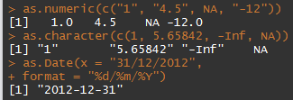
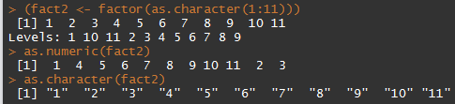
3.4 Data types conversion
Including classes that behave like vectors.
Functions as.<type>(…) usable from different compatible types:
Mind the factor’s split personality!

Slide 51
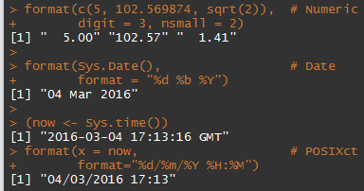
Data types conversion
Text formatting: for numeric, Dates, POSIXct,… you may want further control => format(…)

Slide 52
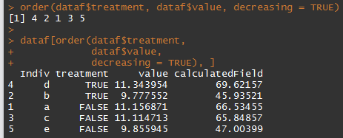
3.5 Ordering data
sort() -> order a vector.
order() -> indices to order data (possibly >1 factor)

Slide 53
Exercises
Using the salmonRaw data
What is the class of the column “river”?
List the different rivers in the dataset (cf. slide 22).
Create a “new” data.frame (named salmonSub) with only individuals from the rivers Corrib and Scorff (and ordered by river and year).
How many rows does it contain?
Save it to a file “salmonSub.csv” (comma separated)

Slide 54
4. Data mining, basics
This section will give you the basics for simple data mining in R

Slide 55


Data preview
Because datasets often very large
<object>[…]
head(<object>, n = <nb_elements/rows>)
tail(<object>, n = <nb_elements/rows>)

Slide 56

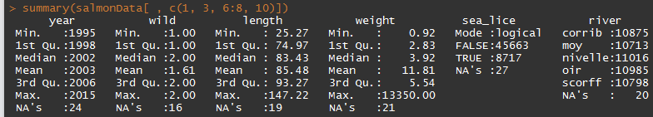
Data types and summary
Data types/structures
summary(…)
vectors
data.frame

Slide 57


Basic statistics
mean(…), median(…), min/max(…), sum(…), sd(…), var(…),…
!!! NA sensitive: use na.rm = TRUE (if any):
Note on logicals: behave as 0/1 => convenient for summarising tests!

Slide 58
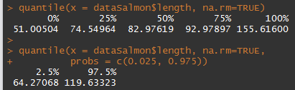
Basic statistics, quantile()
default: quartiles
quantiles can be changed with probs = …

Slide 59
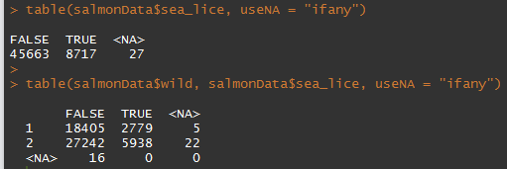
Contingency table, table()

Slide 60
Exercises
Store salmonRaw in a new “salmonTidy” data.frame. You will now work on this data set.
Detect incorrect weights and correct them.
Remove entries with impossible dates (ignore leap years).
Recode the column “wild” (1 -> TRUE, 2 -> FALSE)
Save it in a salmonTidy.csv file

Slide 61
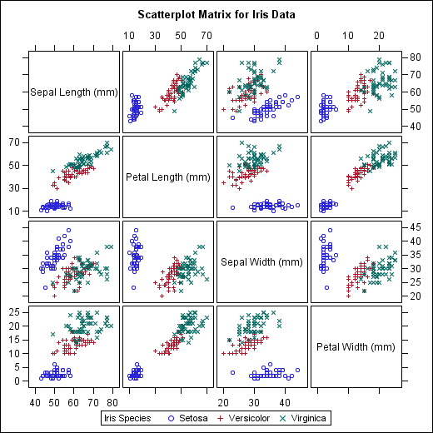
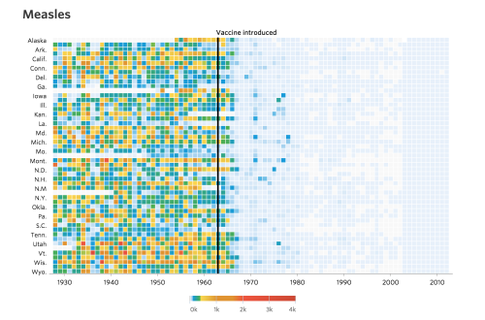
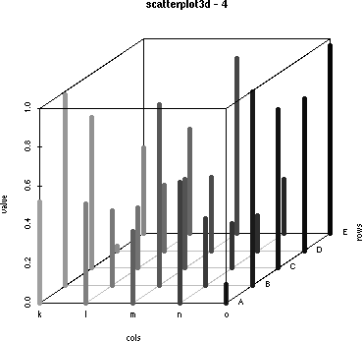
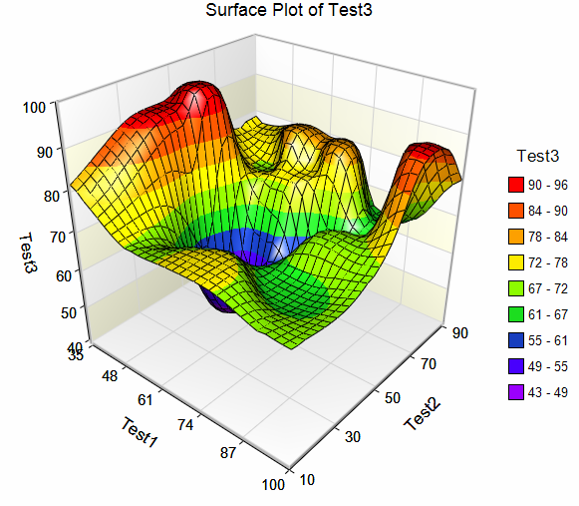
4. Graphics
This section will tell you about the basic elements the R language relies upon

Slide 62
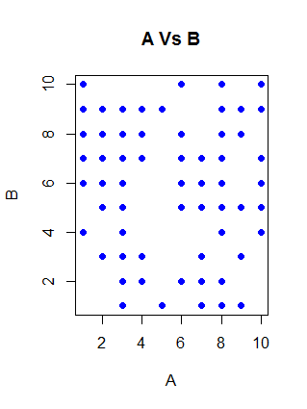

plot()
Most basic plot function, plot Y Vs. X
See ?plot for more customisation

Slide 63
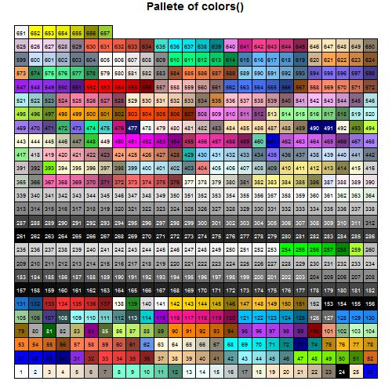
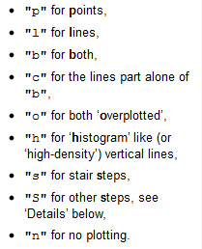
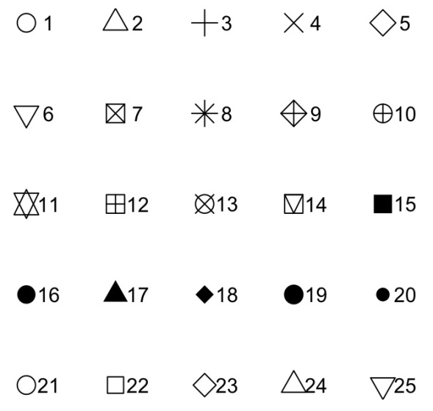
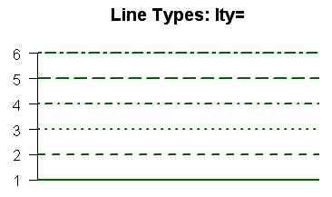
type, pch, lty and col arguments
type
pch

Slide 64
More features
You can insert legends with legend()
Add text to the plot using
text()
mtext()
Create custom axes
Set axes = FALSE in plot() or boxplot() or ...
Draw your custom axes using axis()
Add curves, lines, other points
lines()
abline()
Curve
points()
Find the coordinates of points using locator()

Slide 65
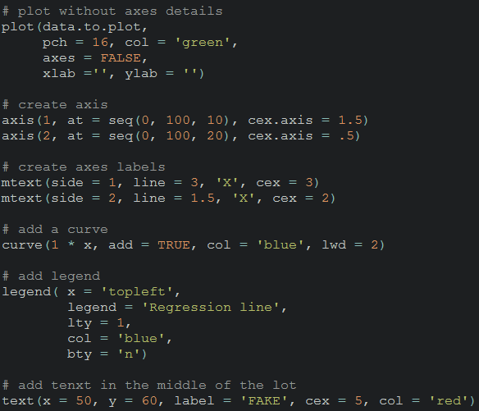
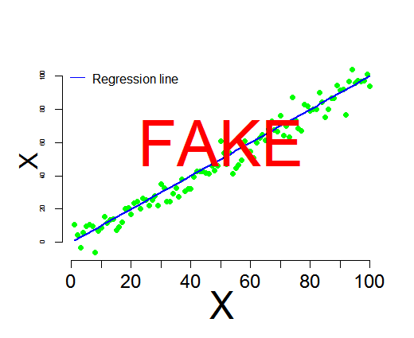
More features

Slide 66
Exercises
Plot the length Vs weight of
all of fish with a different color per river
fish from the Moy river with small points, limit weight axis to 10 (ylim and xlim arguments)
Show us your artsy side, play with the arguments

Slide 67
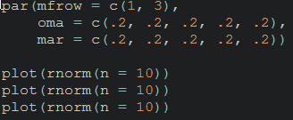
par()
Sets or queries graphical parameters
Sets parameters for all subsequent graphics
Main multiple graph per windows
multiple graphs per window with mfcol or mfrow
control inner and outer margins mar() and oma()

Slide 68
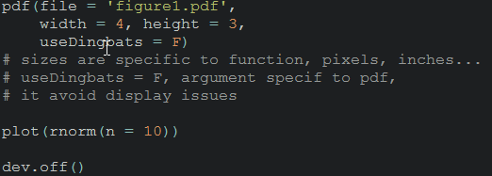
Saving graphics
R graphics can be saved as
.pdf files , pdf() function
.tiff files , tiff() function
.png files, png() function
...
Graph instructions must be specified between 2 instructions:
‘start recording’ instruction using pdf()…
‘closure’ instructions using dev.off()
Arguments needed quite similar for all the kind of graphics

Slide 69
More kinds of plots
There is an long list of possible functions/graphs
barplot() (you can create stacked barplots too)
boxplot()
pairs(), function for quick data mining
matplot(), plot the columns of one matrix against the columns of another

Slide 70
Exercises
Can you make
A histogram of weights ? (?hist)
A boxplot of the julian day ? (?boxplot)
A boxplot of the date of return by year ?
PS : You can use x11() to create new graph windows
Add the 3 graphics on 1 figure panel (use par())
Save that panel as a .pdf file
Try to make use of pairs() & matplot()

Slide 71
ggplot2 package
A package dedicated to graphs
Based on the grammar of graphic approach relying on
Aesthetics, ie what you plot
Geometries, ie how you plot it (points, lines, ribbon…)
According to some people
More intuitive ?
better that basic R graphic functions because you need less code

Slide 72


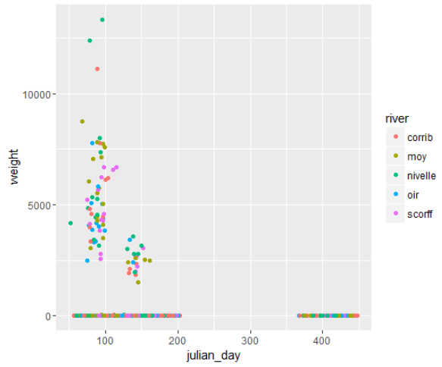
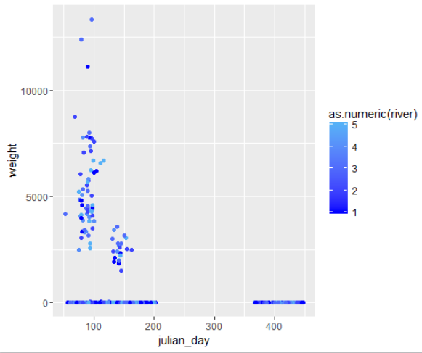
ggplot2 package, examples

Slide 73
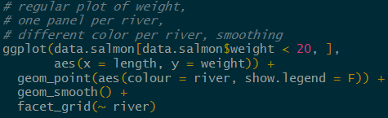
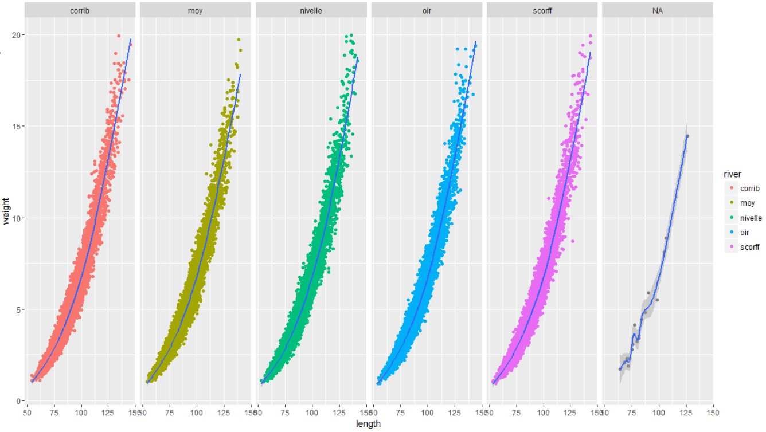
ggplot2 package, examples

Slide 74


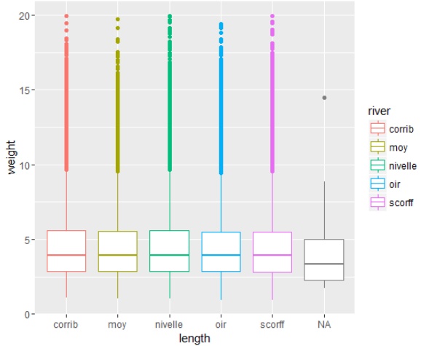
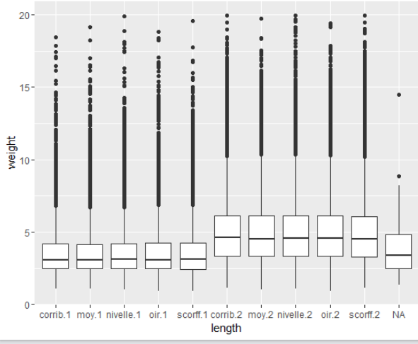
ggplot2 package, examples

Slide 75

More on graphics
ggplot
Sarah BIGFish talk documents https://bigfish.joomla.com/meetings
http://www.cookbook-r.com/Graphs/Axes_(ggplot2)/
maps : see Hans course https://bigfish.joomla.com/meetings
http://girke.bioinformatics.ucr.edu/GEN242/vignettes/15_Rgraphics/Rgraphics.html
http://www.r-graph-gallery.com/

Slide 76
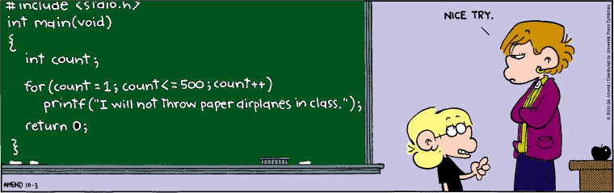
5. Repetitive & conditional tasks
How to avoid loops, well because they are
- slow (not always the case)
- because they are more complicated to write
How to make loops when you have no choice

Slide 77
5.1 Applying the same function - over one dimension of a matrix/dataframe, apply() - by factor levels on a vector, tapply() and by() - over elements of a list, sapply() and lapply()

Slide 78

apply()
To perform an operation by rows or columns of matrix/dataframe
For instance to get quantiles by rows
x, the data you want to use
1 for rows and 2 for columns
The function you want to use
Argument linked to quantile()

Slide 79

sapply() & lapply()
for lists
lapply()
returns a list of the same length as X
each element is the result of applying FUN
sapply()
a user friendly version of lapply(), FUN instead of MARGIN
returns a vector or matrix

Slide 80

tapply() & by() for vectors
Apply functions by factors or combinations of factors
tapply()
by()

Slide 81
Exercises
Subset salmon data for colums weight, length julian_day
Use apply() to calculate the mean of the columns
Calculate mean size of fish by (use full dataset)
year
year and sea age
using both ‘by()’ and ‘tapply()’ functions at least once

Slide 82
5.2 loops - for() loop, performs a given number of instructions - while() loop, perform instructions until condition is satisfied - if(), for conditional tasks, not a loop by itself but often part of nested loops

Slide 83


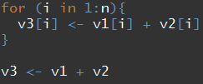


for() loops
repeat action for a determined number of iterations
‘i in 1:n’, i is called a counter, it follows a sequence
When to use them ?
You have to repeat an operation several times (> 3 - 5)
You can’t use vectorization or use apply() and the likes

Slide 84

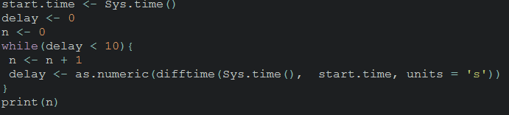
while() loop
2 repeat action until condition satisfied

Slide 85
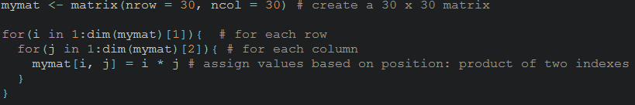
Nesting loops
You can nest as many loops as you need

Slide 86

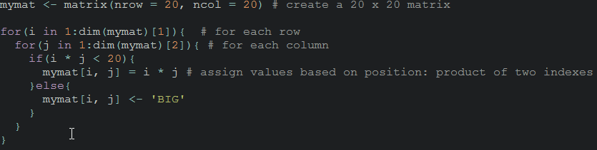
Conditional tasks with if()
Is used to executed a task based on a condition
Is generally within a for loop
Specific options
break() to get out of loop if condition not satisfied
next allows to go to the next iteration

Slide 87
Exercises
Create a loop saving each year of the salmon data into a different ‘.txt’ file (use paste())
Create a loop making a pdf containing an histogram of each column of the salmon data
being of class numeric
add the corresponding column name as title for each graph

Slide 88
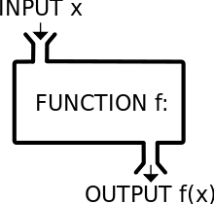

5. More advanced analyses & programming
This section will tell you about
1. creating functions
2. basic analyses of data
3. Reproducibility
Linear models
Y = a + bX + e, e iid

Slide 89

Functions
function = part of a computer program that performs some specific action
You can create your own ones !

Slide 90
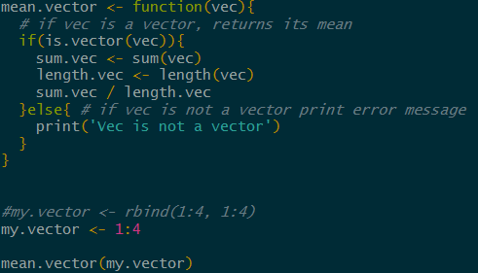
R function writing example
Guess what it does !

Slide 91
Exercises
Create a function
making the sum of 2 integers
including an error message if arguments aren’t integers
Create a function
checking whether a single number is in a vector
giving you an error message if arguments are not a number and a vector

Slide 92
Non parametric smoothing
Used to highlight trends in the data
lowess()
is one function performing smoothing
argument ‘f’ modify the degree of smoothing
For more details and functions see Hans talk at https://bigfish.joomla.com/

Slide 93
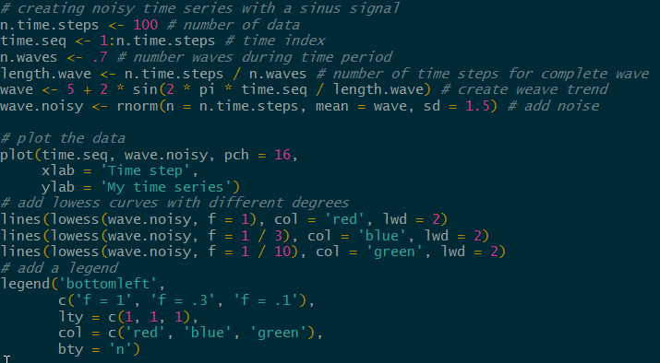

lowess() examples

Slide 94
Correlations / linear models
bartlet.test(), test homoscedasticity or homogeneity of variances, one of the main hypothesis
cor.test() , correlation between 2 variables
anova(), comparison of means
lm(), glm() allow for linear regression

Slide 95


cor.test() and lm() example

Slide 96
Generalized Additive Models
Are linear models and smoothers mixed
Model selection need to be performed
MGCV package advised
Hans talk https://bigfish.joomla.com/

Slide 97
Generalized Additive Models
Are linear models and smoothers mixed
Model selection need to be performed
MGCV package advised
https://bigfish.joomla.com/

Slide 98
Generalized Additive Models
NOT PUBLIC

Slide 99
Reports, R markdown package
It is
Package developed by r studio based on knitr and pandoc
Fully integrated in r studio
Useful for
Easily creating dynamic documents
Web pages
Reproducible analysis and reports
Data work up for WGs – html/word
Working Group reports - word
Survey reports – word/pdf
Documenting packages/functions – pdf
See Colm talk at https://bigfish.joomla.com/

Slide 100
6. More always more
This section will tell you about
1. potentially usefull packages
2. where to learn more

Slide 101
R packages
Data manipulation / cleaning
tydr (no obvious advantage)
stringr for string manipulations
dplyr (uses intuitive syntax)
data.table (syntax ‘close’ to SQL, time efficient on big tables)
lubridate (to mess with date formats)
zoo, xts and quantmod (for time series)
Plots
ggplot, ggplot2 (plotting package based on grammar of graphic)
ggvis (interactive web graphic)
Ploty (interactive, browser-based charting library )
Mapping
See Hans talk on https://bigfish.joomla.com/
Reporting
R markdown in Rstudio, see Colm talk on https://bigfish.joomla.com/
Function Sweave to generate LATEX documents and pdf
Package OdfWeave for open office documents
Web application
Shiny

Slide 102
R packages, fisheries
FSA : Fisheries Stock Assessment
FLR : Fisheries Library in R
fishmethods : Fisheries Methods and Models in R
fishdynr : Fisheries Science Related Population Dynamics models
TropFishR : Tropical Fisheries in R …
More on R for fisheries analyses website
http://derekogle.com/fishR/

Slide 103


Write your own models
Optimizers
nls()
nlminb()
optim()
package optmix
Call software using R package

Slide 104






More help
Books
Forums
http://stats.stackexchange.com/questions/tagged/r
http://r.789695.n4.nabble.com/
Mailing list
R help mailing list, https://stat.ethz.ch/mailman/listinfo/r-help
BIGFish mailing list, bigfish_mailing_list@googlegroups.com
Google
loads of documents
choose you keywords wisely
you’ll probably end up on one of the forums mentioned

Slide 105


Slide 106
More exercises
loops
plot length/weight
by river for every year, all rivers for one year on same panel
save into a pdf

