Slide 1



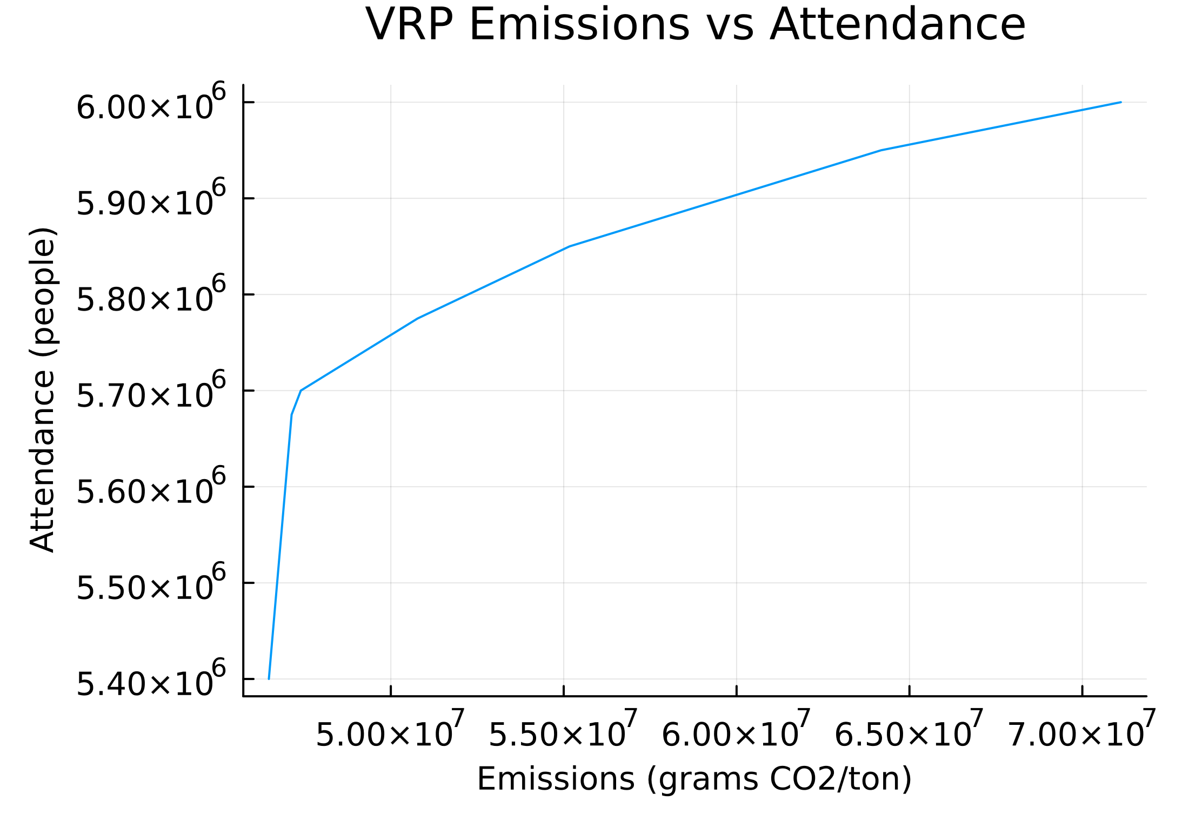
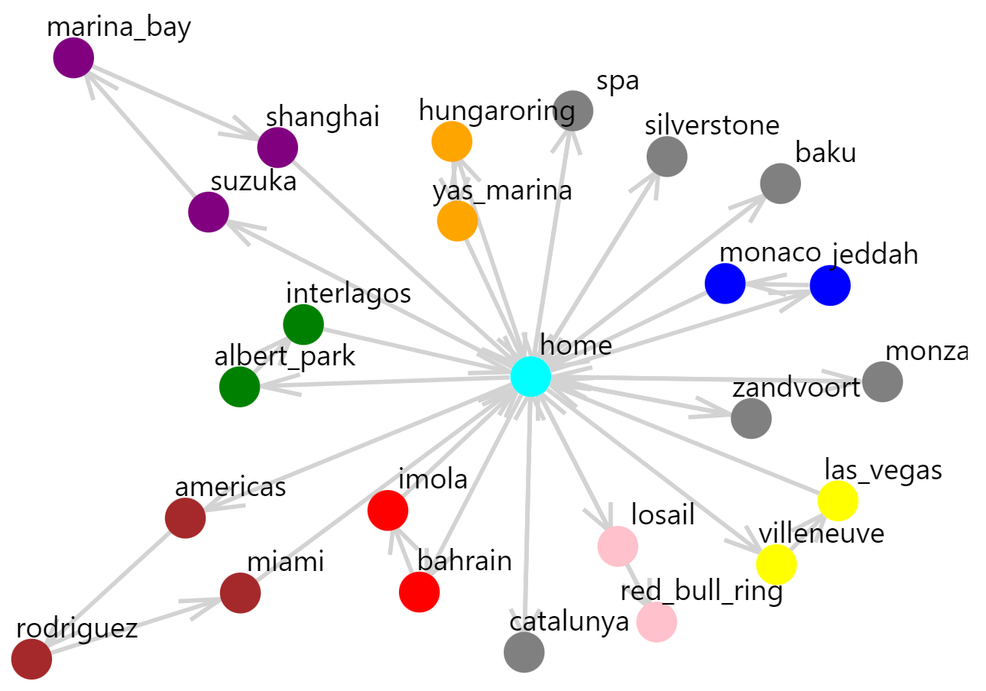
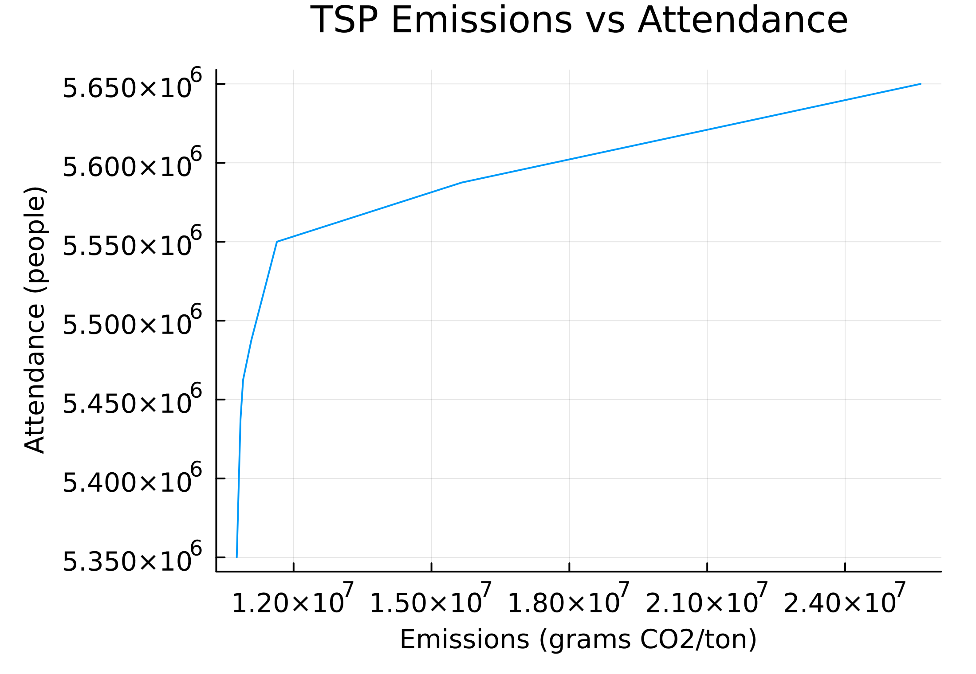
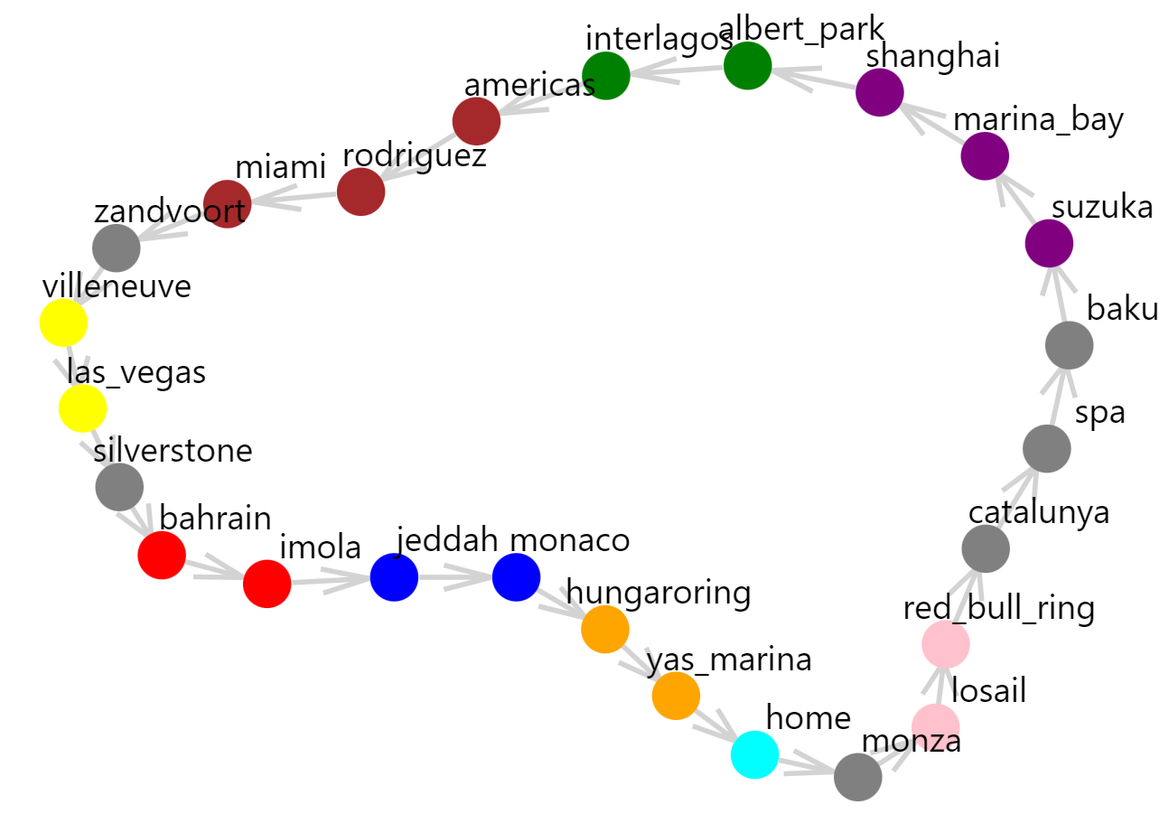

Proposing an Optimal Formula 1 Race Schedule with Minimal Emissions and Maximal Total Attendance
Guillaume BONHEURE and Rodrigo OLIVARES-LOPEZ
Problem Statement
Model Formulation
Emissions and Attendance Trade-Off
Formula 1 is a sport with very complex logistics:
Teams and equipment need to travel the globe in very short timeframes over a 24-race calendar.
Teams cannot sustain many repeated races and need to return home often, with a maximum number of consecutive races allowed.
Many races close to each other decreases overall attendance because of saturation in that area
How to optimize the 2023 race schedule for minimal emissions and maximal attendance?
Objective: Minimize emissions and attendance loss
Vehicle Routing (the teams that return home, determines consecutive races):
Every race is visited exactly once
At most 2 triple consecutive races (triple header)
At most 6 double consecutive races
Never have more than 3 consecutive races
Travelling Salesman (logistics between races, determines overall race schedule):
Triple and double headers from VRP are fixed
Emissions as a function of distance $D_{i,j}$:
$$E_{i,j}=\left\{\begin{aligned}D_{i,j}∗62 if D_{i,j}≤5000 km \\ D_{i,j}∗500 if D_{i,j}>5000 km\end{aligned} (grams\frac{CO_{2}}{ton})\right.$$
(i.e., do we go by truck or by plane?)
Attendance loss as a function of distance $D_{i,j}$:
$$A_{i,j}=\left\{\begin{aligned}150 000 if D_{i,j}≤250 km \\ 125 000 if D_{i,j}≤500 km \\ 100 000 if D_{i,j}≤1000 km \\ 50 000 if D_{i,j}≤3500 km \\ 0 otherwise\end{aligned}\right. (less people)$$
Trade-Off Results
Improvement Over Actual Schedule
Potential Next Steps
Under our assumptions, the optimal trade-off VRP solution leads to the teams having 37% less emissions compared to the actual schedule.
Based on this optimal VRP, our optimal trade-off TSP solution leads to the race supporting logistics having 69% less emissions than in the actual schedule.
Overall race attendance is given by the TSP, and in our optimal solution attendance increases by 5.7% compared to the actual 2023 race schedule.
1) Improve efficiency VRP model consists of 17M+ constraints and 14K+ variables, not tractable for consumer hardware
Explore ways to make problem more computationally tractable
2) What about the weather? A Formula 1 race can only be held if the weather is clear or if there is a limited amount of rain
Add time dimension and weather data to the TSP to minimize chances of races being cancelled due to bad weather
15.071—The Analytics Edge Fall 2019
15.093—Optimization Fall 2022

