Slide 1
Bankruptcy Prediction Machine Learning Approach
Utilizing Advanced Analytics for Financial Stability
Guillaume CAPELLI

Slide 2
Table of Contents
01
02
03
04
Introduction and Data Overview
Quick presentation of the project and the Data
Data Preparation and Initial Modeling
Data preprocessing
Model Optimization and Evaluation
Test Models and Performance
Conclusion and Directions
Model Comparison

Slide 3

The Subject
The Data that gonna be analysed come from the Taiwan Economic Journal for the years 1999 to 2009. Company bankruptcy was defined based on the business regulations of the Taiwan Stock Exchange.

Slide 4
Data Overview
SHAPE
NULL
IMBALANCED
6819 ROWS
96 COLUMNS
All Numerical
0 NULL
0 DUPLICATE
VERY IMBALANCED
6599 - 0
220 - 1

Slide 5
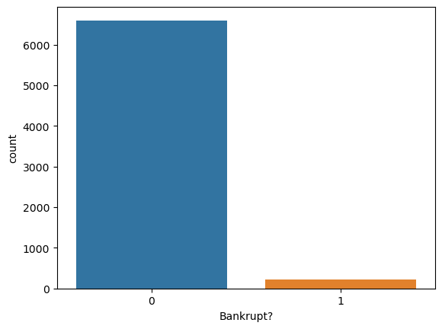

Slide 6
Data Preparation and Initial Modeling
Data Preprocessing
SMOTE and the IMPACT
01
02
Step cleaning and prepare the Data
Handle the Imbalance target/data
Model Training
03
Select and train the initials models, see how the model perform

Slide 7

So like i was saying this data was pretty clear, no nulls, no duplicated, the only thing to do was to understand the meaning, the context prepare the Data to be trained, like split it and choose the goods features !

Slide 8
The Features: Too many features for me (96) and it was impossible to use a Heat Map to visualize the high collinearity, so i use a simple function to find the features with correlation greater than a threshold at 0.5.

Slide 9
PROCESS
Split the test data between the Target and the features.
Scale the DATA and use logistic Regression for its simplicity in binary outcomes.
Preprocessing
SMOTE
Model Training
Evaluation
Use the SMOTE to balance the data, increase the synthetic minority class samples
The metrics showing a correct prediction 74% BUT DOUBLE BUT

Slide 10
A Quick presentation of the Metrics
Precision is important when the cost of a false positive is high. For example, in spam detection, a high precision score means that non-spam emails are not incorrectly classified as spam.
Recall is important when the cost of a false negative is high. For example, in fraud detection or disease screening, you wouldn't want to miss any potential frauds or diagnoses.
F1-Score is critical when you’re dealing with imbalanced classes, which is often the case in real-world problems, and you need a single metric to evaluate your model’s overall performance in terms of precision and recall.
Support is important for understanding the scale of the testing data and for contextualizing the performance metrics; it can indicate whether the dataset is balanced and how representative the metrics are for the various classes.

Slide 11
Logistic Regression Score (0.74)
 | Precision | Recall | F1-Score | Support
0 | 0.97 | 0.75 | 0.85 | 1313
1 | 0.07 | 0.47 | 0.12 | 51
The model's overall accuracy stands at 74%, indicating fair predictive performance. However, it excels in identifying non-bankrupt cases with high precision (0.97) but struggles with a low precision (0.07) for bankrupt cases, leading to many false positives. The recall rate for bankruptcy detection is moderate (0.47), suggesting the model correctly identifies nearly half of the actual bankrupt cases. The F1-score for bankrupt predictions is low (0.12), reflecting poor performance in balancing precision and recall for this class.

Slide 12
SO NOW LET’S TEST MORE MODELS
RandomForest and GradientBoosting
“Pretty OK for one, may try to do some Hyperparameter Tuning”
RIdgeClassifier, SVC and Gradient Boosting
XGBoostClassifier
“Oh ! I think i’ve got something, definitely gonna Tune this one !”
“Not that good for the three”

Slide 13
RidgeClassifier Score
 | Precision | Recall | F1-Score | Support
0 | 0.99 | 0.87 | 0.93 | 1313
1 | 0.20 | 0.80 | 0.31 | 51

Slide 14
SVC Score
 | Precision | Recall | F1-Score | Support
0 | 0.99 | 0.92 | 0.95 | 1313
1 | 0.24 | 0.65 | 0.35 | 51

Slide 15
Gradient Boosting Score
 | Precision | Recall | F1-Score | Support
0 | 0.99 | 0.95 | 0.97 | 1313
1 | 0.34 | 0.65 | 0.44 | 51

Slide 16
RandomForest
 | Precision | Recall | F1-Score | Support
0 | 0.98 | 0.97 | 0.98 | 1313
1 | 0.40 | 0.43 | 0.42 | 51

Slide 17
XGBoost Score
 | Precision | Recall | F1-Score | Support
0 | 0.98 | 0.98 | 0.98 | 1313
1 | 0.50 | 0.55 | 0.52 | 51

Slide 18
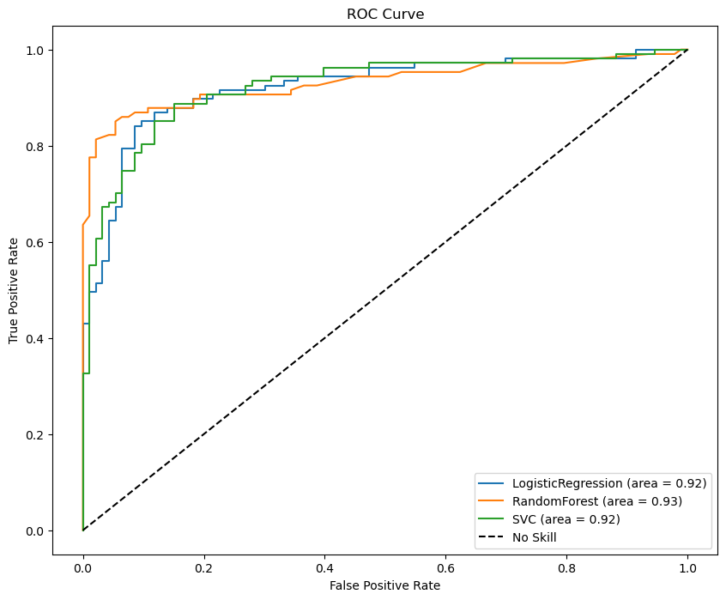
Here’s a ROC Curve to compare some models

Slide 19
Awards
XGBoost (Why him)
Accuracy: 0.96
RandomForest
Accuracy: 0.95
Gradient Boosting
Accuracy: 0.94

Slide 20
Why XGBoost is the Winner
XGBoost: He’s a supervised learning algorithm within the ensemble methods category, which employs the gradient boosting framework with decision trees to incrementally improve predictions. Known for its efficiency in classification, regression, and ranking tasks. Key features include handling missing values, parallel processing capabilities, loss function optimization with regularization to prevent overfitting, and built-in routines for cross-validation and managing a wide range of data types. Commonly used in fields where large amounts of structured data require fast and accurate predictions.

Slide 21
So now, it’s time to do some HyperParameter Tuning on two Models !

Slide 22
Here’s the winners for the GridSearchCV
01
02
XGBoost
RandomForest
Let’s play with the learning rate
Let’s play with the number of trees

Slide 23
RandomForest Before
 | Precision | Recall | F1-Score | Support
0 | 0.98 | 0.97 | 0.98 | 1313
1 | 0.40 | 0.43 | 0.42 | 51

Slide 24
RandomForest After
 | Precision | Recall | F1-Score | Support
0 | 0.98 | 0.97 | 0.98 | 1313
1 | 0.41 | 0.55 | 0.47 | 51

Slide 25
XGBoost Before
 | Precision | Recall | F1-Score | Support
0 | 0.98 | 0.98 | 0.98 | 1313
1 | 0.50 | 0.55 | 0.52 | 51

Slide 26
XGBoost After
 | Precision | Recall | F1-Score | Support
0 | 0.98 | 0.98 | 0.98 | 1313
1 | 0.51 | 0.47 | 0.49 | 51

Slide 27
Conclusion
With SMOTE and after tuning hyperparameters using GridSearchCV, both Random Forest and XGBoost models achieved high accuracy in predicting bankruptcy, but they differ in handling the minority class (bankrupt cases). The best-performing Random Forest model shows a moderate precision and recall for the minority class, while the best XGBoost model slightly improves on these metrics. Despite similar accuracies, these differences in minority class prediction are crucial for practical applications where predicting bankruptcy accurately is more important than overall accuracy. The choice of model should therefore be based on the specific performance requirements of the task at hand.

Slide 28
Thanks!
Do you have any questions?
Please keep this slide for attribution

