Slide 1
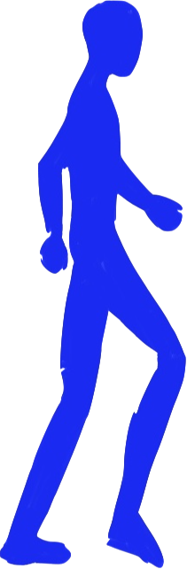
Final Project
A Stony Journey
By Yitao Meng and Guillaume Champtoussel

Slide 2
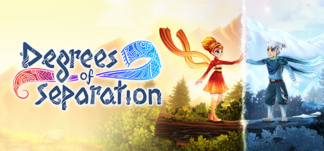
Main Inspirations
Our first game
Classiques games
Recent experiences

Slide 3
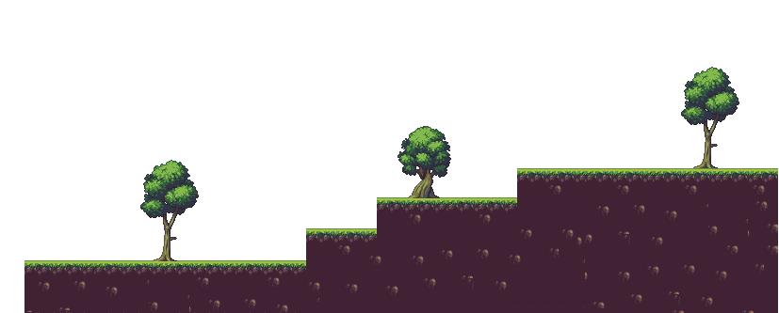
The test
It Your turn to play

Slide 4
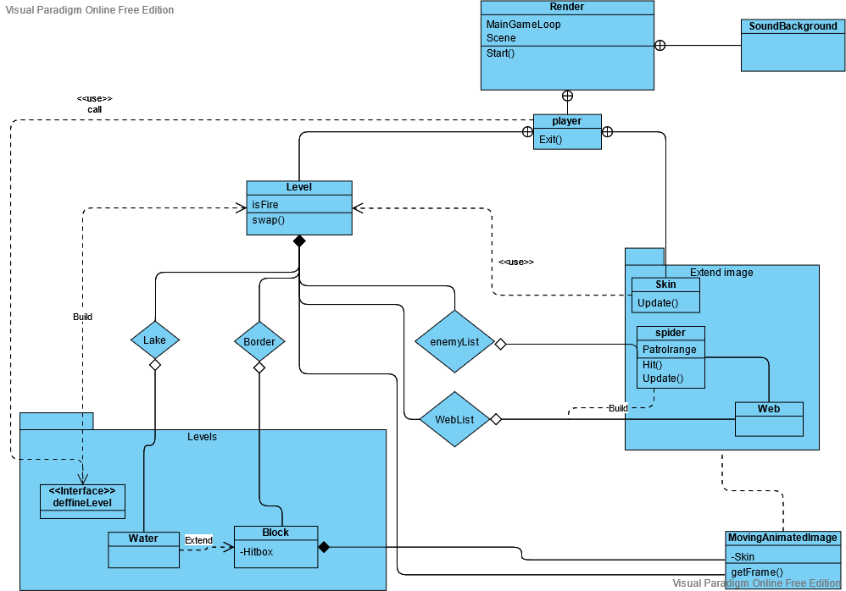
What is our game

Slide 5
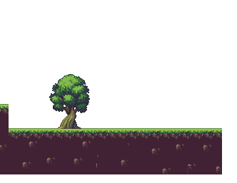

Possible Improvements
More levels (with more mechanics)
Graphic rework
A more developed story

Slide 6
The end of this experience
Great chalenge
Great experience
Great team work

Slide 7
Special thanks
My team mate
Mr Tauvel and the international exchange program
All free use authors (Intellij, shio.io, ...)

