Slide 1
MediaConch
An open source audiovisual file conformance checker

Slide 2
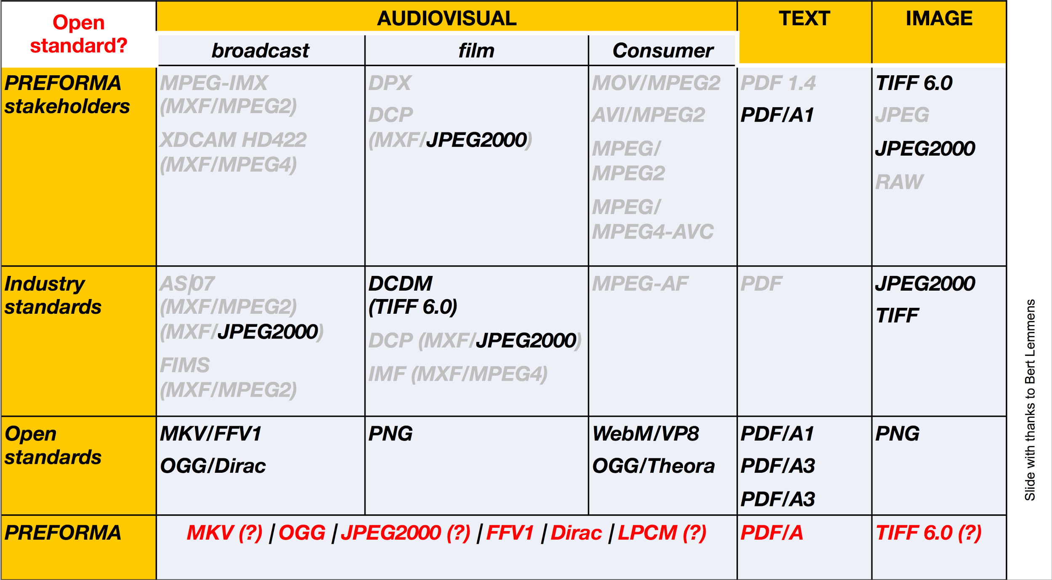

Slide 3
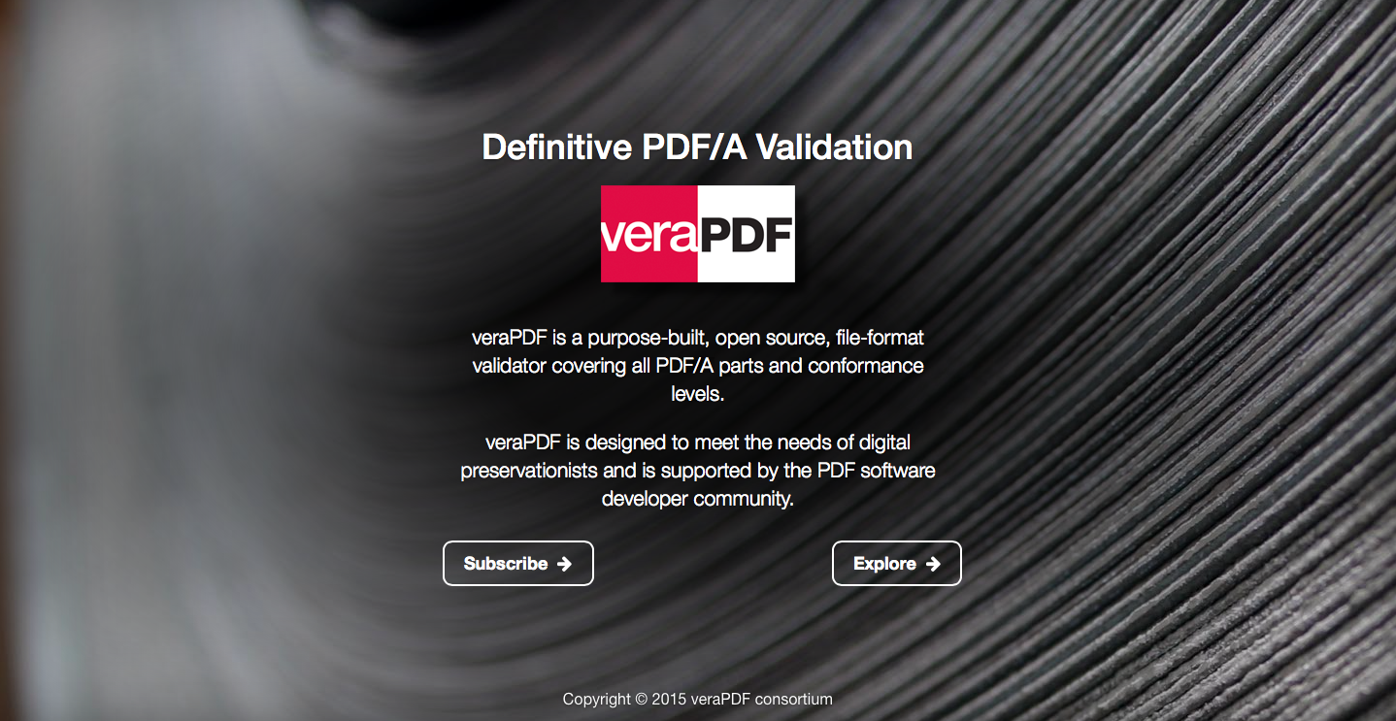

Slide 4
DPF Manager

Slide 5

MediaConch

Slide 6

MediaArea Team
Project Leaders:
Jérôme Martinez (Digital Media Specialist)
Dave Rice (Archivist)
Other Members:
Guillaume Roques (Developer)
Florent Tribouilloy (Developer)
Ashley Blewer (Archivist)
Tessa Fallon (Archivist)
Erik Piil (Archivist)

Slide 7


Slide 8
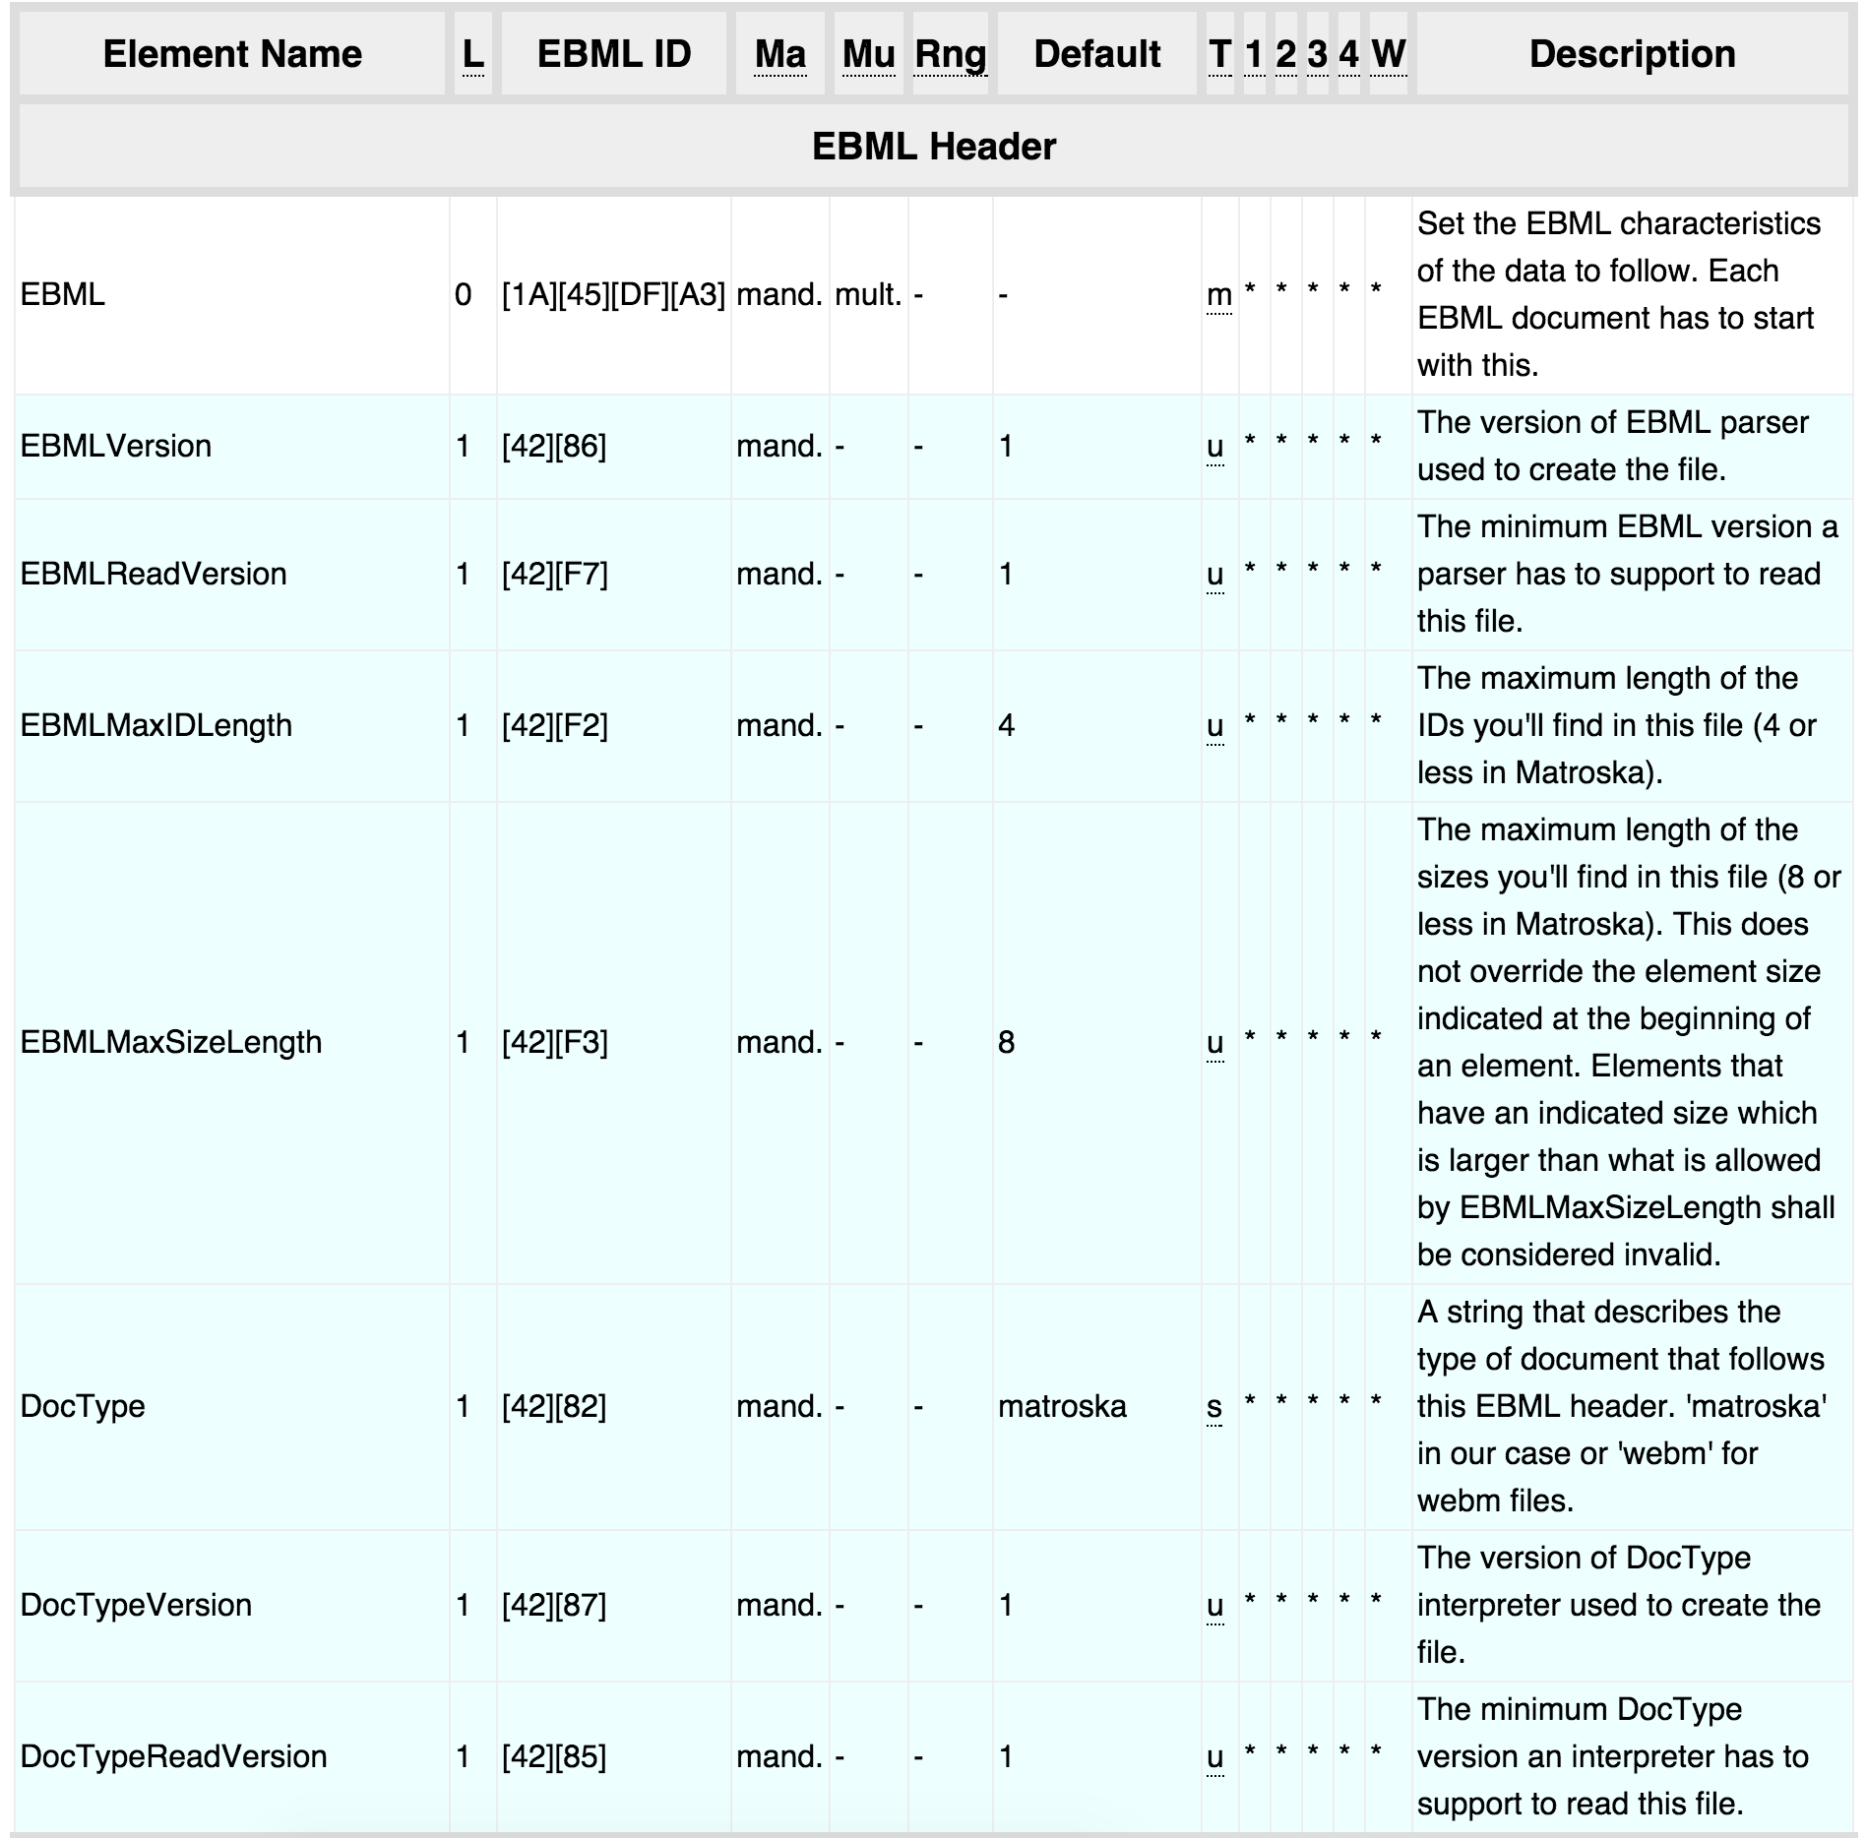

Slide 9
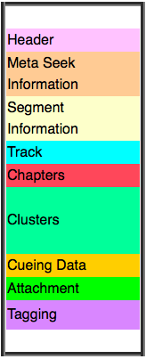

Slide 10


Slide 11
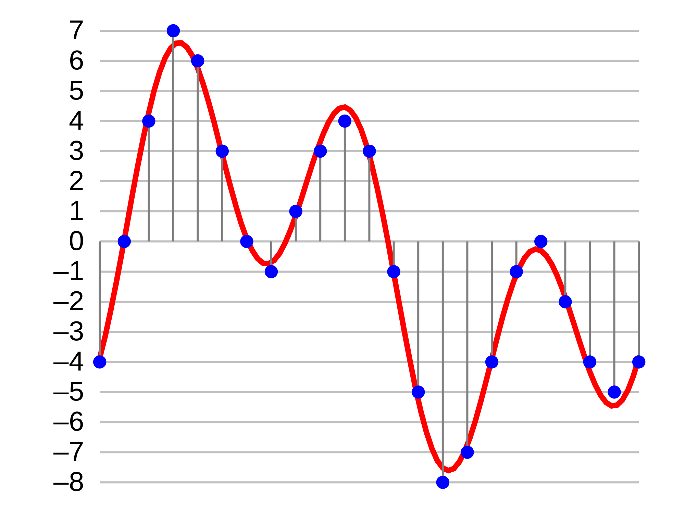

Slide 12
Standardization

Slide 13


Slide 14
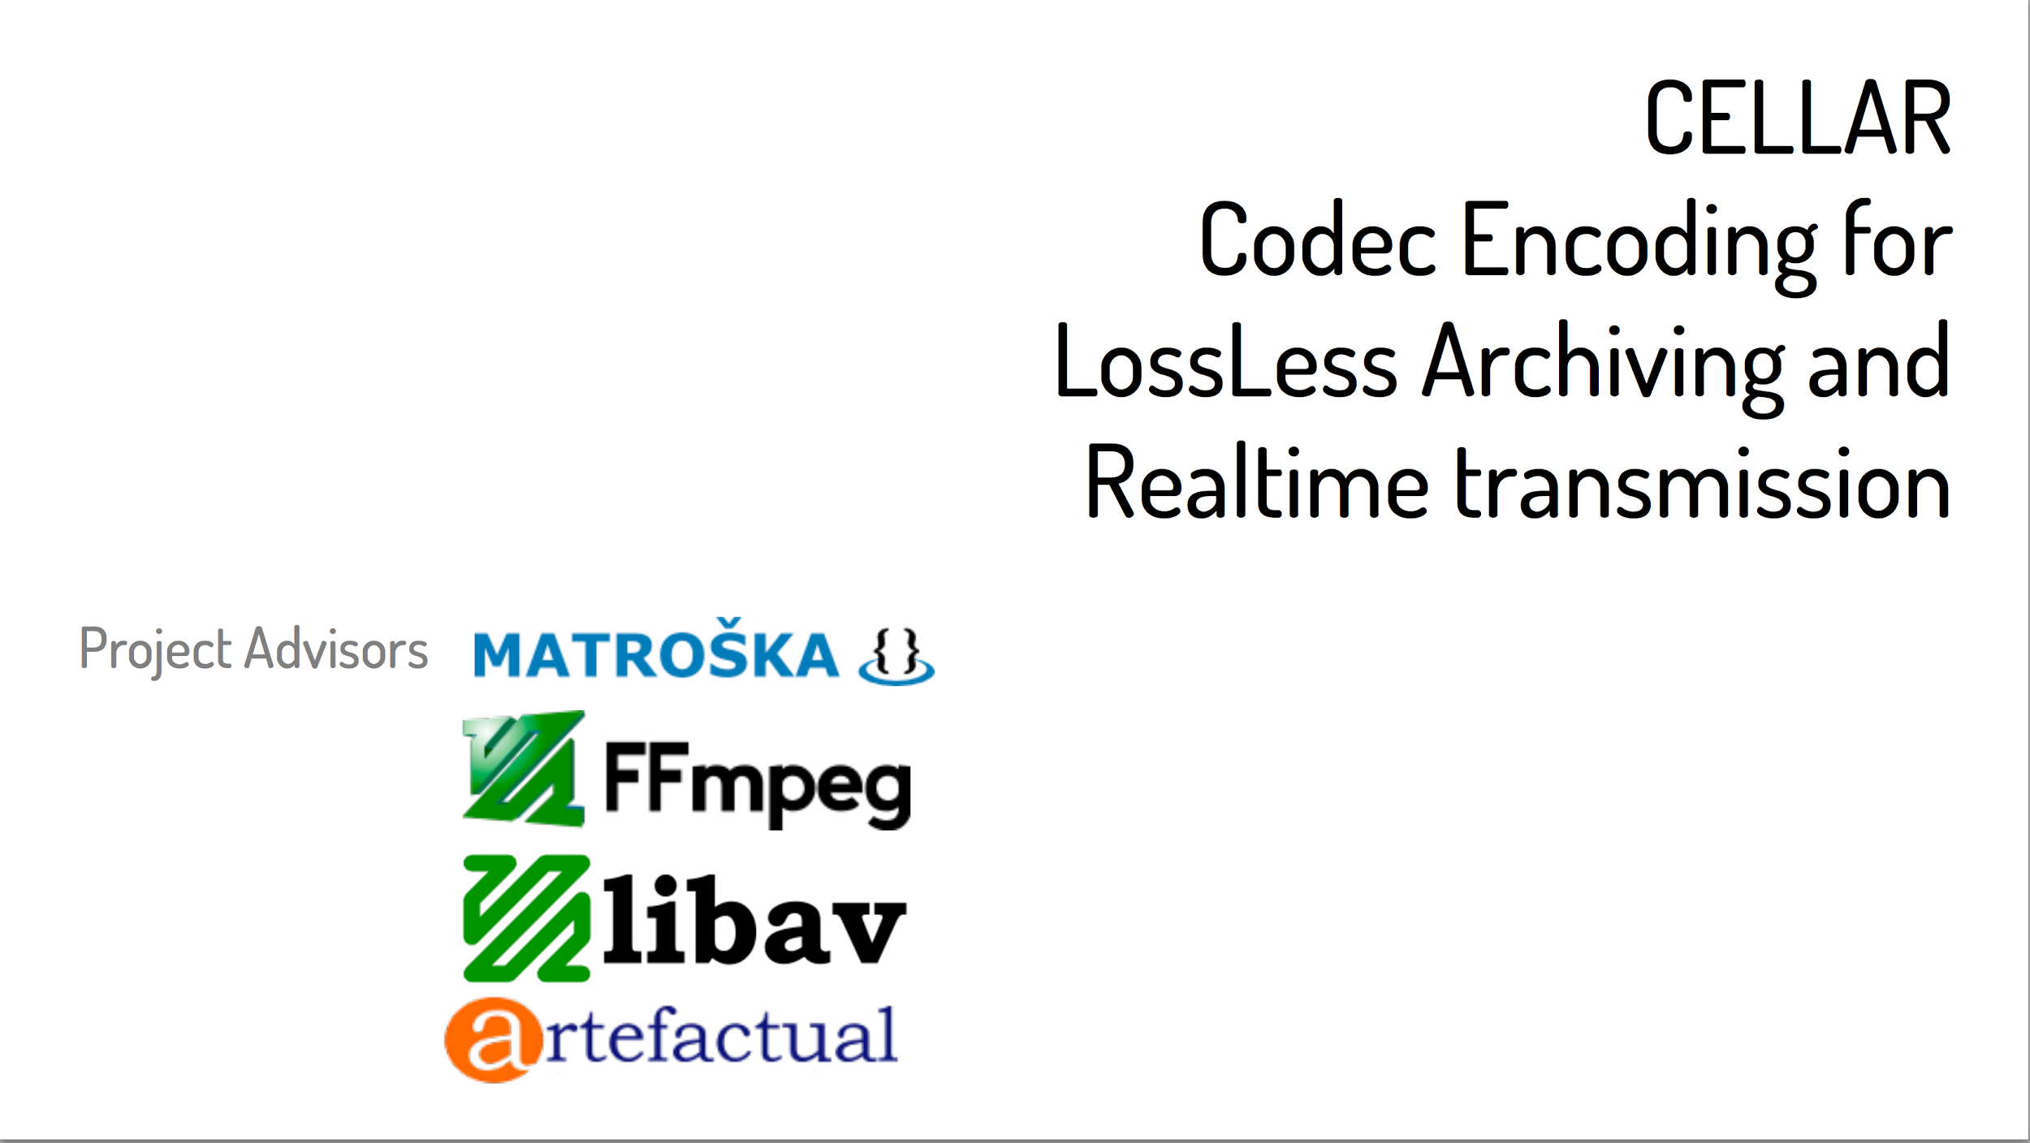

Slide 15
MediaConch components

Slide 16
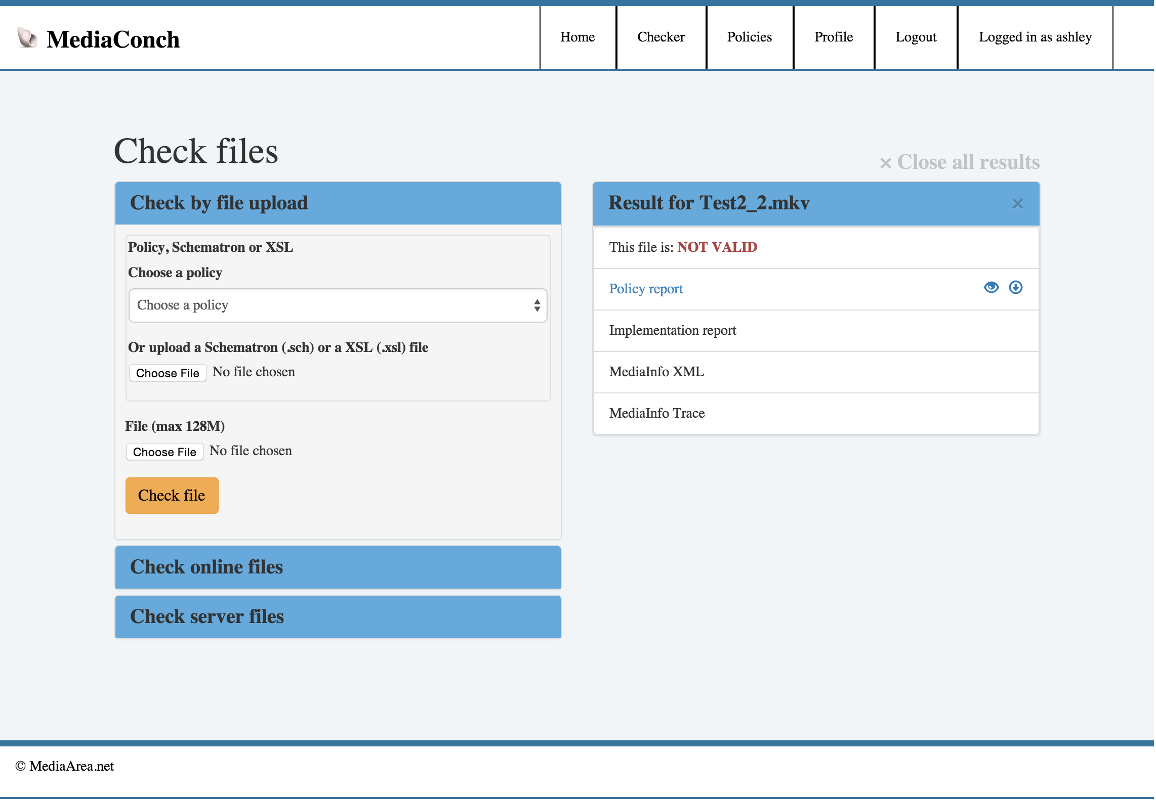

Slide 17
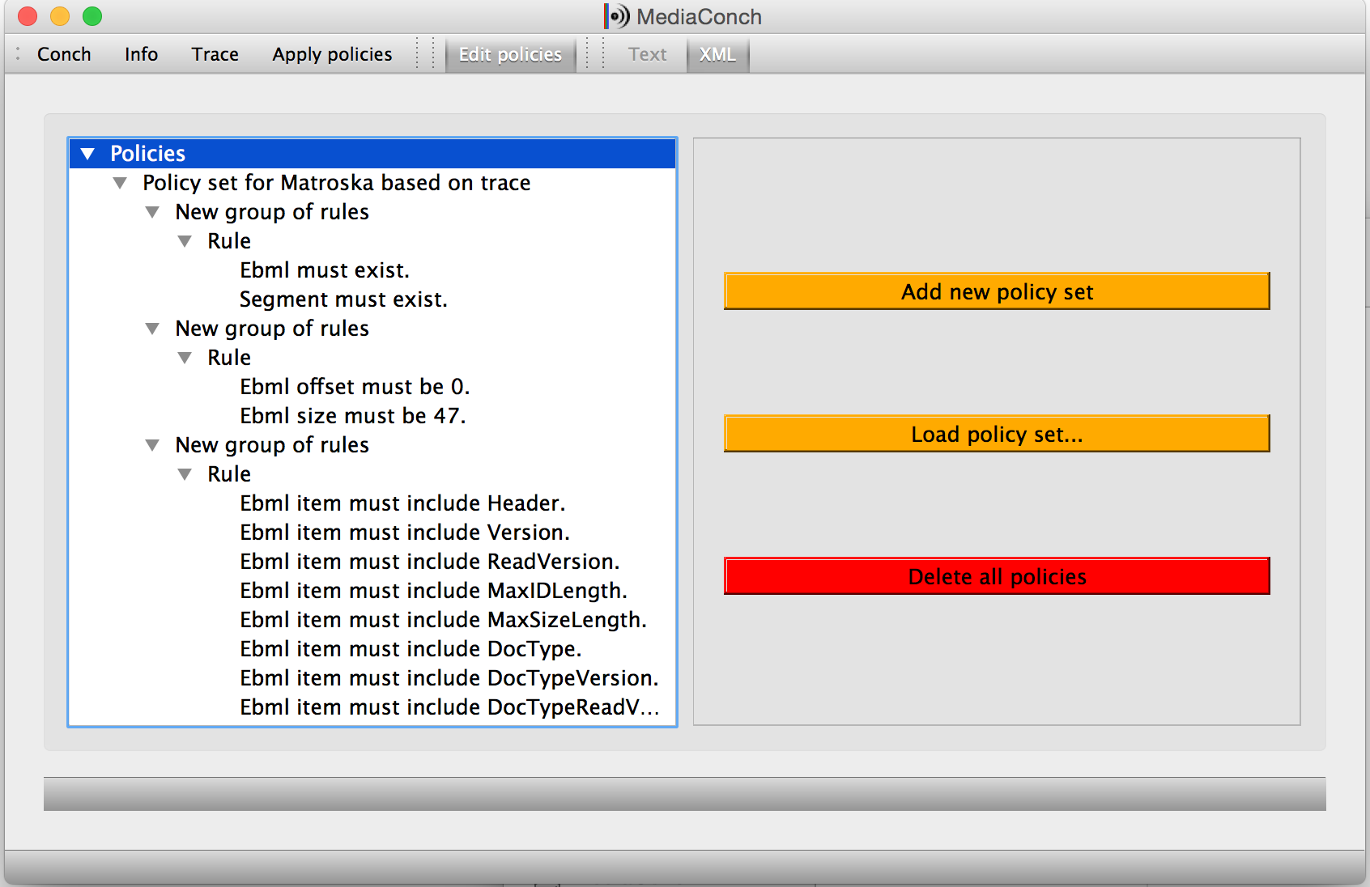
Notes:
MediaConch GUI with policy editor displaying parameters

Slide 18
MediaTrace sample output
<block offset="1920" name="Television information" size="128"> <data offset="1920" name="SMPTE time code">4294967295</data> <data offset="1924" name="SMPTE user bits">4294967295</data> <data offset="1928" name="Interlace" moreinfo="2:1 interlace">255</data> <data offset="1929" name="Field number">255</data> <data offset="1930" name="Video signal standard" moreinfo="Undefined">0</data> <data offset="1931" name="Zero">255</data> <data offset="1932" name="Horizontal sampling rate (Hz)">0.000</data> <data offset="1936" name="Vertical sampling rate (Hz)">0.000</data> <data offset="1940" name="Temporal sampling rate or frame rate (Hz)">0.000</data> <data offset="1944" name="Time offset from sync to first pixel (ms)">0.000</data> <data offset="1948" name="Gamma">0.000</data> <data offset="1952" name="Black level code value">0.000</data> <data offset="1956" name="Black gain">0.000</data> <data offset="1960" name="Breakpoint">0.000</data> <data offset="1964" name="Reference white level code value">0.000</data> <data offset="1968" name="Integration time (s)">0.000</data> <data offset="1972" name="Reserved for future use">(76 bytes)</data> </block>

Slide 20
What’s Next?

