Slide 1
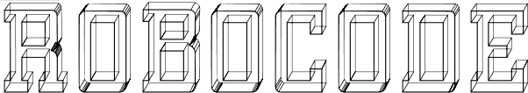
The big challenge of robots

Slide 2


What is Robocode ?
This is a web game, you can play it with only a computer or on your cell phone if you have an internet connection. It means you don’t need a game console to play it.
The game is a turn-based strategy and it's a game for two players only.
Robocode is a game in which two robots compete by fetching flags in order to put them in the opposing base. The first robot to drop two flags in the opponent's base wins the game.
The game board is a square of 9 × 9 boxes. The bases of the robots are arranged on 4 boxes at the west (blue robot) and east ends (red robot). The flags to pick up are arranged on the north and south sides of the game board.

Slide 3
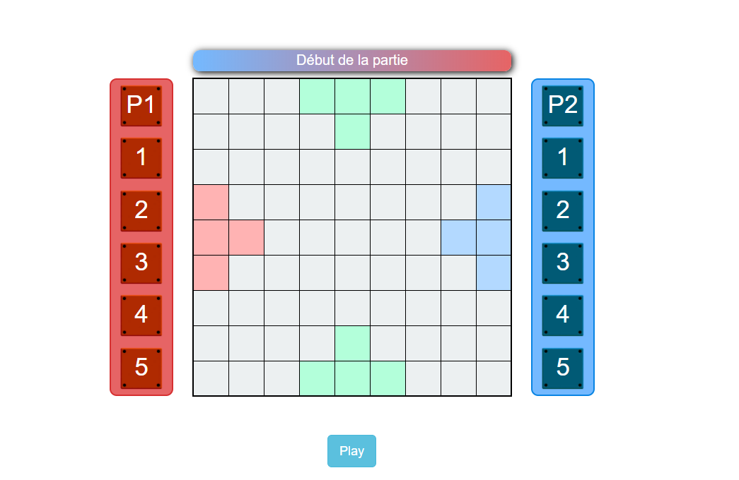

Slide 4
How to play ?
At the beginning of the round, each player chooses 5 "code" cards that will compose the 5 instructions of the program that will be executed by his robot. When both players have written and validated their program, they are executed.
The robots follow their instructions one by one, in turn : the first robot executes its first instruction, then the second robot executes its first instruction, and so on, until the 5 instructions have been executed. At the end of each program (set of 5 instructions), players are asked to write their next program.
The game ends when one of the two players has managed to place two flags in the opposing base.

Slide 5
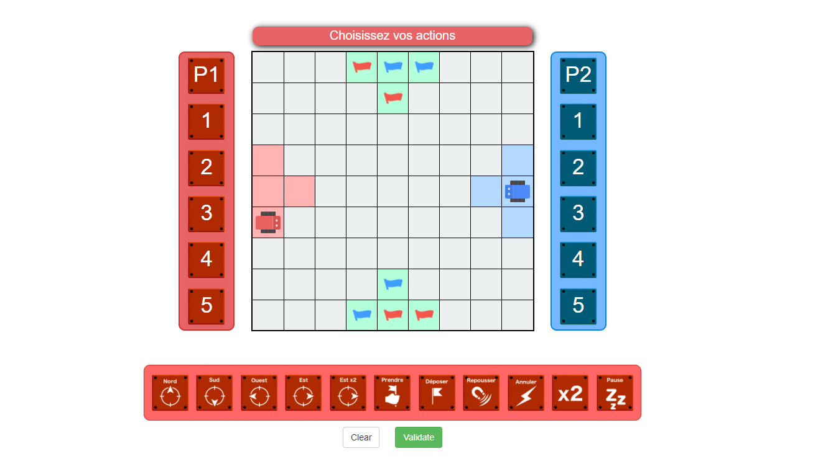

Slide 6



The possible actions/instructions
North, South, East, West
The robot turns in the indicated direction and moves forward one box. It is not possible to advance on a box already occupied by the other robot.
East ×2 – West ×2
The robot moves from two boxes west (blue robot) or east (red robot).
Take
The robot takes the flag that is on the square where it is. The robot can only take one flag at a time.

Slide 7





Drop
The robot drop the flag it carries on the box where it is. There can only be one flag per box.
Repel
The opposing robot moves back one square in the direction of its base (towards the east for the blue, towards the west for the red).
Cancel
The action that the opposing robot must do on this turn is canceled, even if it plays first. As a result, the robot does nothing.
×2
Repeat the action shown on the previous card.
Pause
The robot does nothing.

Slide 8
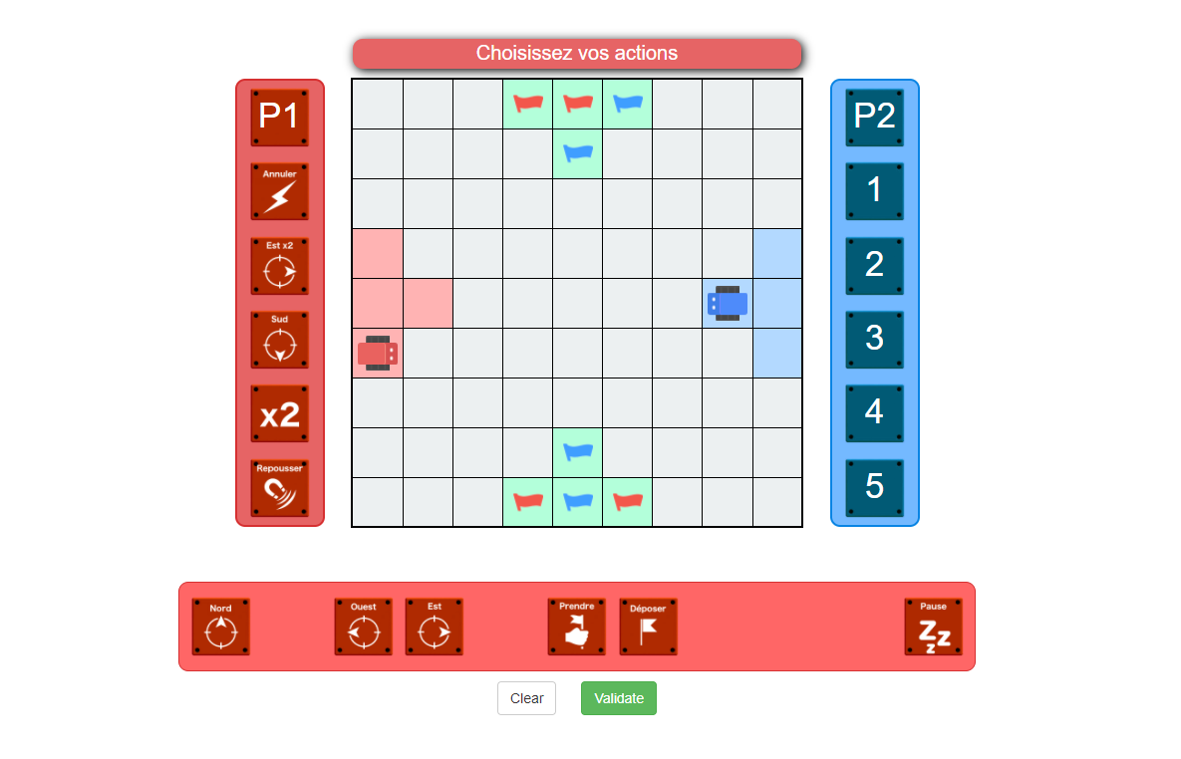
But who will win?

